Slide 1
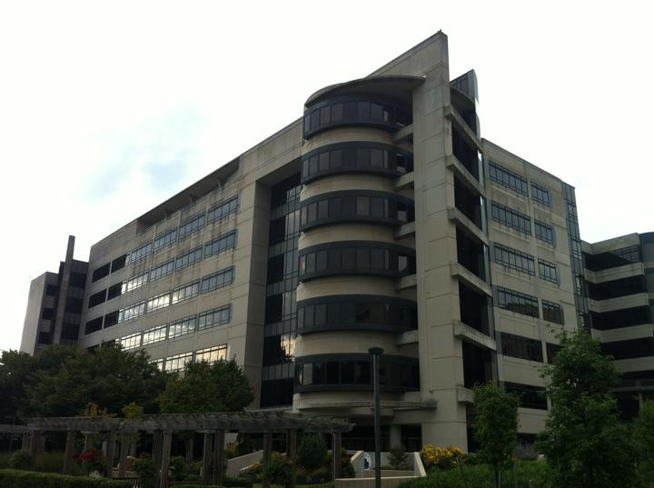
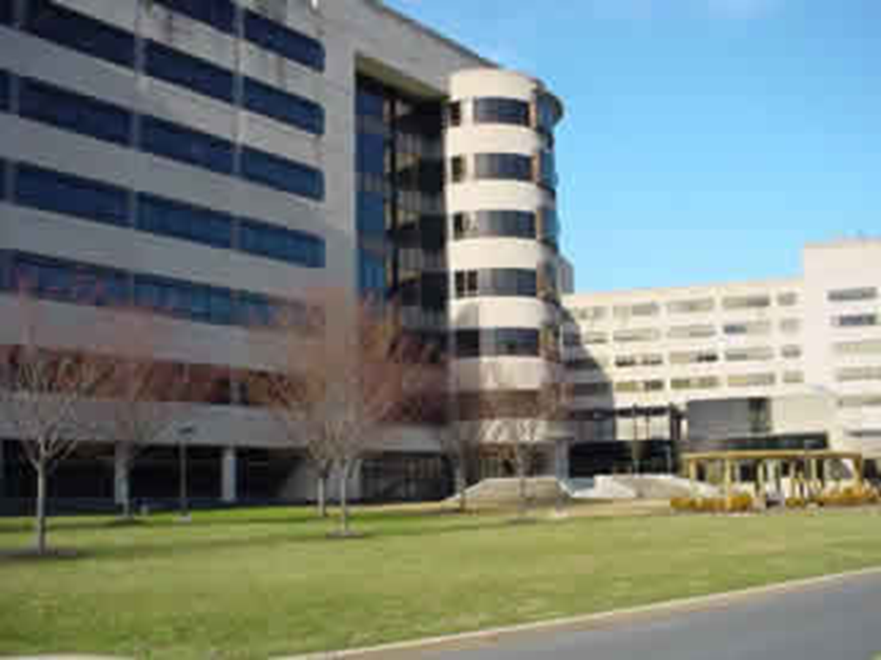
Milton S. Hershey Medical Center Biomedical Research Building
Joshua Zolko, Structural Option

Slide 2
Introduction
Table of Contents
Introduction
Architecture
Structure
Process
HVAC
Lighting
Acoustics
The Biomedical Research Building (BMR) is located in Hershey, Pennsylvania.
245000 sq. ft, in 7 stories above grade
Built between 1991-1993
Cost $49 million
Used a Bid-Build project delivery method
Used for Education and Laboratory space

Slide 3
Architecture
Table of Contents
Introduction
Architecture
Structure
Process
HVAC
Lighting
Acoustics
Façade of the BMR consists of long horizontal concrete and limestone slabs, and black glazing
Façade designed to relate to buildings already existing on campus
Cylinder and Planar wall on corners add to the otherwise flat building

Slide 4
Structure
Table of Contents
Introduction
Architecture
Structure
Process
HVAC
Lighting
Acoustics
The BMR is a monolithic concrete structure, using a one-way flat plate system with the average column size about 22” by 22”
Building sits on a deep foundation system of caissons 3 to 7 feet in diameter

Slide 5
Structure
Table of Contents
Introduction
Architecture
Structure
Process
HVAC
Lighting
Acoustics
Analysis shows that columns have an extra 35% capacity for applied loads
Design of the lateral system maintained symmetry, resulting in only a 6” eccentricity.

Slide 6
Process
Table of Contents
Introduction
Architecture
Structure
Process
HVAC
Lighting
Acoustics
Based on extra capacity of columns, goal was to be adding 3 extra stories to top of building, top story floor to floor height to be 24.6’ instead of the average 12.3’
This extra space would serve for a studio or recreational setting for students.

Slide 7
Typical Column Section
Process
Table of Contents
Introduction
Architecture
Structure
Process
HVAC
Lighting
Acoustics
Assumed gravity loads were to be:
150 PSF dead
40 PSF snow
15 PSF superimposed
80 PSF live
Self weight of the columns and bracing beams factored in as well

Slide 8
Process
Table of Contents
Introduction
Architecture
Structure
Process
HVAC
Lighting
Acoustics
Axial Loads calculated for a typical column over a 21’ by 35’ bay area.
As loads increase, they approach total capacity
This does not allow much room for applied moments from lateral or asymmetrical loading

Slide 9
Process
Table of Contents
Introduction
Architecture
Structure
Process
HVAC
Lighting
Acoustics
Loads were calculated again for the 1st, 2nd and 3rd floors, using live load reduction of 53%
Exceptions were used for live loads over 100 PSF, per IBC, at 20%
Allows more room for moments

Slide 10
Example Calculation
Process
Table of Contents
Introduction
Architecture
Structure
Process
HVAC
Lighting
Acoustics
$$.25+\frac{15}{\sqrt{4(735)}} = .53$$
Loads were calculated again for the 1st, 2nd and 3rd floors, using live load reduction of 53%
Exceptions were used for live loads over 100 PSF, per IBC, at 20%
Allows more room for moments
Minimum allowance: 32% for 31%

Slide 11
Bracing Beam Section
Process
Table of Contents
Introduction
Architecture
Structure
Process
HVAC
Lighting
Acoustics
Bracing beams were necessitated through exceptionally long columns, about 22’ in height
Beams were chosen to be 24” by 24” to match column sizes
Would allow for an architectural feature on the top floor.

Slide 12
Bracing Beam Section
Process
Table of Contents
Introduction
Architecture
Structure
Process
HVAC
Lighting
Acoustics
Assumed a 15 PSF superimposed load for mechanical and electrical equipment
600 PLF dead load.
66 and 96 ft*kip moments necessitate 4 #7 rebar
Torsion and shear reinforcement was found to be negligible according to ACI

Slide 13
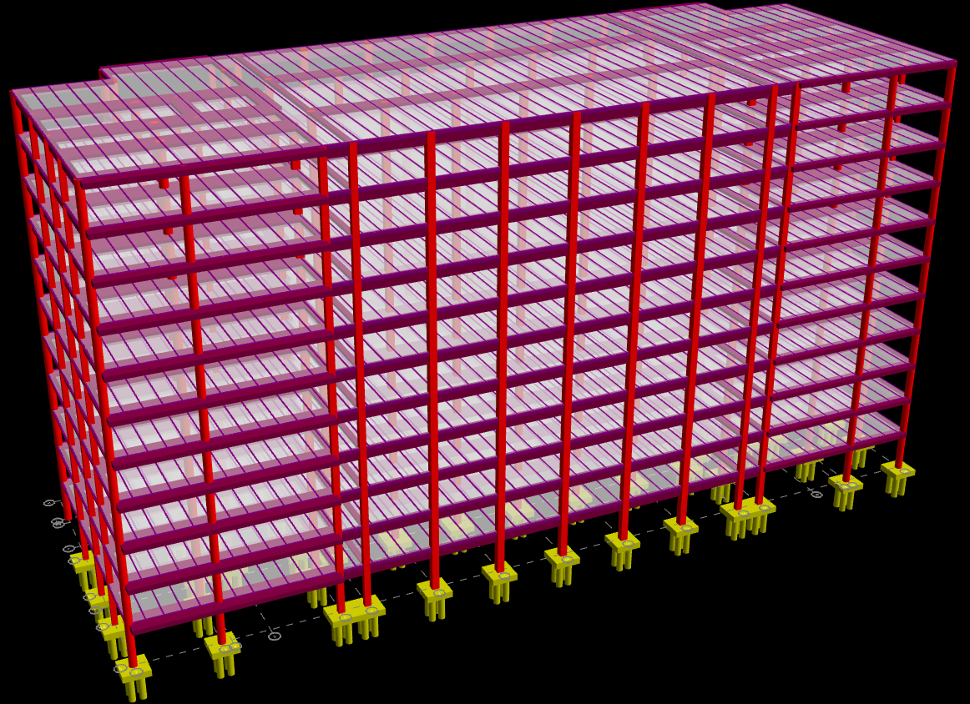
RAM Model
Process
Table of Contents
Introduction
Architecture
Structure
Process
HVAC
Lighting
Acoustics
A RAM Model was developed to analyze the effect of controlling wind and earthquake forces.
Addition was designed maintaining symmetry and negligible eccentricity as rest of building, minimizing unusual torsional effect and forces

Slide 14
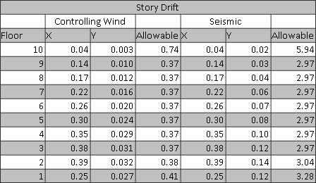
Story Drifts
Process
Table of Contents
Introduction
Architecture
Structure
Process
HVAC
Lighting
Acoustics
Distributing story shear forces across all columns on a story by a factor of 1.5%, lead to a shear force of 9 kips
Moment of 111 ft*kips per column
Story and Total drifts are well within acceptable H/400 limits
Overturning is controlled by gravity loads

Slide 15
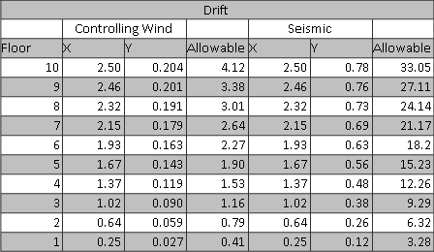
Story Drifts
Process
Table of Contents
Introduction
Architecture
Structure
Process
HVAC
Lighting
Acoustics
Distributing story shear forces across all columns on a story by a factor of 1.5%, lead to a shear force of 9 kips
Moment of 111 ft*kips per column
Story and Total drifts are well within acceptable H/400 limits
Overturning is controlled by gravity loads

Slide 16
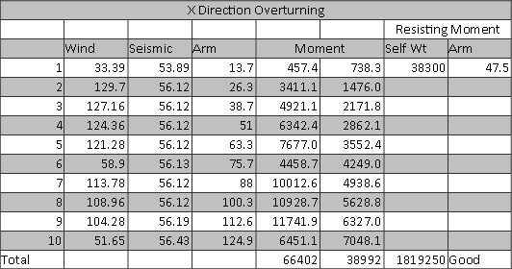
Story Drifts
Process
Table of Contents
Introduction
Architecture
Structure
Process
HVAC
Lighting
Acoustics
Distributing story shear forces across all columns on a story by a factor of 1.5%, lead to a shear force of 9 kips
Moment of 111 ft*kips per column
Story and Total drifts are well within acceptable H/400 limits
Overturning is controlled by gravity loads

Slide 17
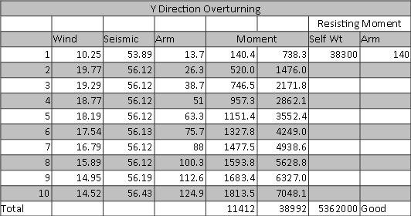
Story Drifts
Process
Table of Contents
Introduction
Architecture
Structure
Process
HVAC
Lighting
Acoustics
Distributing story shear forces across all columns on a story by a factor of 1.5%, lead to a shear force of 9 kips
Moment of 111 ft*kips per column
Story and Total drifts are well within acceptable H/400 limits
Overturning is controlled by gravity loads

Slide 18
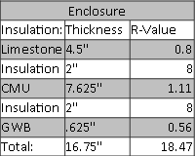
Insulation
HVAC (Breadth 1)
Table of Contents
Introduction
Architecture
Structure
Process
HVAC
Lighting
Acoustics
Calculated CFM requirements for the addition were found to be 86000 CFM
4050 people at 20 CFM and 81000 sq ft at .06 CFM
BTU Loads for CFM and people and insulation were found to be 5 million BTU/HR for both heating and cooling

Slide 19
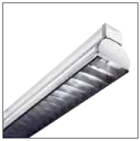
Typical Luminaire
Lighting (Breadth 2)
Table of Contents
Introduction
Architecture
Structure
Process
HVAC
Lighting
Acoustics
For a recommended 500 lux for a work space, the total room of 90’ by 210’ with its 12 bays requires 200 luminaries, allowing 18 per bay
Two systems were developed, one at 12.3’ high, and one at ceiling for the top story, but ceiling height would cast shadows

Slide 20
Calculations
Acoustics (Breadth 3)
Table of Contents
Introduction
Architecture
Structure
Process
HVAC
Lighting
Acoustics
$$10log\frac{19660+400}{400}=17 dB$$
$$10log\frac{11223+400}{400}=15 dB$$
Acoustical tile was initially placed on ceiling, beams, columns, and carpeting was used.
Created a “dead space” which would have been disconcerting to occupants
Toned back acoustical insulation to just beams and columns, as well as carpeting

Slide 21
Questions?

