Slide 1
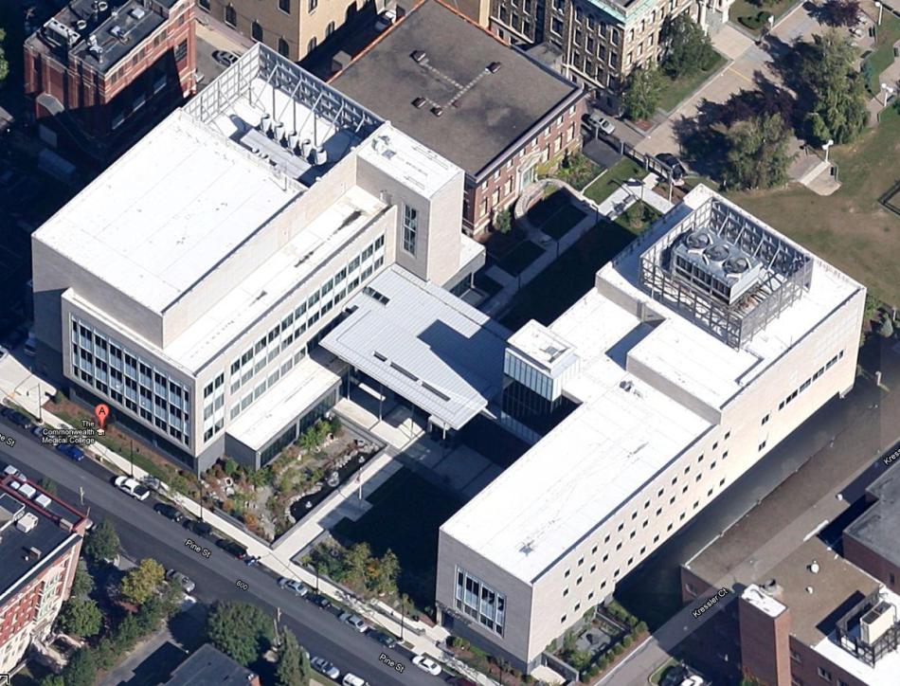
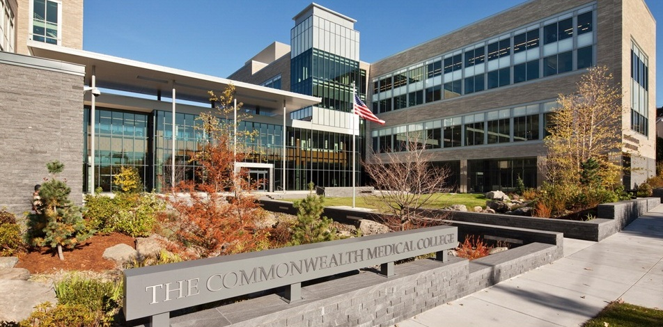
THE COMMONWEALTH
MEDICAL COLLEGE
(TCMC)
SCRANTON, PA
SENIOR THESIS 2013 ADVISOR: HEATHER SUSTERSIC
XIAO YE ZHENG | STRUCTURAL OPTION

Slide 2
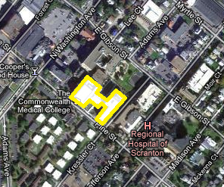
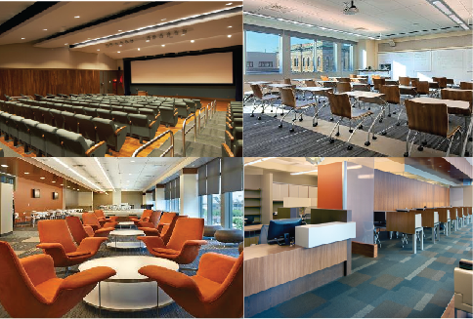
THE COMMONWEALTH MEDICAL COLLEGE
BUILDING INTRODUCTION
SITE MAP
Building Introduction
Existing Structural System
Problem Statement
Proposed Solution
New Lateral Loads
Lateral Frame Designs
Façade Design Breadth
Acknowledgements
Medical College
185,000 SF
4 Story Building plus a Penthouse
Maximum Height at 102’
Cost $120 Million
May 2009 to Oct 2011
Design-Bid-Build
Seeking LEED Silver
Photos From TCMC
Image from Google Map, edited by Xiao

Slide 3





THE COMMONWEALTH MEDICAL COLLEGE
PROJECT TEAM
Building Introduction
Existing Structural System
Problem Statement
Proposed Solution
New Lateral Loads
Lateral Frame Designs
Façade Design Breadth
Acknowledgements
  Owner
  Architects
  Structural/M.E.P. Engineers
  Construction Management
  Landscape Architecture
  Interior Architecture
  TCMC
  Highland Associates & HOK
  Highland Associates
  Quandel Construction Group
  McLane Associates
  Highland Associates & HOK

Slide 4
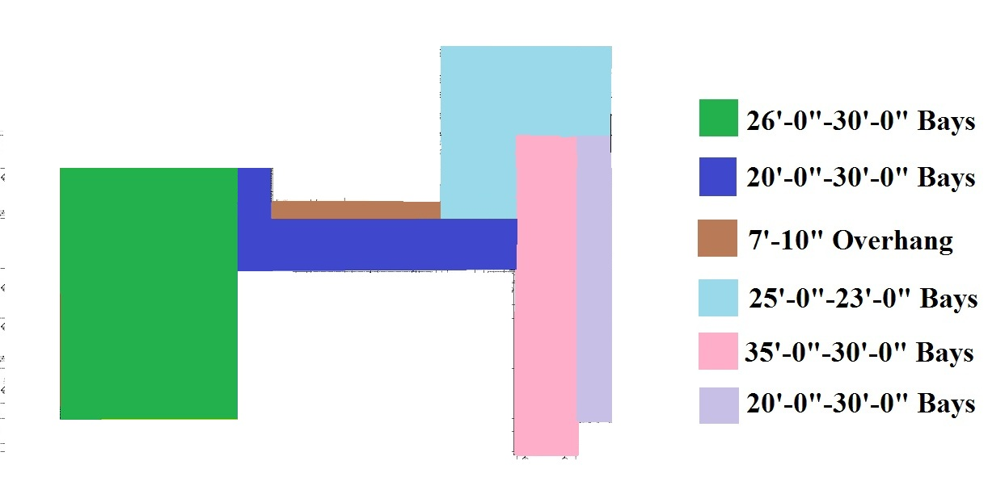
THE COMMONWEALTH MEDICAL COLLEGE
EXISTING STRUCTURAL SYSTEM
BAY SIZES
Building Introduction
Existing Structural System
Problem Statement
Proposed Solution
New Lateral Loads
Lateral Frame Designs
Façade Design Breadth
Acknowledgements
  West Wing
    Foundation- mat slab, 4’-0” thick, 3000 psf bearing pressure
    Floor- composite steel deck, normal weight concrete topping, 7.5” thick
  East Wing
    Foundation- drilled caissons, 36” to 60” in diameters, carry loads to bedrock.
    Floor- composite steel deck, lightweight concrete topping, 5.25” thick
Image from Highland Associates, edited by Xiao

Slide 5
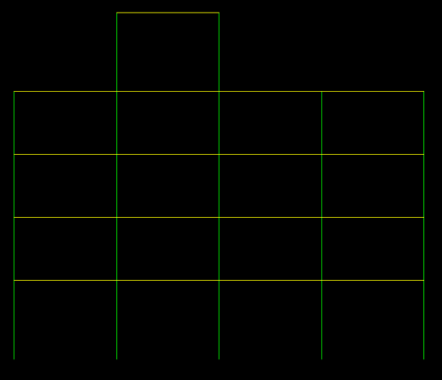
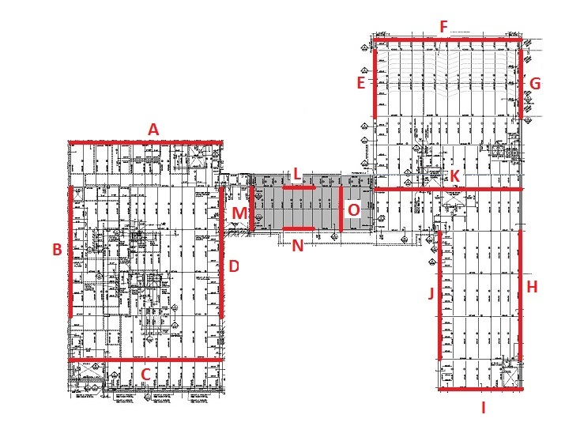
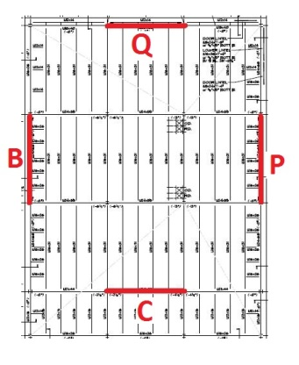
THE COMMONWEALTH MEDICAL COLLEGE
EXISTING STRUCTURAL SYSTEM
MOMENT FRAMES
Building Introduction
Existing Structural System
Problem Statement
Proposed Solution
New Lateral Loads
Lateral Frame Designs
Façade Design Breadth
Acknowledgements
  Framing System
    Composite steel frame
    W8x24 to W14x257, lightest to heaviest
  Lateral System
    15 moment frames (not including penthouse)
Frame C
Image from Highland Associates, edited by Xiao

Slide 6
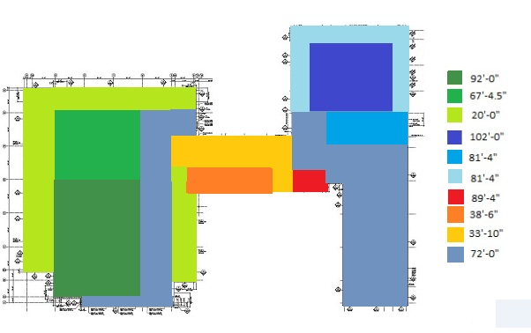
THE COMMONWEALTH MEDICAL COLLEGE
ROOF HEIGHTS
ROOF HEIGHTS PLAN
Building Introduction
Existing Structural System
Problem Statement
Proposed Solution
New Lateral Loads
Lateral Frame Designs
Façade Design Breadth
Acknowledgements
Image from Highland Associates, edited by Xiao
Image from Google Map

Slide 7
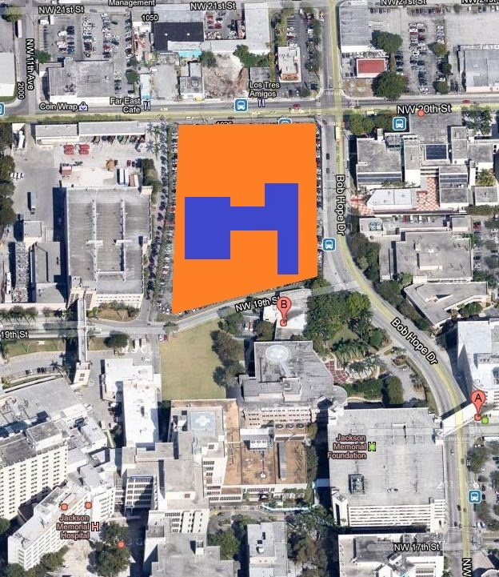
THE COMMONWEALTH MEDICAL COLLEGE
PROBLEM STATEMENT
MIAMI, FL SITE
Building Introduction
Existing Structural System
Problem Statement
Proposed Solution
New Lateral Loads
Lateral Frame Designs
Façade Design Breadth
Acknowledgements
  Interest in Wind Design
  Interest in Steel Design
  Scenario Created for Thesis
    TCMC is to be designed on a site in Miami, FL
    Hurricane Prone region, with wind speed up to 150 mph in building code.
    Geotechnical report obtained from site in Miami-Dade County, Florida
Image from Google Map, edited by Xiao

Slide 8
THE COMMONWEALTH MEDICAL COLLEGE
PROPOSED SOLUTION
PROJECT GOALS
Building Introduction
Existing Structural System
Problem Statement
Proposed Solution
New Lateral Loads
Lateral Frame Designs
Façade Design Breadth
Acknowledgements
  Two Lateral Systems Proposed
    Code Minimum Steel Moment Frames
    Code Minimum Chevron Braced Frames
  Foundation
    MAT Foundation
  Comparison Between Designs
    Moment Frames to Braced Frames
    New Systems to the Original System
    A Typical Braced Connection

Slide 9
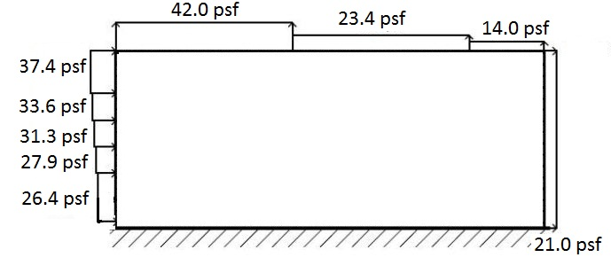
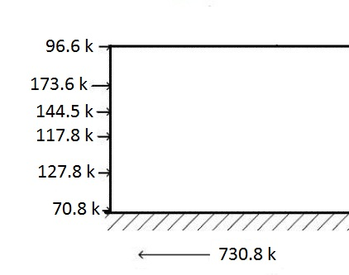
THE COMMONWEALTH MEDICAL COLLEGE
NEW LOADS
COMPARISON
Building Introduction
Existing Structural System
Problem Statement
Proposed Solution
New Lateral Loads
Lateral Frame Designs
Façade Design Breadth
Acknowledgements
Summary: Wind Loads on TCMC
 |  | West Wing |  | East Wing
NS Base Shear |  | 560.0 | k | 296 | k
NS Overturning Moment |  | 27,500.0 | k-ft | 14,500 | k-ft
EW Base Shear |  | 731.0 | k | 960 | k
EW Overturning Moment |  | 35,800.0 | k-ft | 47,220 | k-ft
Comparison of Seismic and Wind Forces
 |  |  | West Wing |  |  | East Wing
Miami, FL |  |  | Wind, N-S | Wind, E-W | Seismic | Wind, N-S | Wind, E-W | Seismic
Base Shear (k) |  |  | 560 | 730 | 136 | 300 | 970 | 126
Overturning Moment (k-ft) |  |  | 27,500 | 35,800 | 7,950 | 14,500 | 47,300 | 7,350
Scranton, PA |  |  | Wind, N-S | Wind, E-W |  | Wind, N-S | Wind, E-W | Seismic
Base Shear (k) |  |  | 200 | 270 | 130 | 110 | 350 | 120
Overturning Moment (k-ft) |  |  | 10,000 | 12,900 | 7,600 | 5,230 | 17,100 | 7,000
Wind Pressure and Wind Force acting on West Wing, EW Direction

Slide 10
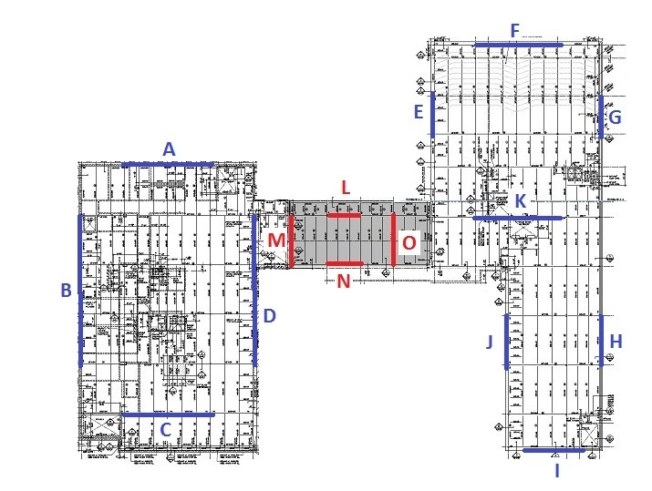
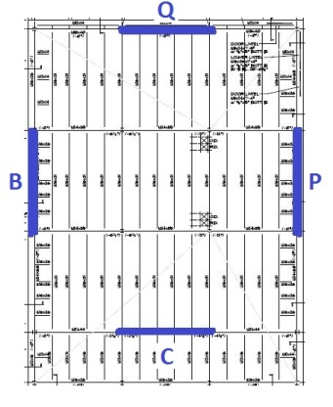
THE COMMONWEALTH MEDICAL COLLEGE
LATERAL FRAME LAYOUTS
Building Introduction
Existing Structural System
Problem Statement
Proposed Solution
New Lateral Loads
Lateral Frame Designs
Façade Design Breadth
Acknowledgements
  Moment Frame Layout
  Braced Frame Layout
  Moment Frame
  Braced Frame

Slide 11
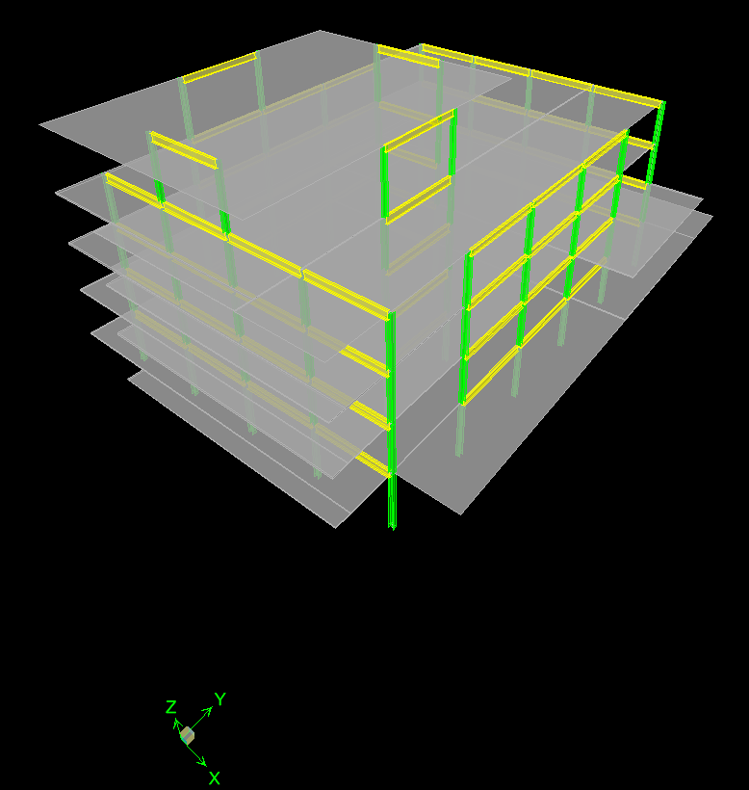
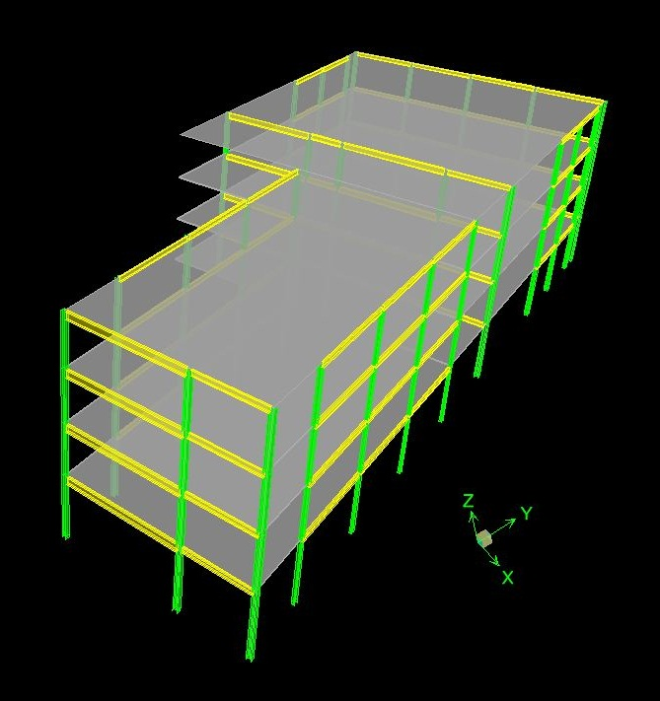
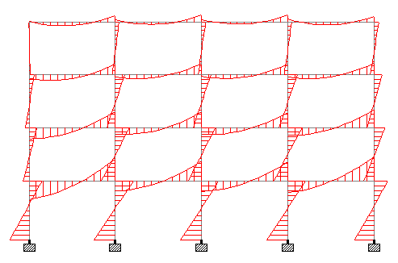
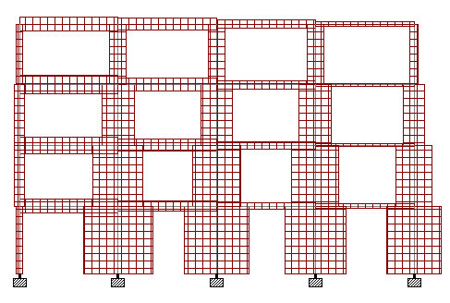
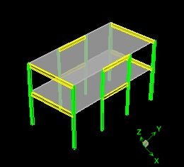
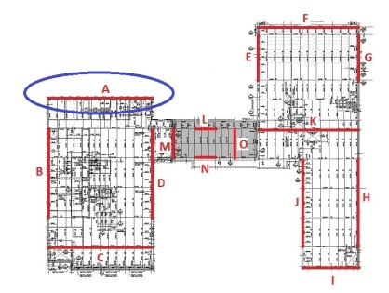
THE COMMONWEALTH MEDICAL COLLEGE
MOMENT FRAME DESIGN
  STAAD Model for Frame A
  Etabs Models
Building Introduction
Existing Structural System
Problem Statement
Proposed Solution
New Lateral Loads
Lateral Frame Designs
Façade Design Breadth
Acknowledgements
  ETABS Model
  AE 530
  Computer Modeling
  1.2D + 1.6W + L + 0.5Lr

Slide 12
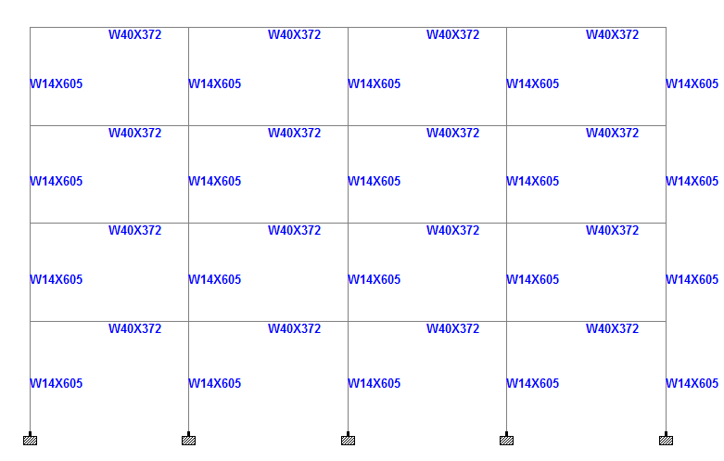
THE COMMONWEALTH MEDICAL COLLEGE
MOMENT FRAME DESIGN
  Frame A Sizes
  Moment Frame Drift
Building Introduction
Existing Structural System
Problem Statement
Proposed Solution
New Lateral Loads
Lateral Frame Designs
Façade Design Breadth
Acknowledgements

Slide 13
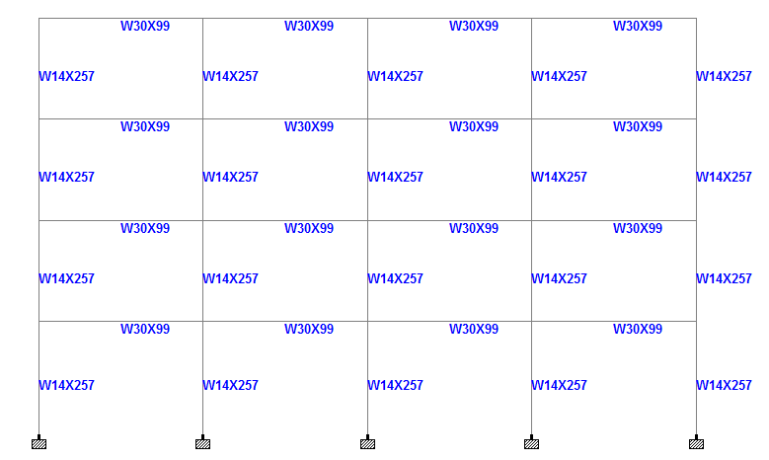
THE COMMONWEALTH MEDICAL COLLEGE
MOMENT FRAME DESIGN
  Frame A Sizes
  Original Frame A Sizes
Building Introduction
Existing Structural System
Problem Statement
Proposed Solution
New Lateral Loads
Lateral Frame Designs
Façade Design Breadth
Acknowledgements

Slide 14
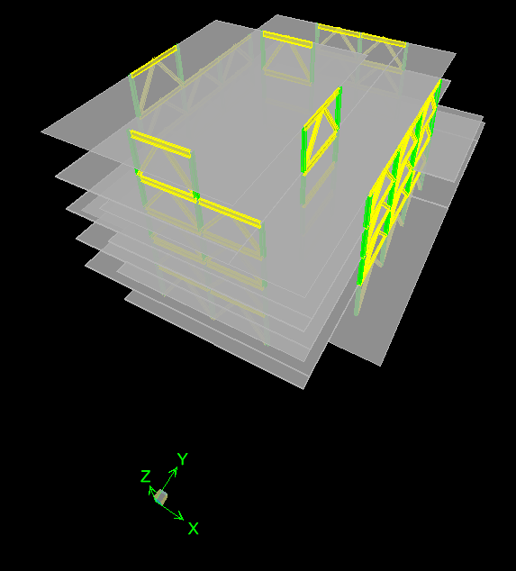
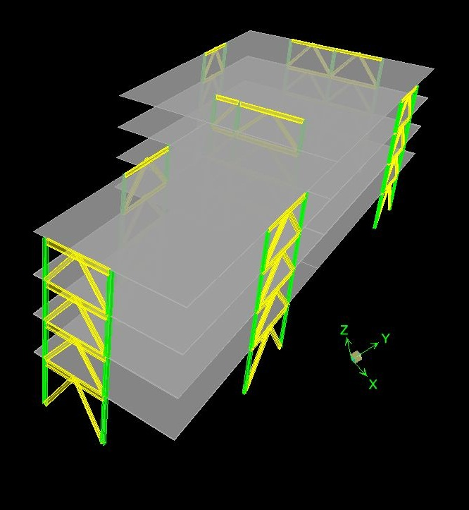
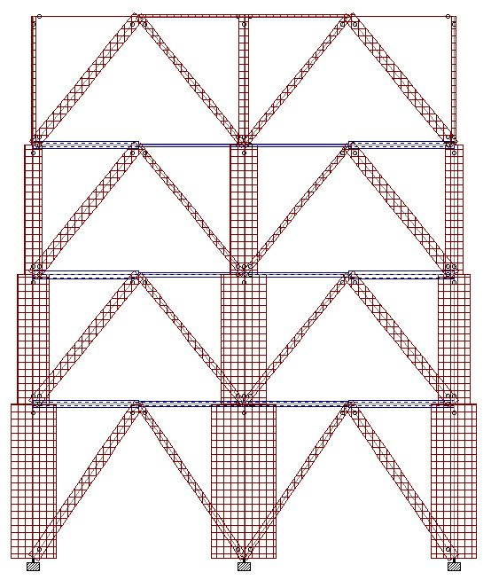
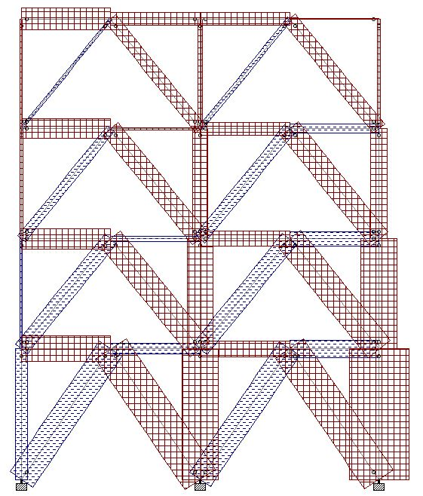
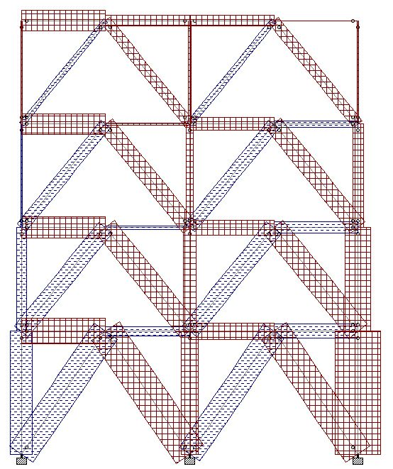
THE COMMONWEALTH MEDICAL COLLEGE
BRACED FRAME DESIGN
  STAAD Model for Frame A
  Etabs Models
Building Introduction
Existing Structural System
Problem Statement
Proposed Solution
New Lateral Loads
Lateral Frame Designs
Façade Design Breadth
Acknowledgements
  ETABS Model
  AE 530
  Computer Modeling
  1.2D + 1.6L + 0.5 Lr
  1.2D + 1.6W + L + 0.5Lr
  0.9D + 1.6W

Slide 15
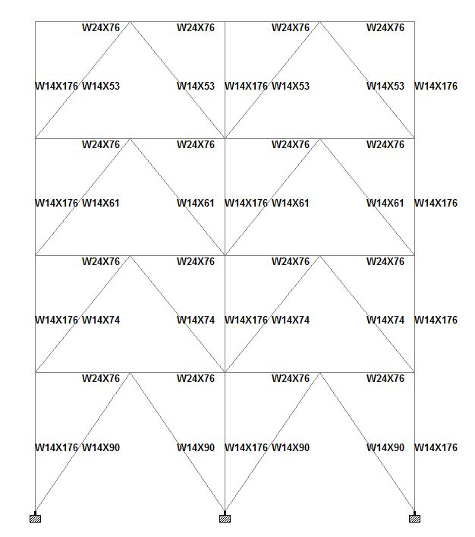
THE COMMONWEALTH MEDICAL COLLEGE
BRACED FRAME DESIGN
Building Introduction
Existing Structural System
Problem Statement
Proposed Solution
New Lateral Loads
Lateral Frame Designs
Façade Design Breadth
Acknowledgements
  Frame A Sizes
  Braced Frame Drift

Slide 16
THE COMMONWEALTH MEDICAL COLLEGE
COMPARISONS
Building Introduction
Existing Structural System
Problem Statement
Proposed Solution
New Lateral Loads
Lateral Frame Designs
Façade Design Breadth
Acknowledgements
Estimated Cost Analysis For Frame A
 | Original | Moment | Braced
Cost | $ 186,281.00 | $ 567,043.00 | $ 202,572.00
Percent | 100% | 304% | 109%
Building Height Change
 | Original | Moment | Braced
Height | 93' | 98' | 92'
Difference | N/A | 5' | -1'

Slide 17
THE COMMONWEALTH MEDICAL COLLEGE
COMPARISONS
Building Introduction
Existing Structural System
Problem Statement
Proposed Solution
New Lateral Loads
Lateral Frame Designs
Façade Design Breadth
Acknowledgements
Estimated Cost Analysis For Frame A
 | Original | Moment | Braced
Cost | $ 186,281.00 | $ 567,043.00 | $ 202,572.00
Percent | 100% | 304% | 109%
Typical Member Size between 1st and 2nd Floor on Frame A
 | Original | Moment | Braced
Beam in NS | W24x68 | W36x256 | W21x68
Beam in EW | W30x99 | W40x372 | W24x76
Column | W14x257 | W14x605 | W14x176
Bracing | N/A | N/A | W14x90
Building Height Change
 | Original | Moment | Braced
Height | 93' | 98' | 92'
Difference | N/A | 5' | -1'
Weight Comparison
 | Original | Moment | Braced
Lateral Resisting Members | 330 k | 1220 k | 256 k
Total Building Weight | 18400 k | 19290 k | 18600 k
Percentage | 100% | 105% | 101%

Slide 18
THE COMMONWEALTH MEDICAL COLLEGE
COMPARISONS
Building Introduction
Existing Structural System
Problem Statement
Proposed Solution
New Lateral Loads
Lateral Frame Designs
Façade Design Breadth
Acknowledgements
Estimated Cost Analysis For Frame A
 | Original | Moment | Braced
Cost | $ 186,281.00 | $ 567,043.00 | $ 202,572.00
Percent | 100% | 304% | 109%
Typical Member Size between 1st and 2nd Floor on Frame A
 | Original | Moment | Braced
Beam in NS | W24x68 | W36x256 | W21x68
Beam in EW | W30x99 | W40x372 | W24x76
Column | W14x257 | W14x605 | W14x176
Bracing | N/A | N/A | W14x90
Building Height Change
 | Original | Moment | Braced
Height | 93' | 98' | 92'
Difference | N/A | 5' | -1'
Weight Comparison
 | Original | Moment | Braced
Lateral Resisting Members | 330 k | 1220 k | 256 k
Total Building Weight | 18400 k | 19290 k | 18600 k
Percentage | 100% | 105% | 101%
  Moment Frames have more Architectural Freedom

Slide 19
THE COMMONWEALTH MEDICAL COLLEGE
FOUNDATION DESIGN
Building Introduction
Existing Structural System
Problem Statement
Proposed Solution
New Lateral Loads
Lateral Frame Designs
Façade Design Breadth
Acknowledgements
  MAT Foundation Design
  Great for Soil with Low Bearing Capacity
  Great for Large Column Loads
  Soil Bearing Capacity of 2500 psf
  Design is Very Complex
Foundation Summary
 | Original | Moment | Braced
F.S. Bearing | N/A | 2.8 | 2.8
F.S. Uplift | N/A | Not an issue | 4.4
F.S. Strength | N/A | 2.5 | 2.5
Depth into Earth | 8'-8" | 10' | 11'-6"
Thickness of MAT | 4' | 6' | 7'-6"

Slide 20
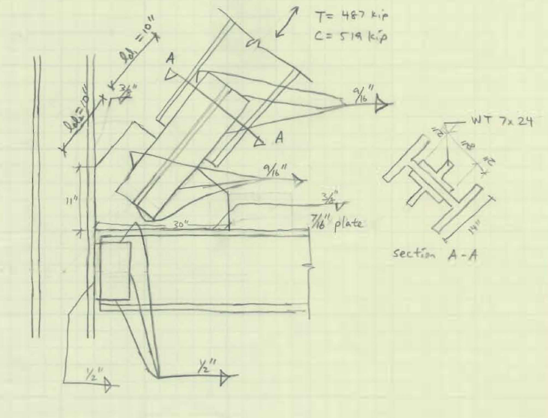
THE COMMONWEALTH MEDICAL COLLEGE
MAE REQUIREMENT
CONNECTIONS
Building Introduction
Existing Structural System
Problem Statement
Proposed Solution
New Lateral Loads
Lateral Frame Designs
Façade Design Breadth
Acknowledgements
  ETABS Model
  AE 530, Computer Modeling
  Typical 2nd Floor Brace Connection
  AE 534, Steel Connections
  Façade Breadth
  AE 542, Building Enclosures

Slide 21
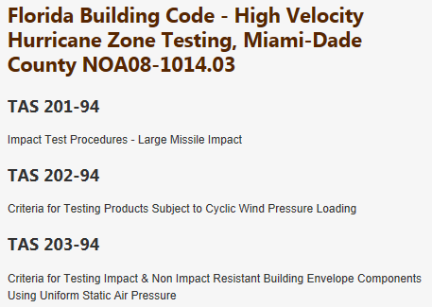
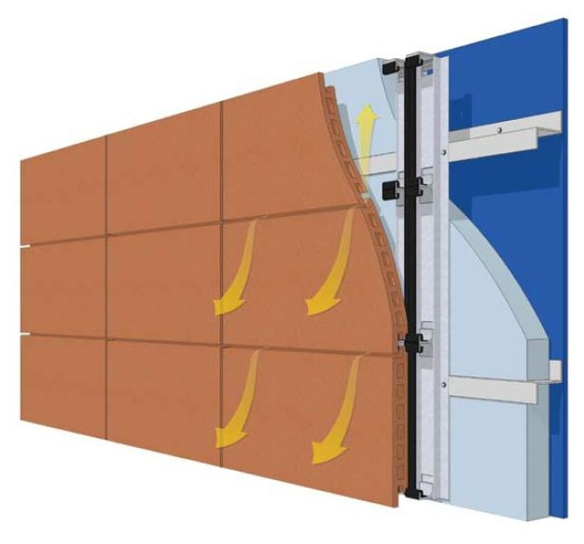
THE COMMONWEALTH MEDICAL COLLEGE
FAÇADE DESIGN
TerraClad RAIN SCREEN
Building Introduction
Existing Structural System
Problem Statement
Proposed Solution
New Lateral Loads
Lateral Frame Designs
Façade Design Breadth
Acknowledgements
  Rain Screen Wall Cladding System
    TerraClad Rain Screen manufactured by Boston Valley Terra Cotta
      Simple to Install
      Shield from wind driven rain
      LEED credit opportunities
      Abundant colors and sizes, match original
      6” additional thickness to exterior wall
http://www.bostonvalley.com/terraclad/product-testing.html

Slide 22
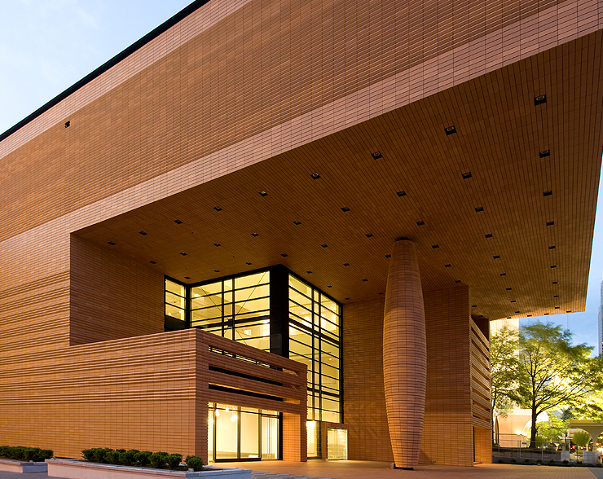
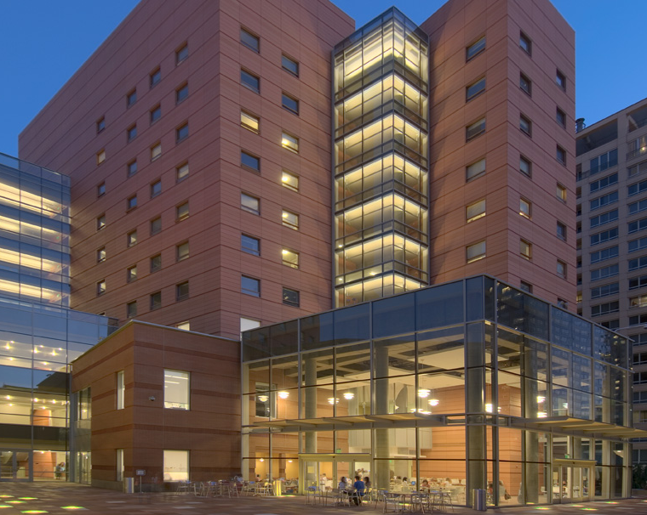
THE COMMONWEALTH MEDICAL COLLEGE
FAÇADE DESIGN
TerraClad RAIN SCREEN
Building Introduction
Existing Structural System
Problem Statement
Proposed Solution
New Lateral Loads
Lateral Frame Designs
Façade Design Breadth
Acknowledgements
  Rain Screen Wall Cladding System
    TerraClad Rain Screen manufactured by Boston Valley Terra Cotta
      Simple to Install
      Shield from wind driven rain
      LEED credit opportunities
      Abundant colors and sizes, match original
      6” additional thickness to exterior wall
http://www.bostonvalley.com
The Bechtler Museum of Modern Arts
The Colburn School of Performing Arts

Slide 23
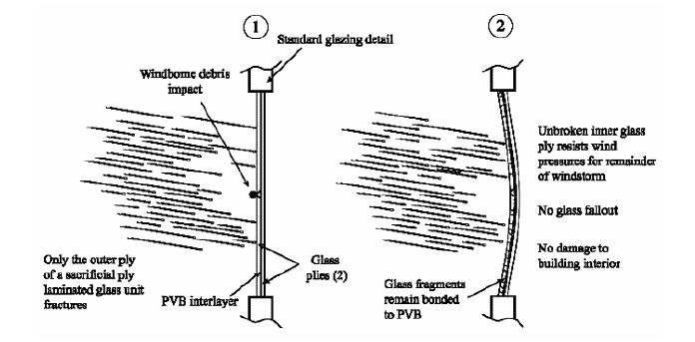
THE COMMONWEALTH MEDICAL COLLEGE
FAÇADE DESIGN
Building Introduction
Existing Structural System
Problem Statement
Proposed Solution
New Lateral Loads
Lateral Frame Designs
Façade Design Breadth
Acknowledgements
  Windows/Glazing
    LGUs with the concept of Sacrificial Ply
Typical Window Design
 | Width | Height | Outer Ply Thickness | Inner Ply Thickness
2'x4' | 2' | 4' | 1/8" | 3/16"
6'x10' | 6' | 10' | 1/8" | 5/8"

Slide 24
THE COMMONWEALTH MEDICAL COLLEGE
ACKNOWLEDGEMENTS
  Penn State Architectural Engineering Faculty
    Heather Sustersic
  Highland Associates
    Eric McAndrew
  TCMC
  Family and Friends
QUESTIONS?

Slide 25
THE COMMONWEALTH MEDICAL COLLEGE
Appendix

Slide 26
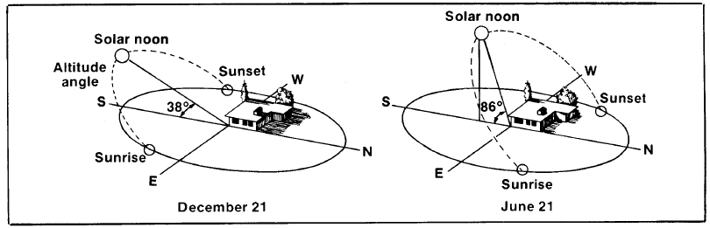
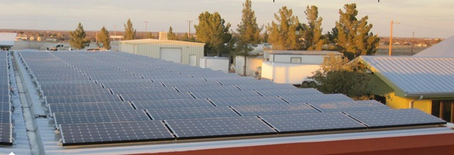
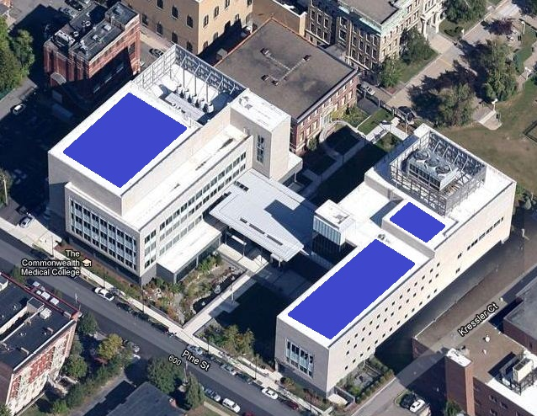
THE COMMONWEALTH MEDICAL COLLEGE
SOLAR PANEL DESIGN
http://us.sanyo.com/Solar/Stone-Brewing-Company
http://www.kahnsolar.com/images/how_solar_works_pic.jpg
The Bechtler Museum of Modern Arts
HIT Power 220A Photovoltaic Module, by Panasonic
  Withstand 60 psf
  Top Energy Producer
  Highest Output on Cloudy Days
Estimated Life-Cycle Cost for 20 years= $ 279,086
Estimated Total Savings = $ 10,000
Estimated Payback Period = 27 years

Slide 27
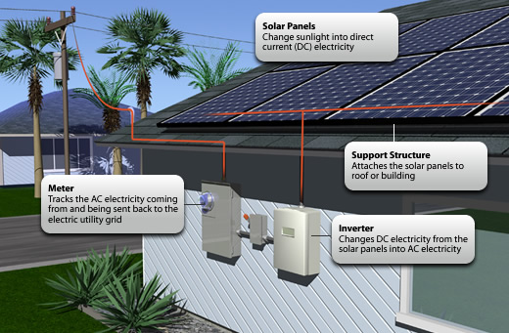
THE COMMONWEALTH MEDICAL COLLEGE
MECHANICAL AND ELECTRICAL
GRID-TIED CONNECTION
    Reduced in Number of Steam Boilers
    Number of McQuay Chillers for Cooling stayed the same
    Main Problem – High Humidity
      RLNL-G Dehumidifier by Rheem
        Money – Saving Efficiency
        Quiet Operation
        Quality
        Remote Monitoring and Control
  Grid-Tied System
    Net-metering
Image from Kahn Solar

Slide 28
THE COMMONWEALTH MEDICAL COLLEGE
BUILDING DRIFT
  Moment Frame Drift
  Braced Frame Drift

Slide 29
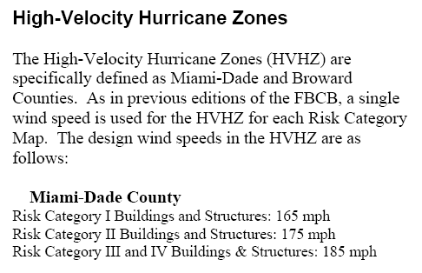
THE COMMONWEALTH MEDICAL COLLEGE
ASCE 7-10 CODE DIFFERENCE
http://www.floridabuilding.org/fbc/Wind_2010/Flyer_Wind_January2012.pdf

Slide 30
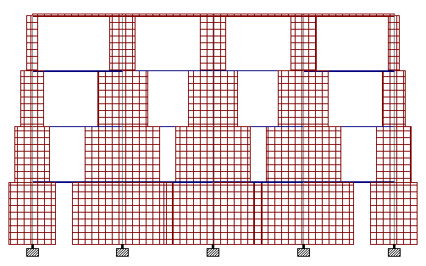
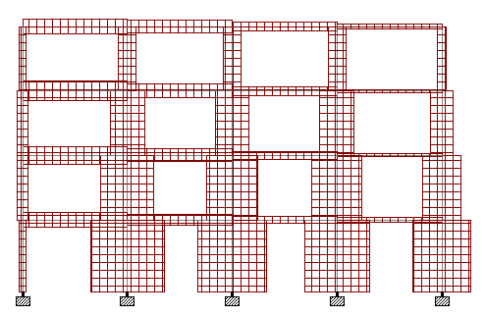
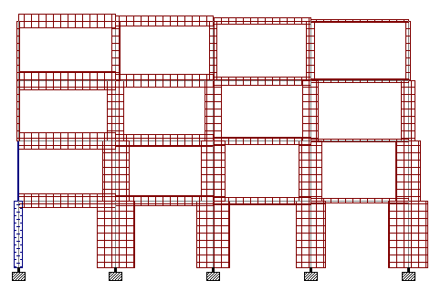
THE COMMONWEALTH MEDICAL COLLEGE
MOMENT FRAMES AXIAL
  Frame A
  1.2D + 1.6L + 0.5 Lr
  1.2D + 1.6W + L + 0.5Lr
  0.9D + 1.6W

Slide 31
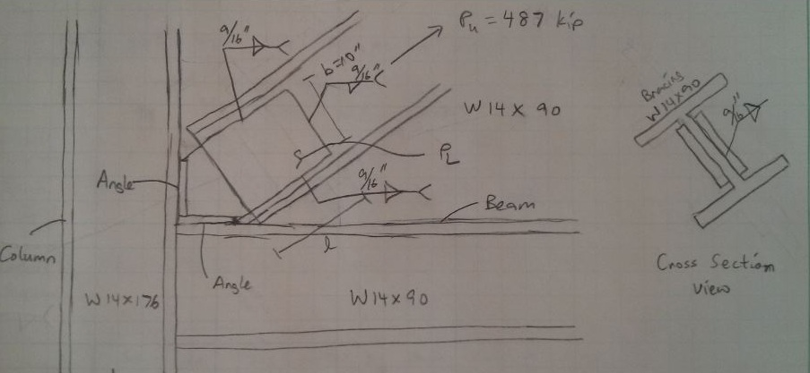
THE COMMONWEALTH MEDICAL COLLEGE
CONNECTIONS
Did not check for Compression Force

