Slide 1
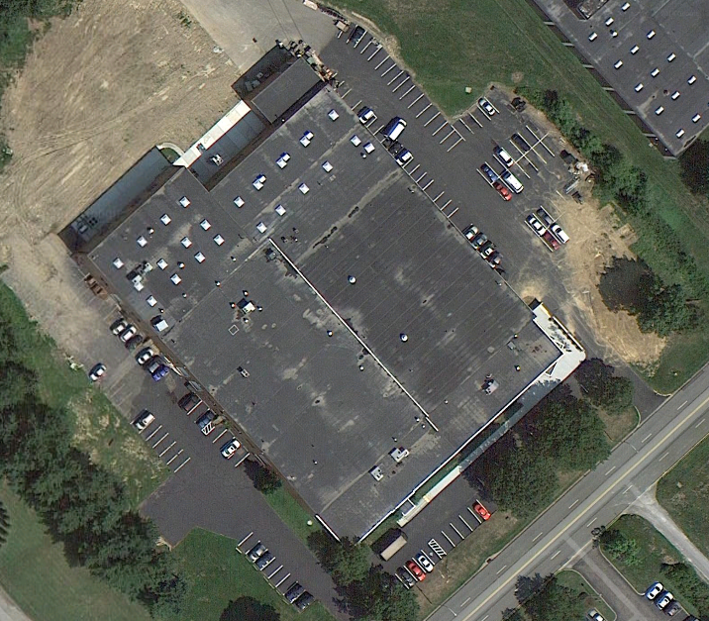
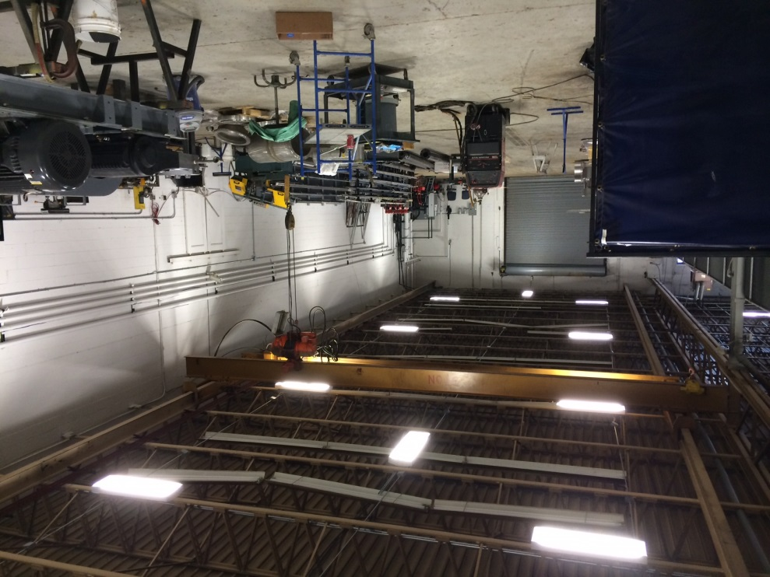
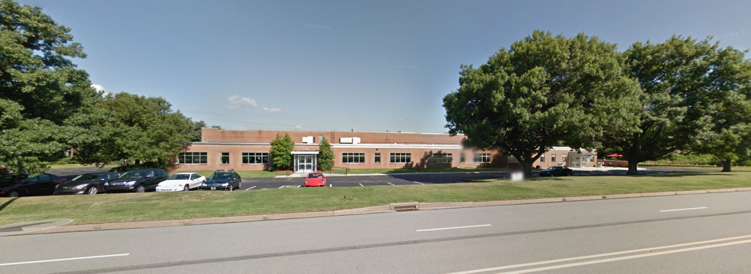
123 Alpha Drive
Pittsburgh,
Pennsylvania
https://www.google.com/maps/place/150+Gamma+Dr/@40.4997521,-79.8681269,18z/data=!4m2!3m1!1s0x8834ecdbc348bd5f:0xd10a14f6b42509a0
Alexander Radkoff
Mechanical Option | Spring 2014
Advisor: Dr. Stephen Treado

Slide 2
Background
123 Alpha Drive
Pittsburgh,
Pennsylvania
Location: Pittsburgh, Pennsylvania
Building Use:
          Warehouse Storage
          Laboratory Space
          Offices
Footprint: 74,900 square feet
Ceiling Height:
          Offices: 9’
          Warehouse: 22’ 6”
Renovated: 2012
Introduction
Existing Mechanical System
Variable Refrigerant Flow System
Cost Analysis
Emissions Analysis
Acoustical Design
Conclusion
Alexander Radkoff
Mechanical Option | Spring 2014
https://www.google.com/maps/place/150+Gamma+Dr/@40.4997521,-79.8681269,18z/data=!4m2!3m1!1s0x8834ecdbc348bd5f:0xd10a14f6b42509a0
Advisor: Dr. Stephen Treado

Slide 3
Pittsburgh,
Design Conditions
123 Alpha Drive
Pennsylvania
Outdoor Design Conditions
Indoor Design Conditions
Introduction
Existing Mechanical System
 | Offices & Lab | Warehouse & Packaging | Storage & Maintenance
Cooling Set Point | 70 °F | 85 °F | 95 °F
Heating Set Point | 55 °F | 55 °F | 60 °F
Relative Humidity | 45% | - | -
Variable Refrigerant Flow System
 | Summer Design Cooling | Winter Design Heating
OA Dry Bulb (°F) | 89 °F | 2.0 °F
OA Wet Bulb (°F) | 72 °F | .3 °F
Cost Analysis
Emissions Analysis
Acoustical Design
Conclusion
Alexander Radkoff
Mechanical Option | Spring 2014
Advisor: Dr. Stephen Treado

Slide 4
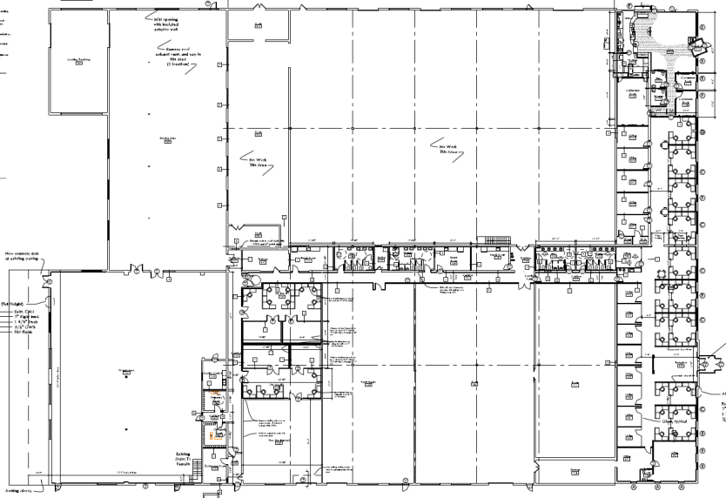

123 Alpha Drive
Pittsburgh,
Existing Mechanical System
Pennsylvania
Office/Lab Space
Warehouse and Storage
Introduction
Existing Mechanical System
6 single zone CAV rooftop units (RTUs)
CO2 preheat conditioning option available
CO2 radiant floor cooling and heating
Primarily electric resistance heat
8 air handling units (AHUs)
Makeup air handling unit
Variable Refrigerant Flow System
Cost Analysis
Emissions Analysis
Acoustical Design
Conclusion
Alexander Radkoff
Mechanical Option | Spring 2014
Advisor: Dr. Stephen Treado

Slide 5
Monthly Cooling Load Figure
Annual Load Simulation
123 Alpha Drive
Pittsburgh,
Pennsylvania
Introduction
Existing Mechanical System
Variable Refrigerant Flow System
Cost Analysis
Emissions Analysis
Acoustical Design
Conclusion
Alexander Radkoff
Mechanical Option | Spring 2014
Advisor: Dr. Stephen Treado

Slide 6
Annual Load Simulation
123 Alpha Drive
Pittsburgh,
Pennsylvania
Introduction
Annual Energy Consumption By Use
HVAC:
Lighting:
Electrical Equipment:
Total Annual Energy Consumption:
Existing Mechanical System
595,045 kWh
Variable Refrigerant Flow System
2,657,011 kWh
Cost Analysis
Emissions Analysis
3,252,057 kWh
Acoustical Design
Conclusion
6,5041,143 kWh
Alexander Radkoff
Mechanical Option | Spring 2014
Advisor: Dr. Stephen Treado

Slide 7
Energy Cost and Consumption
123 Alpha Drive
Pittsburgh,
Pennsylvania
Introduction
Annual Cost per Unit Floor Area
HVAC:
Lighting:
Electrical Equipment:
Total Annual Energy Cost:
Existing Mechanical System
$0.96/ft²
Variable Refrigerant Flow System
$2.04/ft²
Cost Analysis
Emissions Analysis
$1.89/ft²
Acoustical Design
$366,744
Conclusion
Alexander Radkoff
Mechanical Option | Spring 2014
Advisor: Dr. Stephen Treado

Slide 8
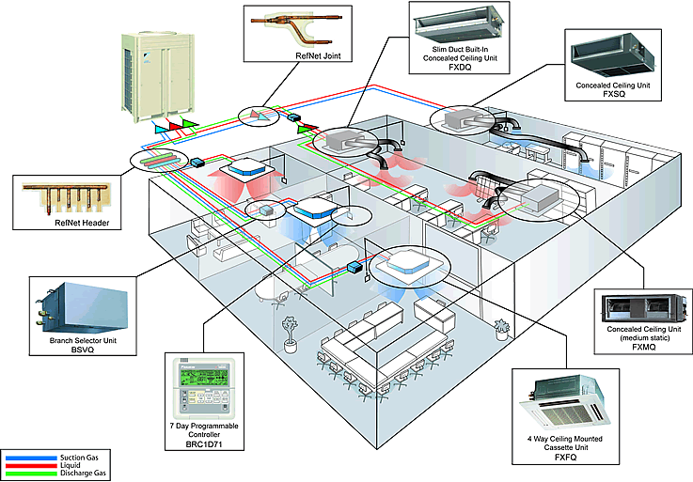
123 Alpha Drive
Pittsburgh,
Variable Refrigerant Flow System
Pennsylvania
Advantages
Introduction
System Components
Lower energy costs
Lower CO2e emissions
Simultaneous heating and cooling
Precise and occupant control capabilities
Outdoor/Indoor Condensing Unit
3 pipe system (suction, liquid, discharge gas)
Mode Change Unit (MCU)
2 pipe system from MCU to fan coil unit
Indoor fan coil units
Existing Mechanical System
Variable Refrigerant Flow System
Cost Analysis
Emissions Analysis
Acoustical Design
Disadvantages
Conclusion
Expensive first costs
Requires DOAS system
Alexander Radkoff
Mechanical Option | Spring 2014
Advisor: Dr. Stephen Treado
http://y.asi.ph/note/commissioning-daikin-vrv-systems/

Slide 9

Pittsburgh,
VRF System Layout
123 Alpha Drive
Pennsylvania
Introduction
Key
System Layout Restrictions
Existing Mechanical System
VRF System 1
Piping Length – 656 feet maximum
External Static Pressure – 1” maximum
Condensing Unit Elevation – 360 feet maximum
Variable Refrigerant Flow System
Cost Analysis
VRF System 2
Emissions Analysis
VRF System 3
Acoustical Design
Conclusion
Alexander Radkoff
Mechanical Option | Spring 2014
Advisor: Dr. Stephen Treado

Slide 10
Pittsburgh,
Condensing Unit Quantity
123 Alpha Drive
Pennsylvania
Introduction
Samsung DVM S Series Condensing Unit Requirements
Existing Mechanical System
Variable Refrigerant Flow System
VRF System | 1 | 2 | 3
Size (tons) | 11.5 | 17.2 | 12.5
Number of Condensing Units Needed | One | Two | Two
Number of Condensing Units Needed | One | Two | Three
Size (tons) | 6-12 | 14-24 | 26-36
Cost Analysis
Emissions Analysis
Acoustical Design
Conclusion
Alexander Radkoff
Mechanical Option | Spring 2014
Advisor: Dr. Stephen Treado

Slide 11
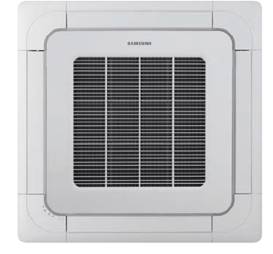
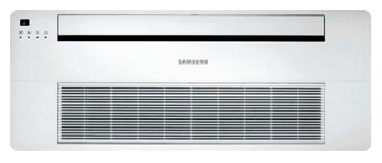
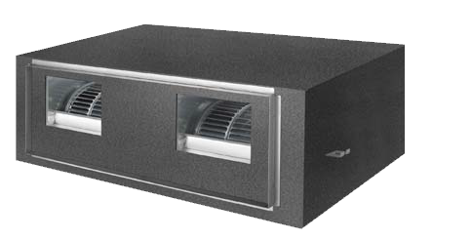
Pittsburgh,
Indoor Fan Coil Unit Selection
123 Alpha Drive
Pennsylvania
1-Way Cassette Terminal Unit
Located at edges of room ceiling
Diffuses in one direction
4-Way Cassette Terminal Unit
Located in central area of ceiling
Distributes air in four directions
High Static Pressure Duct Unit
Up to .99 in wg. external static pressure
Can condition multiple spaces at a time
Introduction
Existing Mechanical System
Variable Refrigerant Flow System
Cost Analysis
1 Way Cassette Terminal Unit
4 Way Cassette Terminal Unit
Source: Samsung DVM S Series Catalog
Source: Samsung DVM S Series Catalog
Emissions Analysis
Acoustical Design
Conclusion
Alexander Radkoff
Mechanical Option | Spring 2014
Advisor: Dr. Stephen Treado
High Static Pressure (HSP) Duct Unit
Source: Samsung DVM S Series Catalog

Slide 12
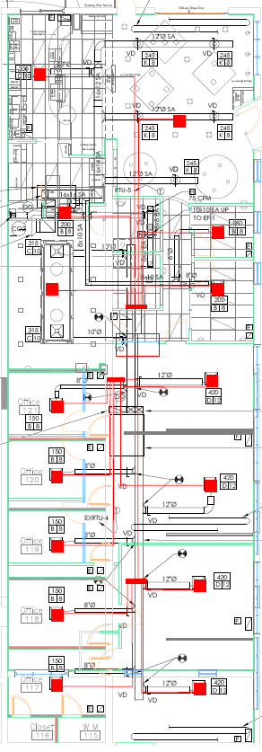
Pittsburgh,
VRF System Selection
123 Alpha Drive
Pennsylvania
VRF System 1
12 ton Outdoor Condensing Unit (1)
Introduction
Existing Mechanical System
Variable Refrigerant Flow System
CU-1
Cost Analysis
Mode Change Units (3)
Emissions Analysis
Acoustical Design
4 Way Cassette FCU (6)
1 Way Cassette FCU (9)
Conclusion
Alexander Radkoff
Mechanical Option | Spring 2014
Advisor: Dr. Stephen Treado

Slide 13
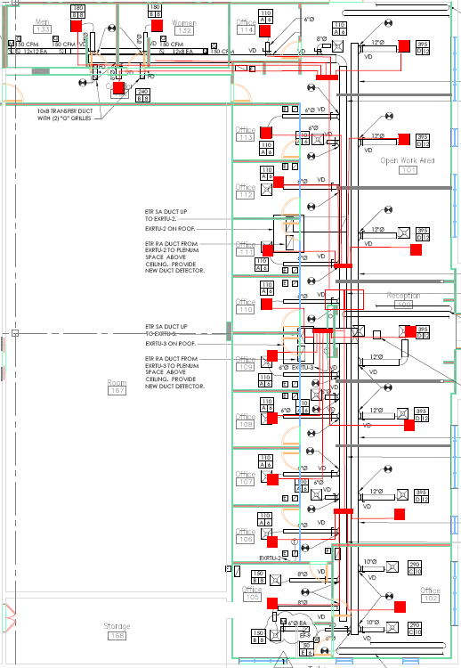

VRF System Selection
123 Alpha Drive
Pittsburgh,
Pennsylvania
VRF System 2
6 ton Outdoor Condensing Unit (1)
10 ton Outdoor Condensing Unit (1)
Introduction
Existing Mechanical System
Variable Refrigerant Flow System
Cost Analysis
Mode Change Units (4)
Emissions Analysis
Acoustical Design
4 Way Cassette FCU (12)
1 Way Cassette FCU (7)
Conclusion
Alexander Radkoff
Mechanical Option | Spring 2014
Advisor: Dr. Stephen Treado

Slide 14
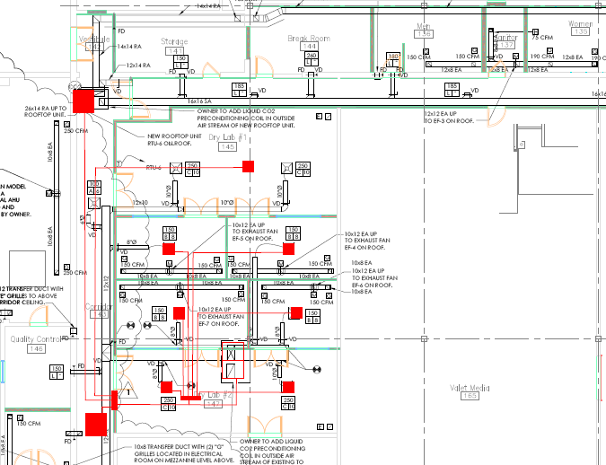
Pittsburgh,
VRF System Selection
123 Alpha Drive
Pennsylvania
VRF System 3
6 ton Outdoor Condensing Unit (1)
10 ton Outdoor Condensing Unit (1)
Introduction
Existing Mechanical System
Variable Refrigerant Flow System
Cost Analysis
Mode Change Units (3)
Emissions Analysis
Acoustical Design
4 Way Cassette FCU (3)
1 Way Cassette FCU (4)
High Static Pressure Unit (2)
Conclusion
Alexander Radkoff
Mechanical Option | Spring 2014
Advisor: Dr. Stephen Treado

Slide 15
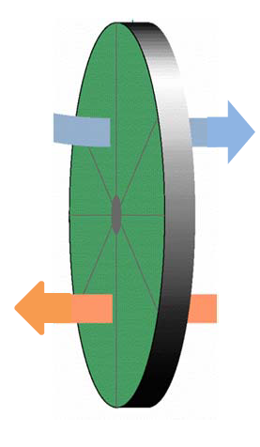
Pittsburgh,
Dedicated Outside Air System
123 Alpha Drive
Pennsylvania
Semco FV-2000 Fresh Air Preconditioner
3 Angstrom Total Energy Wheel
Parallel system to VRF system
Manages humidification and de-humidification
Introduction
Design Conditions: Cooling Season
Existing Mechanical System
Outdoor Airstream
Supply Airstream
Variable Refrigerant Flow System
Dry Bulb (°F) : 95.0
Wet Bulb (°F): 75.0
Enthalpy (BTU/lb): 38.4
Dry Bulb (°F) : 80.2
Wet Bulb (°F): 65.7
Enthalpy (BTU/lb): 30.5
Airflow (CFM): 1,250
Cost Analysis
Emissions Analysis
 | Airflow (cfm) | Ext. Static Pressure (in wg.) | Motor Brake Horsepower | Fan Speed (RPM)
Supply Air | 1,250 | 1.50 | 1.00 | 1723
Exhaust Air | 1,175 | .75 | .64 | 1413
Acoustical Design
Exhaust Airstream
Return Airstream
Conclusion
Dry Bulb (°F) : 90.8
Wet Bulb (°F): 72.5
Enthalpy (BTU/lb): 36.1
Dry Bulb (°F) : 75.0
Wet Bulb (°F): 62.0
Enthalpy (BTU/lb): 27.8
Airflow (CFM): 1,175
Alexander Radkoff
Mechanical Option | Spring 2014
Advisor: Dr. Stephen Treado
Source: Semco FV 2000 Catalog

Slide 16
Pittsburgh,
Dedicated Outside Air System
123 Alpha Drive
Pennsylvania
Introduction
Efficiency and Static Pressure Loss
Design Conditions: Cooling Season
Existing Mechanical System
Outdoor Airstream
Supply Airstream
Sensible Supply Efficiency: 74%
Latent Supply Efficiency: 74%
Supply Air Pressure Loss: .36
Exhaust Air Pressure Loss: .33
Dry Bulb (°F) : 80.2
Wet Bulb (°F): 65.7
Enthalpy (BTU/lb): 30.5
Airflow (CFM): 1,250
Variable Refrigerant Flow System
Dry Bulb (°F) : 95.0
Wet Bulb (°F): 75.0
Enthalpy (BTU/lb): 38.4
Cost Analysis
Emissions Analysis
Acoustical Design
Exhaust Airstream
Return Airstream
Conclusion
Dry Bulb (°F) : 90.8
Wet Bulb (°F): 72.5
Enthalpy (BTU/lb): 36.1
Dry Bulb (°F) : 75.0
Wet Bulb (°F): 62.0
Enthalpy (BTU/lb): 27.8
Airflow (CFM): 1,175
Alexander Radkoff
Mechanical Option | Spring 2014
Advisor: Dr. Stephen Treado

Slide 17
Pittsburgh,
Controls
123 Alpha Drive
Pennsylvania
BACnet Gateway Building Management System
Occupant Controls
Introduction
Existing Mechanical System
Can connect up to 256 indoor units/16 outdoor units
Weekly/Daily Scheduling
Temperature limitations
ERV operation mode and fan speed
Zone Management
MWR-WE10N Wired Remote Controller
Can control up to 16 indoor units and ERV
Operation mode
Temperature setting (limited by BACnet)
ERV operation and fan speed (limited by BACnet)
Variable Refrigerant Flow System
Cost Analysis
Emissions Analysis
Acoustical Design
Conclusion
Alexander Radkoff
Mechanical Option | Spring 2014
Advisor: Dr. Stephen Treado

Slide 18
Pittsburgh,
Cost Analysis
123 Alpha Drive
Pennsylvania
Introduction
Existing Mechanical System
Variable Refrigerant Flow System
Cost Analysis
Emissions Analysis
Acoustical Design
Conclusion
Alexander Radkoff
Mechanical Option | Spring 2014
Advisor: Dr. Stephen Treado

Slide 19
Pittsburgh,
Cost Analysis
123 Alpha Drive
Pennsylvania
Introduction
Annual HVAC Cost Per Unit Area:
$0.71/ft²
Total Annual HVAC Energy Cost:
$9,001
Existing Mechanical System
Variable Refrigerant Flow System
Cost Analysis
Emissions Analysis
Acoustical Design
Conclusion
Alexander Radkoff
Mechanical Option | Spring 2014
Advisor: Dr. Stephen Treado

Slide 20
Energy Consumption Comparison
123 Alpha Drive
Pittsburgh,
Pennsylvania
Original Design Annual HVAC Energy Consumption:
85,148 kWh
VRF System Annual HVAC Energy Consumption:
72,316 kWh
Difference:
12,832 kWh
Introduction
Existing Mechanical System
Variable Refrigerant Flow System
Cost Analysis
Emissions Analysis
Acoustical Design
Conclusion
Alexander Radkoff
Mechanical Option | Spring 2014
Advisor: Dr. Stephen Treado

Slide 21
Energy Cost Comparison
123 Alpha Drive
Pittsburgh,
Pennsylvania
Original Design Annual HVAC Energy Cost:
$16,416
VRF System Annual HVAC Energy Cost:
$9,001
Difference:
$7,415
Introduction
Existing Mechanical System
Variable Refrigerant Flow System
Cost Analysis
Emissions Analysis
Acoustical Design
Conclusion
Alexander Radkoff
Mechanical Option | Spring 2014
Advisor: Dr. Stephen Treado

Slide 22
Mechanical First Costs Comparison
123 Alpha Drive
Pittsburgh,
Pennsylvania
Original HVAC vs. VRF System First Costs
Introduction
Materials Difference: +118%
Labor Difference: -74%
Total First Cost Difference: +51.8%
Existing Mechanical System
 | Materials | Labor | Total
Original HVAC System | $144,663.88 | $79,733.00 | $222,396.88
VRF System | $327,702.26 | $20,690.81 | $348,393.07
Difference | -$178,038.38 | $59,042.19 | -$118,996.19
Variable Refrigerant Flow System
Cost Analysis
Emissions Analysis
Acoustical Design
Conclusion
Alexander Radkoff
Mechanical Option | Spring 2014
Advisor: Dr. Stephen Treado

Slide 23
Payback Period
123 Alpha Drive
Pittsburgh,
Pennsylvania
Introduction
Variables
Equation
FC_{O} + (AEC_{O} * X) = FC_{VRF} + (AEC_{VRF} * X)
$229,396 + ($16,416*X) = $348,393.07 + (9001 * X)
$118996 = $7415 * X
Existing Mechanical System
FC_{O}= First Cost of Original HVAC System
AEC_{O}= Annual Energy Cost of Original HVAC System
FC_{VRF}= First Cost of Original VRF System
AEC_{VRF}= Annual Energy Cost of VRF HVAC System
X= Payback Period in years
Variable Refrigerant Flow System
Cost Analysis
Emissions Analysis
Payback Period
X= 16.04 years
Acoustical Design
Conclusion
Alexander Radkoff
Mechanical Option | Spring 2014
Advisor: Dr. Stephen Treado

Slide 24
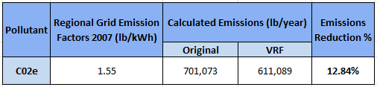
Emissions Comparison
123 Alpha Drive
Pittsburgh,
Pennsylvania
Introduction
Existing Mechanical System
Variable Refrigerant Flow System
Cost Analysis
Emissions Analysis
Acoustical Design
Conclusion
Alexander Radkoff
Mechanical Option | Spring 2014
Advisor: Dr. Stephen Treado

Slide 25
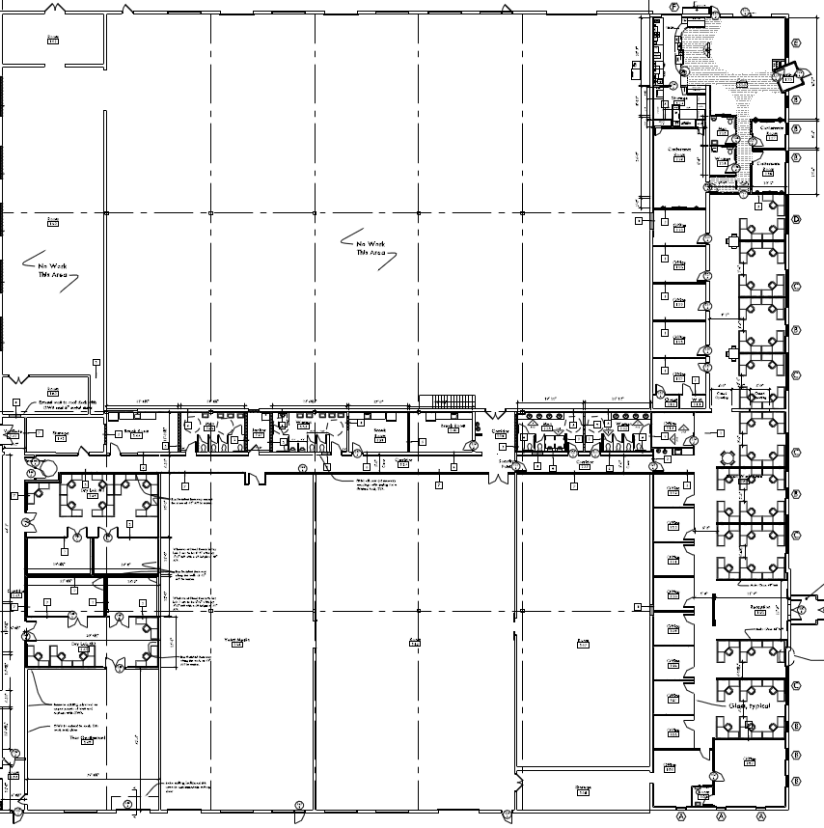
123 Alpha Drive
Pittsburgh,
Acoustical Breadth Investigation
Pennsylvania
Introduction
Recommended Noise Criterion - NC
KEY
Existing Mechanical System
 | Recommended NC Rating | Equivalent Sound Level dBA
Open-Plan Offices | 35-40 | 45-50
Private Offices | 30-35 | 40-45
Conference Rooms | 25-30 | 35-40
Variable Refrigerant Flow System
Private Offices
Conference Rooms
Open Plan
Offices
Cost Analysis
Emissions Analysis
Acoustical Design
Conclusion
Alexander Radkoff
Mechanical Option | Spring 2014
Advisor: Dr. Stephen Treado

Slide 26
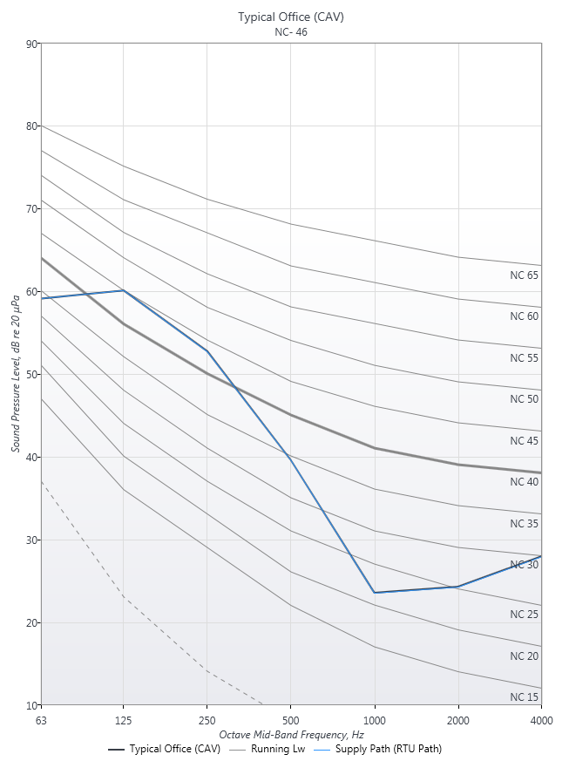
123 Alpha Drive
Pittsburgh,
Acoustical Breadth Investigation
Pennsylvania
Existing Mechanical Conditions
Existing Mechanical NC Rating
Introduction
5 Ton Carrier 50TCD06 Rooftop Unit
1” Fiberglass Insulation
Room Dimensions : 34’x26’x8’
Measure SPL to nearest diffuser
Existing Mechanical System
NC-46
~ 48 dBA
Variable Refrigerant Flow System
Cost Analysis
Emissions Analysis
Acoustical Design
 | Sound Power Level, dB (re 10^-12 W)
Octave Band Frequency, HZ | 63 | 125 | 250 | 500 | 1000 | 2000 | 4000
Discharge | 85.8 | 84.3 | 80.5 | 78.7 | 76.4 | 72.7 | 68.3
Conclusion
Alexander Radkoff
Mechanical Option | Spring 2014
Advisor: Dr. Stephen Treado

Slide 27
123 Alpha Drive
Pittsburgh,
Acoustical Breadth Investigation
Pennsylvania
Existing Mechanical NC Rating
Introduction
Recommended Noise Criterion - NC
Existing Mechanical System
 | Recommended NC Rating | Equivalent Sound Level dBA
Open-Plan Offices | 35-40 | 45-50
Private Offices | 30-35 | 40-45
Conference Rooms | 25-30 | 35-40
NC-46
~ 48 dBA
Variable Refrigerant Flow System
Cost Analysis
Emissions Analysis
Acoustical Design
Conclusion
Alexander Radkoff
Mechanical Option | Spring 2014
Advisor: Dr. Stephen Treado

Slide 28
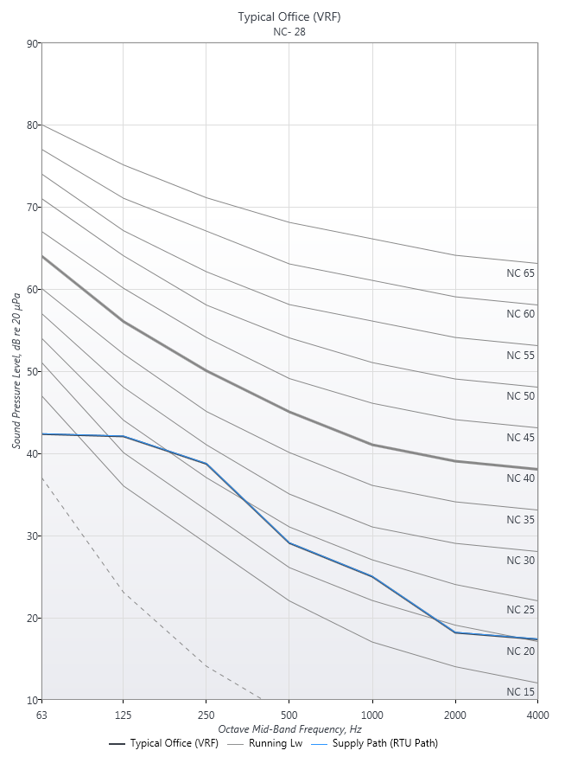
Pittsburgh,
Acoustical Breadth Investigation
123 Alpha Drive
Pennsylvania
Proposed Mechanical Conditions
Recommended Noise Criterion - NC
Introduction
Existing Mechanical System
Samsung DMV AM024FN4dCH/AA 4 Way Cassette Fan Coil Units
Room Dimensions : 34’x26’x8’
NC-25
~ 32 dBA
Variable Refrigerant Flow System
Cost Analysis
Emissions Analysis
Acoustical Design
 | Sound Power Level, dB (re 10^-12 W)
Octave Band Frequency, HZ | 63 | 125 | 250 | 500 | 1000 | 2000 | 4000
Discharge | 40.1 | 37.2 | 36.4 | 33.0 | 29.7 | 27.3 | 22.6
Conclusion
Alexander Radkoff
Mechanical Option | Spring 2014
Advisor: Dr. Stephen Treado

Slide 29
Pittsburgh,
Acoustical Breadth Investigation
123 Alpha Drive
Pennsylvania
Recommended Noise Criterion - NC
Recommended Noise Criterion - NC
Introduction
Existing Mechanical System
 | Recommended NC Rating | Equivalent Sound Level dBA
Open-Plan Offices | 35-40 | 45-50
Private Offices | 30-35 | 40-45
Conference Rooms | 25-30 | 35-40
NC-25
~ 32 dBA
Variable Refrigerant Flow System
Cost Analysis
Emissions Analysis
Acoustical Design
Conclusion
Alexander Radkoff
Mechanical Option | Spring 2014
Advisor: Dr. Stephen Treado

Slide 30
Pittsburgh,
Conclusion
123 Alpha Drive
Pennsylvania
Introduction
Variable Refrigerant Flow System
First Costs – 51% more expensive than original
Annual Costs – 45% cheaper than original system
Payback Period – 16 years (uneconomical)
Emissions – 13% less annually than original
Improve occupant comfort
Acoustical Invesitgation
Original Design – did not meet recommended NC Ratings for office spaces
Potential for rumbly HVAC noise
VRF Design – met all recommended NC Rating and dBA values
Existing Mechanical System
Variable Refrigerant Flow System
Cost Analysis
Emissions Analysis
Acoustical Design
Conclusion
Alexander Radkoff
Mechanical Option | Spring 2014
Advisor: Dr. Stephen Treado

Slide 31
123 Alpha Drive
Pittsburgh,
Acknowledgements
Pennsylvania
Introduction
AE Staff and Faculty
Marc Portnoff
Jonathan Iams
Joel Butler
Dan Gardner
My friends and family
Existing Mechanical System
Variable Refrigerant Flow System
Cost Analysis
Emissions Analysis
Acoustical Design
Conclusion
Alexander Radkoff
Mechanical Option | Spring 2014
Advisor: Dr. Stephen Treado

Slide 32
123 Alpha Drive
Pittsburgh,
Pennsylvania
Introduction
Existing Mechanical System
Variable Refrigerant Flow System
Questions?
Cost Analysis
Emissions Analysis
Acoustical Design
Conclusion
Alexander Radkoff
Mechanical Option | Spring 2014
Advisor: Dr. Stephen Treado

