Slide 1
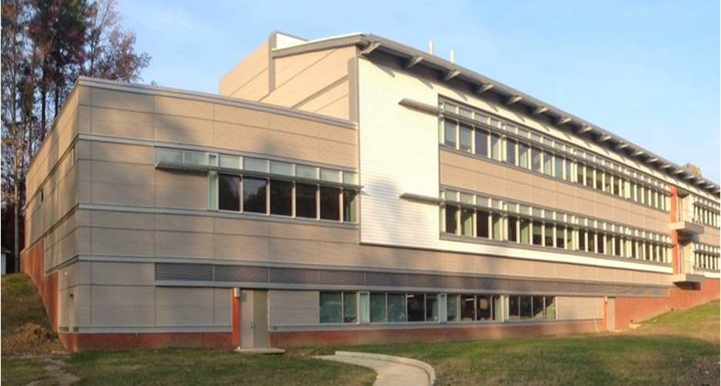
East Coast, USA
Codi Shine
Construction Option
Advisor: Dr. Chimay Anumba
Analysis 1:
Alternative Delivery Method
Analysis 2:
Short Interval Production Schedule (SIPS)
Analysis 3:
Façade Study
Breadths:
Architectural & Mechanical
Analysis 4:
Building Information Modeling (BIM) Implementation

Slide 2
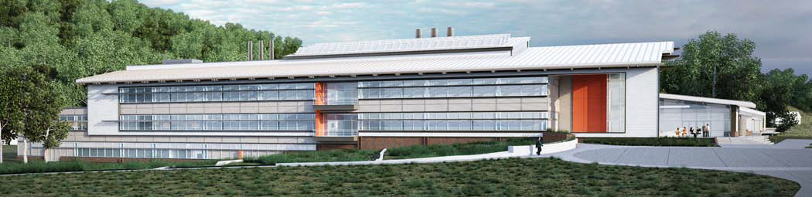
Project Background
Statistics
Size:
72,000 GSF
Stories:
2 plus a penthouse
Delivery Method:
Design-Bid-Build
Contract Value:
$41 million
Construction Dates:
6/1/11-4/22/13
LEED:
Platinum
Project Team
Architect/MEP Engineer | Ewing Cole
General Contractor | Hensel Phelps
Structural Engineer | Woods Peacock
Civil Engineer | Alpha Corporation
Schedule Summary | Start | End
Notice to Proceed | June 1, 2011
Earthwork | November 3, 2011 | November 1, 2012
Concrete | November 7,2011 | November 12, 2012
Structural Steel | February 22, 2012 | April 23,2012
HVAC | October 31, 2011 | November 27, 2012
Electrical | December 19, 2011 | November 30, 2012
Plumbing | December 21, 2011 | October 24, 2012
Specialty Trades | December 21,2011 | February 22, 2013
Turnover |  | April 22, 2013

Slide 3
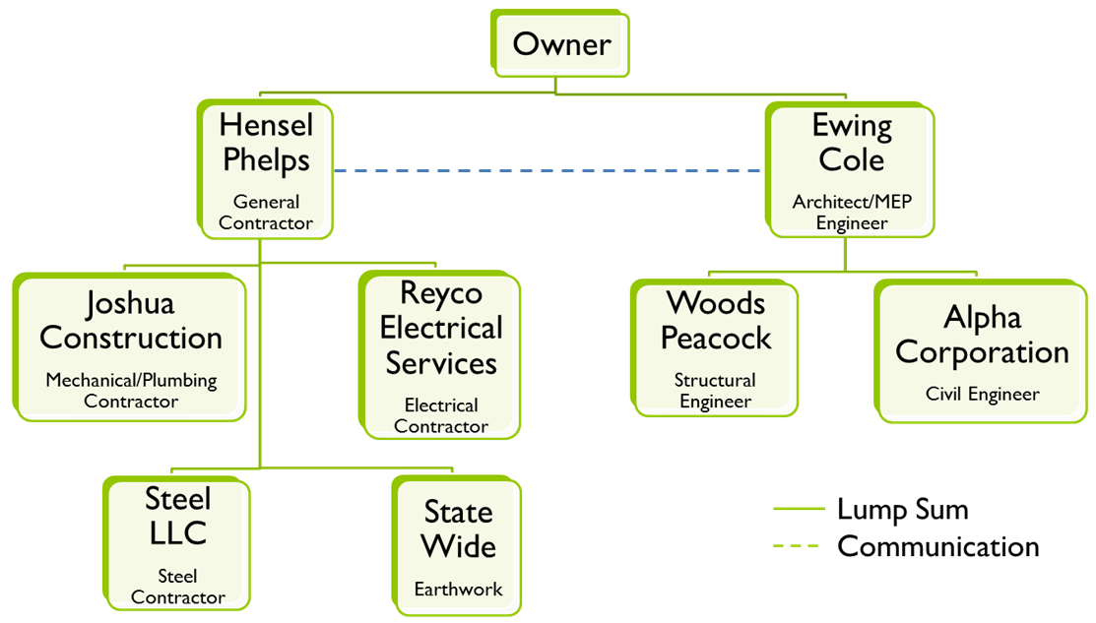
Background
Analysis 1 – Alternative Delivery Method
Project Background
Analysis 1 – Alternative Delivery Method
Background
  Research/Comparisons
  Schedule reduction
Analysis 2 – SIPS
Sequence & crews
  Different SIPS Options
  Schedule Reduction
Analysis 3 – Façade Study
Background
  Materials/Research
  Architectural Breadth
  Changes
    Model
  Mechanical Breadth
    R-value & Condensation
    Production & Cost
Recommendations
Acknowledgements
Current: Design-Bid-Build | Proposed: Design-Build
Phases are Finish-Start relationship Lacks chemistry Owner acts as a mediator Owner has to find all parties Owner holds the liability Multiple contracts | GC can be involved earlier Subcontractors assist with design GC and designer are in a joint venture One point of contact Cost effective Shared risk One contract
Analysis Goals
Reduce the schedule by getting the General Contractor in earlier
Notes:
Current:
Finish-start = construction cannot start until the bidding phase is over and the building awarded
Chemistry = lack coordination and collaboration, which could lead to problems later in the field with schedule/construction or with people
Everything including RFIs goes through the owner = time consuming
Proposed:
Earlier GC = assist w/design so there is less problems in the field, get subs involved earlier to assist w/design and coordination
Joint venture = designer and GC have worked together, good chemistry. Lots of coordination and collaboration
Cost effective = designer and estimator have access to construction cost as the project moves along, so things can be adjusted if need be.

Slide 4
Research & Comparisons
Analysis 1 – Alternative Delivery Method
Project Background
Analysis 1 – Alternative Delivery Method
Background
  Research/Comparisons
  Schedule reduction
Analysis 2 – SIPS
Sequence & crews
  Different SIPS Options
Schedule Reduction
Analysis 3 – Façade Study
Background
  Materials/Research
  Architectural Breadth
  Changes
    Model
  Mechanical Breadth
    R-value & Condensation
    Production & Cost
Recommendations
Acknowledgements
Interviews
Design assist subcontractors
Involved owner
Owner let Hensel Phelps take control
Start site work early
Innovation
Finalize long lead items early
Building Name | Square Foot | Cost/Sq Ft | Intensity | Construction Speed | Delivery Duration
Environmental Studies | 72,000 | $491 | $1,756,192 | 3576 | 3473
Technical Monitoring Hub | 71,336 | $460 | $2,218,444 | 4820 | --
Commercial Hanger | 60,000 | $329 | $1,768,125 | -- | 3947
Notes:
Intensity = Unit cost/ (actual project duration days/30)
Construction Speed = Gross sq ft/ (actual construction duration days/30)
Delivery Duration = Gross sq ft/ (actual project duration days/30)

Slide 5
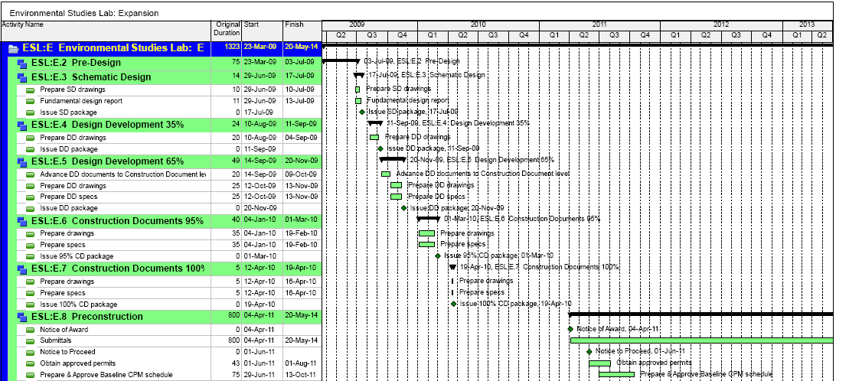
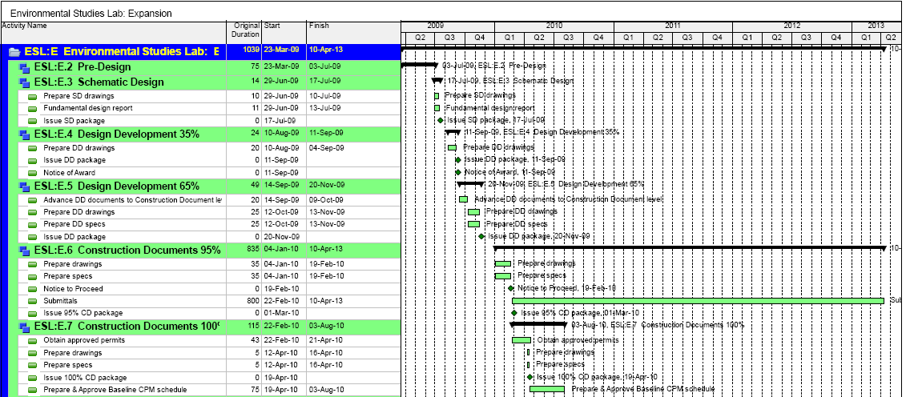
Schedule Reduction
Analysis 1 – Alternative Delivery Method
Project Background
Analysis 1 – Alternative Delivery Method
Background
  Research/Comparisons
  Schedule reduction
Analysis 2 – SIPS
Sequence & crews
  Different SIPS Options
  Schedule Reduction
Analysis 3 – Façade Study
Background
  Materials/Research
  Architectural Breadth
  Changes
    Model
  Mechanical Breadth
    R-value & Condensation
    Production & Cost
Recommendations
Acknowledgements
Notes:
On the left = original design and precon schedule

Slide 6
Schedule Reduction
Analysis 1 – Alternative Delivery Method
Project Background
Analysis 1 – Alternative Delivery Method
Background
  Research/Comparisons
  Schedule reduction
Analysis 2 – SIPS
Sequence & crews
  Different SIPS Options
  Schedule Reduction
Analysis 3 – Façade Study
Background
  Materials/Research
  Architectural Breadth
  Changes
    Model
  Mechanical Breadth
    R-value & Condensation
    Production & Cost
Recommendations
Acknowledgements
Notes:
On the right = precon incorporated into design
several sources have expressed that with design-build the gc should get involved within 15-50% of the design phase. Therefore notice of award is involved in 35% design development.
bridging documents – the owner hires arch or engineer to hold the owners

Slide 7
Schedule Reduction
Analysis 1 – Alternative Delivery Method
Project Background
Analysis 1 – Alternative Delivery Method
Background
  Research/Comparisons
  Schedule reduction
Analysis 2 – SIPS
Sequence & crews
  Different SIPS Options
  Schedule Reduction
Analysis 3 – Façade Study
Background
  Materials/Research
  Architectural Breadth
  Changes
    Model
  Mechanical Breadth
    R-value & Condensation
    Production & Cost
Recommendations
Acknowledgements
Notes:
As you can see it saves 315 days
Recommended

Slide 8
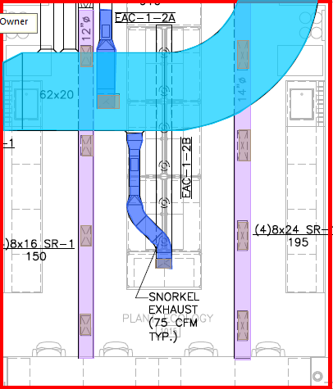
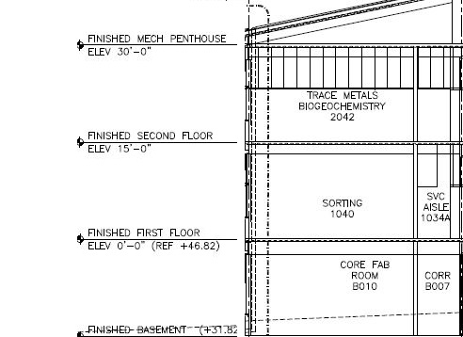
Sequencing & Crews
Analysis 2 – Short Interval Production Schedule (SIPS)
Project Background
Analysis 1 – Alternative Delivery Method
Background
  Research/Comparisons
  Schedule reduction
Analysis 2 – SIPS
Sequence & crews
  Different SIPS Options
  Schedule Reduction
Analysis 3 – Façade Study
Background
  Materials/Research
  Architectural Breadth
  Changes
    Model
  Mechanical Breadth
    R-value & Condensation
    Production & Cost
Recommendations
Acknowledgements
8 hour work days
Slightly different sequence on first and second floors
Analysis Goals
Reduce the schedule by creating a repetitive manner of construction that will also improve the quality of the work.

Slide 9
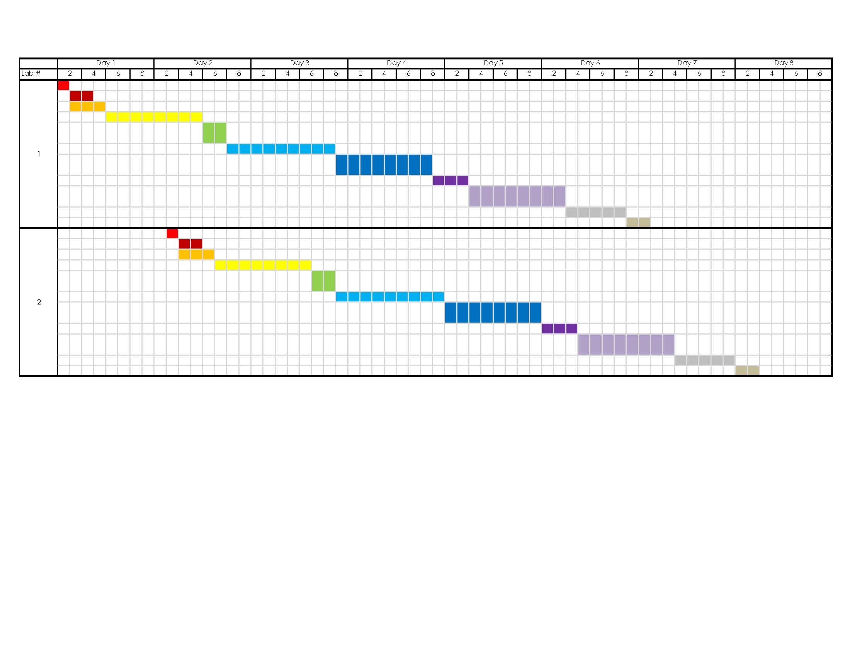
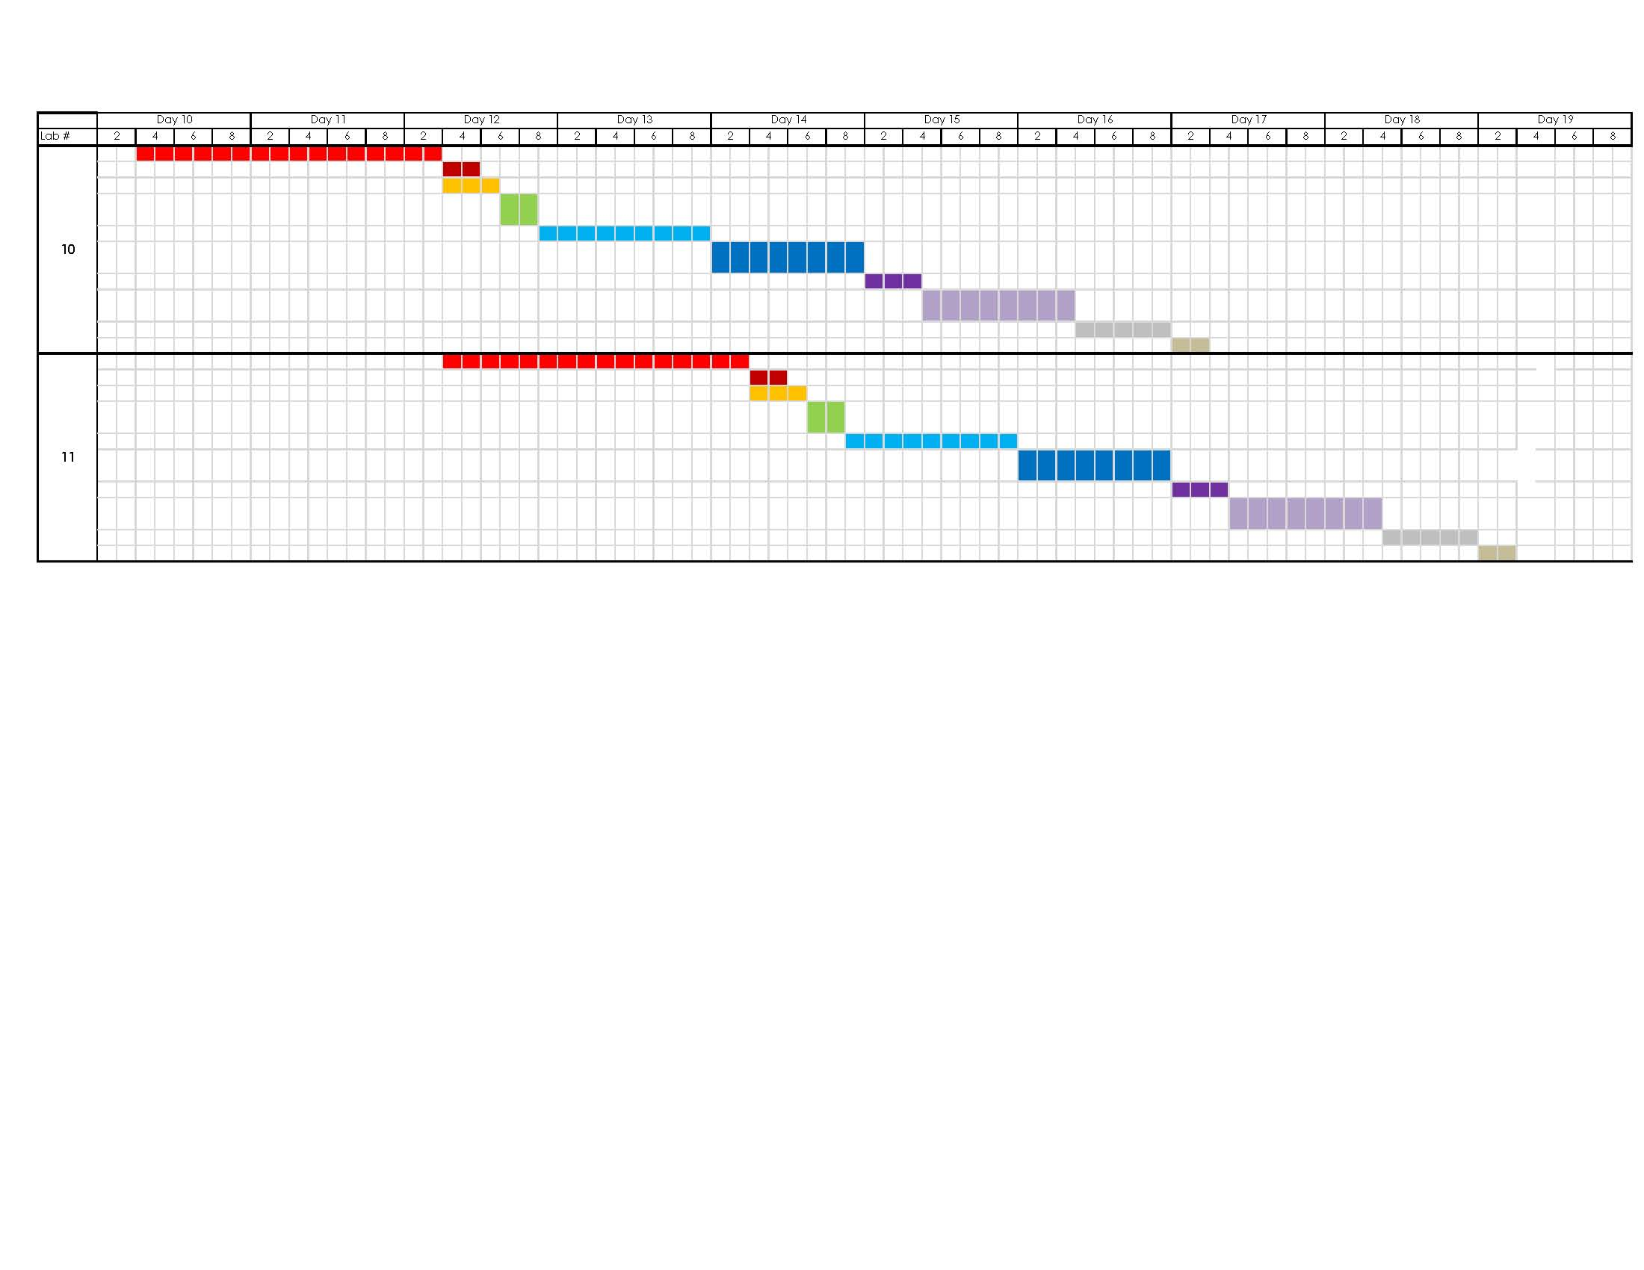
Sequencing & Crews
Analysis 2 – Short Interval Production Schedule (SIPS)
Project Background
Analysis 1 – Alternative Delivery Method
Background
  Research/Comparisons
  Schedule reduction
Analysis 2 – SIPS
Sequence & crews
  Different SIPS Options
  Schedule Reduction
Analysis 3 – Façade Study
Background
  Materials/Research
  Architectural Breadth
  Changes
    Model
  Mechanical Breadth
    R-value & Condensation
    Production & Cost
Recommendations
Acknowledgements
Notes:
Ends on day 33

Slide 10
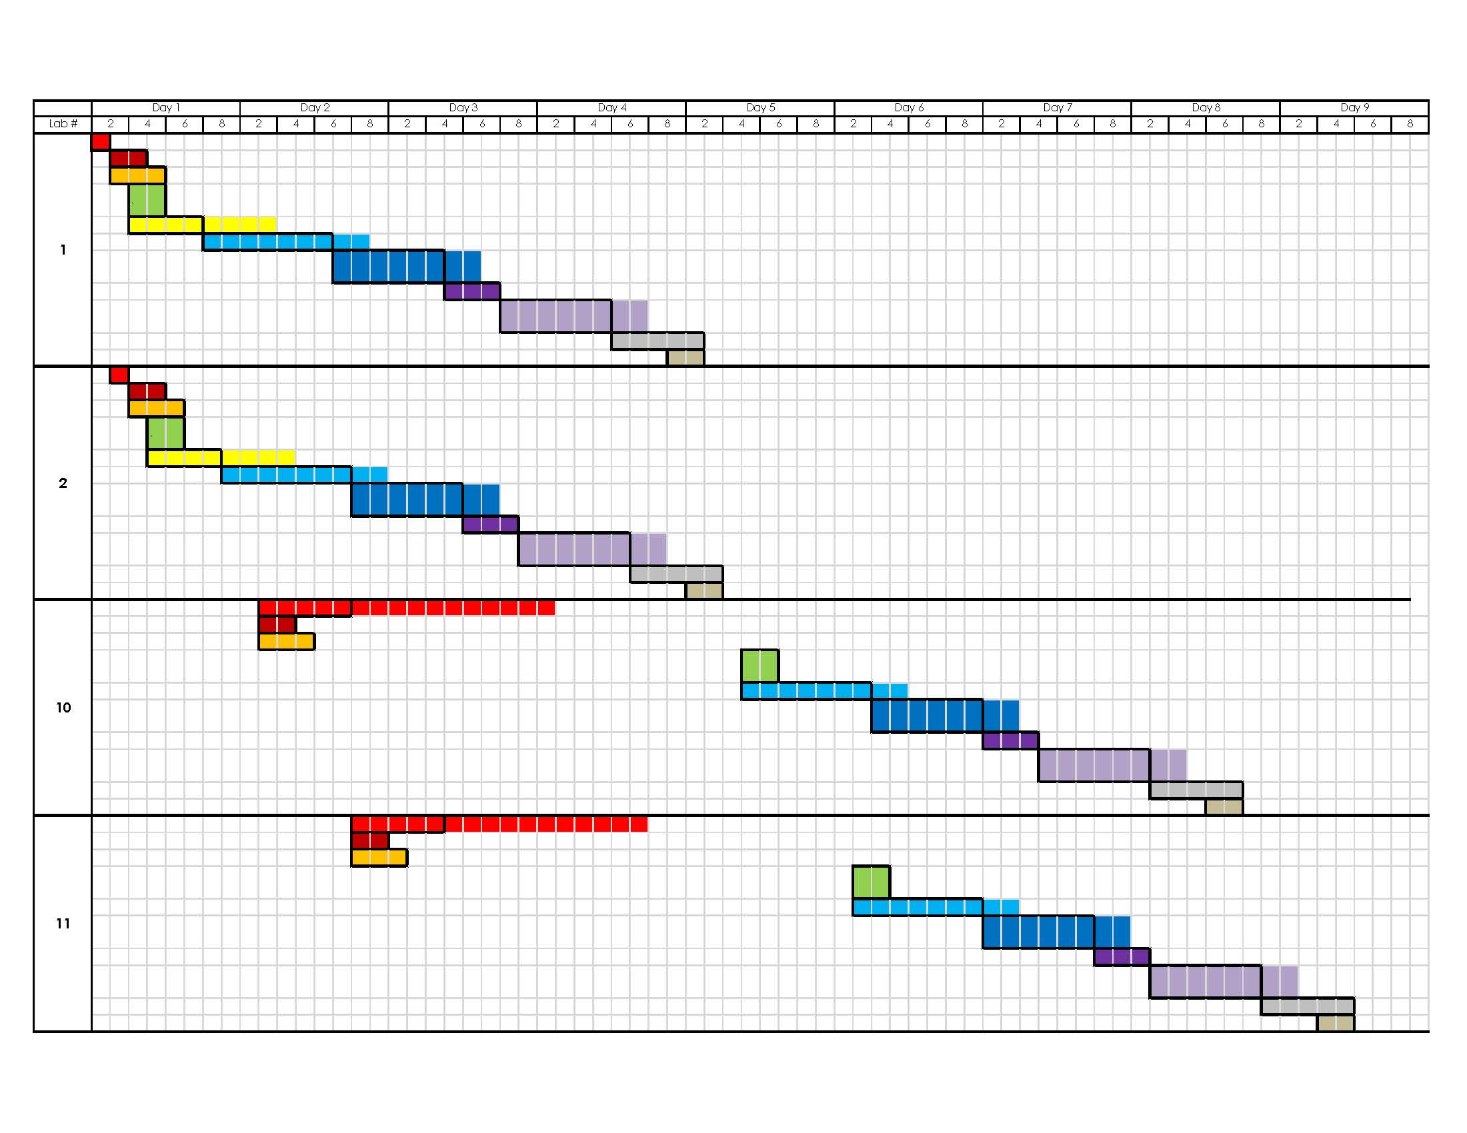
Different SIPS Options
Analysis 2 – Short Interval Production Schedule (SIPS)
SIPS 1
Project Background
Analysis 1 – Alternative Delivery Method
Background
  Research/Comparisons
  Schedule reduction
Analysis 2 – SIPS
Sequence & crews
  Different SIPS Options
  SIPS 1
  Schedule Reduction
Analysis 3 – Façade Study
Background
  Materials/Research
  Architectural Breadth
  Changes
    Model
  Mechanical Breadth
    R-value & Condensation
    Production & Cost
Recommendations
Multiple crews on all activities except for “Layout,” “Install sleeves,” “Install hangers/anchors.”
Notes:
Explain multiple crews
Ends on Day 12

Slide 11
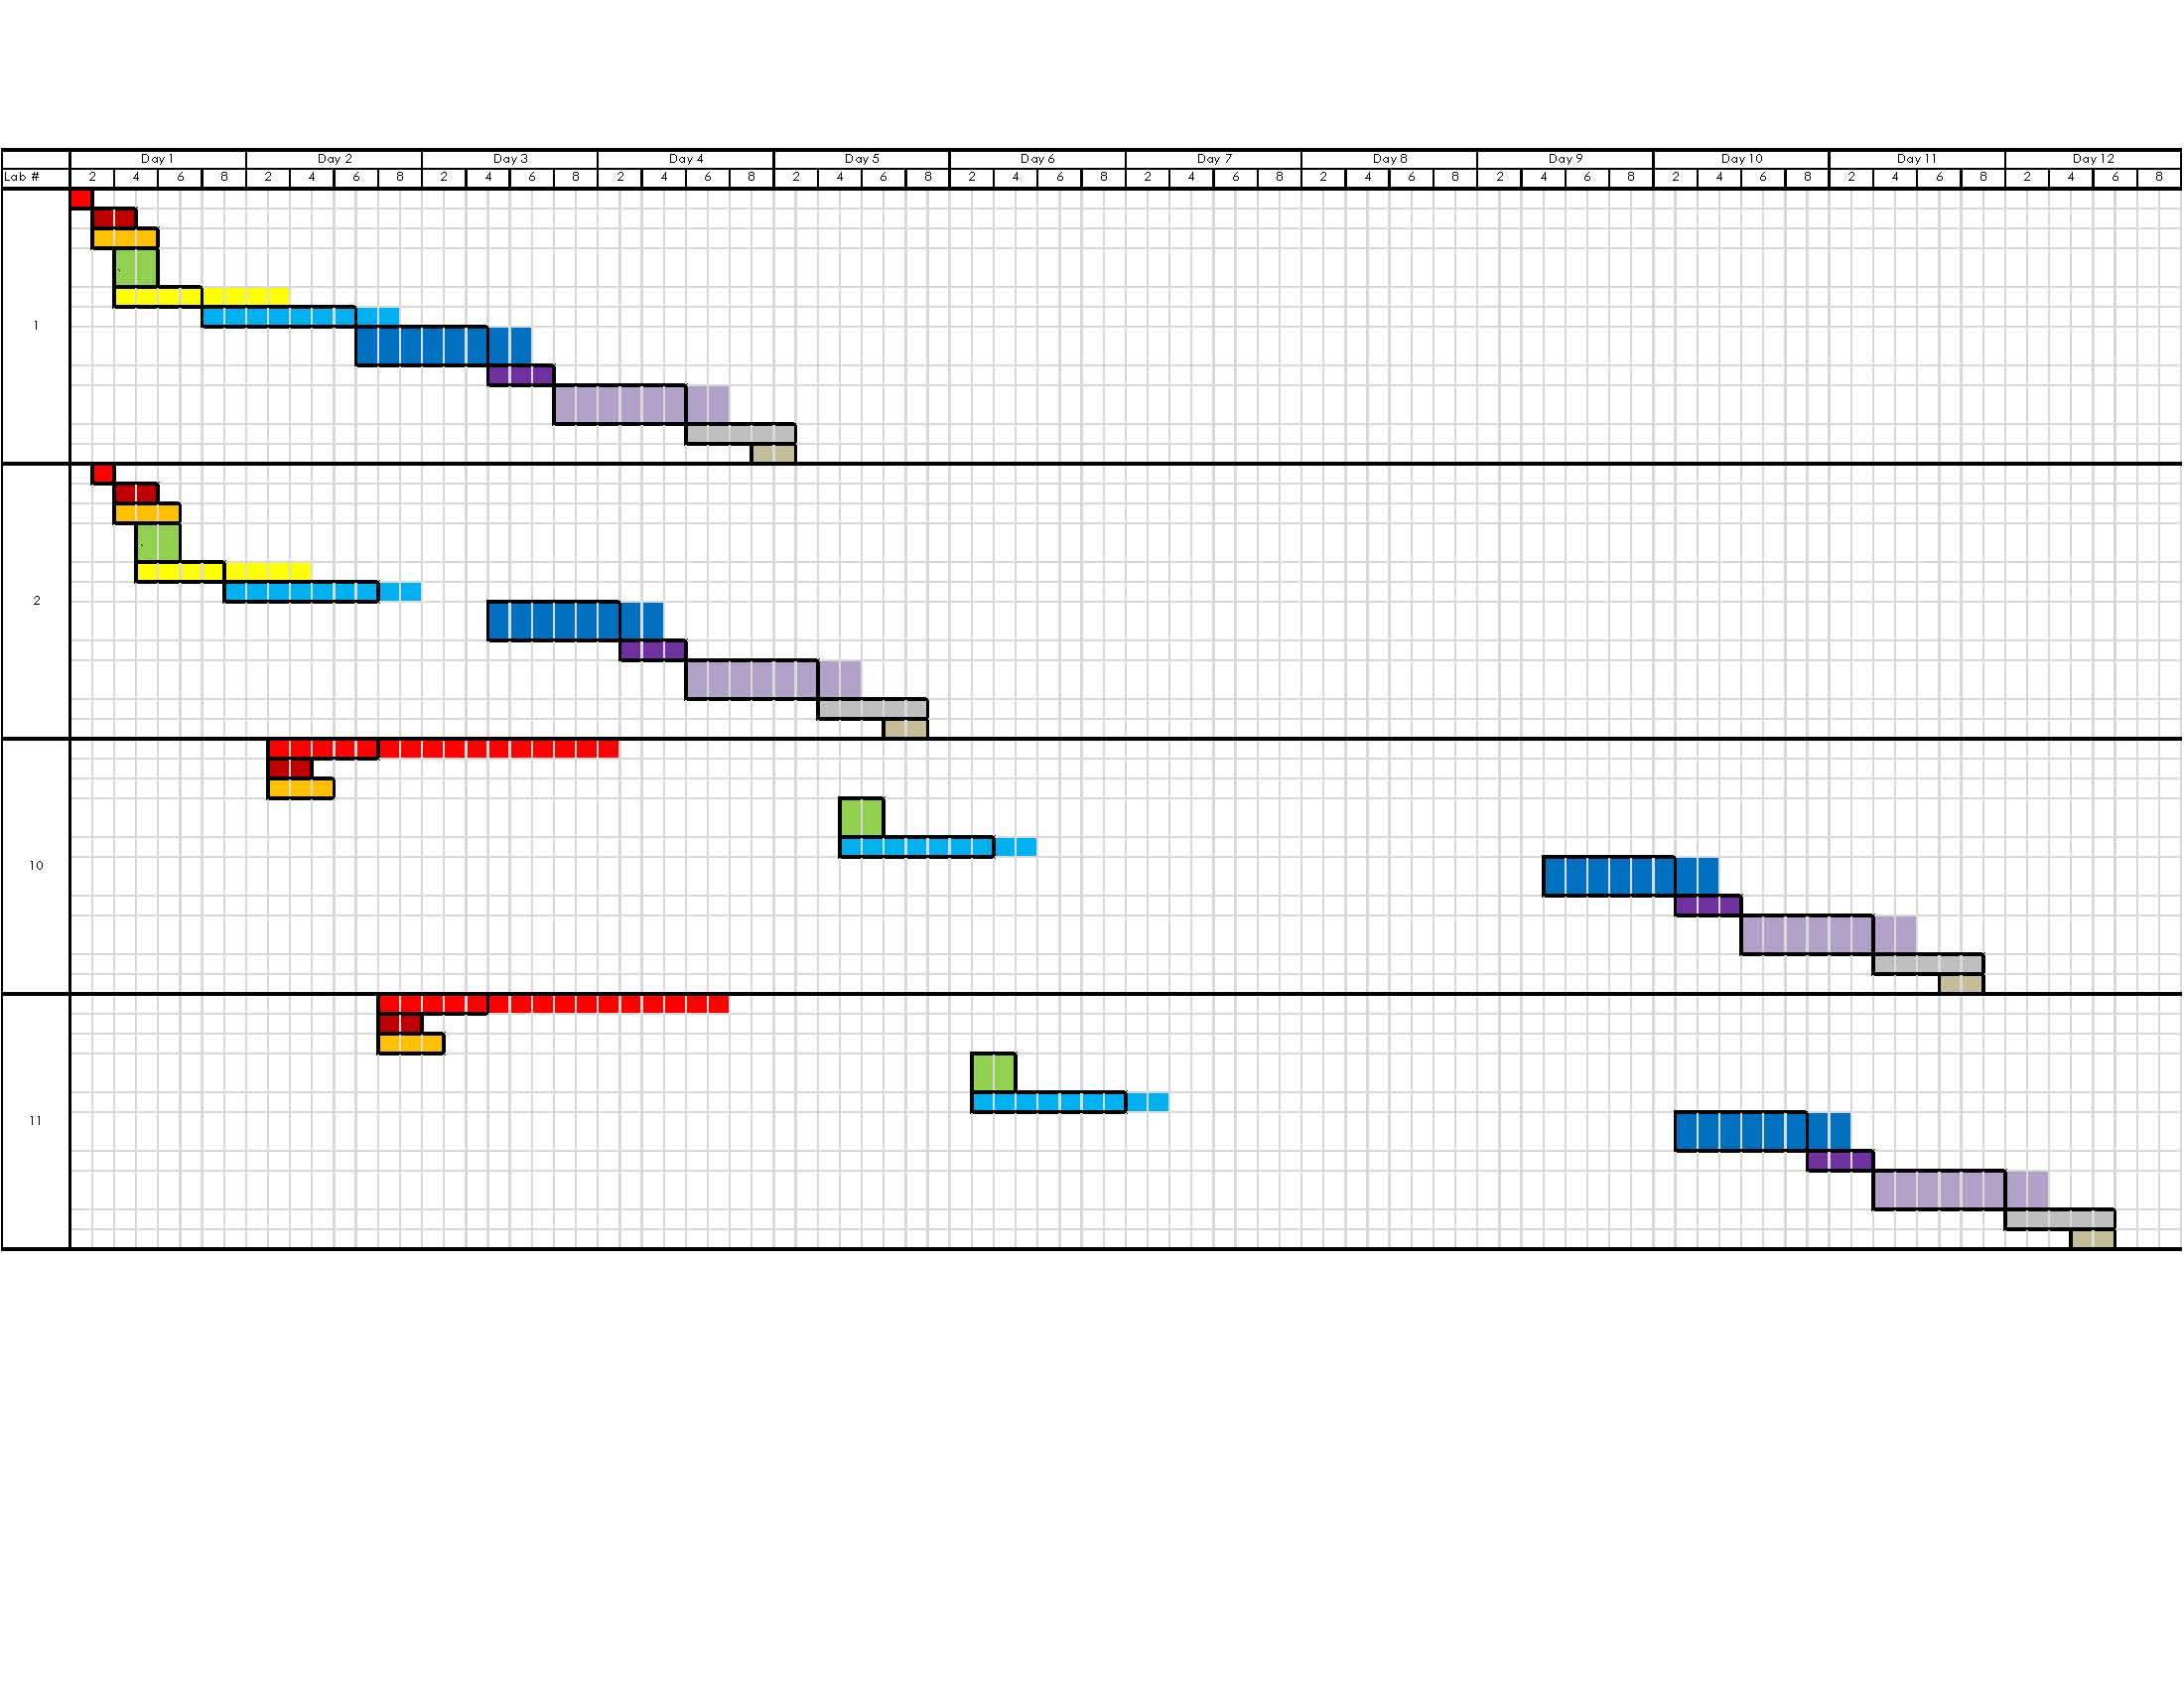
Different SIPS Options
Analysis 2 – Short Interval Production Schedule (SIPS)
SIPS 2
Project Background
Analysis 1 – Alternative Delivery Method
Background
  Research/Comparisons
  Schedule reduction
Analysis 2 – SIPS
Sequence & crews
  Different SIPS Options
  SIPS 2
  Schedule Reduction
Analysis 3 – Façade Study
Background
  Materials/Research
  Architectural Breadth
  Changes
    Model
  Mechanical Breadth
    R-value & Condensation
    Production & Cost
Recommendations
Multiple crews on the activities “Layout” and “Hang Trunk Lines”
Notes:
Ends on Day 17

Slide 12
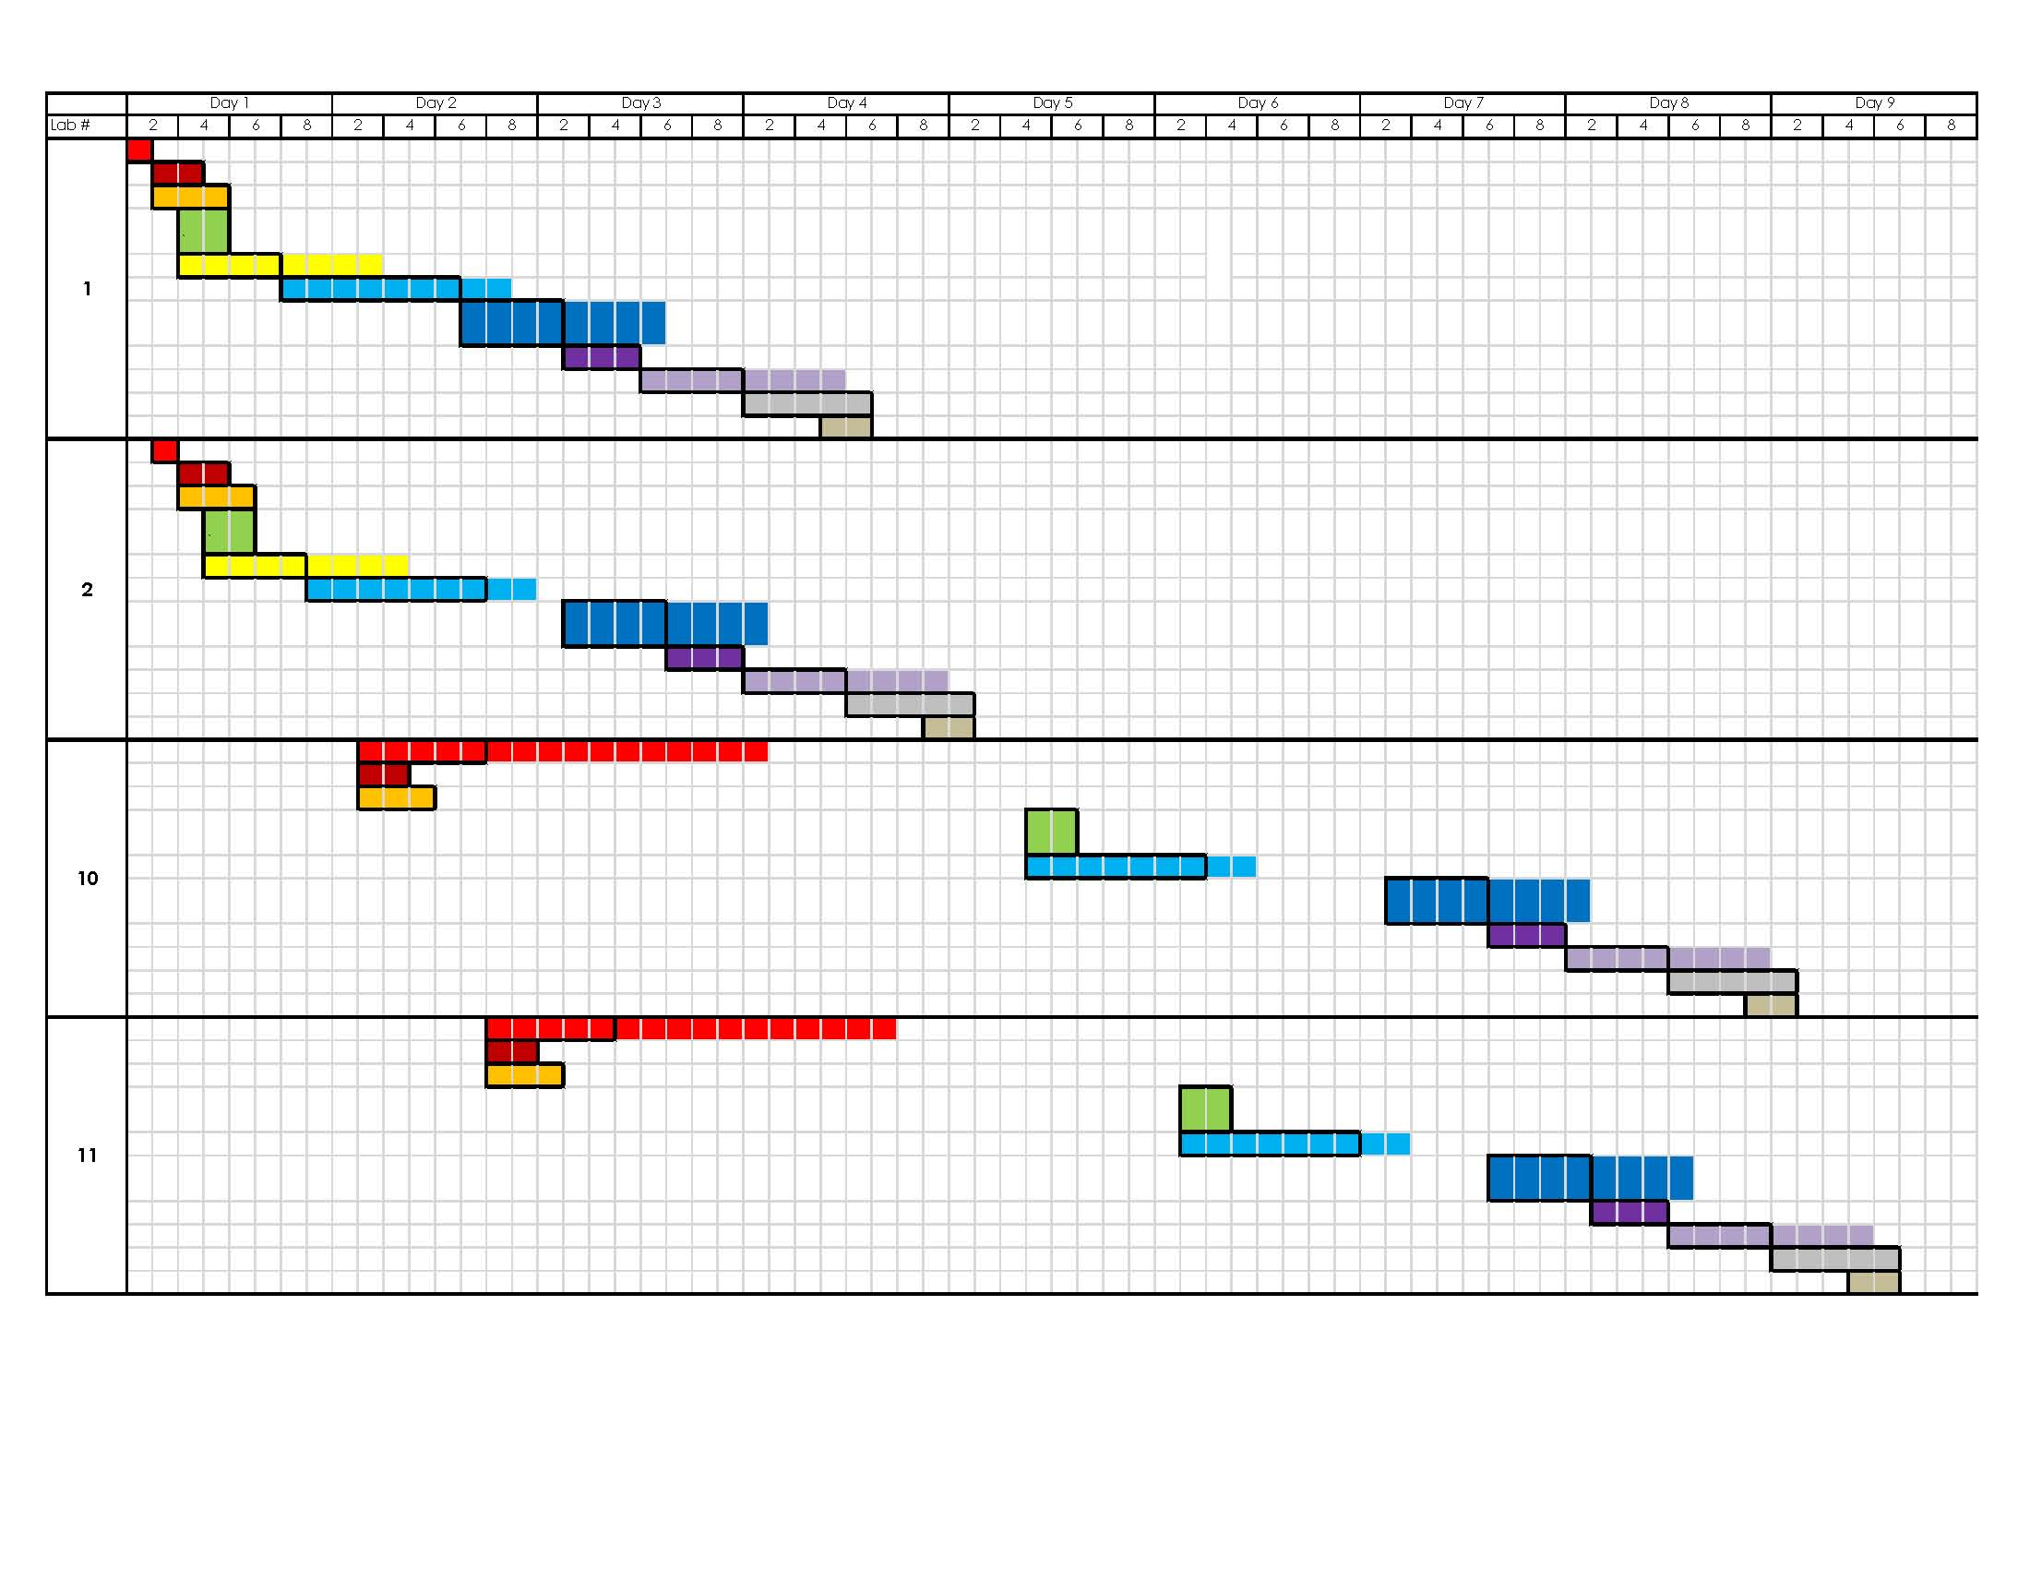
Different SIPS Options
Analysis 2 – Short Interval Production Schedule (SIPS)
SIPS 3
Project Background
Analysis 1 – Alternative Delivery Method
Background
  Research/Comparisons
  Schedule reduction
Analysis 2 – SIPS
Sequence & crews
  Different SIPS Options
  SIPS 3
  Schedule Reduction
Analysis 3 – Façade Study
Background
  Materials/Research
  Architectural Breadth
  Changes
    Model
  Mechanical Breadth
    R-value & Condensation
    Production & Cost
Recommendations
Multiple crews on the activities “Layout” and “Hang Trunk Lines.” Add a crew member to “Install Medium Pressure Branch” and “Install Low Pressure Branch.”
Notes:
Ends on day 13

Slide 13
Schedule Reduction
Analysis 2 – Short Interval Production Schedule (SIPS)
Project Background
Analysis 1 – Alternative Delivery Method
Background
  Research/Comparisons
  Schedule reduction
Analysis 2 – SIPS
Sequence & crews
  Different SIPS Options
  Schedule Reduction
Analysis 3 – Façade Study
Background
  Materials/Research
  Architectural Breadth
  Changes
    Model
  Mechanical Breadth
    R-value & Condensation
    Production & Cost
Recommendations
Acknowledgements
Schedule 1st | Crew/Lab | Hourly Rate | Hours/lab | Total Cost/lab | Total cost
Original | 22 | $39.93 | 50.22 | 44,116 | $397,046
SIPS 1 | 48 | $39.93 | 40.00 | 76,666 | $689,990
SIPS 2 | 32 | $39.93 | 40.00 | 51,110 | $459,994
SIPS 3 | 34 | $39.93 | 37.60 | 51,047 | $459,419
Schedule 2nd | Crew/Lab | Hourly Rate | Hours/lab | Total Cost/lab | Total cost
Original | 21 | $39.93 | 57.33 | 48,073 | $432,656
SIPS 1 | 44 | $39.93 | 40.44 | 71,050 | $639,449
SIPS 2 | 32 | $39.93 | 40.44 | 51,673 | $465,054
SIPS 3 | 32 | $39.93 | 38.04 | 48,612 | $437,505
TOTAL |  |  |  |  | Total cost
Original |  |  |  |  | $829,703
SIPS 1 |  |  |  |  | $1,329,439
SIPS 2 |  |  |  |  | $925,047
SIPS 3 |  |  |  |  | $896,924
Schedule | Duration | Days Saved
Original | 33 | -
SIPS 1 | 12 | 21
SIPS 2 | 17 | 16
SIPS 3 | 13 | 20
Notes:
Put detailed in appendix

Slide 14
Schedule Reduction
Analysis 2 – Short Interval Production Schedule (SIPS)
Project Background
Analysis 1 – Alternative Delivery Method
Background
  Research/Comparisons
  Schedule reduction
Analysis 2 – SIPS
Sequence & crews
  Different SIPS Options
  Schedule Reduction
Analysis 3 – Façade Study
Background
  Materials/Research
  Architectural Breadth
  Changes
    Model
  Mechanical Breadth
    R-value & Condensation
    Production & Cost
Recommendations
Acknowledgements
Schedule 1st | Crew/Lab | Hourly Rate | Hours/lab | Total Cost/lab | Total cost
Original | 22 | $39.93 | 50.22 | 44,116 | $397,046
SIPS 1 | 48 | $39.93 | 40.00 | 76,666 | $689,990
SIPS 2 | 32 | $39.93 | 40.00 | 51,110 | $459,994
SIPS 3 | 34 | $39.93 | 37.60 | 51,047 | $459,419
Schedule 2nd | Crew/Lab | Hourly Rate | Hours/lab | Total Cost/lab | Total cost
Original | 21 | $39.93 | 57.33 | 48,073 | $432,656
SIPS 1 | 44 | $39.93 | 40.44 | 71,050 | $639,449
SIPS 2 | 32 | $39.93 | 40.44 | 51,673 | $465,054
SIPS 3 | 32 | $39.93 | 38.04 | 48,612 | $437,505
TOTAL |  |  |  |  | Total cost
Original |  |  |  |  | $829,703
SIPS 1 |  |  |  |  | $1,329,439
SIPS 2 |  |  |  |  | $925,047
SIPS 3 |  |  |  |  | $896,924
Schedule | Duration | Days Saved
Original | 33 | -
SIPS 1 | 12 | 21
SIPS 2 | 17 | 16
SIPS 3 | 13 | 20
SIPS 3 saves 20 days and only $67,000 more for labor
Notes:
Put detailed in appendix

Slide 15
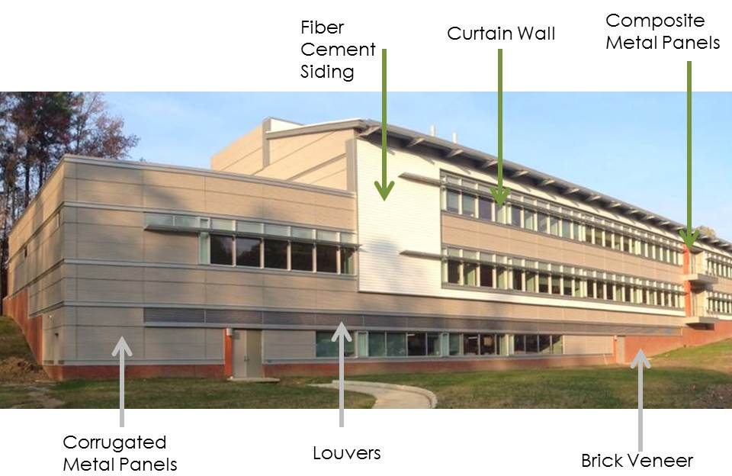
Background
Analysis 3 – Façade Study
Project Background
Analysis 1 – Alternative Delivery Method
Background
  Research/Comparisons
  Schedule reduction
Analysis 2 – SIPS
Sequence & crews
  Different SIPS Options
Analysis 3 – Façade Study
Background
  Materials/Research
  Architectural Breadth
  Changes
    Model
  Mechanical Breadth
    R-value & Condensation
    Production & Cost
Recommendations
Acknowledgements
Expansion
Elevation | Corrugated | Composite (orange) | Fiber Cement Siding | Louvers | Brick Veneer | Total Square Footage
North | 2,307 | 0 | 992 | 0 | 818 | 4,117
South | 14,769 | 2,412 | 8,146 | 1,833 | 5,737 | 32,897
East | 490 | 0 | 0 | 0 | 0 | 490
West | 3,846 | 0 | 0 | 0 | 959 | 4,805
Total | 19,105 | 2,412 | 9,138 | 1,833 | 7,514 | 40,002
Analysis Goals
Reduce the schedule by reducing the complexity of the façade materials.
Notes:
Analysis goal
Focusing on fiber cement siding, composite metal panels, corrugated metal panels, louvers, and brick veneer for this analysis.
South façade has most material on it and mostly corrugated metal panels

Slide 16
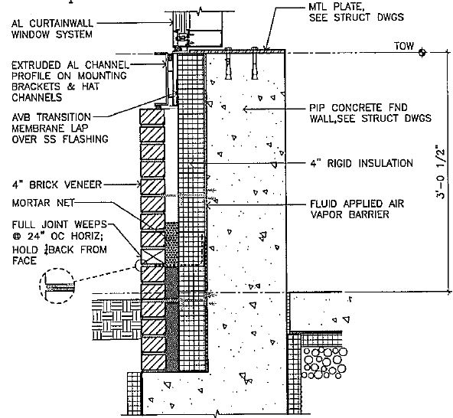
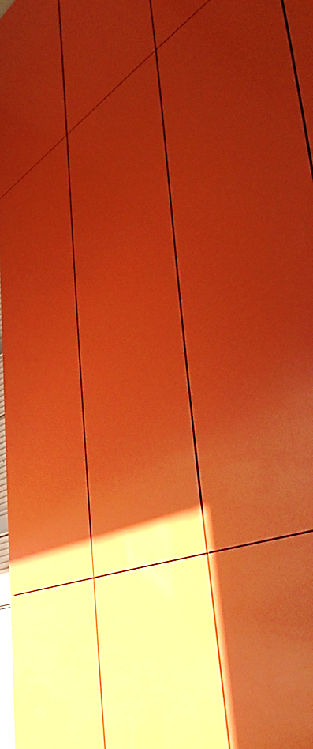
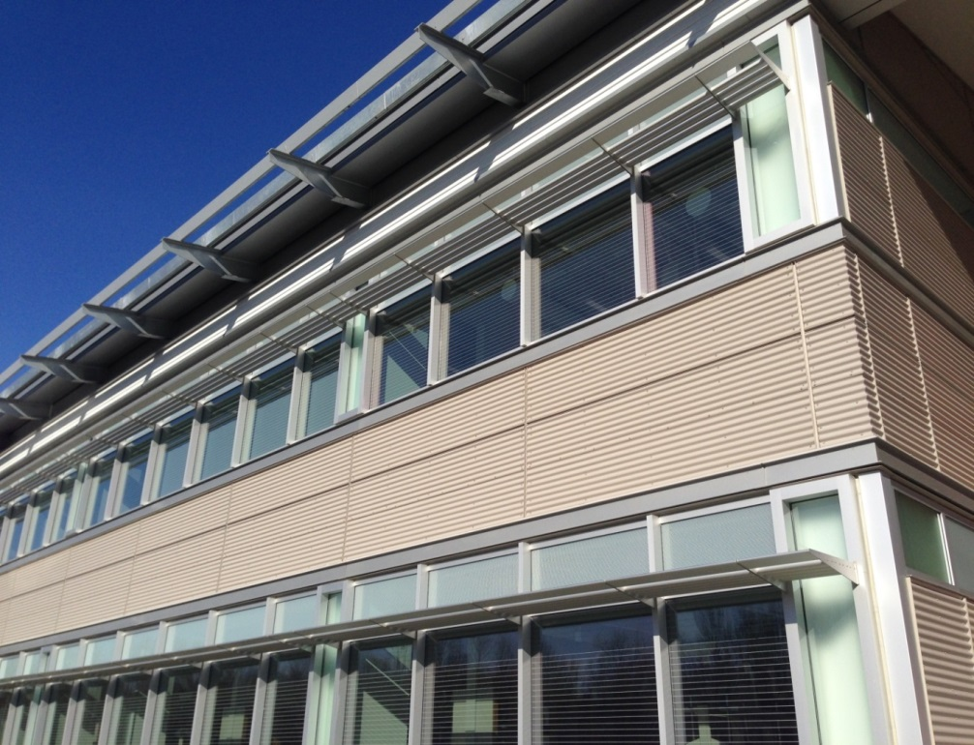
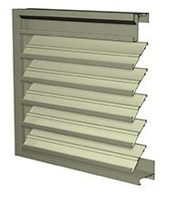
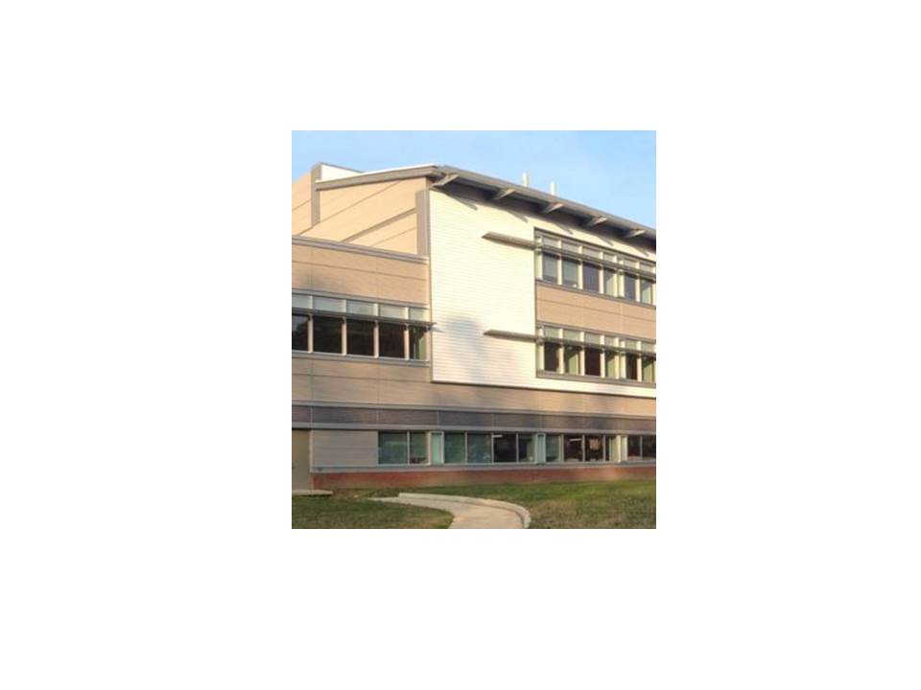
Materials & Research
Analysis 3 – Façade Study
Project Background
Analysis 1 – Alternative Delivery Method
Background
  Research/Comparisons
  Schedule reduction
Analysis 2 – SIPS
Sequence & crews
  Different SIPS Options
Analysis 3 – Façade Study
Background
  Materials/Research
  Architectural Breadth
  Changes
    Model
  Mechanical Breadth
    R-value & Condensation
    Production & Cost
Recommendations
Acknowledgements
Composite Metal Panels
Corrugated Metal Panels
Brick Veneer
Louvers
Fiber Cement Siding
Notes:
Brick Veneer – One layer of brick and not very difficult to install and affordable, installation is weather dependent.
Composite metal panels – orange accent panels, smooth sophisticated look, but expensive and challenging to install
Corrugated metal panels – flexible with different sizes of ribbing to fit architects preferences, versatile and easily installed. Stainless steel panels
Louvers – Only working louvers are above basement doors, all other ones have a flat panel behind them. Difficult to install
Fiber cement siding – added to tie into the admin building beside it. Little-to-no maintenance and can be painted any color, cut onsite

Slide 17
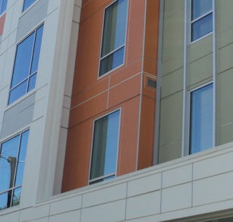
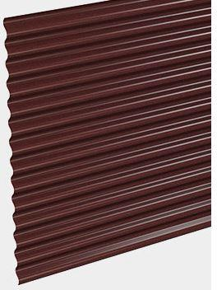

Architectural Breadth
Analysis 3 – Façade Study
Project Background
Analysis 1 – Alternative Delivery Method
Background
  Research/Comparisons
  Schedule reduction
Analysis 2 – SIPS
Sequence & crews
  Different SIPS Options
Analysis 3 – Façade Study
Background
  Materials/Research
  Architectural Breadth
  Changes
    Model
  Mechanical Breadth
    R-value & Condensation
    Production & Cost
Recommendations
Acknowledgements
Change 1: Composite Metal Panels to Fiber Cement Siding
Difficult installation on metal Z-clips
Same Manufacturer
Vertical Panels are 4’x10’
Not fabricated metal look
Change 2: Corrugated Metal Panels to Fiber Cement Siding
Stainless-steel fasteners over hat channels
Same Manufacturer
4” Minimum exposure
Not fabricated metal look
Notes:
Change 1:
Difficult installation on metal z-clips
James Hardie was manufacturer
The panels would need to be cut more times since they need to be 15 and 20 foot sections
From close up, they do not have the fabricated metal look
Change 2:
Since fiber cement siding was the easiest to manage and install, it made sense to try to replace the material that had the most square footage on the façade, which was corrugated metal panels
Stainless-steel fasteners over hat channels
James Hardie was manufacturer
Each rib is 2.5” which is about half of the 4” minimum exposure the fiber cement siding can be
Obvious aesthetic difference that will however be similar

Slide 18
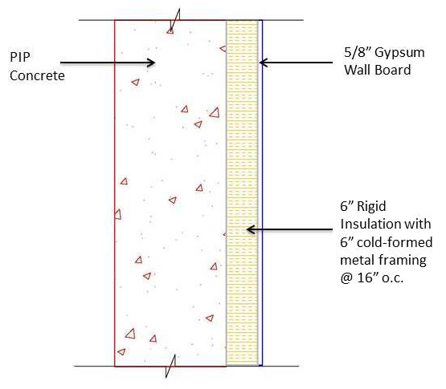
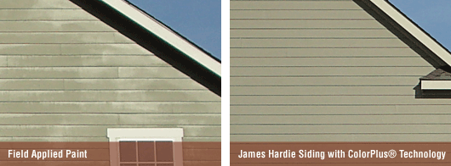
Architectural Breadth
Analysis 3 – Façade Study
Project Background
Analysis 1 – Alternative Delivery Method
Background
  Research/Comparisons
  Schedule reduction
Analysis 2 – SIPS
Sequence & crews
  Different SIPS Options
Analysis 3 – Façade Study
Background
  Materials/Research
  Architectural Breadth
  Changes
    Model
  Mechanical Breadth
    R-value & Condensation
    Production & Cost
Recommendations
Acknowledgements
Change 3: Louvers to Fiber Cement Siding
Stainless-steel screws
Same exposure
Consistent look
Change 4: Brick Veneer to Concrete
Dovetail connection to concrete
Ties into the site
Hensel Phelps will self-perform
Fewer wall materials
Notes:
Change 3:
Fake louvers
Same 4” exposure
Consistent look
Fiber cement siding replacing the materials: nailed to ¾” plywood every 24” o.c. with a pneumatic fastening tool
Change 4:
Dovetail connection to concrete
Concrete ties into the concrete weir walls
Hensel Phelps self-performs concrete = get rid of brick sub
Fewer wall materials

Slide 19
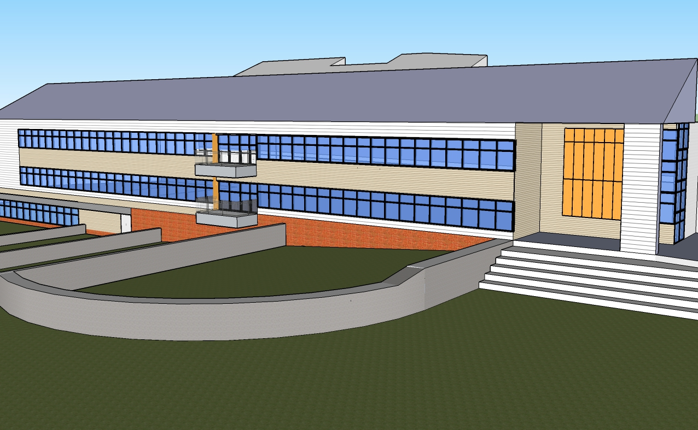
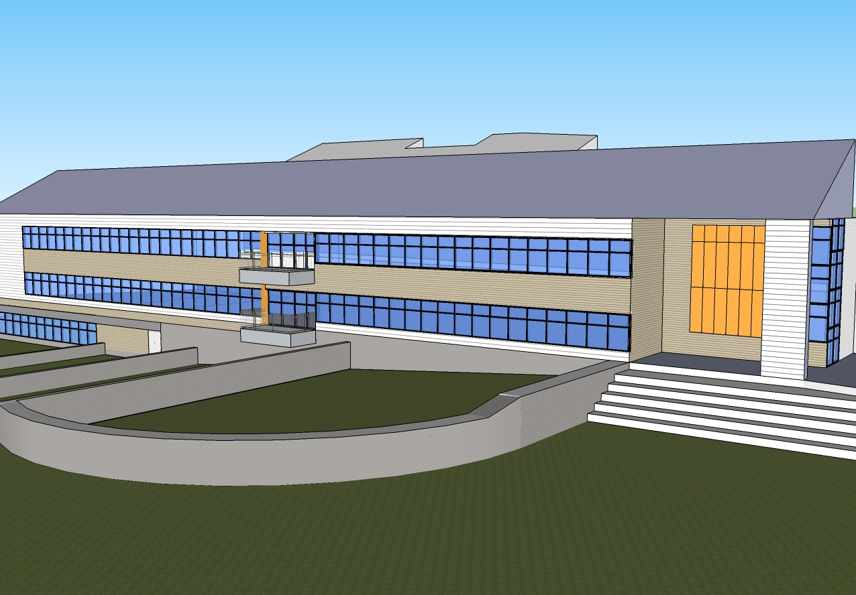
Architectural Breadth
Analysis 3 – Façade Study
Project Background
Analysis 1 – Alternative Delivery Method
Background
  Research/Comparisons
  Schedule reduction
Analysis 2 – SIPS
Sequence & crews
  Different SIPS Options
Analysis 3 – Façade Study
Background
  Materials/Research
  Architectural Breadth
  Changes
    Model
  Mechanical Breadth
    R-value & Condensation
    Production & Cost
Recommendations
Acknowledgements
Notes:
Similar appearances but easier constructability.

Slide 20
Mechanical Breadth
Analysis 3 – Façade Study
Project Background
Analysis 1 – Alternative Delivery Method
Background
  Research/Comparisons
  Schedule reduction
Analysis 2 – SIPS
Sequence & crews
  Different SIPS Options
Analysis 3 – Façade Study
Background
  Materials/Research
  Architectural Breadth
  Changes
    Model
  Mechanical Breadth
    R-value & Condensation
    Production & Cost
Recommendations
Acknowledgements
R-Value
Original Summer | 35.64
New Summer | 43.33
Concrete Summer | 31.68
Original Summer
New Summer
Notes:
Increased the R-value without changing the condensation much. Which means the new wall system is not in danger of

Slide 21
Production & Cost
Analysis 3 – Façade Study
Project Background
Analysis 1 – Alternative Delivery Method
Background
  Research/Comparisons
  Schedule reduction
Analysis 2 – SIPS
Sequence & crews
  Different SIPS Options
Analysis 3 – Façade Study
Background
  Materials/Research
  Architectural Breadth
  Changes
    Model
  Mechanical Breadth
    R-value & Condensation
    Production & Cost
Recommendations
Acknowledgements
Original Production and Cost
Material | Square Footage | Duration (Days) | Production Rate (SF/Day) | Cost/Sqft | Cost/Day | Total Cost
Corrugated | 19,105 | 21 | 940 | $15.00 | $14,100.00 | $296,100
Composite | 2,412 | 15 | 161 | $40.00 | $6,440.00 | $96,600
Fiber Cement Siding | 9,138 | 10 | 979 | $13.09 | $12,815.11 | $128,151
Louvers | 1,833 | 5 | 367 | $41.50 | $15,230.50 | $76,153
Brick | 7,514 | 19 | 395 | $23.00 | $9,095.89 | $172,822
Total | 40,002 | 70 | 2,842 |  | $57,681.50 | $769,826
New Production and Cost
Material | Quantity | Units | Duration (Days) | Production Rate (Unit/Day) | Cost/Unit | Cost/Day | Total Cost
Fiber Cement Siding | 32,488 | SF | 33 | 979 | $13.09 | $12,815.11 | $425,268
Concrete | 509 | CY | 14 | 37 | $100.00 | $3,700.00 | $50,928
Total |  |  | 47 | 1,016 |  | $16,515.11 | $476,196
Notes:
The total cost for all the materials is $769,826 with a total of 70 days.

Slide 22
Production & Cost
Analysis 3 – Façade Study
Project Background
Analysis 1 – Alternative Delivery Method
Background
  Research/Comparisons
  Schedule reduction
Analysis 2 – SIPS
Sequence & crews
  Different SIPS Options
Analysis 3 – Façade Study
Background
  Materials/Research
  Architectural Breadth
  Changes
    Model
  Mechanical Breadth
    R-value & Condensation
    Production & Cost
Recommendations
Acknowledgements
Original Production and Cost
Material | Square Footage | Duration (Days) | Production Rate (SF/Day) | Cost/Sqft | Cost/Day | Total Cost
Corrugated | 19,105 | 21 | 940 | $15.00 | $14,100.00 | $296,100
Composite | 2,412 | 15 | 161 | $40.00 | $6,440.00 | $96,600
Fiber Cement Siding | 9,138 | 10 | 979 | $13.09 | $12,815.11 | $128,151
Louvers | 1,833 | 5 | 367 | $41.50 | $15,230.50 | $76,153
Brick | 7,514 | 19 | 395 | $23.00 | $9,095.89 | $172,822
Total | 40,002 | 70 | 2,842 |  | $57,681.50 | $769,826
New Production and Cost
Material | Quantity | Units | Duration (Days) | Production Rate (Unit/Day) | Cost/Unit | Cost/Day | Total Cost
Fiber Cement Siding | 32,488 | SF | 33 | 979 | $13.09 | $12,815.11 | $425,268
Concrete | 509 | CY | 14 | 37 | $100.00 | $3,700.00 | $50,928
Total |  |  | 47 | 1,016 |  | $16,515.11 | $476,196
Façade changes saves 23 days and $293,630
Notes:
However with these façade changes, there is a 23 day savings and a $293,630 cost savings.

Slide 23
Recommendations
Project Background
Analysis 1 – Alternative Delivery Method
Background
  Research/Comparisons
  Schedule reduction
Analysis 2 – SIPS
Sequence & crews
  Different SIPS Options
Analysis 3 – Façade Study
Background
  Materials/Research
  Architectural Breadth
  Changes
    Model
  Mechanical Breadth
    R-value & Condensation
    Production & Cost
Recommendations
Acknowledgements
Analysis 1: Alternative Delivery Method
Saves 315 days with construction starting August 3, 2010
Analysis 2: Short Interval Production Schedule (SIPS)
Saves 21 days with a slight labor cost increase
Analysis 3: Façade Study
Saves 23 days with about a $300,000 cost savings
Recommend
Recommend
Recommend

Slide 24
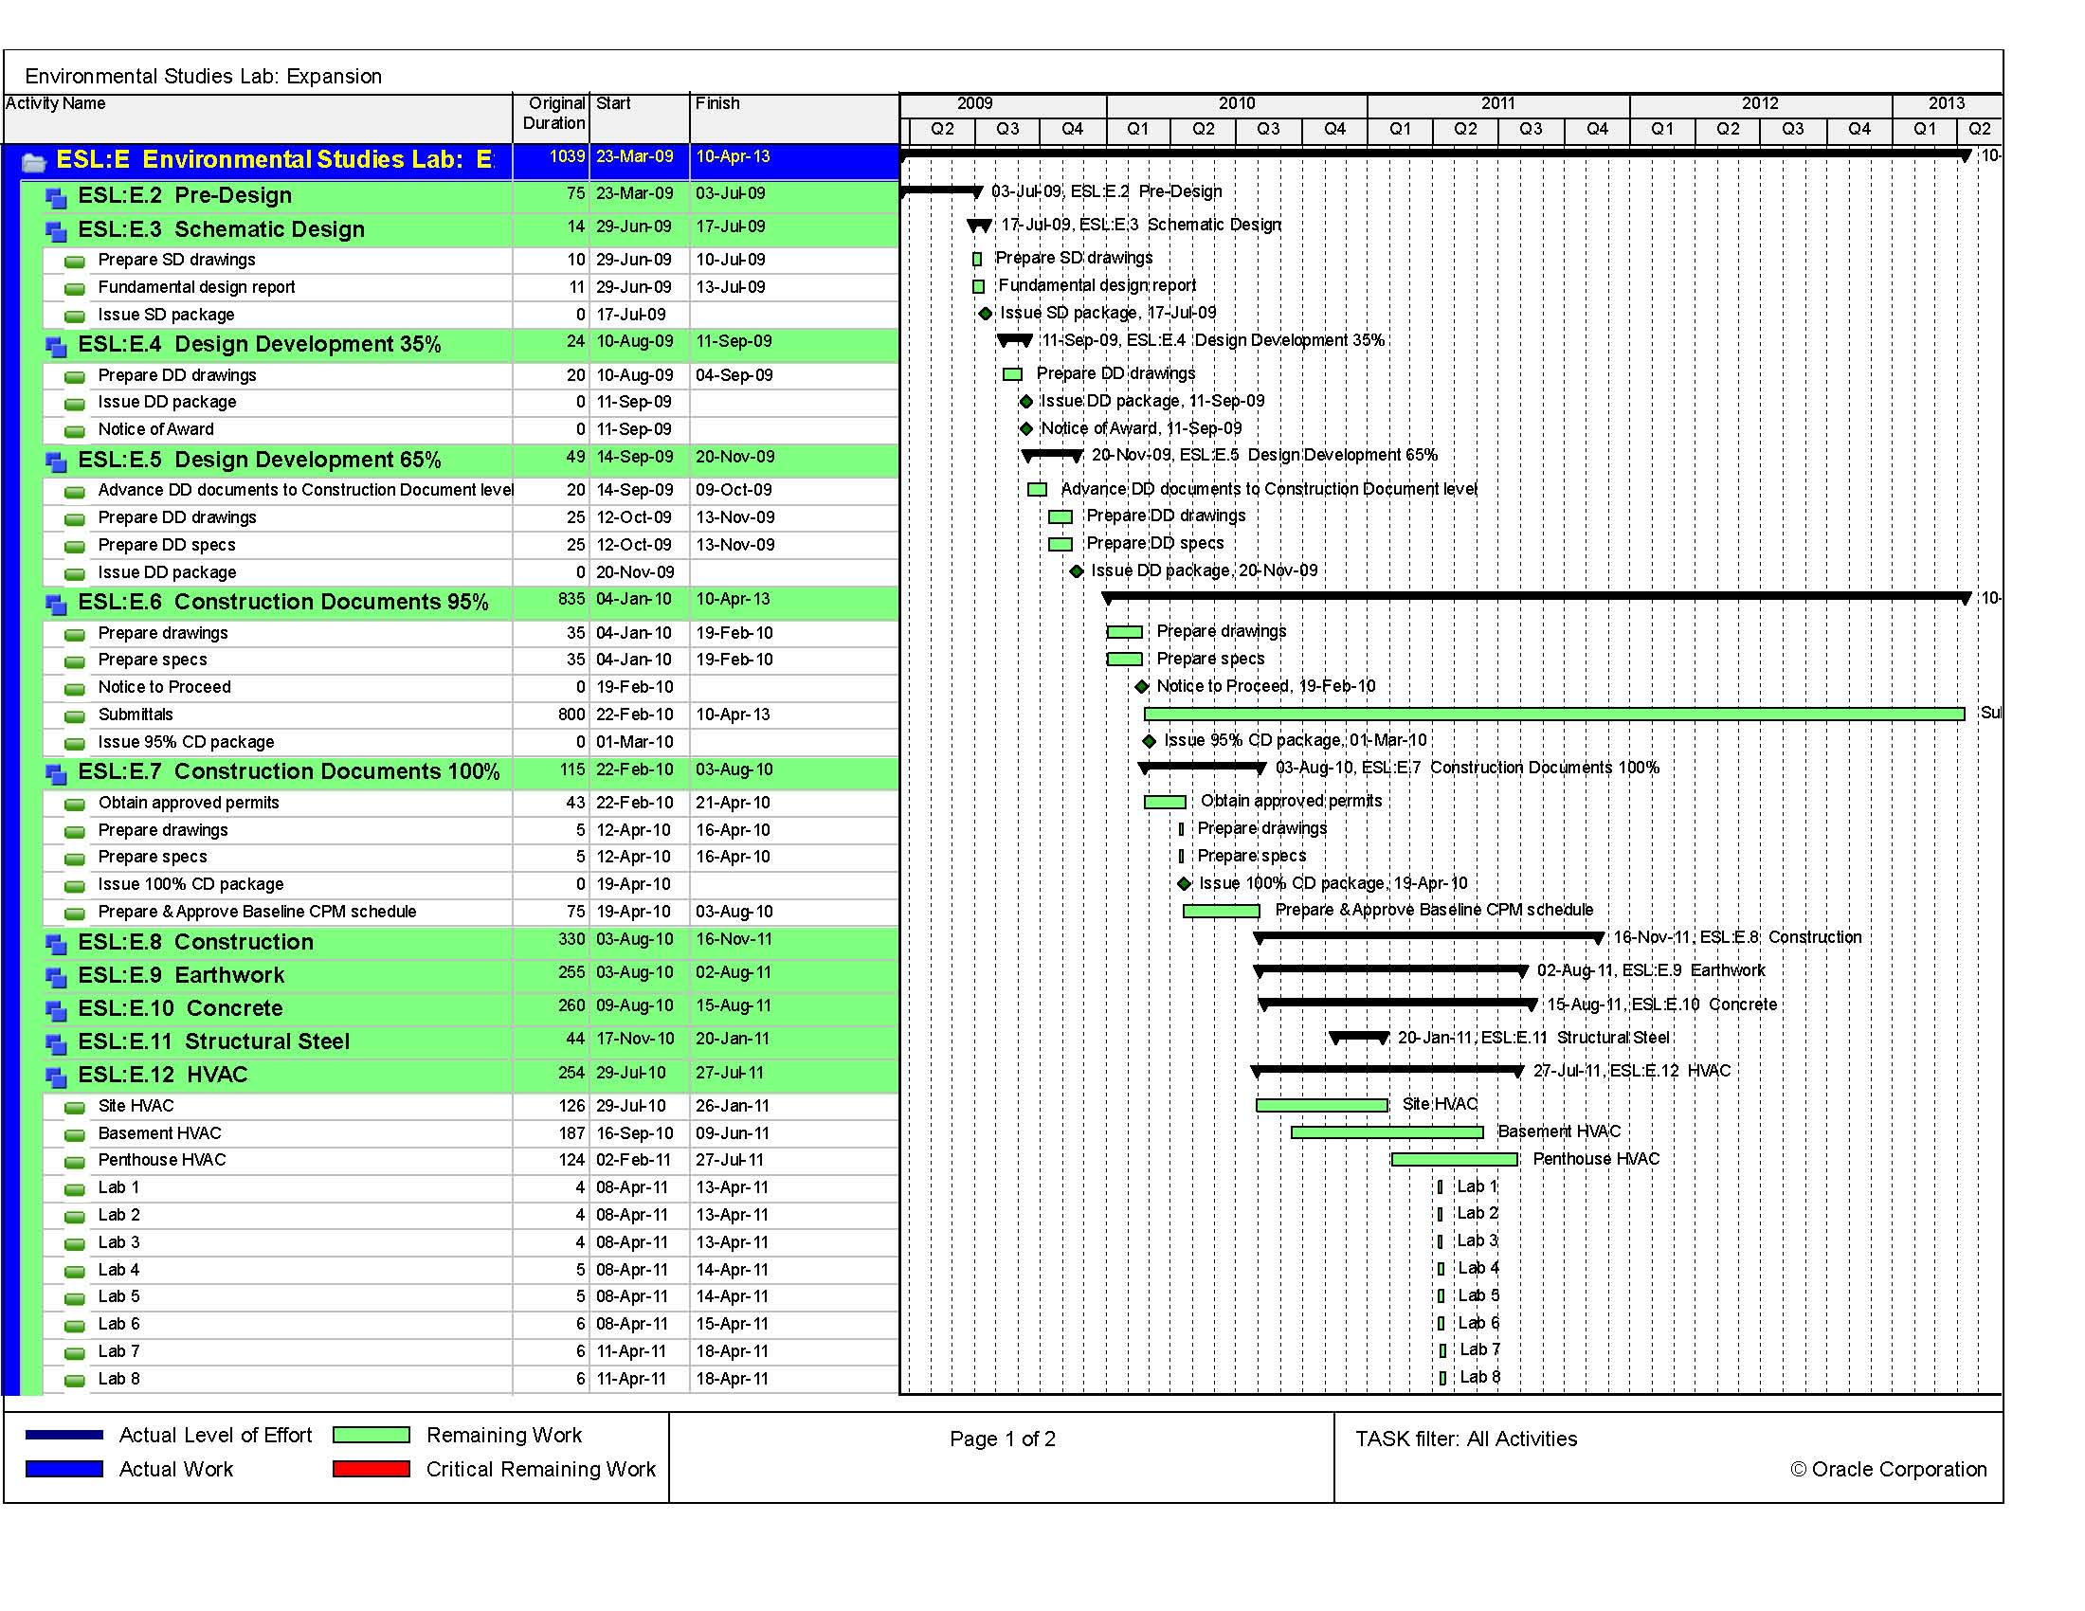
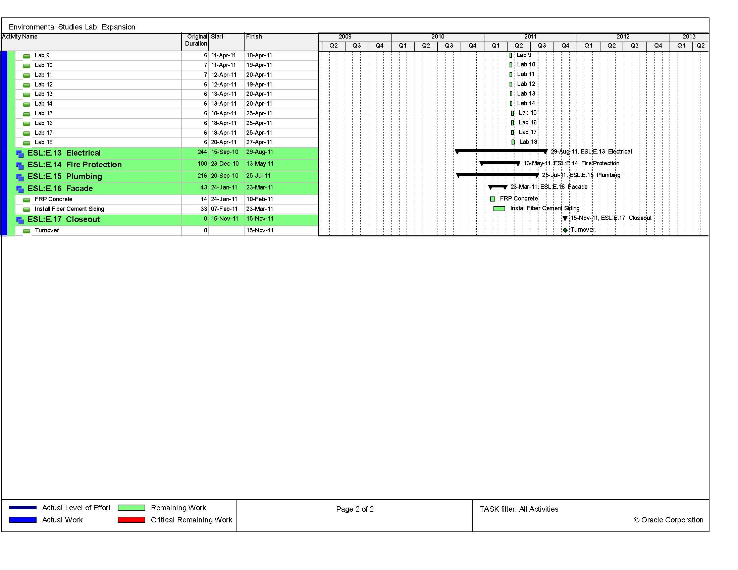
Recommendations
Project Background
Analysis 1 – Alternative Delivery Method
Background
  Research/Comparisons
  Schedule reduction
Analysis 2 – SIPS
Sequence & crews
  Different SIPS Options
Analysis 3 – Façade Study
Background
  Materials/Research
  Architectural Breadth
  Changes
    Model
  Mechanical Breadth
    R-value & Condensation
    Production & Cost
Recommendations
Acknowledgements
Notes:
Putting the new end date at November 15, 2011

Slide 25
Acknowledgments
Industry:
Hensel Phelps
Ewing Cole
Centria
Academic:
Dr. Chimay Anumba
Dr. Robert Leicht
Dr. Craig Dubler
Dr. David Riley
Professor Parfitt
Dr. Cox
Penn State Architectural Engineering Facility
Special Thanks to:
The Project team
The Owner and Owner’s Representative
Pace Industry Members
My Family and Friends
Jessica Weber

Slide 26
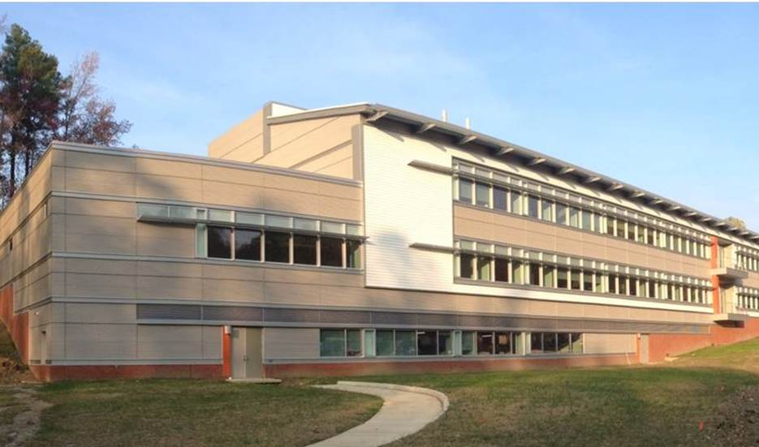
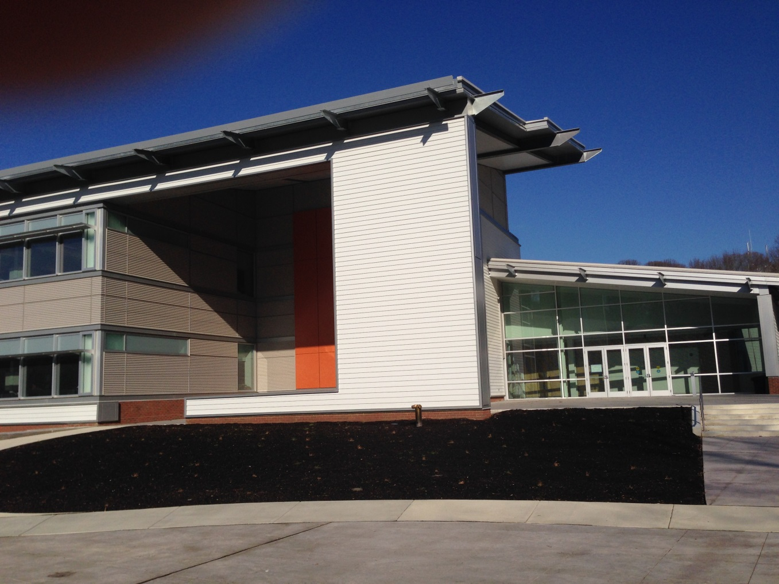
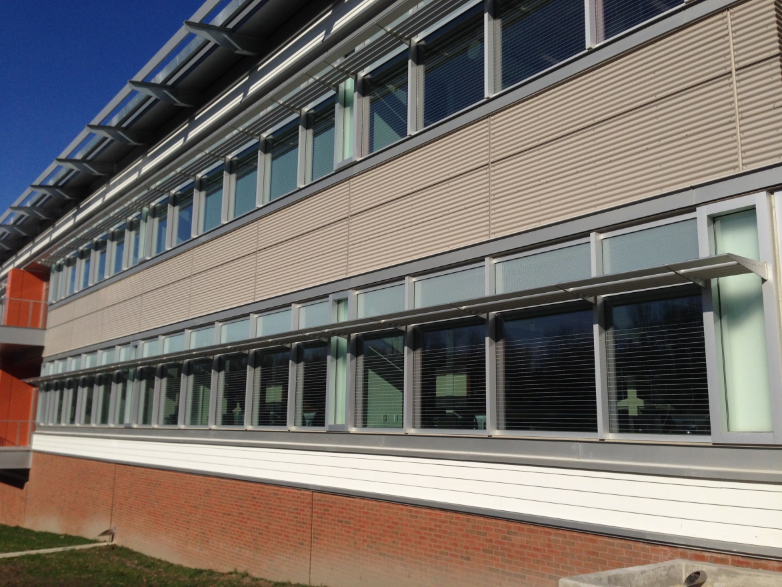

Slide 27
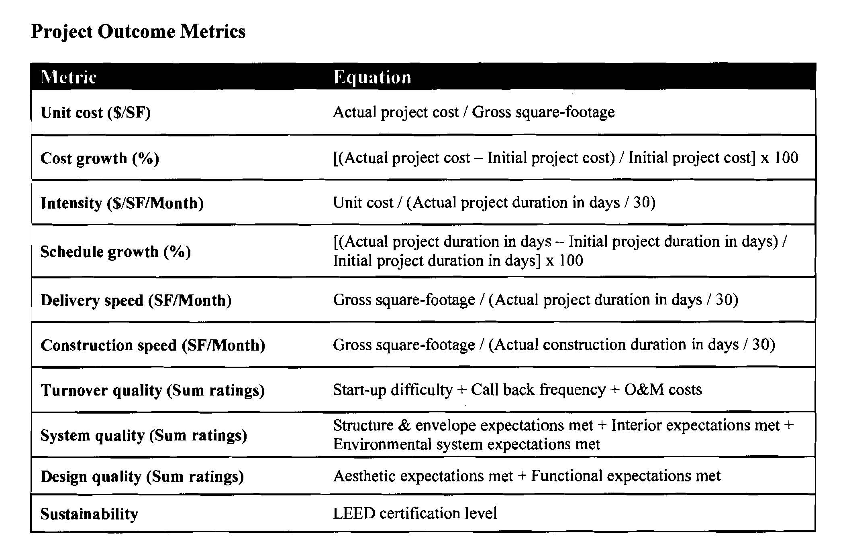
Appendix
Notes:
calculations

Slide 28
Appendix

Slide 29
Appendix

Slide 30
Appendix

Slide 31
Appendix

Slide 32
Appendix

Slide 33
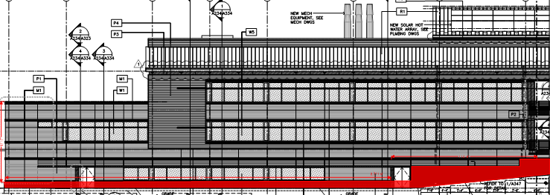
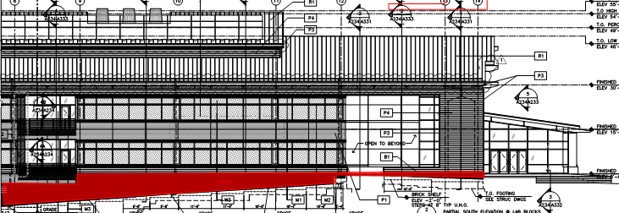
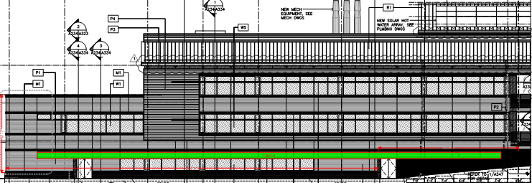
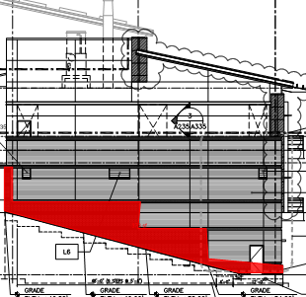
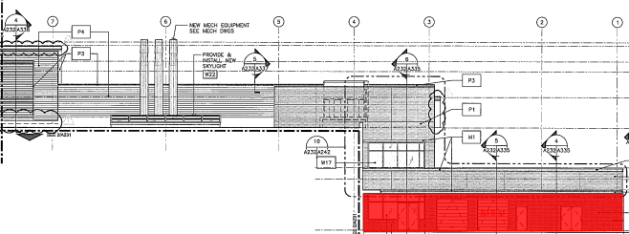
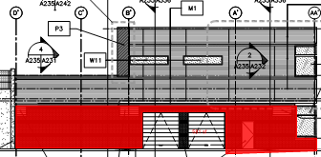
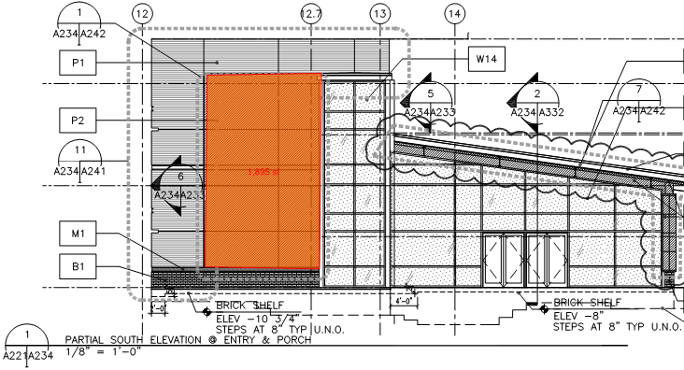
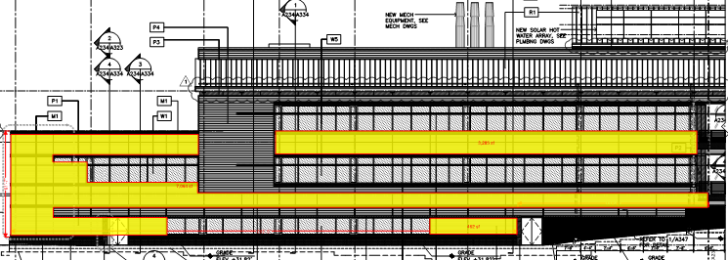
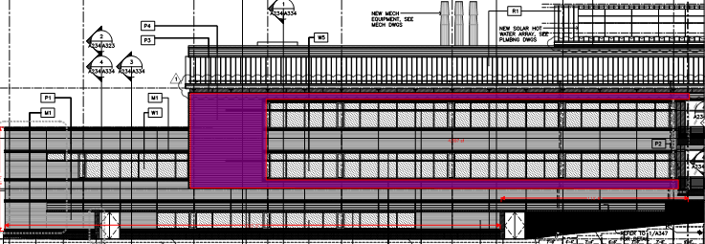
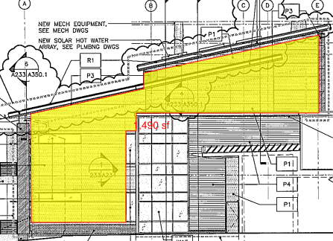
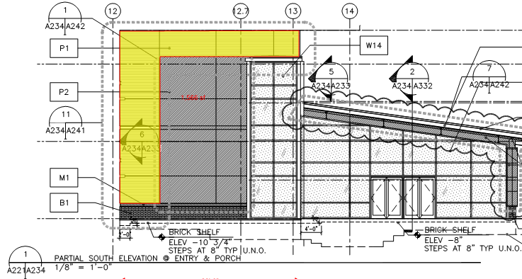
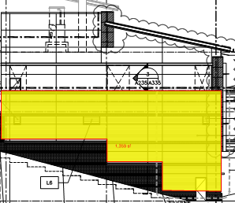
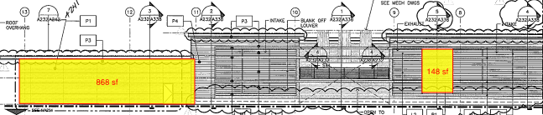
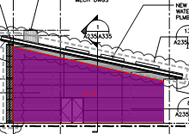
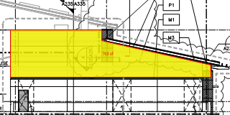
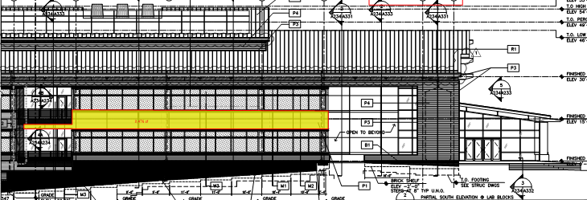
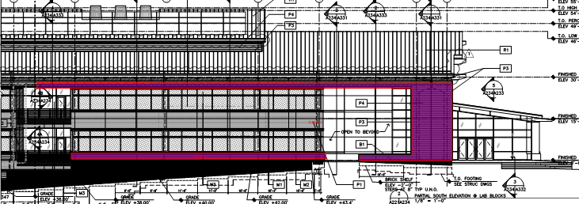
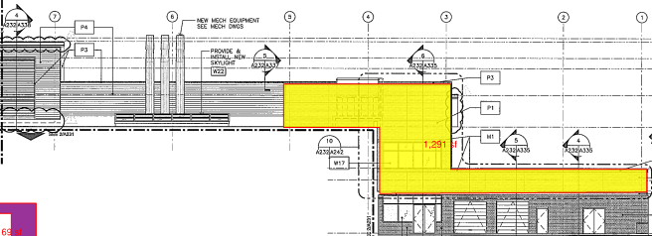

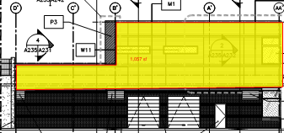
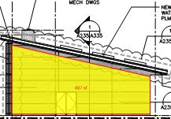

Appendix
Brick to change
Louvers to change

Slide 34
Appendix
Corrugated to change

Slide 35
Appendix
Composite to change
Current Fiber Cement Siding

Slide 36
Appendix

