Slide 1
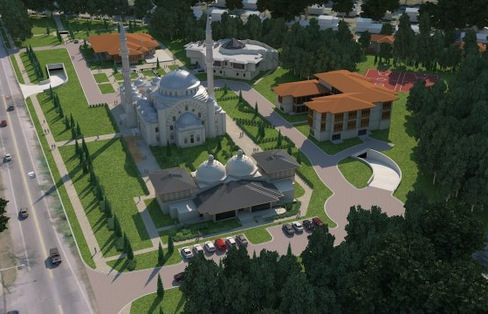
Penn State AE Senior Capstone Project
Garrett Schwier | Construction Management
Advisor | Craig Dubler

Slide 2
Analysis IV – Foreign Worker Safety
Overview
Foreign Worker Safety Plan
Conclusions and Recommendations
Acknowledgments
Not Discussed: Analysis II: Bid Package Redesign & Mechanical Breadth
Project Background
General Information
Buildings Overview
Unique Features
Analysis I – Structural Redesign
Overview
Breadth 1 - Structural Redesign
Results
Recommendations
Analysis III – Workforce Management
Overview
Site Specific Plan
Cultural Analysis

Slide 3
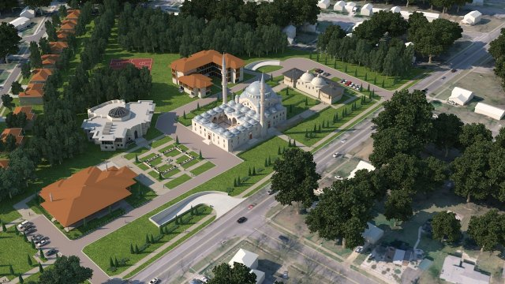
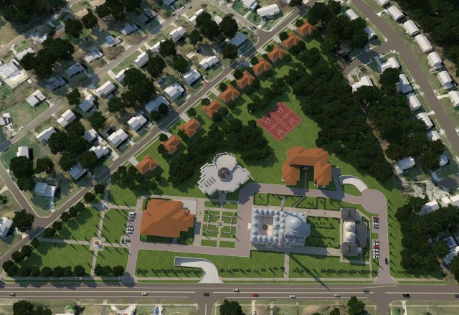
Project Background: General Information
Size: 308,000 SF Total
136,500 SF of Buildings
150,900 SF Underground Parking Garage
Location: Northeastern US
Cost: $69.5 million + $20 million allowance
Contract: GMP
Schedule: Sept. 2012 to Sept. 2014
Owner: Identity Withheld
CM: Balfour Beatty Construction
US Architect: Fentress Architects
Foreign Architect: Hassa
Project Background
General Information
Buildings Overview
Unique Features
Analysis I – Structural Redesign
Analysis III – Workforce Management
Analysis IV – Foreign Worker Safety
Conclusions and Recommendations
Acknowledgments

Slide 4
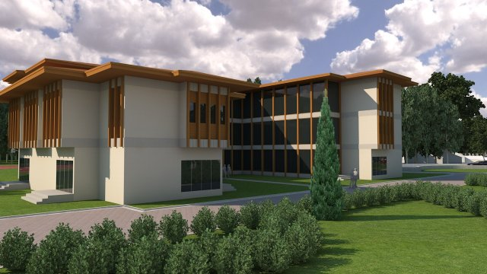
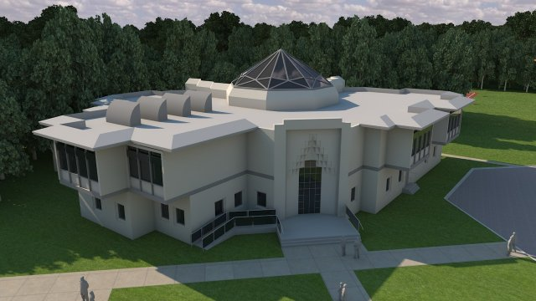
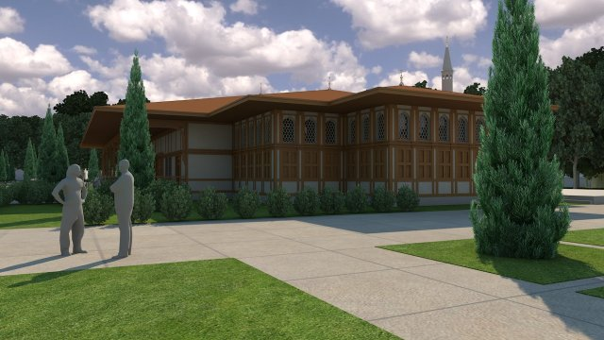
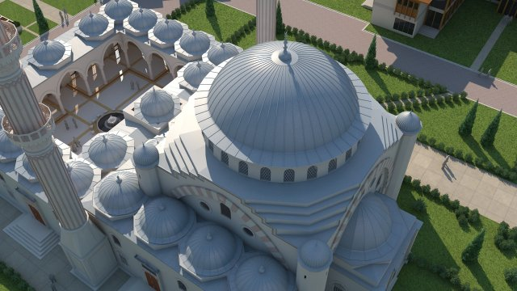
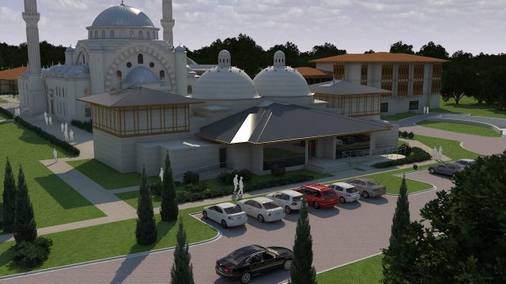
Project Background: Buildings Overview
Project Background
General Information
Buildings Overview
Unique Features
Analysis I – Structural Redesign
Analysis III – Workforce Management
Analysis IV – Foreign Worker Safety
Conclusions and Recommendations
Acknowledgments
Convent/Monastery
Cultural Center
Fellowship Hall
Mosque
Turkish Bath

Slide 5
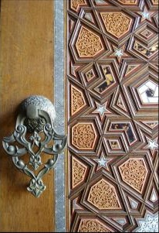
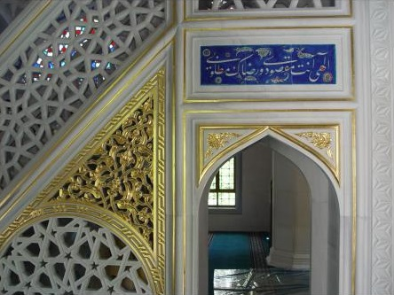
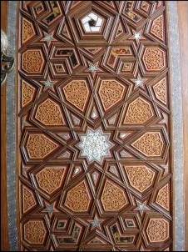
Project Background: Unique Features
Finishes, Details, and Ornaments Completed
by Foreign Workers
Workers will complete these finishes as part of the cultural objectives of the project.
Include:
Stained Glass Windows
Wood Trim
Detailed Stone Work
Ornamental Metals
Project Background
General Information
Buildings Overview
Unique Features
Analysis I – Structural Redesign
Analysis III – Workforce Management
Analysis IV – Foreign Worker Safety
Conclusions and Recommendations
Acknowledgments
Images courtesy of http://www.hassa.com/en.
Images courtesy of http://www.hassa.com/en.

Slide 6
Analysis I: Overview
Problem Statement:
Fellowship Hall and Convent/Monastery are only buildings to have a mostly steel structure.
Does not take advantage of worker affinity to concrete operations.
Potential Solution:
Design the structure of these buildings to be concrete rather than steel.
Volume of Concrete: 25,000 CY
Total Cost: $15.5 million
Concrete Strength: 5000 psi
Typical Dimensions Used on Site:
Project Background
Analysis I – Structural Redesign
Overview
Breadth 1 - Structural Redesign
Results
Recommendations
Analysis III – Workforce Management
Analysis IV – Foreign Worker Safety
Conclusions and Recommendations
Acknowledgments
Structural Element | Dimension
Beams | 12”x18” --- 12”x30” --- 18”x30”
Columns | 12”x24” --- 16”x24” --- 30”x30”
Slabs | 8” --- 10” --- 12”

Slide 7
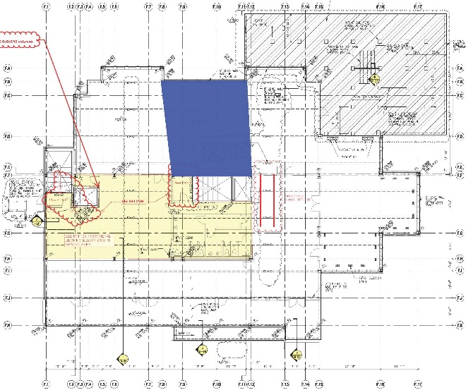
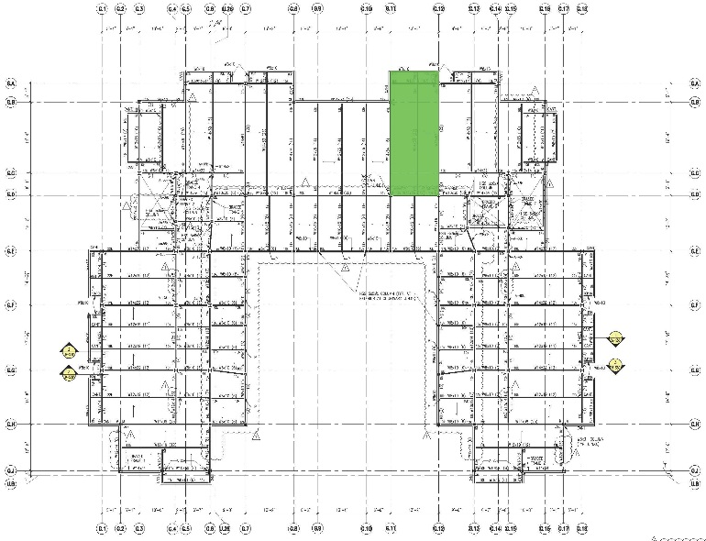
Analysis I: Breadth 1 - Structural Redesign
Convent/Monastery
Size of Designed Area: 1312 SF per Floor
Total Floor Areas: 2nd – 9800 SF
3rd – 7400 SF
Roof – 9800 SF
Supported Load: 2nd/3rd – 220 psf + 22 psf Ext. Wall
Roof – 55 psf
Two-Way Solid Flat Slab w/ Drop Panels: 10.5”
10’ 4” Square -- 8 ¼” Depth (for spans >20’)
7’ Square -- 2 ¼” Depth (for spans <20’)
Beam Design:
16 ½” x 36” Joist-Band
(10) #11 Bars along Transverse Axis
18” x 12”
(4) #8 Bars along Transverse Axis
Column Design:
20” x 20” Square
(4) #9 Bars along Transverse Axis
Fellowship Hall
Size of Designed Area: 1562 SF
Total Floor Area: 9600 SF
Supported Load: 50 psf by Roof
Beam Design:
24” x 16”
(5) #10 Bars along Transverse Axis
Column Design:
12” x 12” Square
(4) #6 Bars along Transverse Axis
Project Background
Analysis I – Structural Redesign
Overview
Breadth 1 - Structural Redesign
Results
Recommendations
Analysis III – Workforce Management
Analysis IV – Foreign Worker Safety
Conclusions and Recommendations
Acknowledgments

Slide 8
Analysis I: Results
Size of Designed Area: 1562 SF
Total Floor Area: 9600 SF
Cost of Designed Area: $52,000
Extrapolated Cost: $321,000
Original Steel Cost: $318,995
Difference: +$2,005
Original Duration: 36 days
New Duration: 116 days
Difference: +80 days
No architectural assessment required because of high ceiling height
Fellowship Hall
Project Background
Analysis I – Structural Redesign
Overview
Breadth 1 - Structural Redesign
Results
Recommendations
Analysis III – Workforce Management
Analysis IV – Foreign Worker Safety
Conclusions and Recommendations
Acknowledgments
 | Original Structure | Concrete Redesign | Difference
Total Structural Cost | $826,758 | $828,763 | +$2,005
Masonry | $128,670 | $128,670 | $0
Concrete | $215,000 | $536,000 | +$321,000
Steel | $318,995 | $0.00 | -$318,995
Roof Truss | $164,093 | $164,093 | $0
Duration | 36 | 116 | +80

Slide 9
Analysis I: Results
Size of Designed Area: 1312 SF per Floor
Total Floor Areas: 27000 SF
Cost of Designed Area: $109,928
Extrapolated Cost: $754,079
Original Steel Cost: $581,950
Difference: $172,129 + $80,000 allotment for remaining steel
Original Duration: 39 days
New Duration: 984 days
Difference: 945 days
Architectural Assessment
Steel Structure:
2’ ¾” to 2’ 6¾” of clear space in ceiling
21 SF of area occupied by columns per floor
8” x 8” columns
Concrete Structure:
8¾” to 1’ 6¾” of clear space in ceiling
118 SF of area occupied by columns per floor
20” x 20” columns
Convent/Monastery
Project Background
Analysis I – Structural Redesign
Overview
Breadth 1 - Structural Redesign
Results
Recommendations
Analysis III – Workforce Management
Analysis IV – Foreign Worker Safety
Conclusions and Recommendations
Acknowledgments
 | Original Structure | Concrete Redesign | Difference
Total Structural Cost | $1,497,202 | $1,669,331 | +$252,129
Masonry | $0 | $0 | $0
Concrete | $728,000 | $1,482,079 | +$754,079
Steel | $581,950 | $80,000 | -$501,950
Roof Truss | $187,252 | $187,252 | $0
Duration | 39 | 984 | +945

Slide 10
Analysis I: Recommendations
Final Recommendations
Convent/Monastery: Not recommended
Increased schedule duration.
Increased cost.
Negative effects to architecture.
Fellowship Hall: Possibly recommended.
If schedule can afford the extended duration or if the duration can be reduced.
Fellowship Hall
Convent/Monastery
Project Background
Analysis I – Structural Redesign
Overview
Breadth 1 - Structural Redesign
Results
Recommendations
Analysis III – Workforce Management
Analysis IV – Foreign Worker Safety
Conclusions and Recommendations
Acknowledgments

Slide 11
Analysis III: Overview
Problem Statement:
Multiple buildings create the opportunity to operate construction in multiple locations across the site.
More challenging to manage the site and ensure productivity.
Potential Solution:
Develop a Workforce Management Plan to enable strategies to improve productivity.
Include suggestions to motivating the foreign workforce.
Project Background
Analysis I – Structural Redesign
Analysis III – Workforce Management
Overview
Site Specific Plan
Cultural Analysis
Analysis IV – Foreign Worker Safety
Conclusions and Recommendations
Acknowledgments

Slide 12
Analysis III: Site Specific Plan
Management Structure:
Divide the site/buildings among separate superintendents.
One – Parking Garage, Mosque, Fellowship Hall
Two – Cultural Center, Convent/Monastery, Turkish Bath
Overall site superintendent to manage these superintendents.
Requires effective and frequent communication, cooperation, and coordination.
Management and Planning Tools:
Last Planner
Benefits according to Lean Construction Institute:
Master Scheduling
Make Work Ready Planning
Weekly Work Planning
Learning
Phase “Pull” Planning
Production Analysis:
Information collected through site observation, video, and pictures.
Crew Balance Charts to identify waste in crew size.
Process Charts to identify waste in process steps.
Labor Utilization Factors to identify slow or fast progressing activities.
Project Background
Analysis I – Structural Redesign
Analysis III – Workforce Management
Overview
Site Specific Plan
Cultural Analysis
Analysis IV – Foreign Worker Safety
Conclusions and Recommendations
Acknowledgments
$$LUF=\frac{Effective Work}{Total Work Observed}$$
$$LUF=\frac{Effective Work+(0.25 ×Contributory Work)}{Total Work Observed}$$

Slide 13
Analysis III: Cultural Analysis
Project Background
Analysis I – Structural Redesign
Analysis III – Workforce Management
Overview
Site Specific Plan
Cultural Analysis
Analysis IV – Foreign Worker Safety
Conclusions and Recommendations
Acknowledgments
Background of Foreign Workers:
Most are uneducated or come from farming.
Patriarchal society.
Authoritarian leadership style.
Higher expectations of management.
Motivational Techniques:
Clearly defined disciplinary system.
Inspirational group speeches.
Recognition of individual effort and achievement.
Leadership Techniques:
Avoid ambiguity.
Give clear and directive instructions.
Management work longer hours – arrive earlier, stay later than laborers.

Slide 14
Analysis IV: Overview
Problem Statement:
Crew of foreign workers brought to US to complete details and finishes across the project.
Workers may not be familiar with US construction practices and regulations.
Potential Solution:
Develop a Foreign Worker Safety Plan.
Will present strategies to improve communication and safety on-site despite language and cultural barriers.
Project Background
Analysis I – Structural Redesign
Analysis III – Workforce Management
Analysis IV – Foreign Worker Safety
Overview
Foreign Worker Safety Plan
Conclusions and Recommendations
Acknowledgments
Images courtesy of http://www.hassa.com/en.

Slide 15
Analysis IV: Foreign Worker Safety Plan
A. Training Foreign Workers:
Comprehensive and specific program.
Learn more about foreign workers.
B. Interpreters and Translators:
Facilitate communication on-site.
Foreign workers w/ strong English.
C. Teaching English:
Provide classes for workers to learn basic English.
Motivation is key.
D. Worker-Management Communication Methods:
Additional mediums for communication.
Bilingual reporting systems.
E. Racism in the Workplace:
Fight early and actively.
Schedule site bonding activities.
F. Visual Safety Notification Techniques:
Communication that can be easily understand regardless of language.
Colored hard hats, two card system, Talk-Sign.
Project Background
Analysis I – Structural Redesign
Analysis III – Workforce Management
Analysis IV – Foreign Worker Safety
Overview
Foreign Worker Safety Plan
Conclusions and Recommendations
Acknowledgments

Slide 16
Analysis IV: Foreign Worker Safety Plan
A. Training Foreign Workers:
Comprehensive and specific program.
Learn more about foreign workers.
B. Interpreters and Translators:
Facilitate communication on-site.
Foreign workers w/ strong English.
C. Teaching English:
Provide classes for workers to learn basic English.
Motivation is key.
D. Worker-Management Communication Methods:
Additional mediums for communication.
Bilingual reporting systems.
E. Racism in the Workplace:
Fight early and actively.
Schedule site bonding activities.
F. Visual Safety Notification Techniques:
Communication that can be easily understand regardless of language.
Colored hard hats, two card system, Talk-Sign.
Project Background
Analysis I – Structural Redesign
Analysis III – Workforce Management
Analysis IV – Foreign Worker Safety
Overview
Foreign Worker Safety Plan
Conclusions and Recommendations
Acknowledgments
Note: Picture is self-taken.

Slide 17
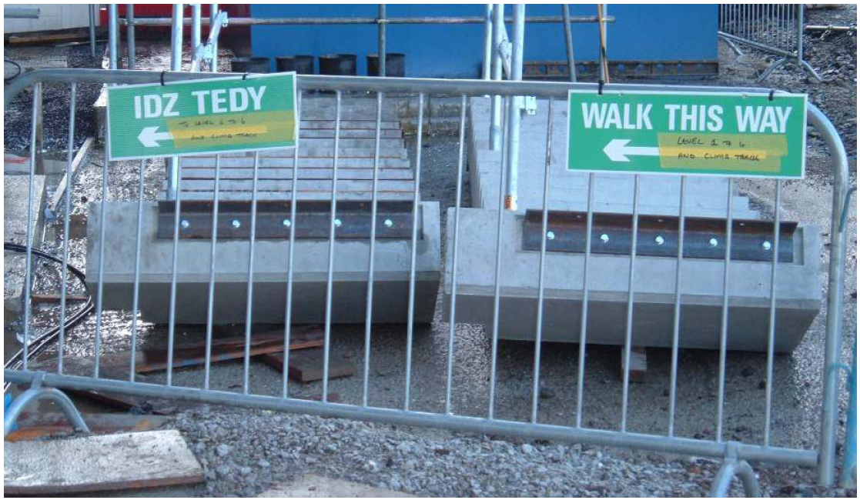
Analysis IV: Foreign Worker Safety Plan
A. Training Foreign Workers:
Comprehensive and specific program.
Learn more about foreign workers.
B. Interpreters and Translators:
Facilitate communication on-site.
Foreign workers w/ strong English.
C. Teaching English:
Provide classes for workers to learn basic English.
Motivation is key.
D. Worker-Management Communication Methods:
Additional mediums for communication.
Bilingual reporting systems.
E. Racism in the Workplace:
Fight early and actively.
Schedule site bonding activities.
F. Visual Safety Notification Techniques:
Communication that can be easily understand regardless of language.
Colored hard hats, two card system, Talk-Sign.
Project Background
Analysis I – Structural Redesign
Analysis III – Workforce Management
Analysis IV – Foreign Worker Safety
Overview
Foreign Worker Safety Plan
Conclusions and Recommendations
Acknowledgments
Image courtesy of https://www.citb.co.uk/.

Slide 18
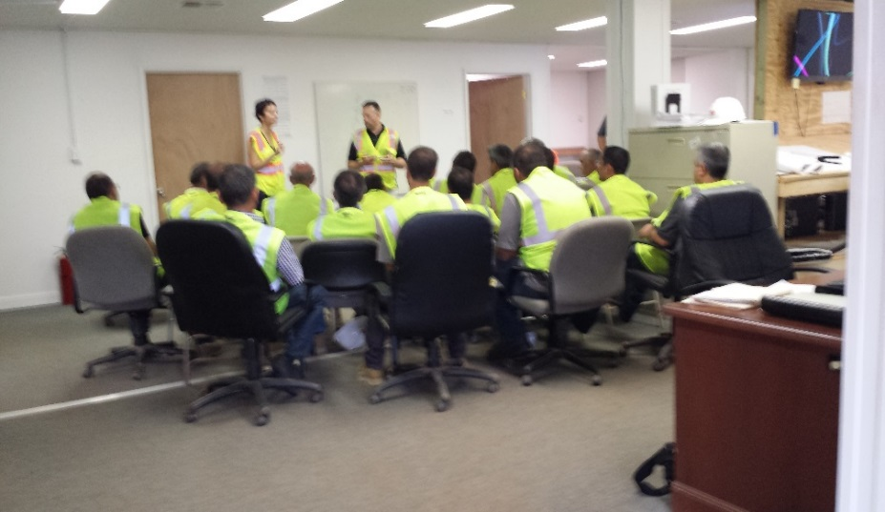
Analysis IV: Foreign Worker Safety Plan
A. Training Foreign Workers:
Comprehensive and specific program.
Learn more about foreign workers.
B. Interpreters and Translators:
Facilitate communication on-site.
Foreign workers w/ strong English.
C. Teaching English:
Provide classes for workers to learn basic English.
Motivation is key.
D. Worker-Management Communication Methods:
Additional mediums for communication.
Bilingual reporting systems.
E. Racism in the Workplace:
Fight early and actively.
Schedule site bonding activities.
F. Visual Safety Notification Techniques:
Communication that can be easily understand regardless of language.
Colored hard hats, two card system, Talk-Sign.
Project Background
Analysis I – Structural Redesign
Analysis III – Workforce Management
Analysis IV – Foreign Worker Safety
Overview
Foreign Worker Safety Plan
Conclusions and Recommendations
Acknowledgments
Note: Picture is self-taken.

Slide 19
Analysis IV: Foreign Worker Safety Plan
A. Training Foreign Workers:
Comprehensive and specific program.
Learn more about foreign workers.
B. Interpreters and Translators:
Facilitate communication on-site.
Foreign workers w/ strong English.
C. Teaching English:
Provide classes for workers to learn basic English.
Motivation is key.
D. Worker-Management Communication Methods:
Additional mediums for communication.
Bilingual reporting systems.
E. Racism in the Workplace:
Fight early and actively.
Schedule site bonding activities.
F. Visual Safety Notification Techniques:
Communication that can be easily understand regardless of language.
Colored hard hats, two card system, Talk-Sign.
Project Background
Analysis I – Structural Redesign
Analysis III – Workforce Management
Analysis IV – Foreign Worker Safety
Overview
Foreign Worker Safety Plan
Conclusions and Recommendations
Acknowledgments

Slide 20
Analysis IV: Foreign Worker Safety Plan
A. Training Foreign Workers:
Comprehensive and specific program.
Learn more about foreign workers.
B. Interpreters and Translators:
Facilitate communication on-site.
Foreign workers w/ strong English.
C. Teaching English:
Provide classes for workers to learn basic English.
Motivation is key.
D. Worker-Management Communication Methods:
Additional mediums for communication.
Bilingual reporting systems.
E. Racism in the Workplace:
Fight early and actively.
Schedule site bonding activities.
F. Visual Safety Notification Techniques:
Communication that can be easily understand regardless of language.
Colored hard hats, two card system, Talk-Sign.
Project Background
Analysis I – Structural Redesign
Analysis III – Workforce Management
Analysis IV – Foreign Worker Safety
Overview
Foreign Worker Safety Plan
Conclusions and Recommendations
Acknowledgments
Zero
Tolerance

Slide 21
Analysis IV: Foreign Worker Safety Plan
A. Training Foreign Workers:
Comprehensive and specific program.
Learn more about foreign workers.
B. Interpreters and Translators:
Facilitate communication on-site.
Foreign workers w/ strong English.
C. Teaching English:
Provide classes for workers to learn basic English.
Motivation is key.
D. Worker-Management Communication Methods:
Additional mediums for communication.
Bilingual reporting systems.
E. Racism in the Workplace:
Fight early and actively.
Schedule site bonding activities.
F. Visual Safety Notification Techniques:
Communication that can be easily understand regardless of language.
Colored hard hats, two card system, Talk-Sign.
Project Background
Analysis I – Structural Redesign
Analysis III – Workforce Management
Analysis IV – Foreign Worker Safety
Overview
Foreign Worker Safety Plan
Conclusions and Recommendations
Acknowledgments
Image courtesy of https://www.citb.co.uk/.
Note: Picture is self-taken.

Slide 22
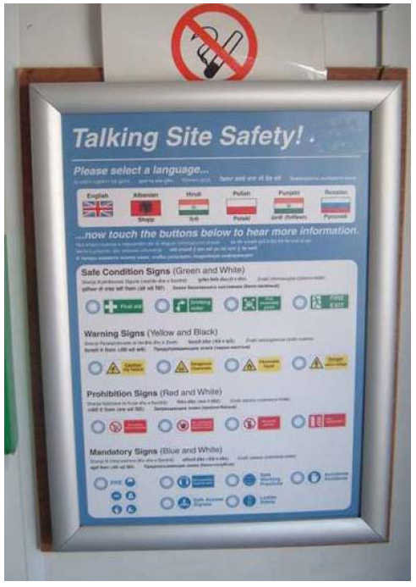
Analysis IV: Foreign Worker Safety Plan
A. Training Foreign Workers:
Comprehensive and specific program.
Learn more about foreign workers.
B. Interpreters and Translators:
Facilitate communication on-site.
Foreign workers w/ strong English.
C. Teaching English:
Provide classes for workers to learn basic English.
Motivation is key.
D. Worker-Management Communication Methods:
Additional mediums for communication.
Bilingual reporting systems.
E. Racism in the Workplace:
Fight early and actively.
Schedule site bonding activities.
F. Visual Safety Notification Techniques:
Communication that can be easily understand regardless of language.
Colored hard hats, two card system, Talk-Sign.
Project Background
Analysis I – Structural Redesign
Analysis III – Workforce Management
Analysis IV – Foreign Worker Safety
Overview
Foreign Worker Safety Plan
Conclusions and Recommendations
Acknowledgments
Image courtesy of https://www.citb.co.uk/.
Image courtesy of https://juicy303.wordpress.com.

Slide 23
Conclusions and Recommendations
Analysis I: Structural Redesign
Convent/Monastery → Not recommended
Fellowship Hall → Worth Exploring
Analysis III: Workforce Management
Recommended.
Manage the workforce and improve productivity.
Analysis IV: Foreign Worker Safety
Recommended.
Ensure worker safety and improve the culture on site.
Project Background
Analysis I – Structural Redesign
Analysis III – Workforce Management
Analysis IV – Foreign Worker Safety
Conclusions and Recommendations
Acknowledgments
Note: Pictures are self-taken.

Slide 24
Acknowledgments
Thank you:
AE Department and Faculty
Craig Dubler, Advisor
Pelin Gultekin, PSU Graduate Student
Dan Weiger, Alexander Building Construction, Co.
Friends and Family, and Jeff
Project Background
Analysis I – Structural Redesign
Analysis III – Workforce Management
Analysis IV – Foreign Worker Safety
Conclusions and Recommendations
Acknowledgments
Bhavin Patel, Project Engineer
Note: All site and building renderings and images are courtesy of Balfour Beatty Construction.

Slide 25
Thank You!
Questions?
Penn State AE Senior Capstone Project
Garrett Schwier | Construction Management
Advisor | Craig Dubler

