Slide 1
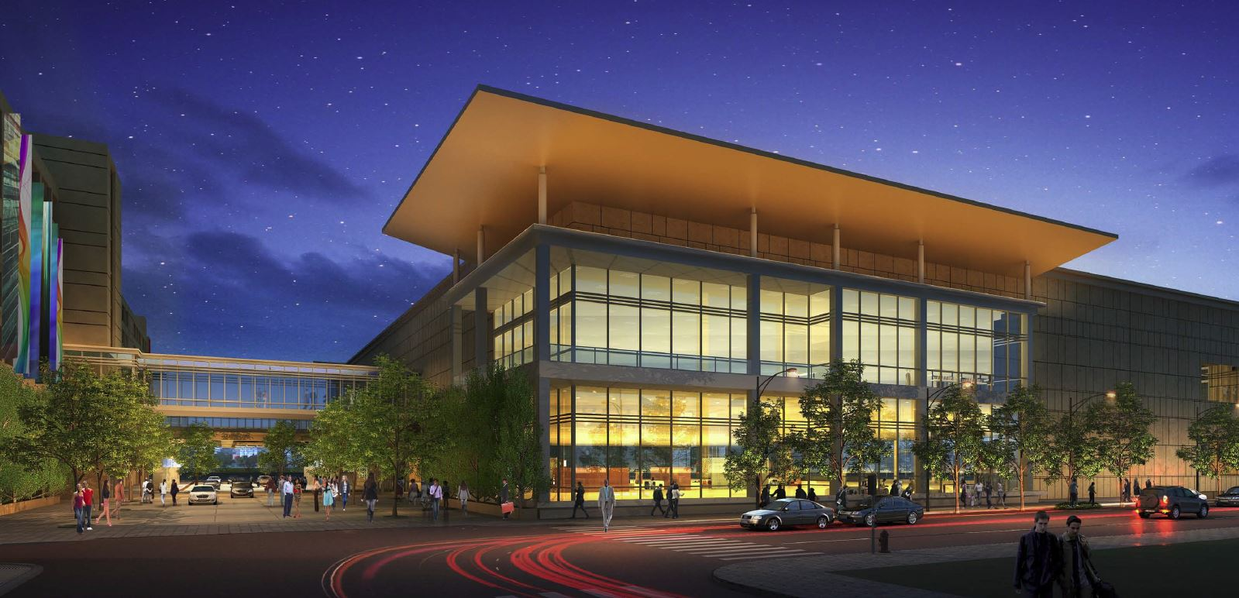
Casino Gold
AE Senior Thesis
Brad Robertson

Slide 2
Project Overview
Lighting Concept
Poker Room
Design Criteria
Lighting Solution
Calculations
Pre-Function
Design Criteria
Lighting Solution
Calculations
Solar Array
Structural Effects
Conclusion
Scope of Senior Thesis
Lighting Redesign
  Outdoor Plaza
  Pre-Function
  Poker Room
  Player’s Lounge
Electrical Depth
  Modifications for Lighting Redesign
  Addition of Solar Array
Construction Breadth
Structural Breadth

Slide 3
Project Overview
Lighting Concept
Poker Room
Design Criteria
Lighting Solution
Calculations
Pre-Function
Design Criteria
Lighting Solution
Calculations
Solar Array
Structural Effects
Conclusion
Scope of Senior Thesis
Lighting Redesign
  Outdoor Plaza
  Pre-Function
  Poker Room
  Player’s Lounge
Electrical Depth
  Modifications for Lighting Redesign
  Addition of Solar Array
Construction Breadth
Structural Breadth

Slide 4
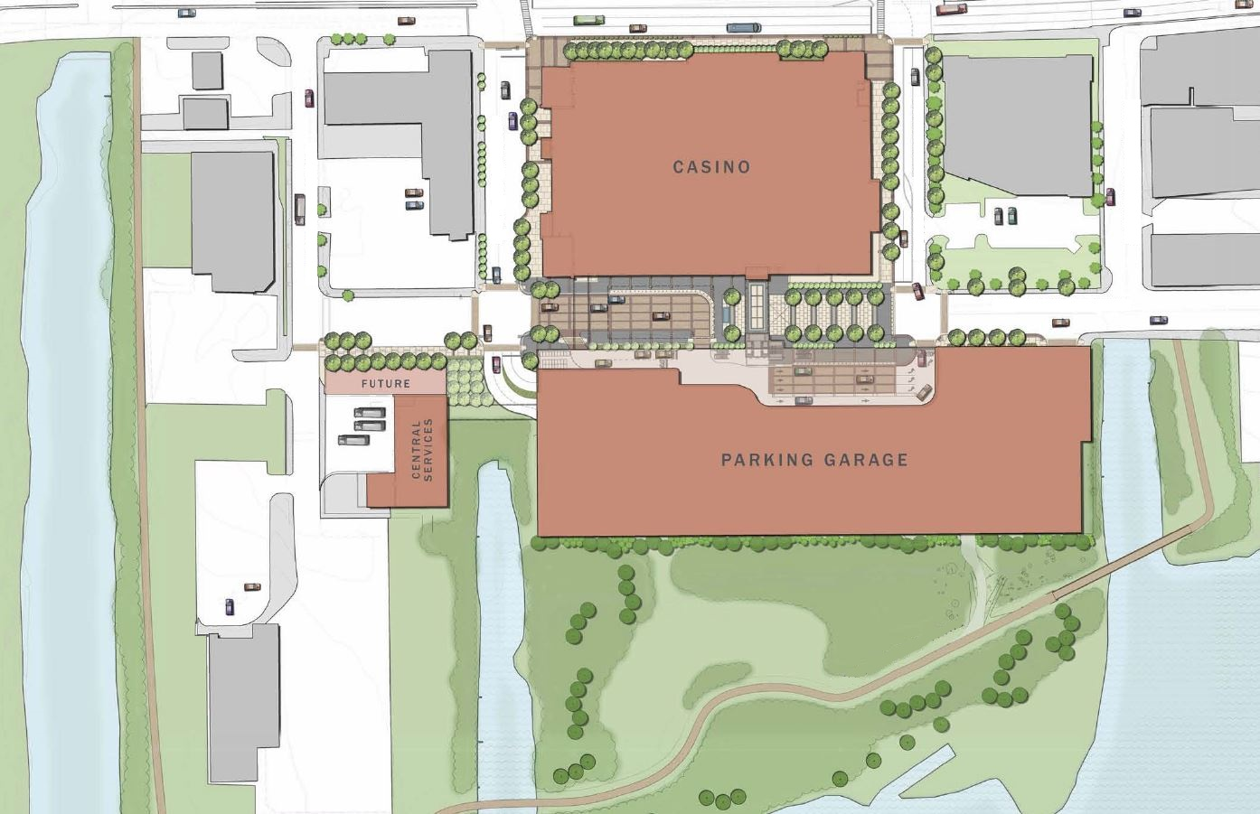
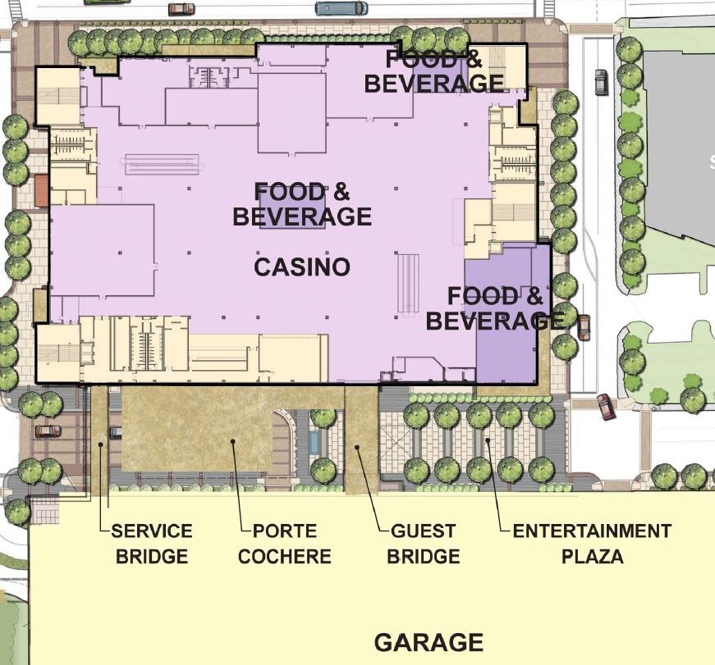
Project Overview
Lighting Concept
Poker Room
Design Criteria
Lighting Solution
Calculations
Pre-Function
Design Criteria
Lighting Solution
Calculations
Solar Array
Structural Effects
Conclusion

Slide 5
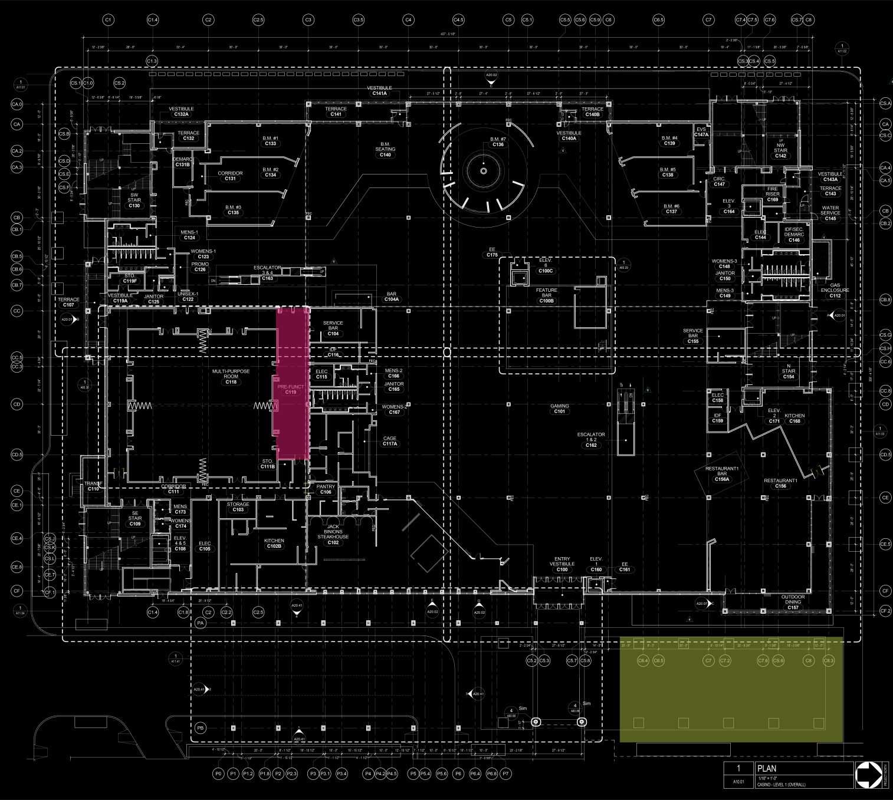
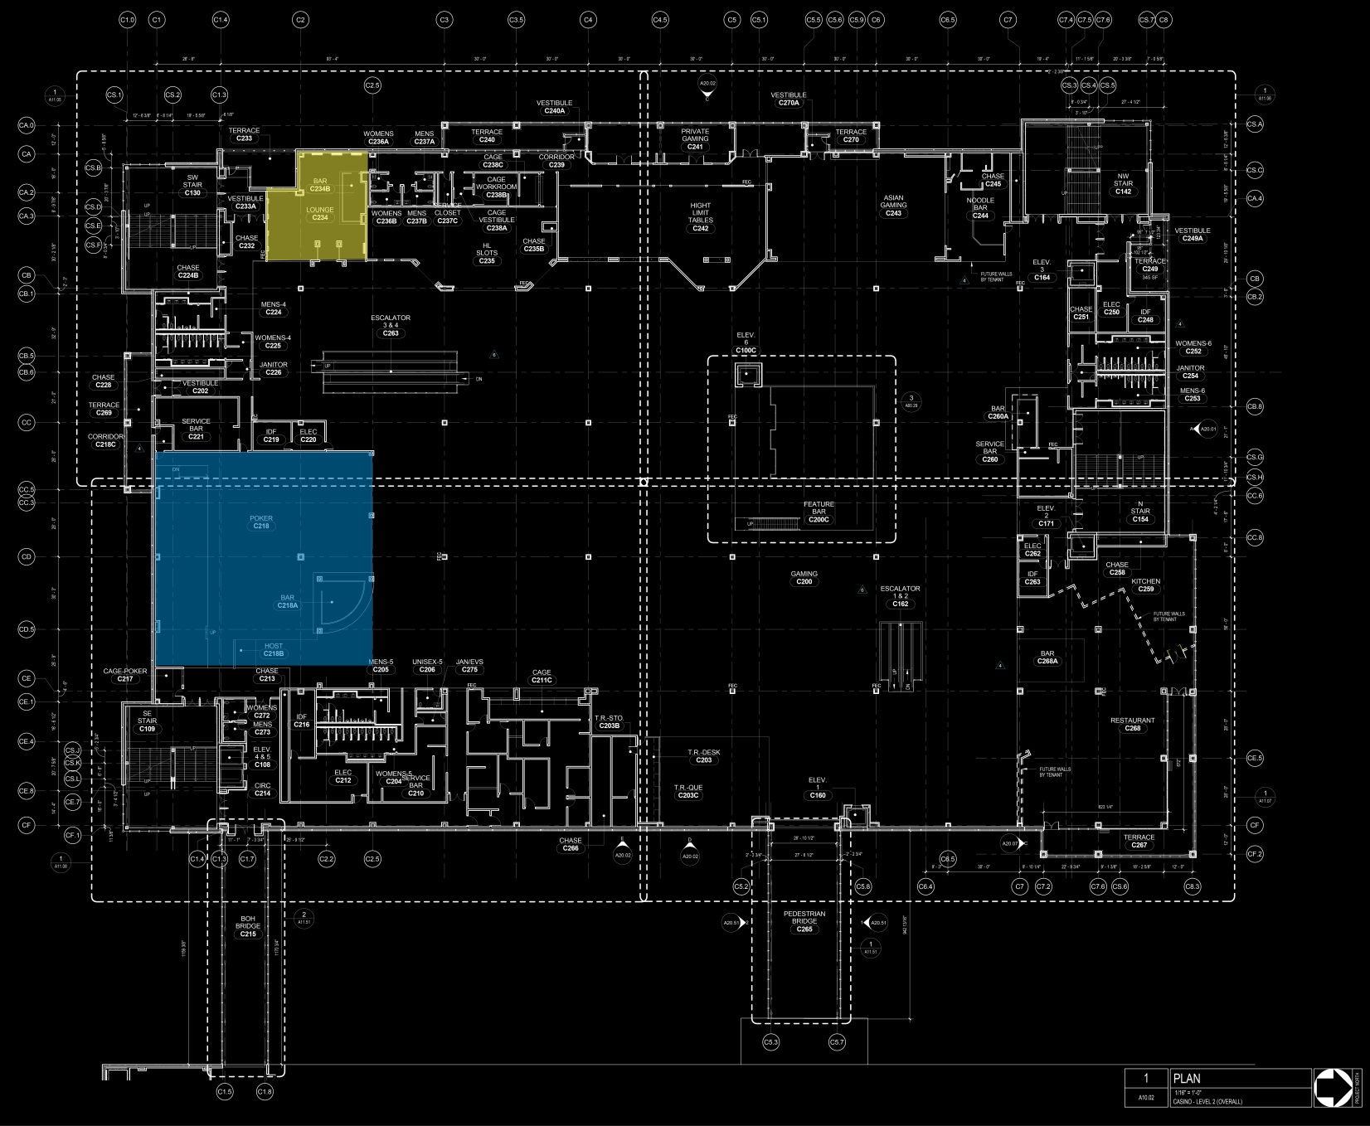
Size: 309,450 sq. ft.
Levels: 3
Approximate Cost: $400 Million
Project Team
  Executive Architect: ka
  Design/Interiors Architect: Friedmutter Group
  Construction Manager: Whiting-Turner
  Structural Engineer: Carroll Engineering, Inc.
  MEPT Engineer: JBA Consulting Engineers
  Lighting Design: The Lighting Practice
Level 1
Level 2

Slide 6

Project Overview
Lighting Concept
Poker Room
Design Criteria
Lighting Solution
Calculations
Pre-Function
Design Criteria
Lighting Solution
Calculations
Solar Array
Structural Effects
Conclusion
“Connecting People”
*http://online-free-casino-games.blogspot.com

Slide 7
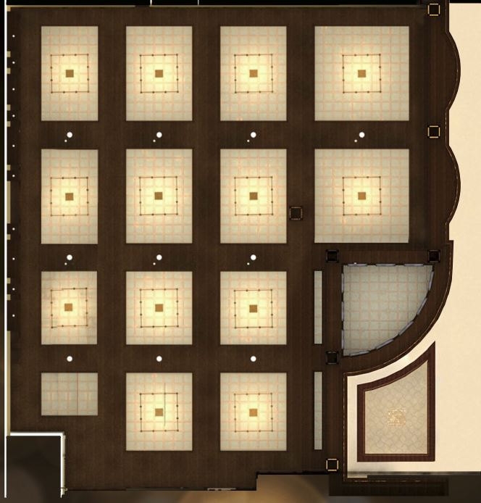
Description
Located on the 2nd level
Approx. 8,100 sq. ft.
15ft woodwork
16ft ceilings
Project Overview
Lighting Concept
Poker Room
Design Criteria
Lighting Solution
Calculations
Pre-Function
Design Criteria
Lighting Solution
Calculations
Solar Array
Structural Effects
Conclusion
Poker Room RCP *Friedmutter Group

Slide 8
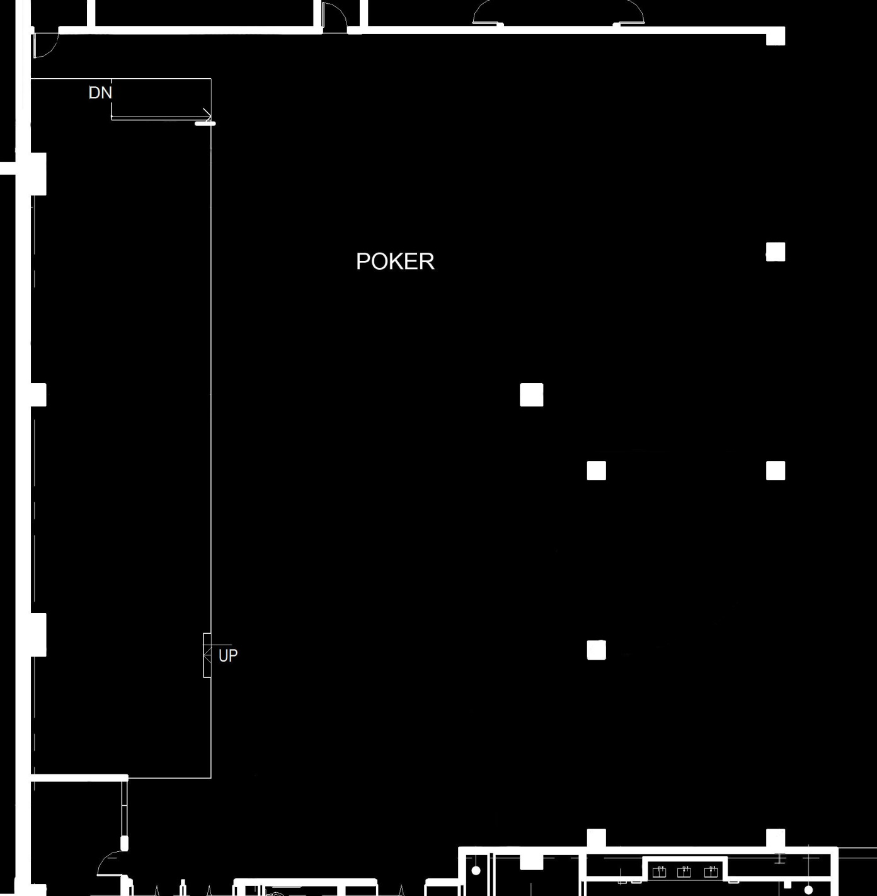
Design Criteria and Considerations
Workspace for Players
Uniform Light
  Avg. / Min. of 5:1
Horizontal Illuminance
  E_{h,avg} = 30fc
Lighting Power Density
  Classroom/Lecture: 1.24 W/ft²
Project Overview
Lighting Concept
Poker Room
Design Criteria
Lighting Solution
Calculations
Pre-Function
Design Criteria
Lighting Solution
Calculations
Solar Array
Structural Effects
Conclusion

Slide 9
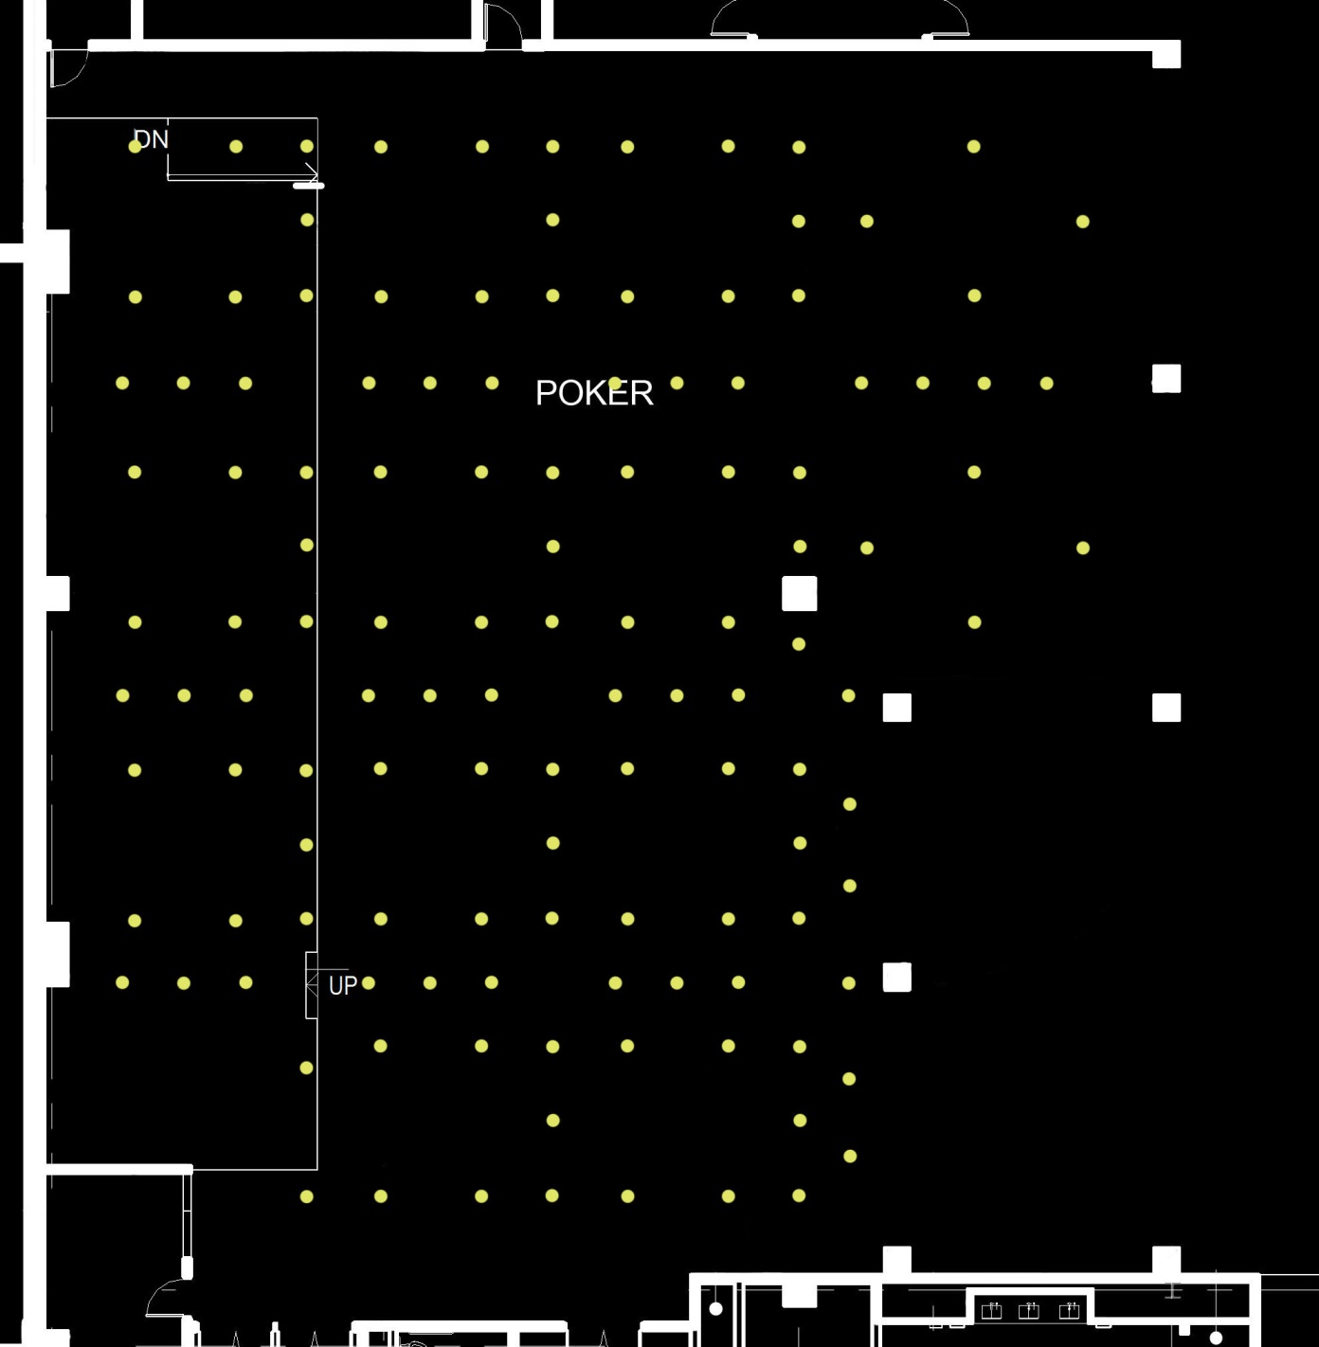
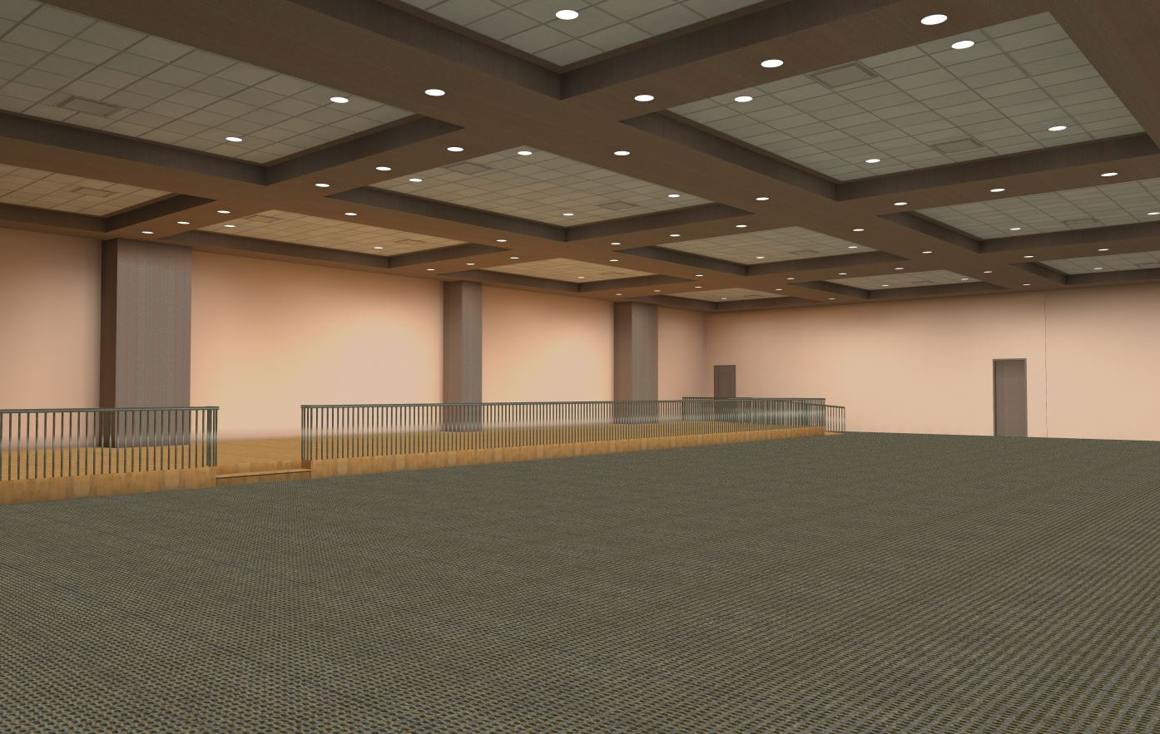
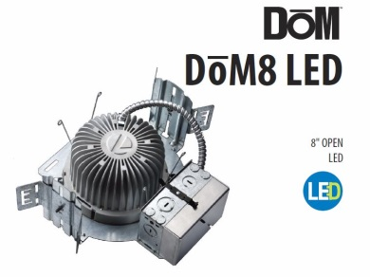
Project Overview
Lighting Concept
Poker Room
Design Criteria
Lighting Solution
Calculations
Pre-Function
Design Criteria
Lighting Solution
Calculations
Solar Array
Structural Effects
Conclusion
Lithonia, 8” Downlight, 27.5W
123 total
Poker Room Lighting Plan

Slide 10
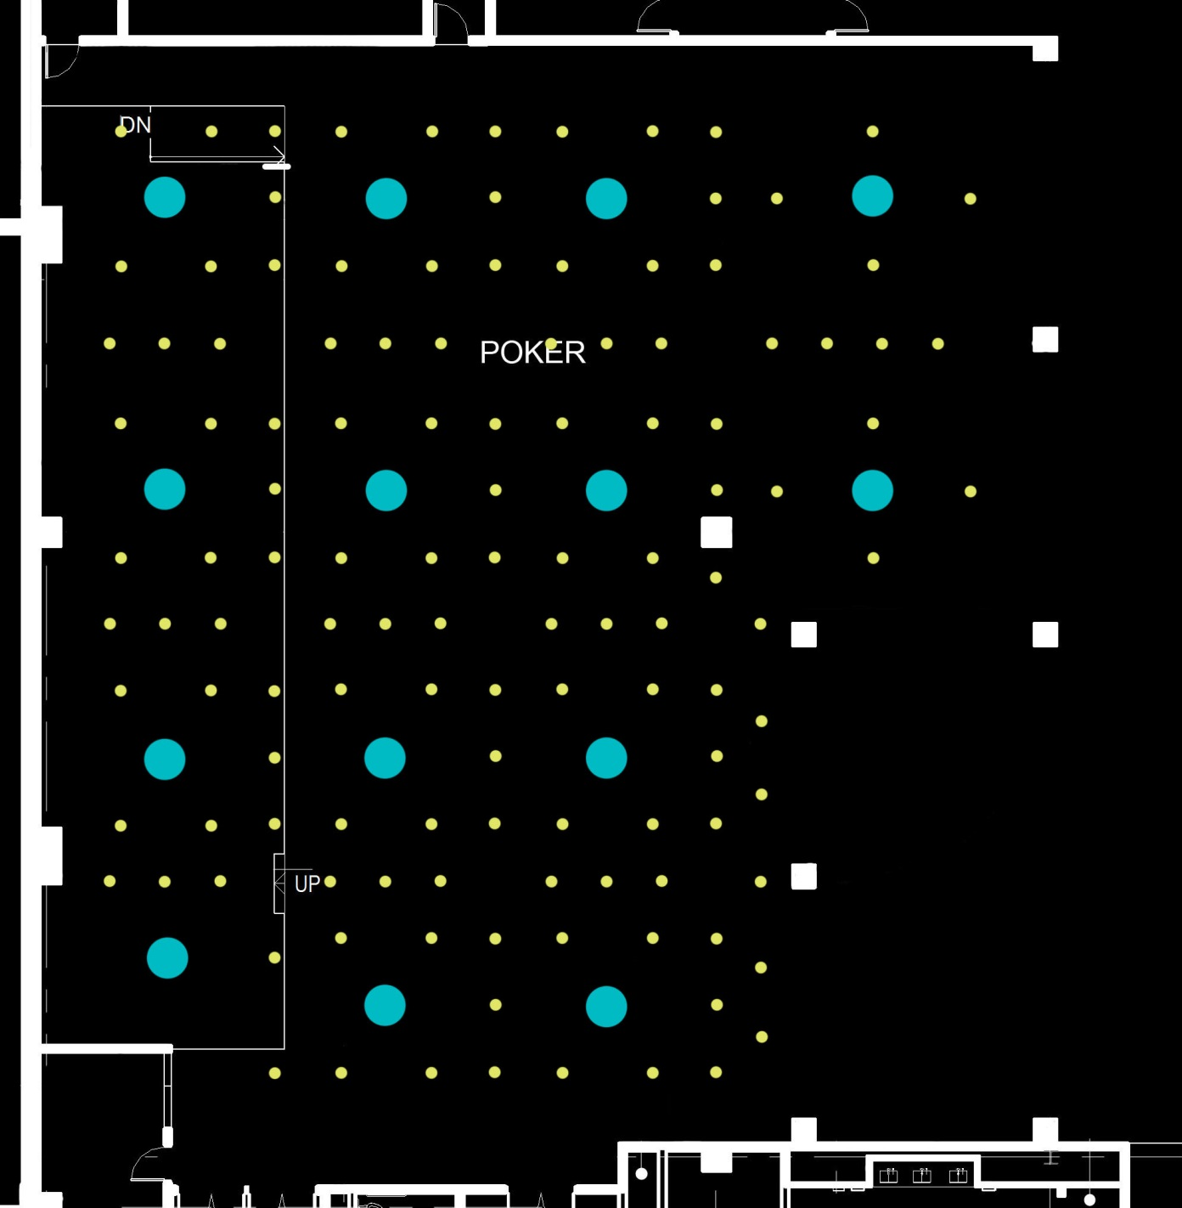
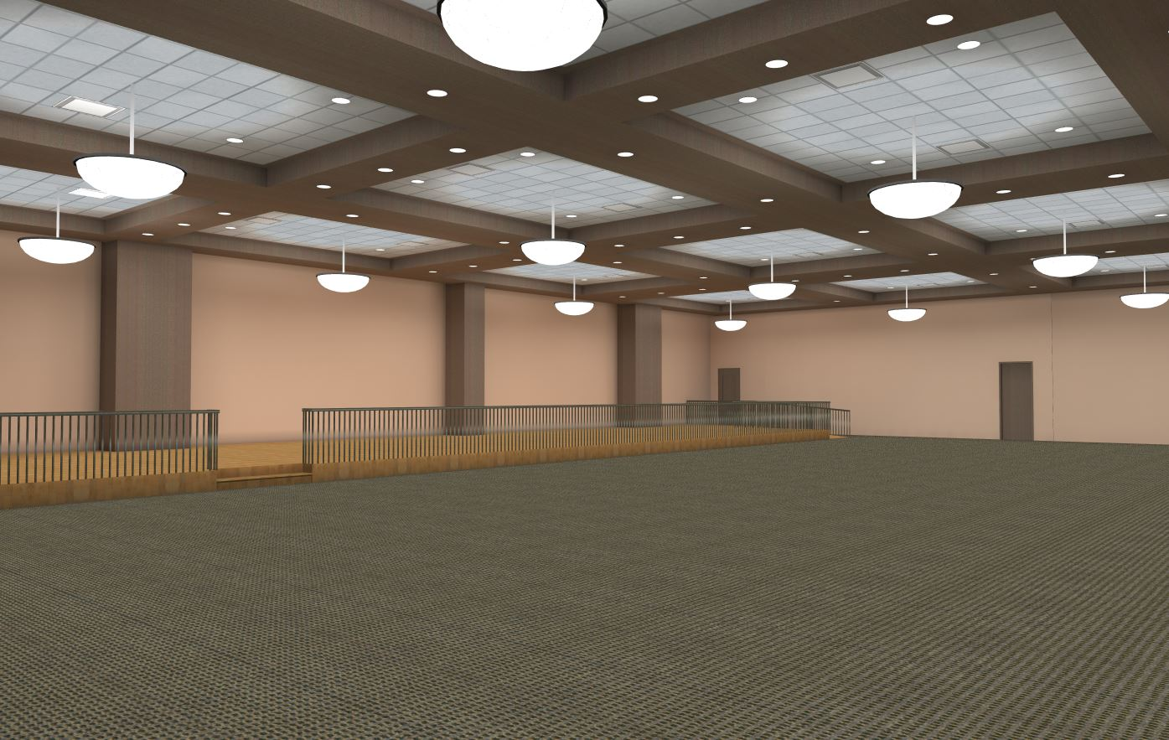
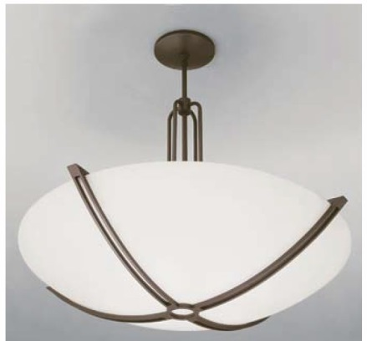
Project Overview
Lighting Concept
Poker Room
Design Criteria
Lighting Solution
Calculations
Pre-Function
Design Criteria
Lighting Solution
Calculations
Solar Array
Structural Effects
Conclusion
43” Dia. Winona Decorative Pendant, 186W
14 total
Poker Room Lighting Plan

Slide 11
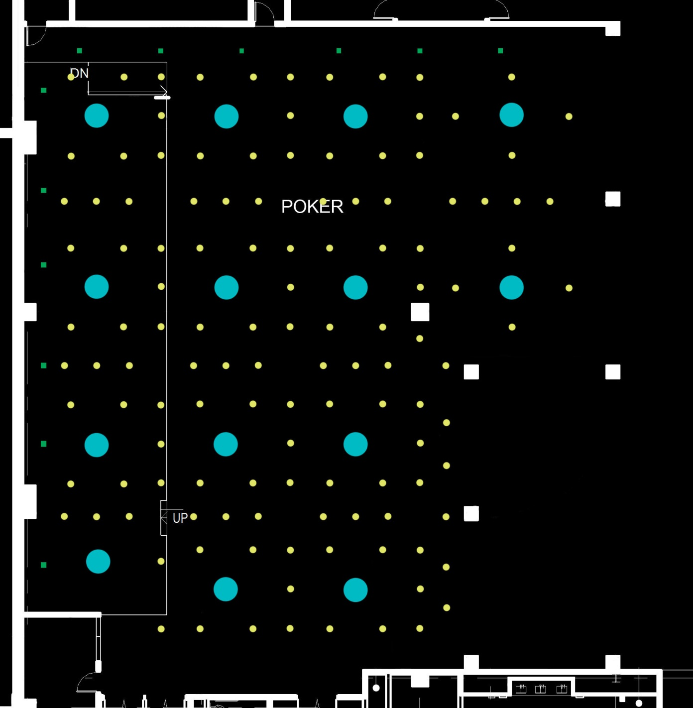
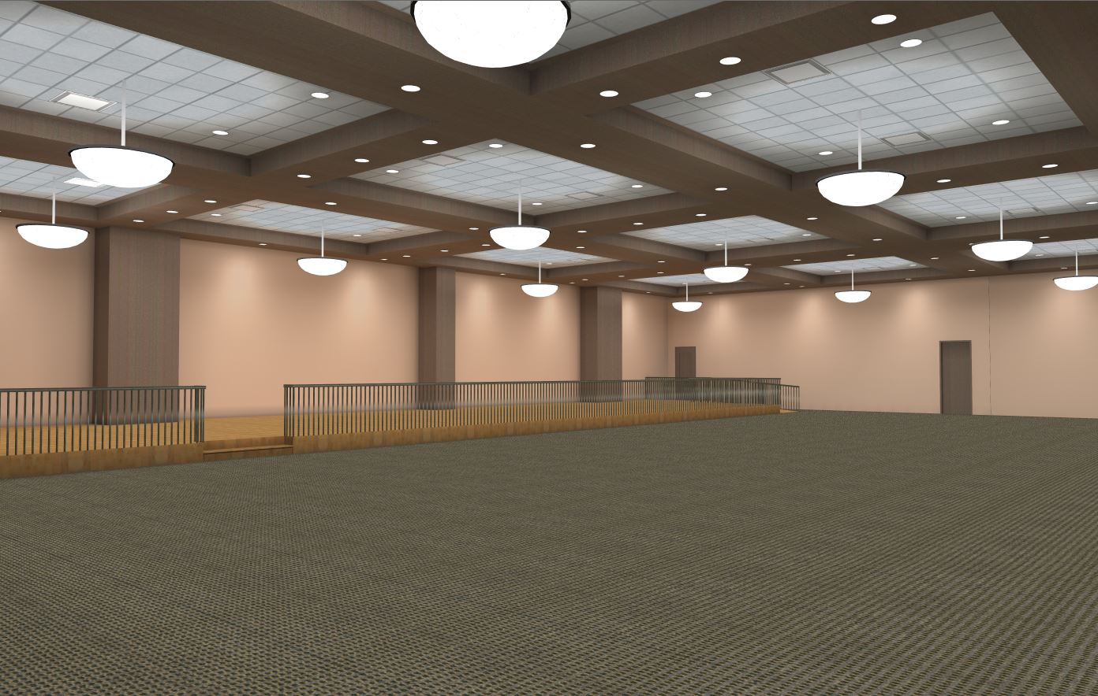
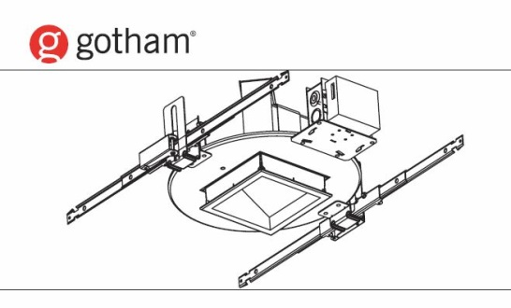
Project Overview
Lighting Concept
Poker Room
Design Criteria
Lighting Solution
Calculations
Pre-Function
Design Criteria
Lighting Solution
Calculations
Solar Array
Structural Effects
Conclusion
6” Square Wallwash, 32.5W
12 total
Poker Room Lighting Plan

Slide 12
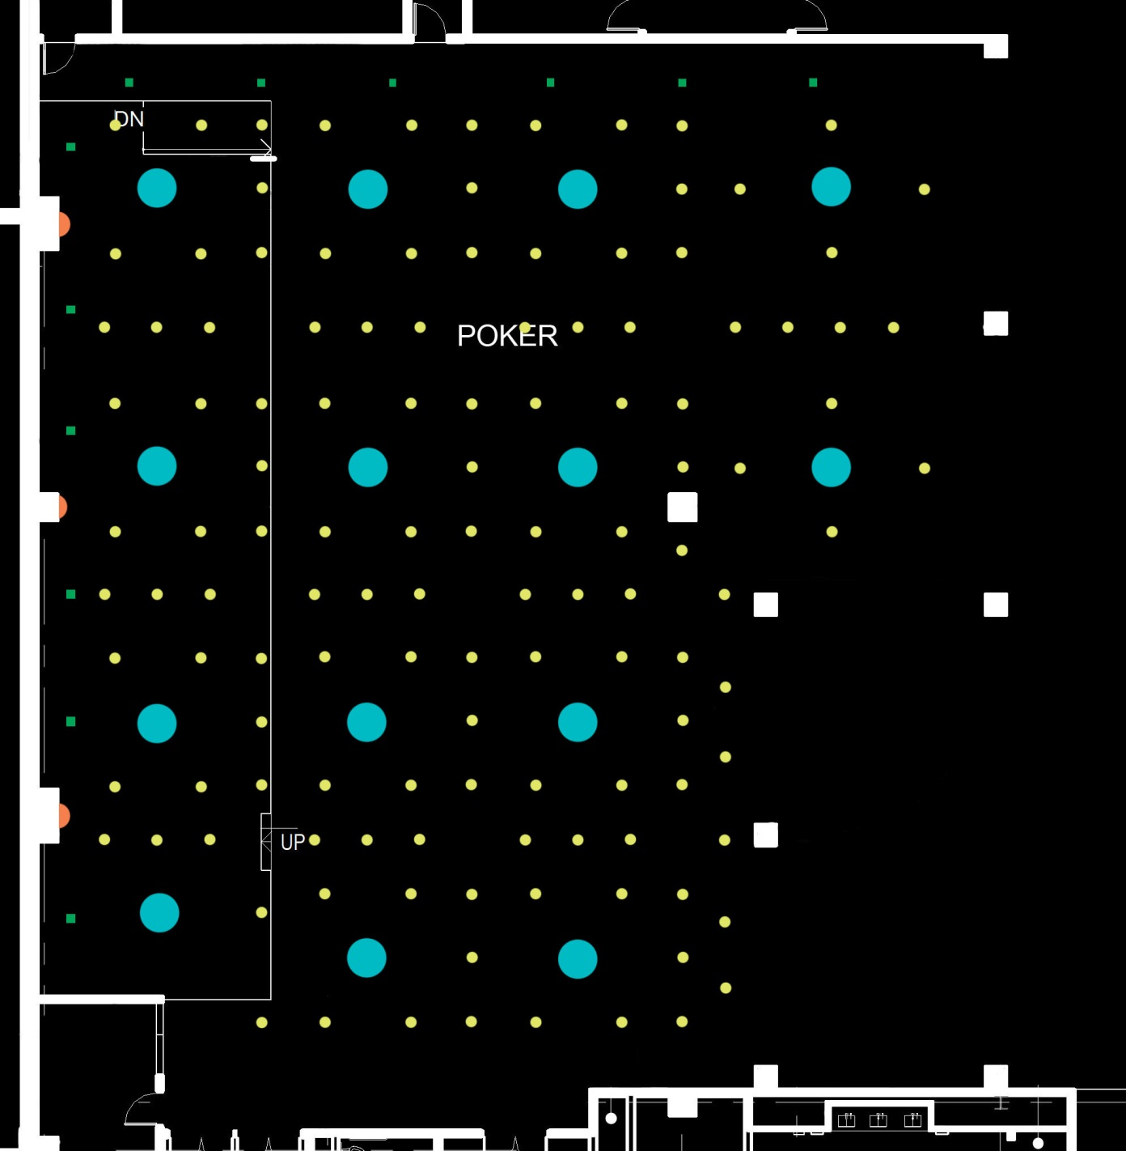
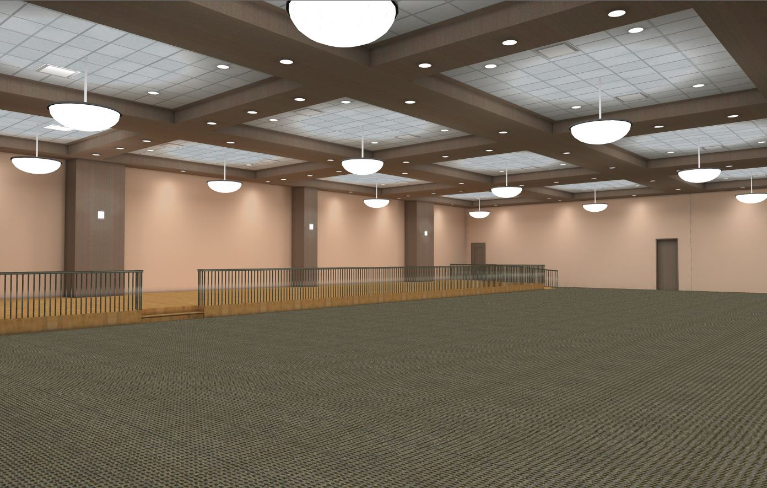
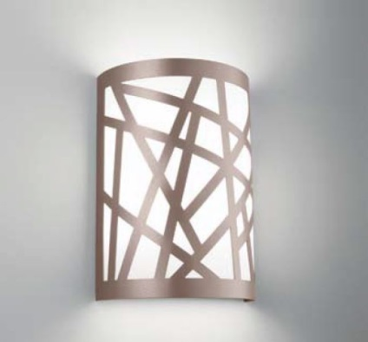
Project Overview
Lighting Concept
Poker Room
Design Criteria
Lighting Solution
Calculations
Pre-Function
Design Criteria
Lighting Solution
Calculations
Solar Array
Structural Effects
Conclusion
Winona Wall Drum, 32.2W
3 total
Poker Room Lighting Plan

Slide 13
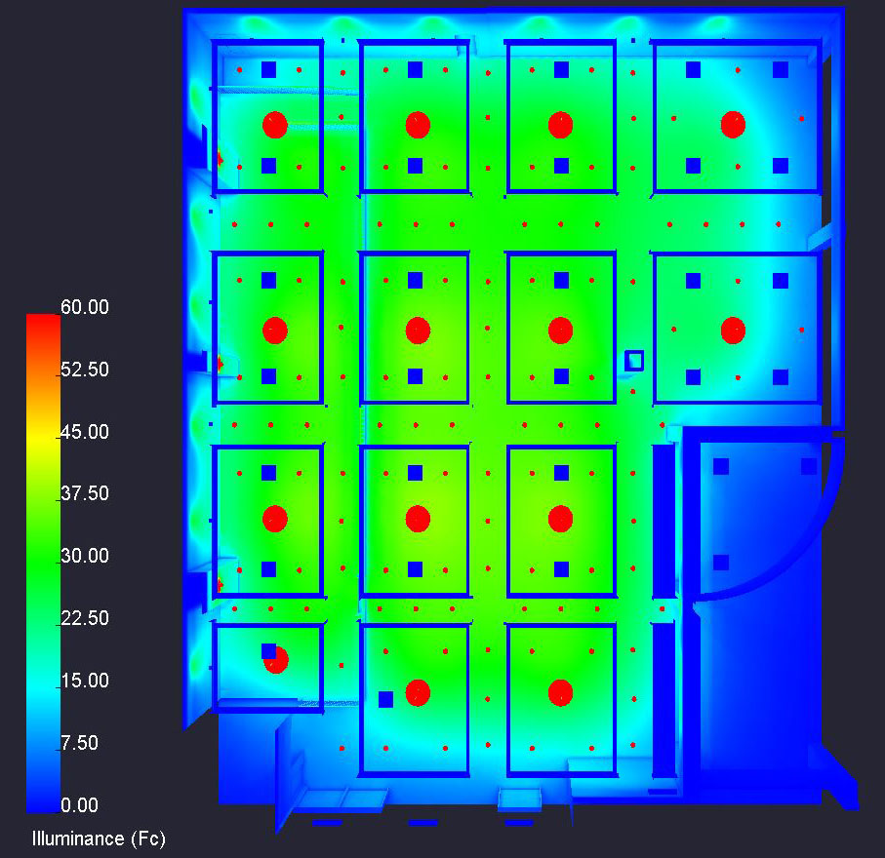
Design Criteria and Considerations
Uniform Light
  Avg. / Min. of 5:1
Horizontal Illuminance
  E_{h,avg} = 30fc
Lighting Power Density
  Classroom/Lecture: 1.24 W/ft²
Final Design
  Avg. / Min. ratio of 1.85
  Horizontal Illuminance of 32fc
  Lighting Power Density of 0.80 W/ft²
Project Overview
Lighting Concept
Poker Room
Design Criteria
Lighting Solution
Calculations
Pre-Function
Design Criteria
Lighting Solution
Calculations
Solar Array
Structural Effects
Conclusion

Slide 14
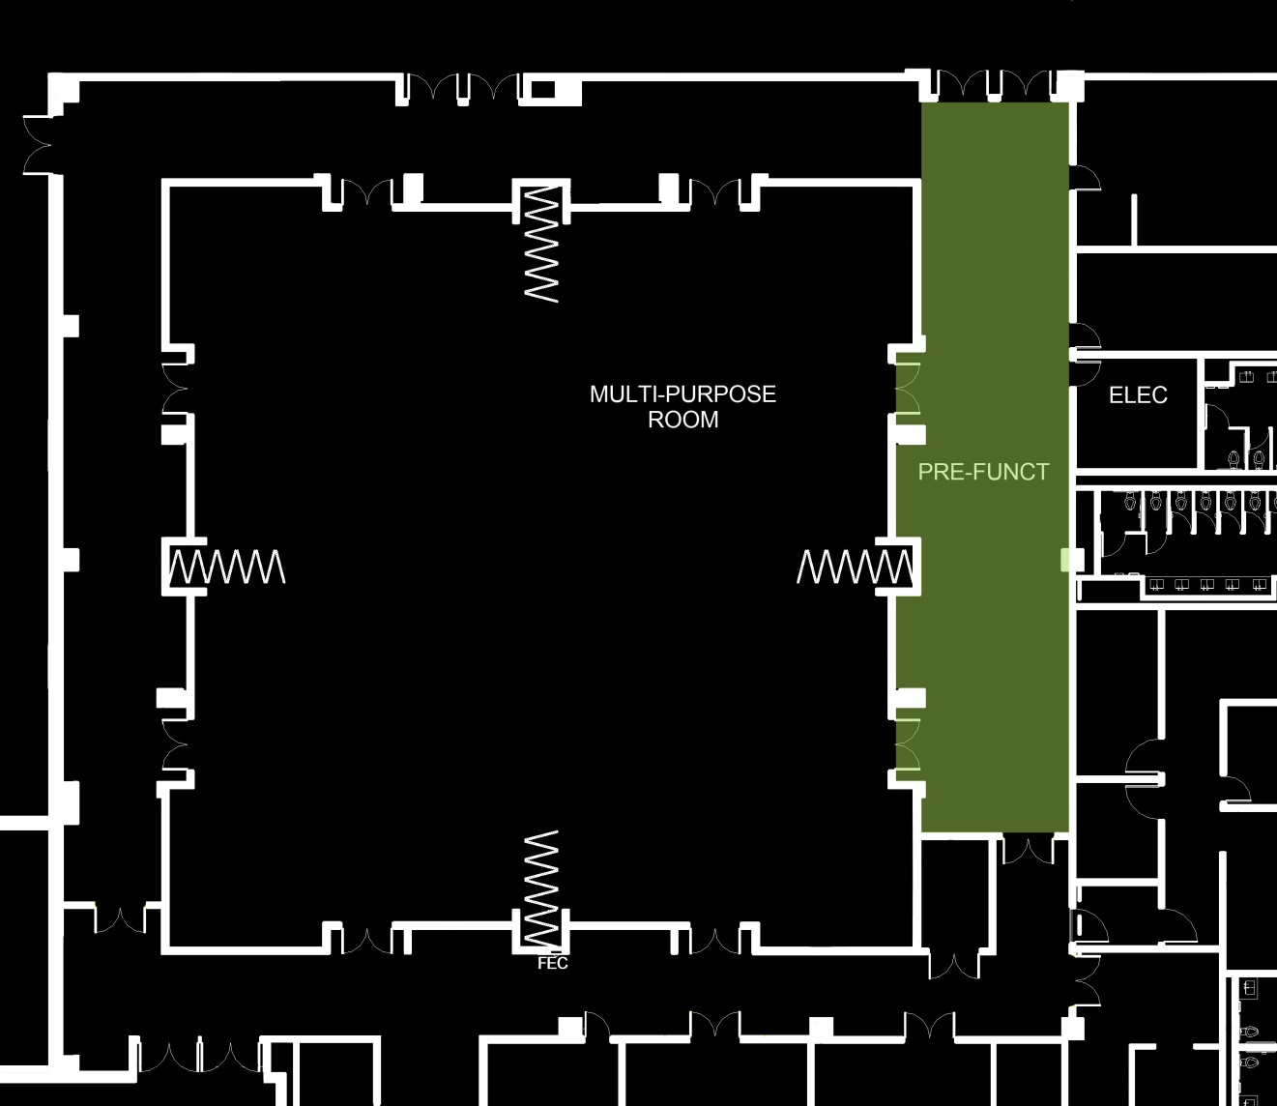
Description
Located on the 1st level
Approx. 1,980 sq. ft.
15ft ceiling
17ft recessed ceilings
Project Overview
Lighting Concept
Poker Room
Design Criteria
Lighting Solution
Calculations
Pre-Function
Design Criteria
Lighting Solution
Calculations
Solar Array
Structural Effects
Conclusion

Slide 15
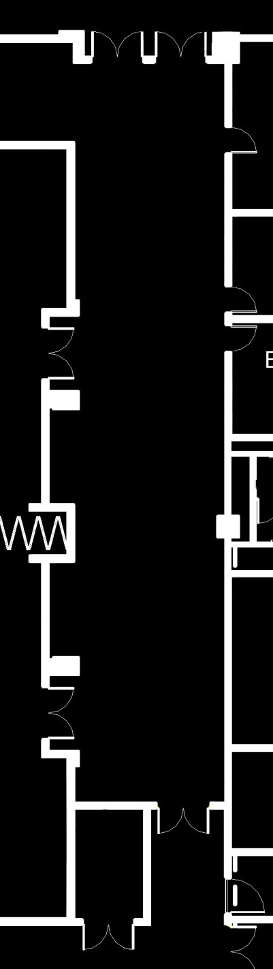
Design Criteria and Considerations
Promote Impression of Spaciousness
Guide Guests
Horizontal Illuminance
  E_{h,avg} = 30fc
Avg. / Min. ratio of 4:1
Lighting Power Density
  Corridor/Transition: 0.66 W/ft²
Project Overview
Lighting Concept
Poker Room
Design Criteria
Lighting Solution
Calculations
Pre-Function
Design Criteria
Lighting Solution
Calculations
Solar Array
Structural Effects
Conclusion

Slide 16
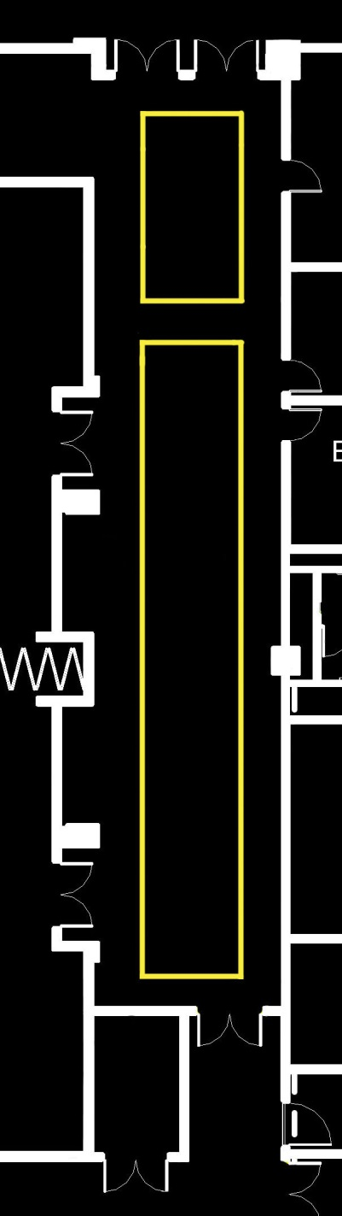
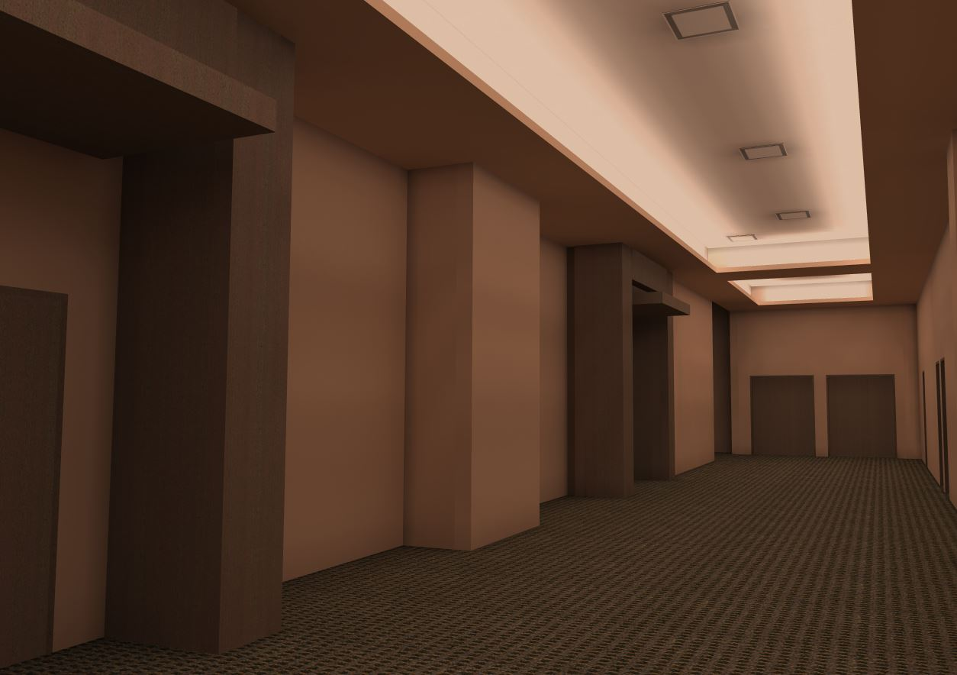
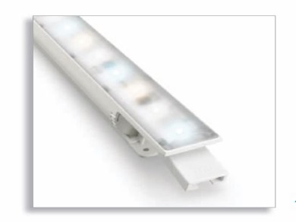
Project Overview
Lighting Concept
Poker Room
Design Criteria
Lighting Solution
Calculations
Pre-Function
Design Criteria
Lighting Solution
Calculations
Solar Array
Structural Effects
Conclusion
Philips 4ft Linear Cove w/ Intelligent White, 20.7W
22 total
Pre-Function Lighting Design

Slide 17
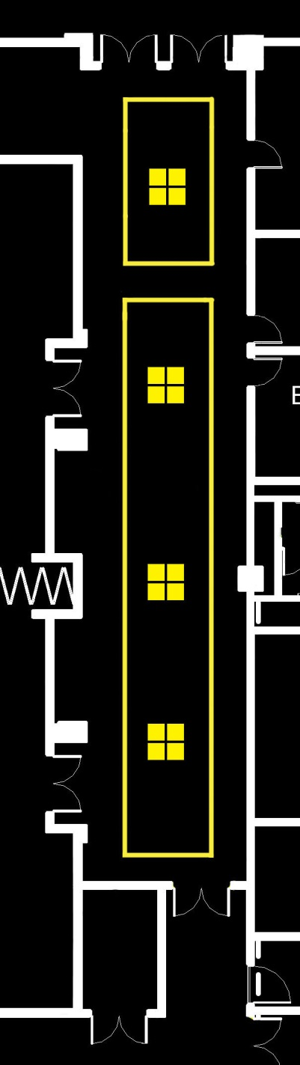
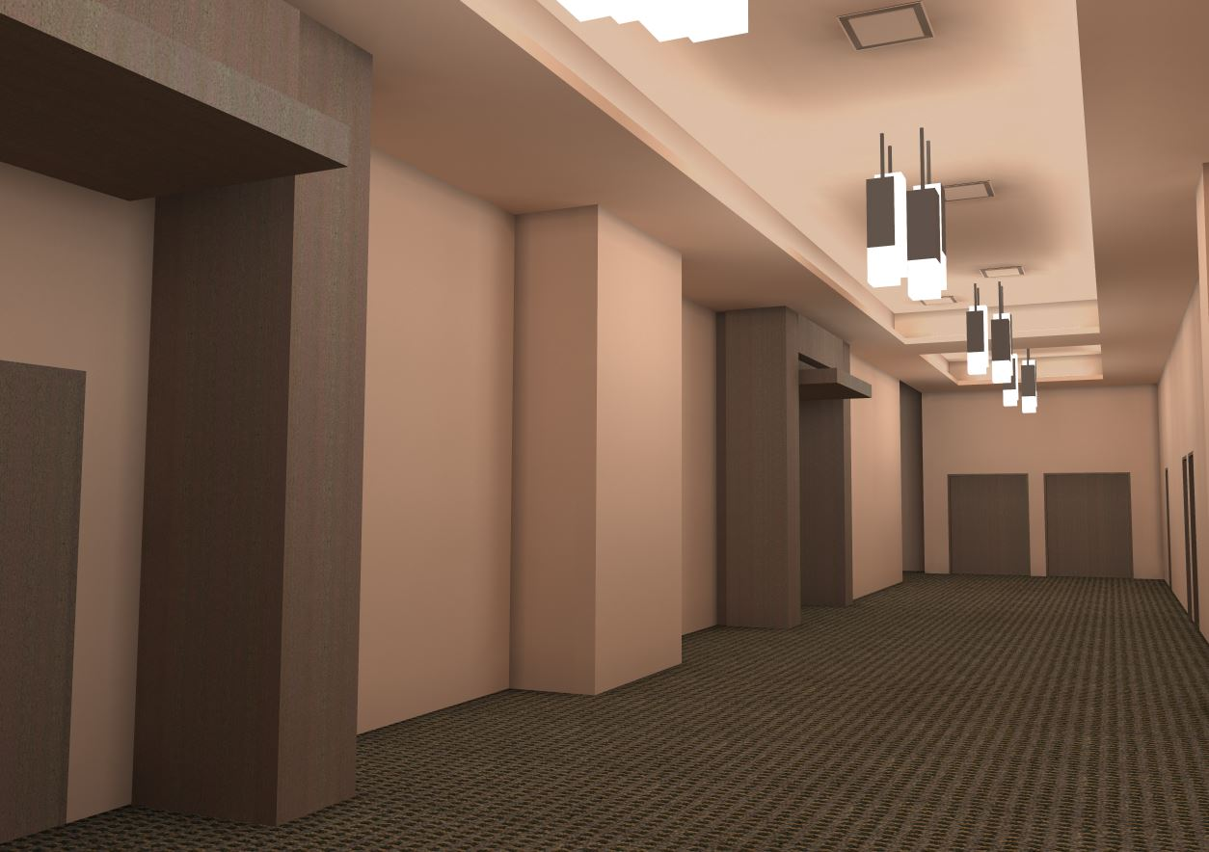
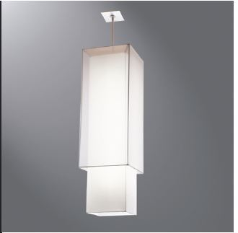
Project Overview
Lighting Concept
Poker Room
Design Criteria
Lighting Solution
Calculations
Pre-Function
Design Criteria
Lighting Solution
Calculations
Solar Array
Structural Effects
Conclusion
Shaper Fabric Covered Pendant, 93W
4 total
Pre-Function Lighting Design

Slide 18

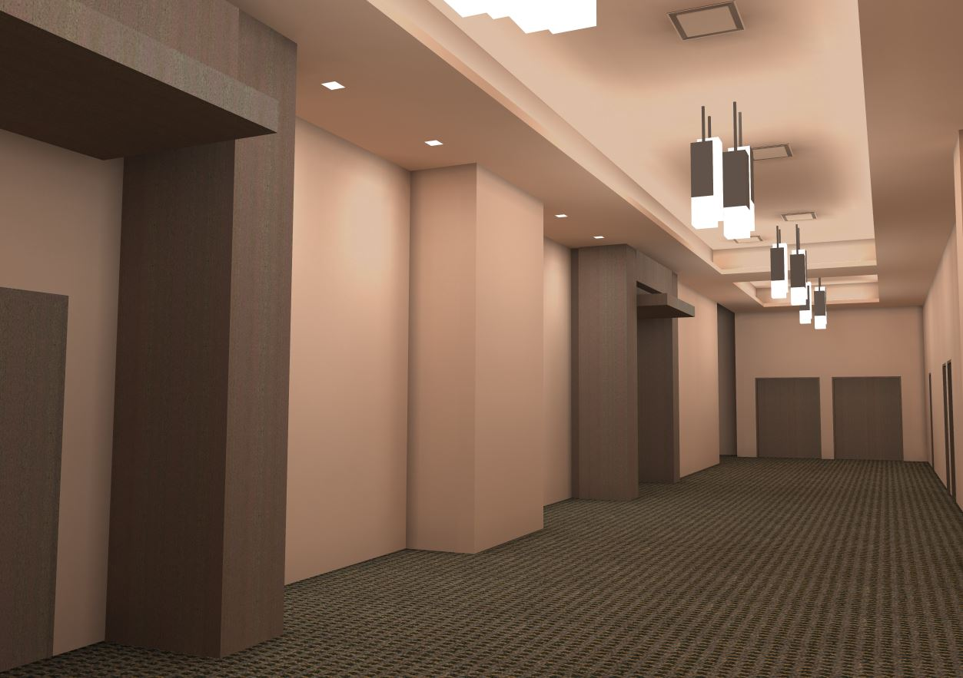
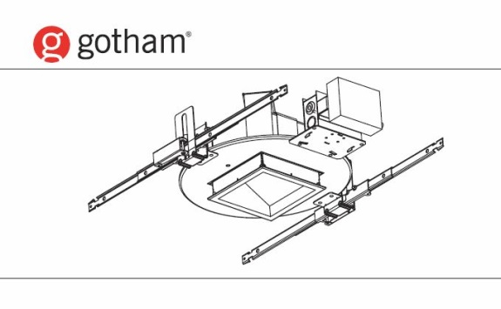
Project Overview
Lighting Concept
Poker Room
Design Criteria
Lighting Solution
Calculations
Pre-Function
Design Criteria
Lighting Solution
Calculations
Solar Array
Structural Effects
Conclusion
6” Square Wallwash, 86.6
4 total
Pre-Function Lighting Design

Slide 19

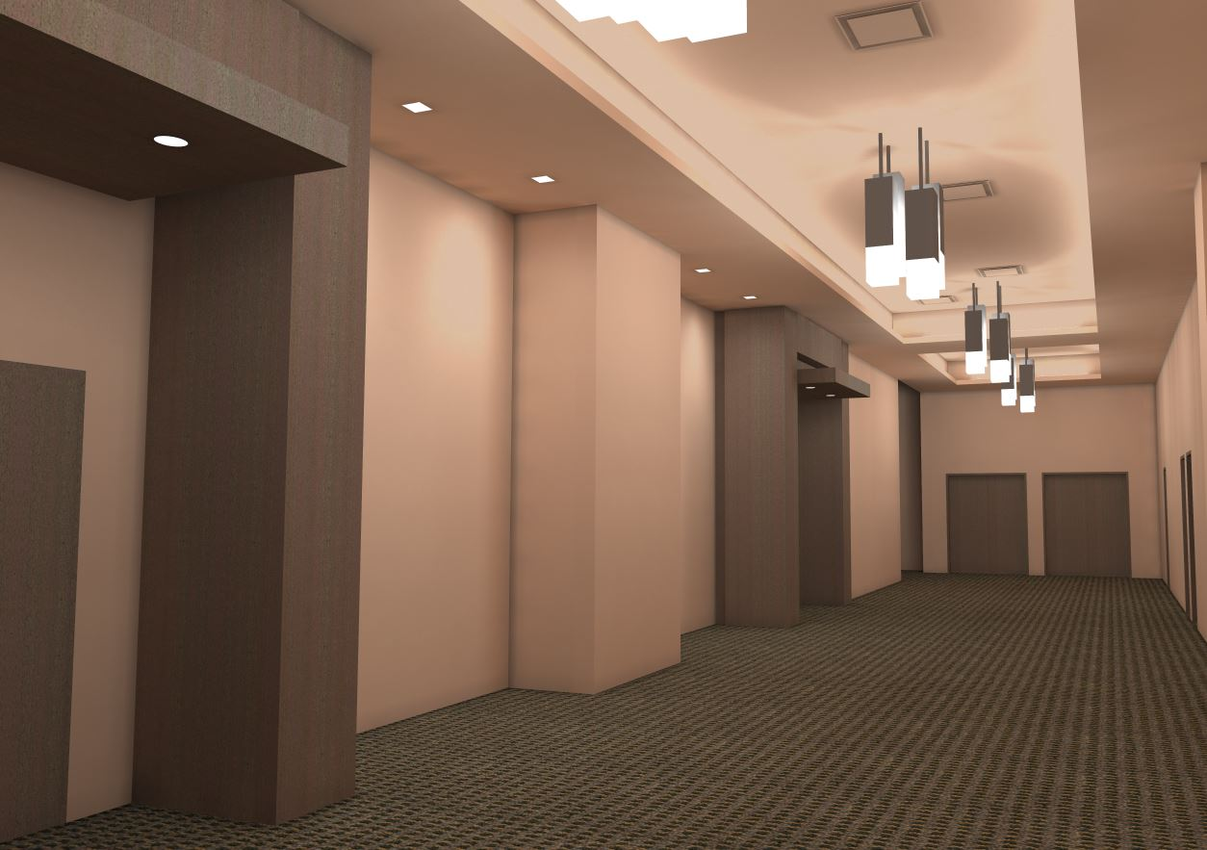
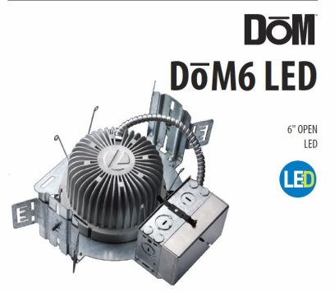
Project Overview
Lighting Concept
Poker Room
Design Criteria
Lighting Solution
Calculations
Pre-Function
Design Criteria
Lighting Solution
Calculations
Solar Array
Structural Effects
Conclusion
6” Recessed Downlight, Lithonia, 15.6W
4 total
Pre-Function Lighting Design

Slide 20
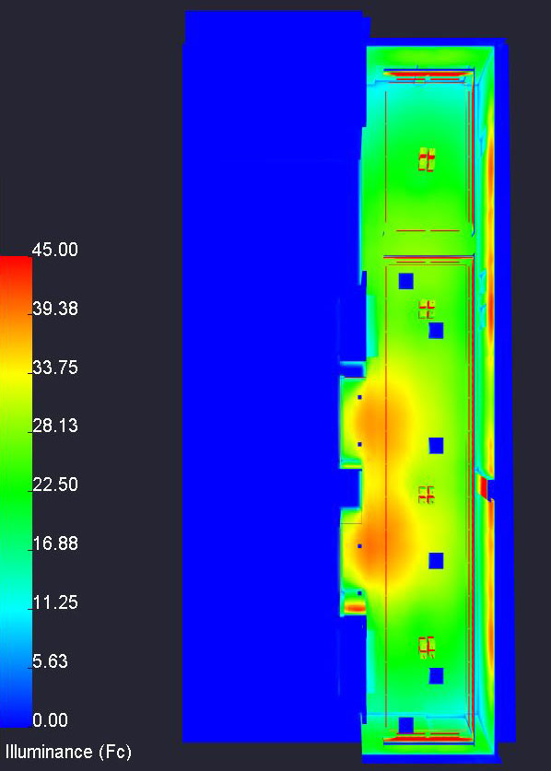
Design Criteria and Considerations
Avg. / Min. of 4:1
Horizontal Illuminance
  E_{h,avg} = 30fc
Lighting Power Density
  Corridor/Transition: 0.66 W/ft²
Final Design
  Avg. / Min. ratio of 1.95
  Horizontal Illuminance of 30fc
  Lighting Power Density of 0.62 W/ft²
Project Overview
Lighting Concept
Poker Room
Design Criteria
Lighting Solution
Calculations
Pre-Function
Design Criteria
Lighting Solution
Calculations
Solar Array
Structural Effects
Conclusion

Slide 21
Photovoltaic Array
System Advisor Model, SAM
Suntech Power STP250 – 20Wd Module
  250W, 37.4A, efficiency of 15.4%
Growatt 20000TL3-US Inverter
400 Panels, 20x20
5 inverters needed
Project Overview
Lighting Concept
Poker Room
Design Criteria
Lighting Solution
Calculations
Pre-Function
Design Criteria
Lighting Solution
Calculations
Solar Array
Structural Effects
Conclusion

Slide 22
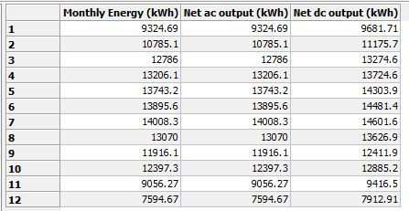
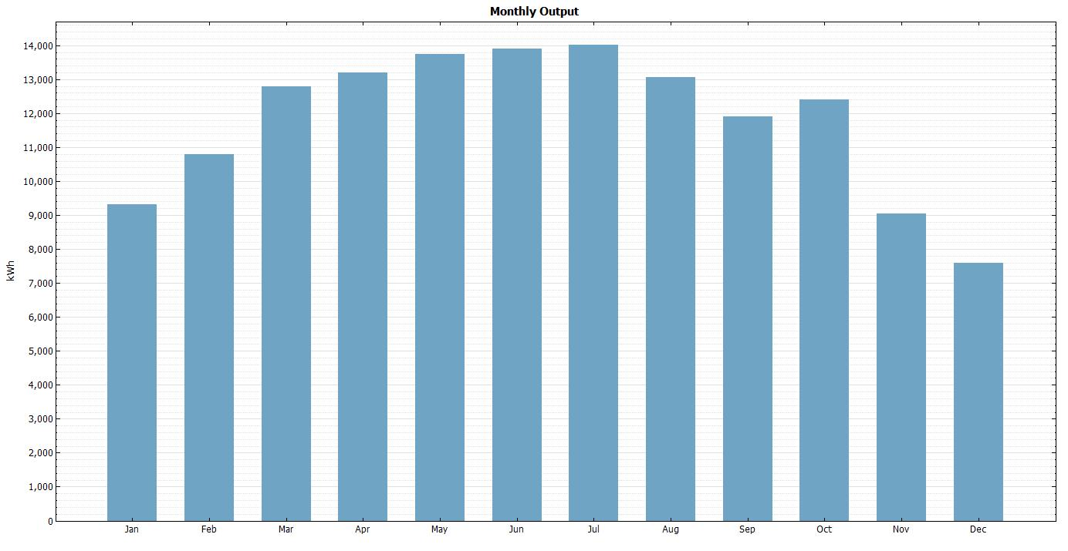
Photovoltaic Array
Peak production of 14,000kWh in July
Monthly Average of 11,820kWh
Total Cost of Array
  $239,680
Assuming $0.09/kWh
  Payback Period of 18 years and 9 months
Project Overview
Lighting Concept
Poker Room
Design Criteria
Lighting Solution
Calculations
Pre-Function
Design Criteria
Lighting Solution
Calculations
Solar Array
Structural Effects
Conclusion

Slide 23
Dead Load
3psf – Suntech panel
5.5psf – Roof Assembly (AISC Table 17-13, 14th Edition
10psf – Superimposed
1.78psf – Vulcraft 1.5B x 22 gauge roof deck
  Total = 21psf
Live Load
30psf - Snow
Roof Deck
Vulcraft 1.5B x 22 gauge
Meets requirements for a 3-span, unshored condition
Current Roof Joist
32LH09
  Span of 60ft, 5’ 8” spacing
Does not meet deflection requirements
New Roof joist
Increase size to 32LH11
  Depth does not change
Project Overview
Lighting Concept
Poker Room
Design Criteria
Lighting Solution
Calculations
Pre-Function
Design Criteria
Lighting Solution
Calculations
Solar Array
Structural Effects
Conclusion

Slide 24
Dead Load
3psf – Suntech panel
5.5psf – Roof Assembly (AISC Table 17-13, 14th Edition
10psf – Superimposed
1.78psf – Vulcraft 1.5B x 22 gauge roof deck
  Total = 21psf
Live Load
30psf - Snow
Joist Girder
60G10N20K
  60” deep, has 10 panels, unfactored point load of 20kips
  Calculations find actual point load of 17.5kips
Third Level Column
W8X48
  Table 4-1, AISC 14th Edition used to evaluate column
  Calculations find column to be adequate
Project Overview
Lighting Concept
Poker Room
Design Criteria
Lighting Solution
Calculations
Pre-Function
Design Criteria
Lighting Solution
Calculations
Solar Array
Structural Effects
Conclusion

Slide 25
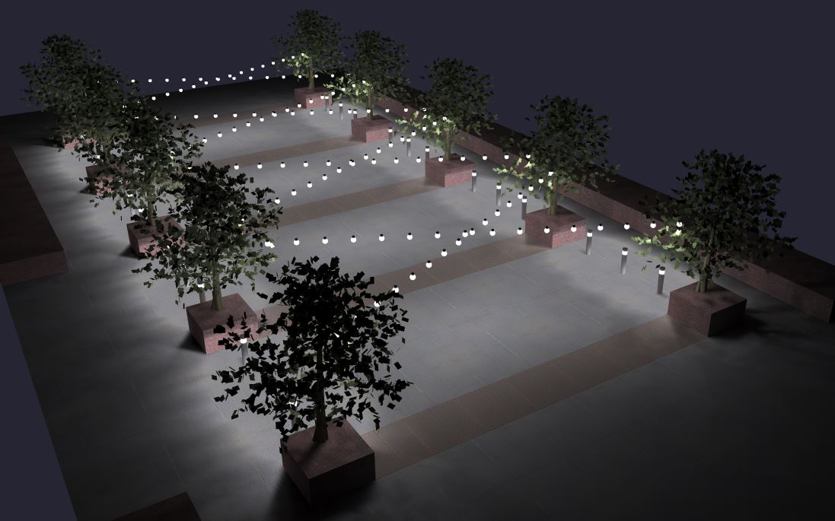
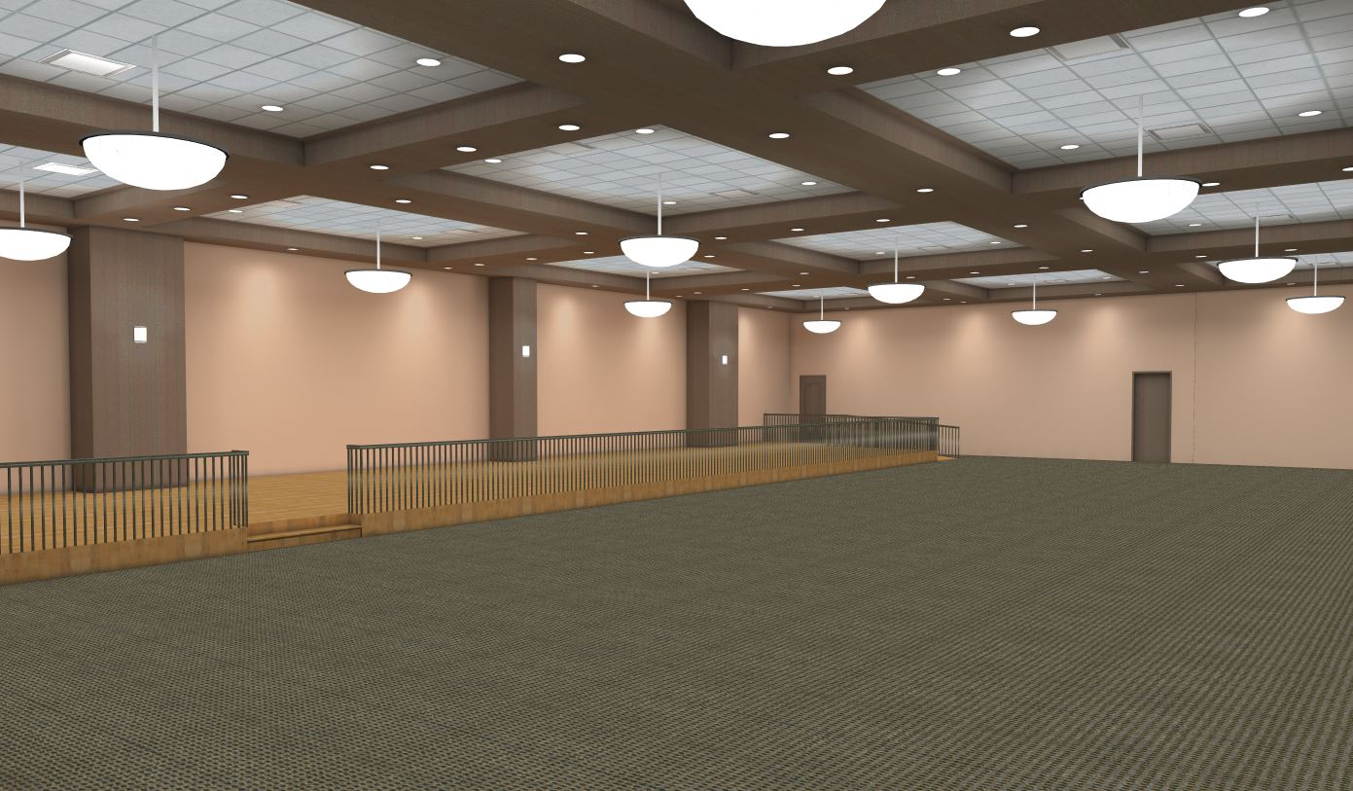
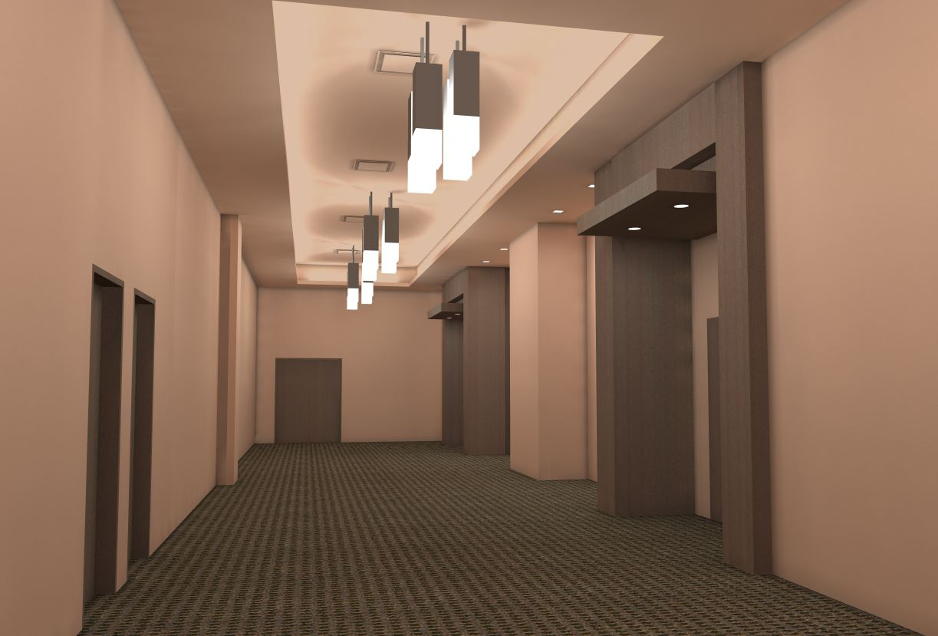
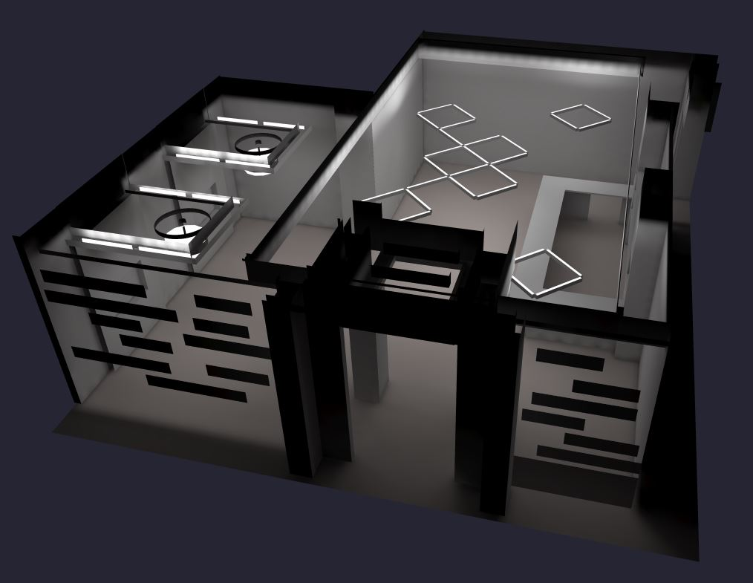
Project Overview
Lighting Concept
Poker Room
Design Criteria
Lighting Solution
Calculations
Pre-Function
Design Criteria
Lighting Solution
Calculations
Solar Array
Structural Effects
Conclusion

