Slide 1
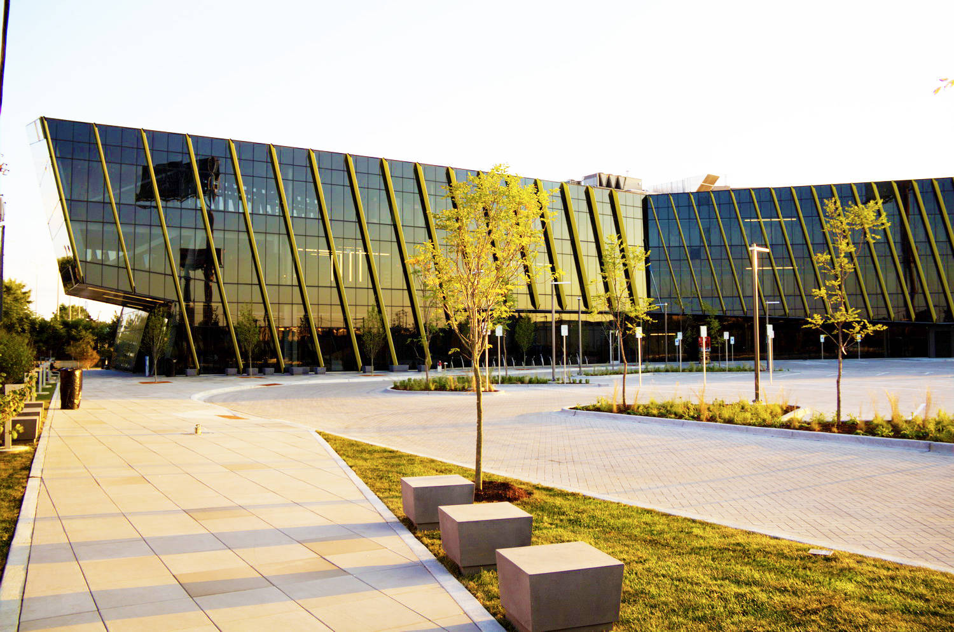

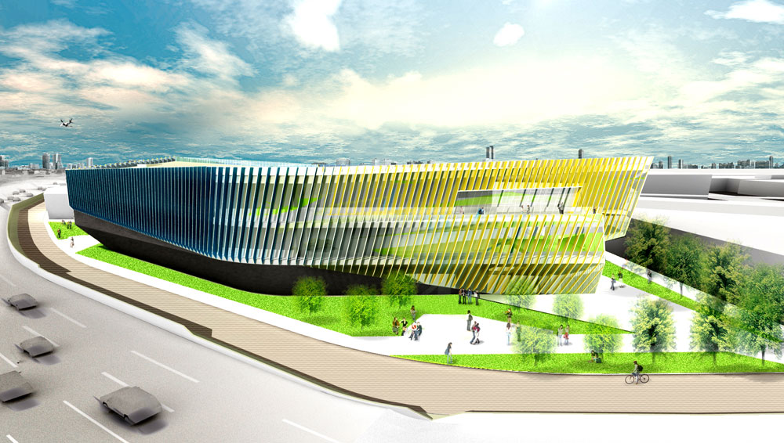
Northeastern Illinois University’s El Centro Building
Chicago, Illinois
Michael Gramarossa, BAE/MAE
Mechanical Option
Advisor: Dr. James Freihaut
JGMA
JGMA

Slide 2
Building Summary
Thesis Objective
Mechanical Depth
Structural Breadth
Electrical Breadth
Evaluation and Conclusion
JGMA
JGMA

Slide 3
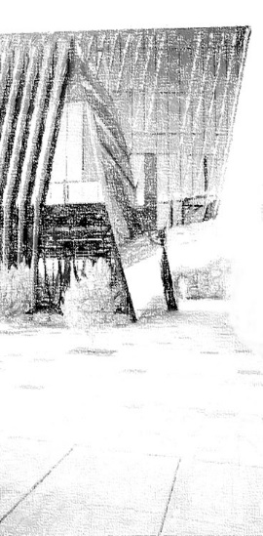
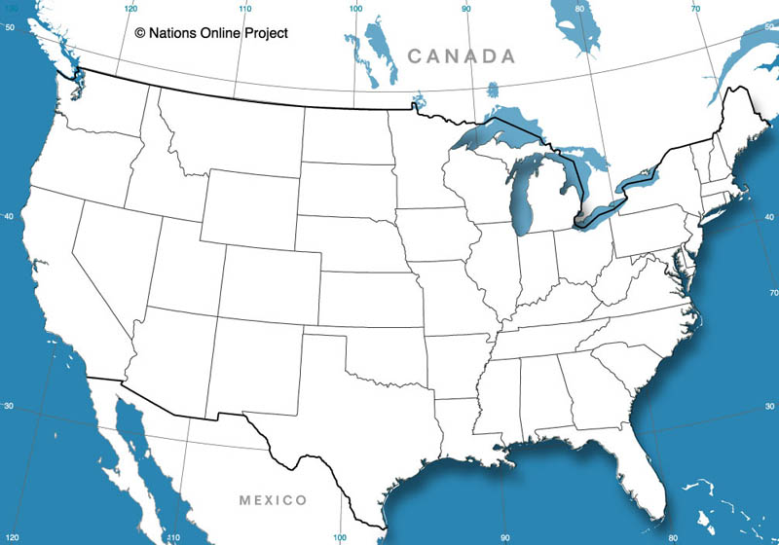

Building Summary
  Overview
  Existing Mechanical System
    Cooling and Ventilation
    Heating
Thesis Objective
Mechanical Depth
Structural Breadth
Electrical Breadth
Evaluation & Conclusion
Site and Location
Chicago Illinois
  Summer: 91.9°F (0.4%)
  Winter -4.0°F (99.6%)
Michael Gramarossa Northeastern Illinois University’s El Centro Mechanical Option

Slide 4
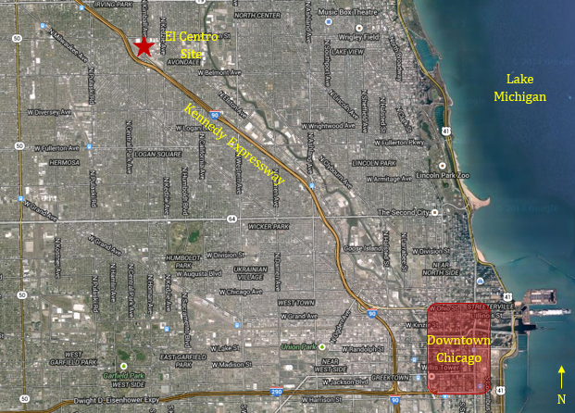
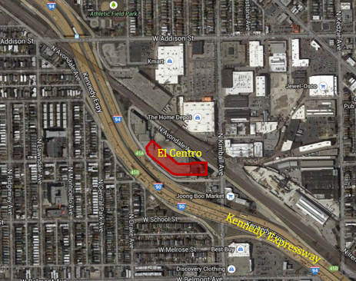
Building Summary
  Overview
  Existing Mechanical System
    Cooling and Ventilation
    Heating
Thesis Objective
Mechanical Depth
Structural Breadth
Electrical Breadth
Evaluation & Conclusion
Site and Location
Chicago Illinois
  Summer: 91.9°F (0.4%)
  Winter -4.0°F (99.6%)
Located along Kennedy Expressway
Michael Gramarossa Northeastern Illinois University’s El Centro Mechanical Option

Slide 5
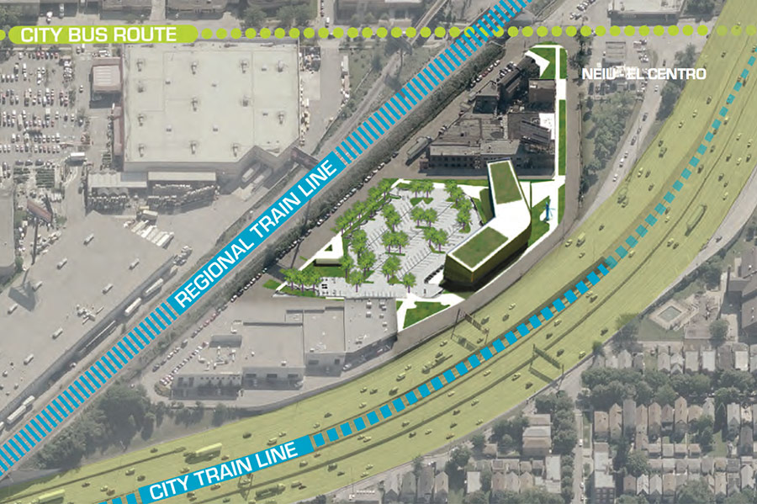
Building Summary
  Overview
  Existing Mechanical System
    Cooling and Ventilation
    Heating
Thesis Objective
Mechanical Depth
Structural Breadth
Electrical Breadth
Evaluation & Conclusion
Site and Location
Chicago Illinois
  Summer: 91.9°F (0.4%)
  Winter -4.0°F (99.6%)
Located along Kennedy Expressway
Passed by 400,000 vehicles each day
archpaper.com
Michael Gramarossa Northeastern Illinois University’s El Centro Mechanical Option

Slide 6
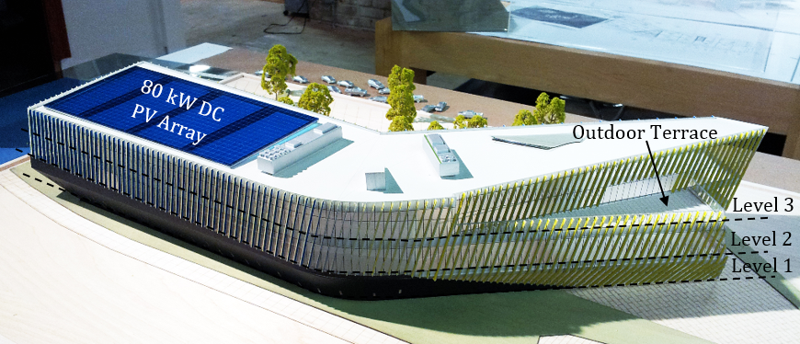
Building Summary
  Overview
  Existing Mechanical System
    Cooling and Ventilation
    Heating
Thesis Objective
Mechanical Depth
Structural Breadth
Electrical Breadth
Evaluation & Conclusion
Architecture and Façade
Recently completed in September 2014
3 stories (no basement)
55,000 ft²
Classrooms, offices, labs, lounges, etc.
JGMA
Michael Gramarossa Northeastern Illinois University’s El Centro Mechanical Option

Slide 7
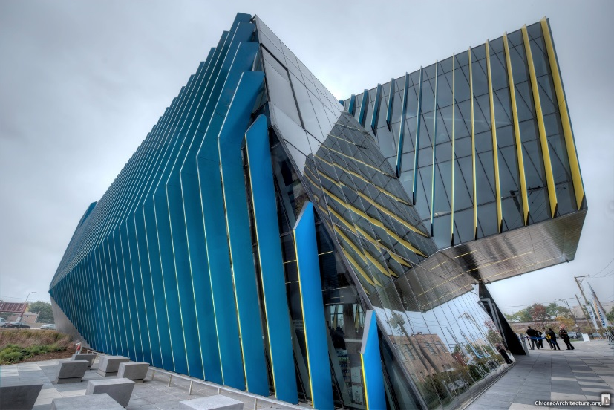
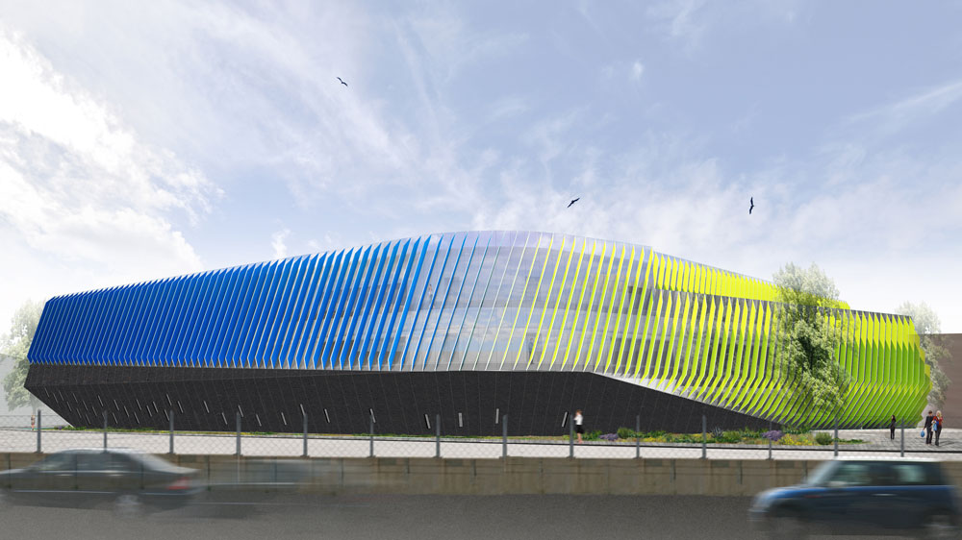
Building Summary
  Overview
  Existing Mechanical System
    Cooling and Ventilation
    Heating
Thesis Objective
Mechanical Depth
Structural Breadth
Electrical Breadth
Evaluation & Conclusion
Architecture and Façade
Recently completed in September 2014
3 stories (no basement)
55,000 ft²
Classrooms, offices, labs, lounges, etc.
Curtain Wall Façade with solar fins
Blue and Gold Fins
JGMA
Chicagoarchitectue.com
JGMA
Michael Gramarossa Northeastern Illinois University’s El Centro Mechanical Option

Slide 8
Building Summary
  Overview
  Existing Mechanical System
    Cooling and Ventilation
    Heating
Thesis Objective
Mechanical Depth
Structural Breadth
Electrical Breadth
Evaluation & Conclusion
Existing Mechanical System
Cooling and Ventilation
[2] 100 ton air handling roof top units (RTUs)
The RTUs supply 55°F air year round
JGMA
Michael Gramarossa Northeastern Illinois University’s El Centro Mechanical Option

Slide 9
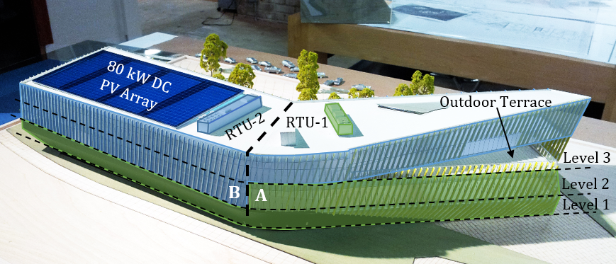
Building Summary
  Overview
  Existing Mechanical System
    Cooling and Ventilation
    Heating
Thesis Objective
Mechanical Depth
Structural Breadth
Electrical Breadth
Evaluation & Conclusion
Existing Mechanical System
Cooling and Ventilation
[2] 100 ton air handling roof top units (RTUs)
The RTUs supply 55°F air year round
RTU-1 & RTU-2
Separate Air Cooled Condensing Units (CU-1 & CU-2)
JGMA
Unit | Area Served (ft²) | Supply Capacity (CFM) | Ventilation (CFM) | Cooling (Ton) | Heating (MBh)
RTU-1 | 24,000 | 38,000 | 12,000 | 100 | 1250
RTU-2 | 27,800 | 38,000 | 12,000 | 100 | 1250
Michael Gramarossa Northeastern Illinois University’s El Centro Mechanical Option

Slide 10
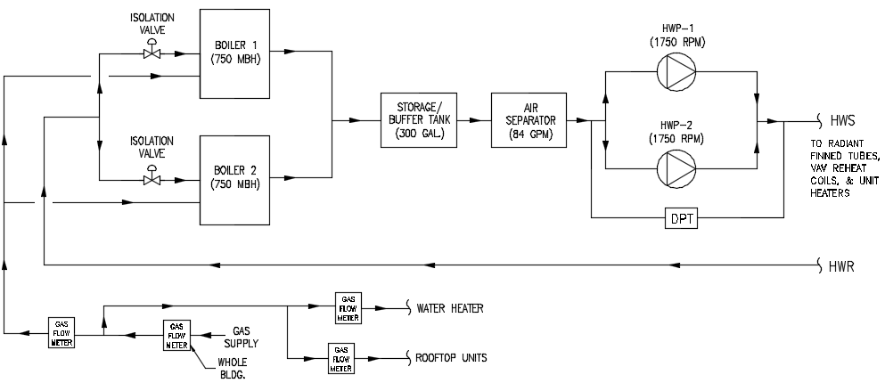
Building Summary
  Overview
  Existing Mechanical System
    Cooling and Ventilation
    Heating
Thesis Objective
Mechanical Depth
Structural Breadth
Electrical Breadth
Evaluation & Conclusion
Existing Mechanical System
Heating
[2] 750 MBh Boilers
Boilers serve 71 VAV reheat coils and hot water radiant finned tubes
Tag | Fuel Type | Rating (MBH) |  | Water Temperature (°F) |  | Flow Rate (GPM) | Min. Thermal Efficiency (%)
 |  | Input | Output | Entering | Leaving
B-1 | NG | 750 | 657 | 130 | 150 | 66 | 90
B-2 | NG | 750 | 657 | 130 | 150 | 66 | 90
Michael Gramarossa Northeastern Illinois University’s El Centro Mechanical Option

Slide 11
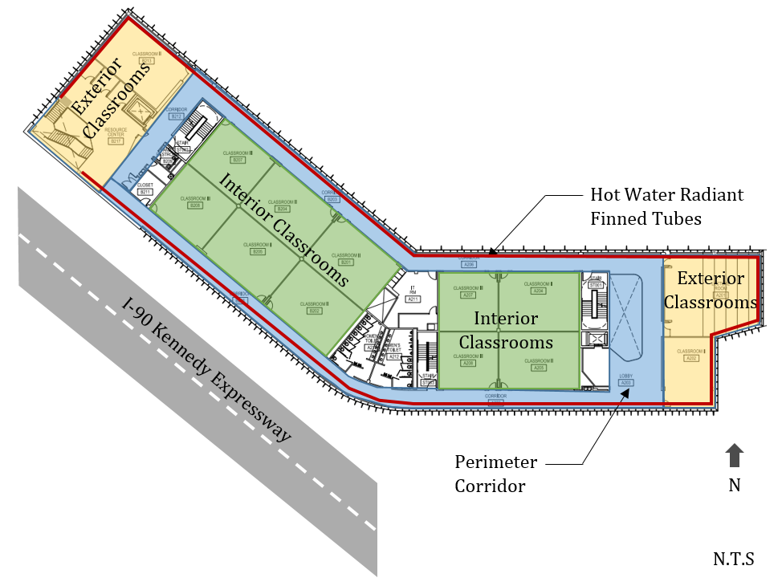
Building Summary
  Overview
  Existing Mechanical System
    Cooling and Ventilation
    Heating
Thesis Objective
Mechanical Depth
Structural Breadth
Electrical Breadth
Evaluation & Conclusion
Existing Mechanical System
Heating
[2] 750 MBh Boilers
Boilers serve 71 VAV reheat coils and hot water radiant finned tubes
Tag | Fuel Type | Rating (MBH) |  | Water Temperature (°F) |  | Flow Rate (GPM) | Min. Thermal Efficiency (%)
 |  | Input | Output | Entering | Leaving
B-1 | NG | 750 | 657 | 130 | 150 | 66 | 90
B-2 | NG | 750 | 657 | 130 | 150 | 66 | 90
Second Floor Plan Hot Water Schematic
Michael Gramarossa Northeastern Illinois University’s El Centro Mechanical Option

Slide 12
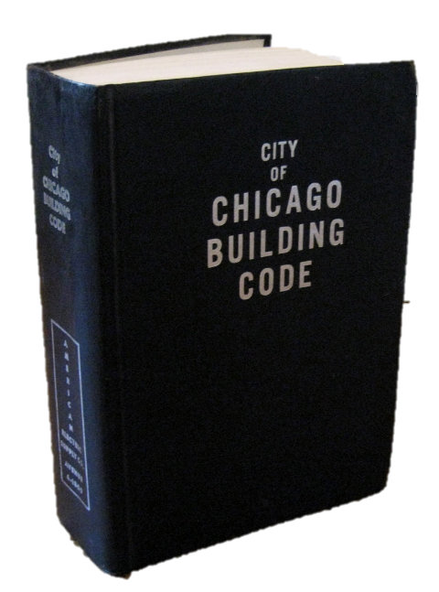
Building Summary
Thesis Objective
Mechanical Depth
Structural Breadth
Electrical Breadth
Evaluation and Conclusion
Thesis Objective
The Chicago Building Code (CBC) requires a certain amount of airflow be supplied to a space regardless of the load
Michael Gramarossa Northeastern Illinois University’s El Centro Mechanical Option

Slide 13
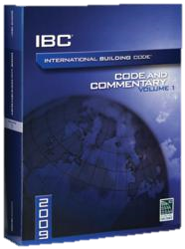
Building Summary
Thesis Objective
Mechanical Depth
Structural Breadth
Electrical Breadth
Evaluation and Conclusion
Thesis Objective
The Chicago Building Code (CBC) requires a certain amount of airflow be supplied to a space regardless of the load
Redesign the current mechanical system according to the International Building Code (IBC)
Michael Gramarossa Northeastern Illinois University’s El Centro Mechanical Option

Slide 14
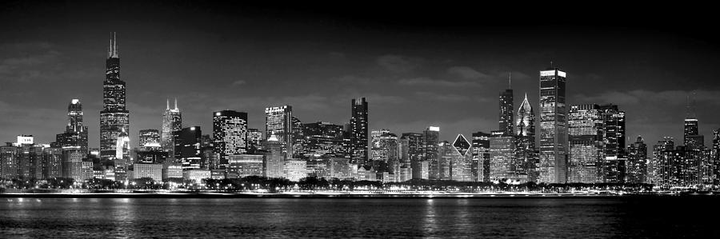
Building Summary
Thesis Objective
Mechanical Depth
Structural Breadth
Electrical Breadth
Evaluation and Conclusion
Thesis Objective
The Chicago Building Code (CBC) requires a certain amount of airflow be supplied to a space regardless of the load
Redesign the current mechanical system according to the International Building Code (IBC)
What are the greater implications if all mechanical systems for commercial buildings in Chicago were designed to the IBC rather than CBC.
fineartamerica.com
Michael Gramarossa Northeastern Illinois University’s El Centro Mechanical Option

Slide 15
Building Summary
Thesis Objective
Mechanical Depth
  RTU Resize
  Energy Savings
  Emission Savings
Structural Breadth
Electrical Breadth
Evaluation and Conclusion
RTU Resize
Ventilation Requirements
System | CBC | IBC/IMC | % Saved
 | Req'd OA (CFM) | Req'd OA (CFM)
RTU-1 Total | 9260 | 5761 | 37.79%
RTU-2 Total | 10890 | 8292 | 23.86%
System Total | 20150 | 14053 | 30.26%
Load Requirements
System | CBC |  | IBC/IMC
 | Cooling (Tons) | Supply Air (CFM) | Cooling (Tons) | Supply Air (CFM)
RTU-1 | 93 | 20,700 | 84 | 20,700
RTU-2 | 97 | 22,100 | 89 | 22,100
Total | 190 | 42,800 | 173 | 42,800
 |  | % Saved | -9.10% | 0%
Michael Gramarossa Northeastern Illinois University’s El Centro Mechanical Option

Slide 16

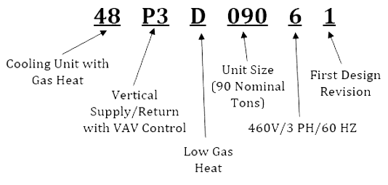
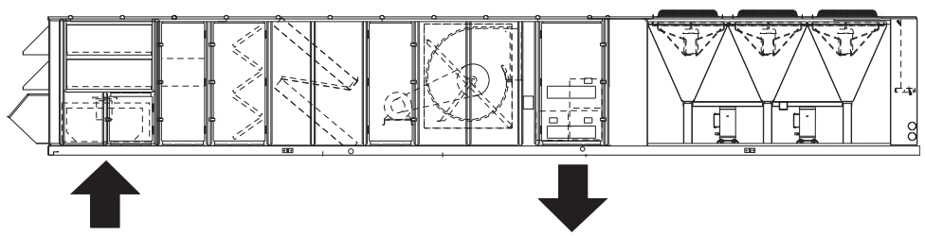
Building Summary
Thesis Objective
Mechanical Depth
  RTU Resize
  Energy Savings
  Emission Savings
Structural Breadth
Electrical Breadth
Evaluation and Conclusion
RTU Resize
Carrier model number chosen
Ventilation Requirements
System | CBC | IBC/IMC | % Saved
 | Req'd OA (CFM) | Req'd OA (CFM)
RTU-1 Total | 9260 | 5761 | 37.79%
RTU-2 Total | 10890 | 8292 | 23.86%
System Total | 20150 | 14053 | 30.26%
Load Requirements
System | CBC |  | IBC/IMC
 | Cooling (Tons) | Supply Air (CFM) | Cooling (Tons) | Supply Air (CFM)
RTU-1 | 93 | 20,700 | 84 | 20,700
RTU-2 | 97 | 22,100 | 89 | 22,100
Total | 190 | 42,800 | 173 | 42,800
 |  | % Saved | -9.10% | 0%
carrier.com
Michael Gramarossa Northeastern Illinois University’s El Centro Mechanical Option

Slide 17
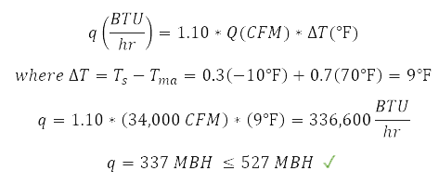
Building Summary
Thesis Objective
Mechanical Depth
  RTU Resize
  Energy Savings
  Emission Savings
Structural Breadth
Electrical Breadth
Evaluation and Conclusion
RTU Resize
Carrier model number chosen
Ventilation Requirements
System | CBC | IBC/IMC | % Saved
 | Req'd OA (CFM) | Req'd OA (CFM)
RTU-1 Total | 9260 | 5761 | 37.79%
RTU-2 Total | 10890 | 8292 | 23.86%
System Total | 20150 | 14053 | 30.26%
Low Gas Heat Capacity: 527 MBH
High Gas Heat Capacity: 790 MBH
Load Requirements
System | CBC |  | IBC/IMC
 | Cooling (Tons) | Supply Air (CFM) | Cooling (Tons) | Supply Air (CFM)
RTU-1 | 93 | 20,700 | 84 | 20,700
RTU-2 | 97 | 22,100 | 89 | 22,100
Total | 190 | 42,800 | 173 | 42,800
 |  | % Saved | -9.10% | 0%
Michael Gramarossa Northeastern Illinois University’s El Centro Mechanical Option

Slide 18
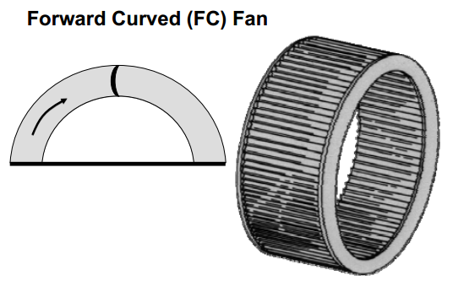
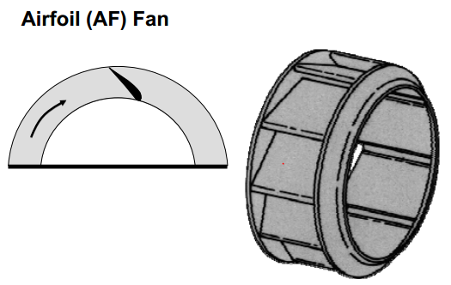
Building Summary
Thesis Objective
Mechanical Depth
  RTU Resize
  Energy Savings
  Emission Savings
Structural Breadth
Electrical Breadth
Evaluation and Conclusion
RTU Resize
Fan Selection
or…
trane.com
trane.com
Michael Gramarossa Northeastern Illinois University’s El Centro Mechanical Option

Slide 19
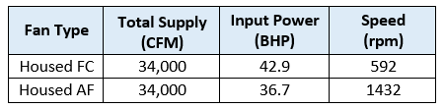
Building Summary
Thesis Objective
Mechanical Depth
  RTU Resize
  Energy Savings
  Emission Savings
Structural Breadth
Electrical Breadth
Evaluation and Conclusion
RTU Resize
Fan Selection
or…
trane.com
trane.com
Michael Gramarossa Northeastern Illinois University’s El Centro Mechanical Option

Slide 20
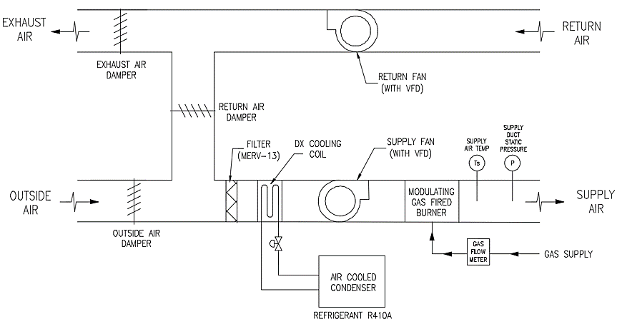
Building Summary
Thesis Objective
Mechanical Depth
  RTU Resize
  Energy Savings
  Emission Savings
Structural Breadth
Electrical Breadth
Evaluation and Conclusion
RTU Resize
RTU Schematic
Michael Gramarossa Northeastern Illinois University’s El Centro Mechanical Option

Slide 21
Building Summary
Thesis Objective
Mechanical Depth
  RTU Resize
  Energy Savings
  Emission Savings
Structural Breadth
Electrical Breadth
Evaluation and Conclusion
RTU Resize
RTU Schematic
Code | RTU Size | Cost (incl. O&P) | Location Factor | Adjusted Cost | Qty. of RTUs | Total Cost
CBC | 105 tons | $252,000 | 113.6% | $286,272 | 2 | $572,544
IBC/IMC | 90 tons | $225,500 | 113.6% | $256,168 | 2 | $512,336
Potential Savings
10.5%
$60,000
Michael Gramarossa Northeastern Illinois University’s El Centro Mechanical Option

Slide 22
Building Summary
Thesis Objective
Mechanical Depth
  RTU Resize
  Energy Savings
  Emission Savings
Structural Breadth
Electrical Breadth
Evaluation and Conclusion
Annual Utility Usage
CBC |  |  | IBC/IMC
Elec Used (kWh) | NG Used (therms) | Total Utility Cost | Elec Used (kWh) | NG Used (therms) | Total Utility Cost
727,000 | 9,600 | $65,500 | 723,000 | 7,400 | $63,700
 |  | Savings | 0.5% | 29.5% | 2.9%
Electricity Cost Savings: 0.5%
Natural Gas Cost Savings: 29.5%
Total Utility Cost Savings: 2.9%
Electric & NG Cost Savings: $1800
Michael Gramarossa Northeastern Illinois University’s El Centro Mechanical Option

Slide 23
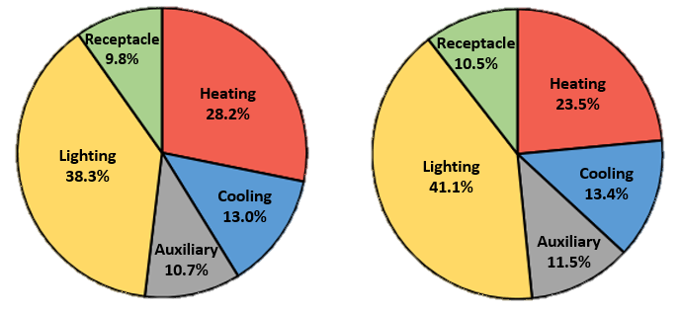
Building Summary
Thesis Objective
Mechanical Depth
  RTU Resize
  Energy Savings
  Emission Savings
Structural Breadth
Electrical Breadth
Evaluation and Conclusion
Annual Utility Usage
Why are there more energy savings in the heating system than the cooling system?
CBC |  |  | IBC/IMC
Elec Used (kWh) | NG Used (therms) | Total Utility Cost | Elec Used (kWh) | NG Used (therms) | Total Utility Cost
727,000 | 9,600 | $65,500 | 723,000 | 7,400 | $63,700
 |  | Savings | 0.5% | 29.5% | 2.9%
CBC
IBC/IMC
Michael Gramarossa Northeastern Illinois University’s El Centro Mechanical Option

Slide 24
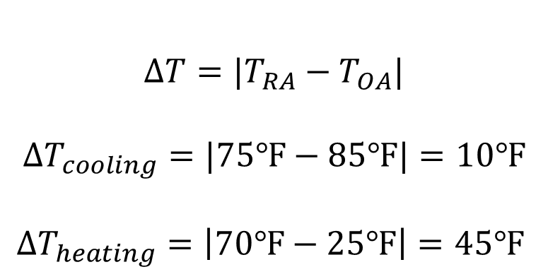
Building Summary
Thesis Objective
Mechanical Depth
  RTU Resize
  Energy Savings
  Emission Savings
Structural Breadth
Electrical Breadth
Evaluation and Conclusion
Annual Utility Usage
Why are there more energy savings in the heating system than the cooling system?
CBC |  |  | IBC/IMC
Elec Used (kWh) | NG Used (therms) | Total Utility Cost | Elec Used (kWh) | NG Used (therms) | Total Utility Cost
727,000 | 9,600 | $65,500 | 723,000 | 7,400 | $63,700
 |  | Savings | 0.5% | 29.5% | 2.9%
Cooling Degree Days | 842
Heating Degree Days | 6311
CBC
IBC/IMC
$$∆T={|T}_{RA}−T_{OA}|$$
$$∆T_{cooling}=|75℉−85℉|=10℉$$
$$∆T_{heating}=\left|70℉−25℉\right|=45℉$$
Michael Gramarossa Northeastern Illinois University’s El Centro Mechanical Option

Slide 25
Building Summary
Thesis Objective
Mechanical Depth
  RTU Resize
  Energy Savings
  Emission Savings
Structural Breadth
Electrical Breadth
Evaluation and Conclusion
Annual Utility Usage
CBC |  |  | IBC/IMC
Elec Used (kWh) | NG Used (therms) | Total Utility Cost | Elec Used (kWh) | NG Used (therms) | Total Utility Cost
727,000 | 9,600 | $65,500 | 723,000 | 7,400 | $63,700
 |  | Savings | 0.5% | 29.5% | 2.9%
CBC
IBC/IMC
Michael Gramarossa Northeastern Illinois University’s El Centro Mechanical Option

Slide 26
Building Summary
Thesis Objective
Mechanical Depth
  RTU Resize
  Energy Savings
  Emission Savings
Structural Breadth
Electrical Breadth
Evaluation and Conclusion
Annual Utility Usage
CBC |  |  | IBC/IMC
Elec Used (kWh) | NG Used (therms) | Total Utility Cost | Elec Used (kWh) | NG Used (therms) | Total Utility Cost
727,000 | 9,600 | $65,500 | 723,000 | 7,400 | $63,700
 |  | Savings | 0.5% | 29.5% | 2.9%
CBC
IBC/IMC
Michael Gramarossa Northeastern Illinois University’s El Centro Mechanical Option

Slide 27
Building Summary
Thesis Objective
Mechanical Depth
  RTU Resize
  Energy Savings
  Emission Savings
Structural Breadth
Electrical Breadth
Evaluation and Conclusion
Emission Savings
Emission Savings ~37,000 lbs. CO_{2e} per year
Michael Gramarossa Northeastern Illinois University’s El Centro Mechanical Option

Slide 28
Building Summary
Thesis Objective
Mechanical Depth
Structural Breadth
  RTU-2
  RTU-1
  Conclusion
Electrical Breadth
Evaluation & Conclusion
Structural Breadth
Will smaller RTU’s designed according to the IBC lead to a reduction in structural steel?
Michael Gramarossa Northeastern Illinois University’s El Centro Mechanical Option

Slide 29
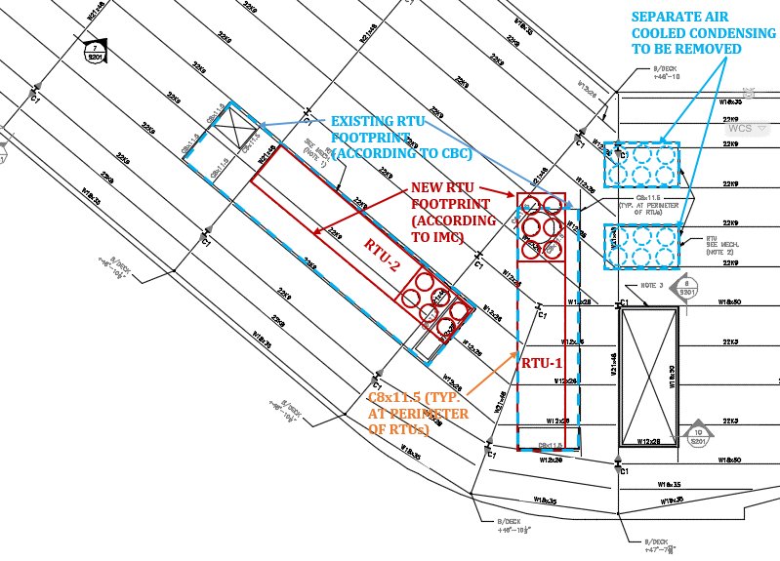
Building Summary
Thesis Objective
Mechanical Depth
Structural Breadth
  RTU-2
  RTU-1
  Conclusion
Electrical Breadth
Evaluation & Conclusion
Structural Breadth
Load Type | Material | Weight (psf)
Dead Load | PVC Roof | 10
 | 1/2" Cover Board | 2
 | R-30 Insulation Board | 2
 | Galvanized Metal Deck | 2
 | Misc. (lights, duct, PV array, etc.) | 10
Live Load or Snow Load | Live Load | 20
 | Snow Load | 25
Total | Dead Load | 26
 | Snow Load | 25
$$1.2\left(26 psf\right)+1.6\left(25 psf\right)=71 psf factored load$$
Michael Gramarossa Northeastern Illinois University’s El Centro Mechanical Option

Slide 30
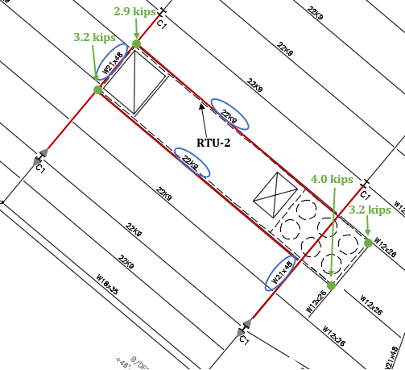
Building Summary
Thesis Objective
Mechanical Depth
Structural Breadth
  RTU-2
  RTU-1
  Conclusion
Electrical Breadth
Evaluation & Conclusion
RTU-2 Analysis
C8x11.5
C8x11.5
N
Michael Gramarossa Northeastern Illinois University’s El Centro Mechanical Option

Slide 31
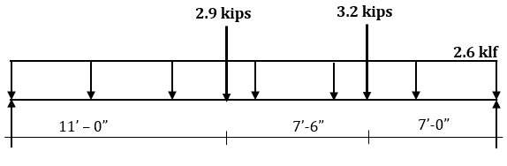
Building Summary
Thesis Objective
Mechanical Depth
Structural Breadth
  RTU-2
  RTU-1
  Conclusion
Electrical Breadth
Evaluation & Conclusion
RTU-2 Analysis
C8x11.5
C8x11.5
N
Michael Gramarossa Northeastern Illinois University’s El Centro Mechanical Option

Slide 32
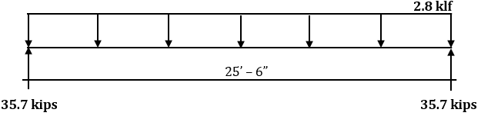
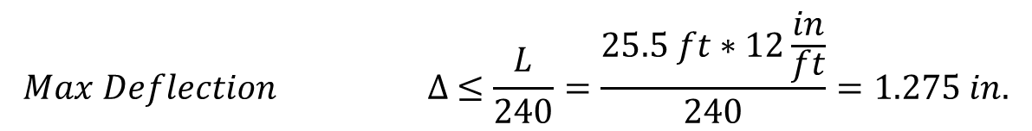
Building Summary
Thesis Objective
Mechanical Depth
Structural Breadth
  RTU-2
  RTU-1
  Conclusion
Electrical Breadth
Evaluation & Conclusion
RTU-2 Analysis
C8x11.5
$$Mid Span Moment M=\frac{wl^{2}}{8}=\frac{\left(2.8 klf\right){\left(25.5 ft\right)}^{2}}{8}=228 kip−ft$$
C8x11.5
$$Max Deflection ∆ ≤\frac{L}{240}=\frac{25.5 ft∗12\frac{in}{ft}}{240}=1.275 in.$$
N
Michael Gramarossa Northeastern Illinois University’s El Centro Mechanical Option

Slide 33
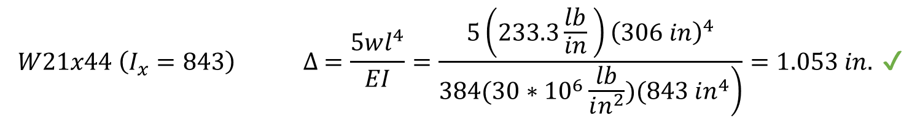

Building Summary
Thesis Objective
Mechanical Depth
Structural Breadth
  RTU-2
  RTU-1
  Conclusion
Electrical Breadth
Evaluation & Conclusion
RTU-2 Analysis
C8x11.5
$$Mid Span Moment M=\frac{wl^{2}}{8}=\frac{\left(2.8 klf\right){\left(25.5 ft\right)}^{2}}{8}=228 kip−ft$$
C8x11.5
$$Max Deflection ∆ ≤\frac{L}{240}=\frac{25.5 ft∗12\frac{in}{ft}}{240}=1.275 in.$$
$$W21x44 \left(I_{x}=843\right) ∆ =\frac{5wl^{4}}{EI}=\frac{5\left(233.3\frac{lb}{in} \right){\left(306 in\right)}^{4}}{\left.384(30∗{10}^{6}\frac{lb}{in^{2}})(843 in^{4}\right)}=1.053 in. ✔$$
N
(Max M = 358 kip-ft)$✔$
Michael Gramarossa Northeastern Illinois University’s El Centro Mechanical Option

Slide 34
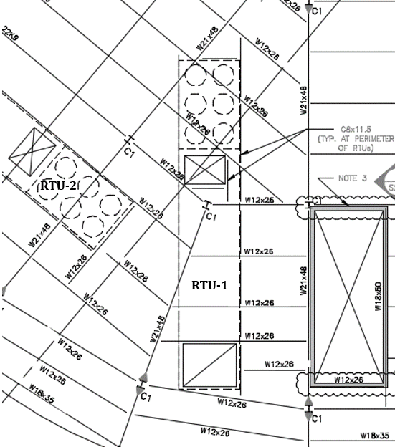
Building Summary
Thesis Objective
Mechanical Depth
Structural Breadth
  RTU-2
  RTU-1
  Conclusion
Electrical Breadth
Evaluation & Conclusion
RTU-1 Analysis
These beams are not reduced in size because the structural engineer did not use a smaller beam than W12x26.
Michael Gramarossa Northeastern Illinois University’s El Centro Mechanical Option

Slide 35
Building Summary
Thesis Objective
Mechanical Depth
Structural Breadth
  RTU-2
  RTU-1
  Conclusion
Electrical Breadth
Evaluation & Conclusion
Structural Breadth Conclusion
Beam Size | Existing Design | New Design | Cost ($/LF)
 | Length (ft) | Length (ft)
C8x11.5 | 151 | 124 | $83.68
W21x44 | 0 | 51 | $84.21
W21x48 | 51 | 0 | $94.34
Total Cost | $17,447 | $14,671
New design leads to $2,800 in savings
Michael Gramarossa Northeastern Illinois University’s El Centro Mechanical Option

Slide 36
Building Summary
Thesis Objective
Mechanical Depth
Structural Breadth
  RTU-2
  RTU-1
  Conclusion
Electrical Breadth
Evaluation & Conclusion
Structural Breadth Conclusion
Structural steel savings are a result of a different design approach.
There would be negligible structural steel savings associated with designing to the IBC rather than the CBC with regards to the mechanical system.
Beam Size | Existing Design | New Design | Cost ($/LF)
 | Length (ft) | Length (ft)
C8x11.5 | 151 | 124 | $83.68
W21x44 | 0 | 51 | $84.21
W21x48 | 51 | 0 | $94.34
Total Cost | $17,447 | $14,671
New design leads to $2,800 in savings
Michael Gramarossa Northeastern Illinois University’s El Centro Mechanical Option

Slide 37
Building Summary
Thesis Objective
Mechanical Depth
Structural Breadth
Electrical Breadth
Evaluation & Conclusion
Electrical Breadth
Will smaller RTU’s designed according to the IBC lead to a reduction in electrical wiring?
Michael Gramarossa Northeastern Illinois University’s El Centro Mechanical Option

Slide 38
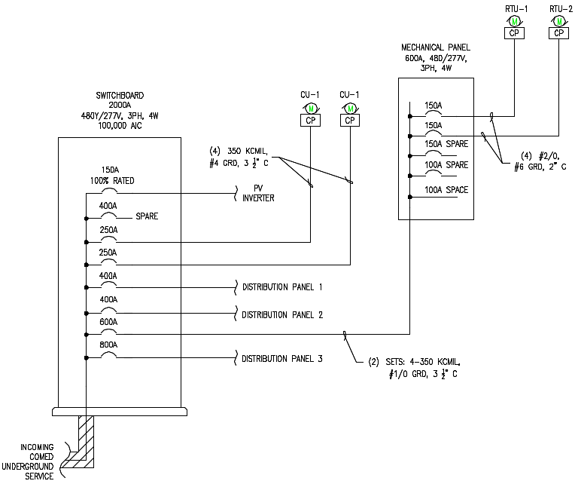
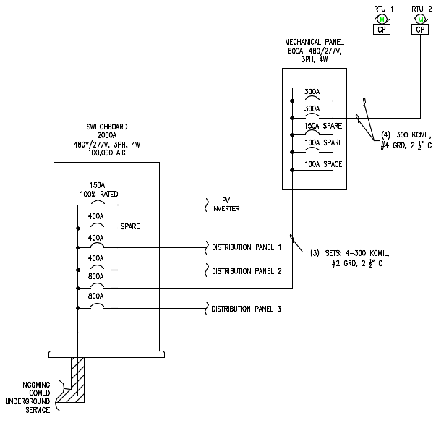
Building Summary
Thesis Objective
Mechanical Depth
Structural Breadth
Electrical Breadth
Evaluation & Conclusion
Electrical Breadth
Existing Design
New Design
Michael Gramarossa Northeastern Illinois University’s El Centro Mechanical Option

Slide 39
Building Summary
Thesis Objective
Mechanical Depth
Structural Breadth
Electrical Breadth
Evaluation & Conclusion
Electrical Breadth
The same as structural, using the IBC in lieu of the CBC will lead to minimal to no electrical cost savings
The savings associated were a result of a different design strategy
New Design
Michael Gramarossa Northeastern Illinois University’s El Centro Mechanical Option

Slide 40
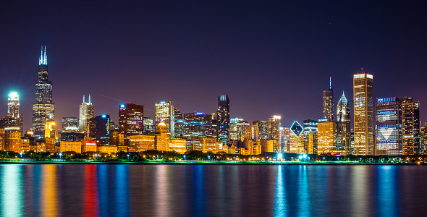
Building Summary
Thesis Objective
Mechanical Depth
Structural Breadth
Electrical Breadth
Evaluation & Conclusion
  City of Chicago Study
  Overall Evaluation
  Acknowledgements
City of Chicago Study
envato.com
Michael Gramarossa Northeastern Illinois University’s El Centro Mechanical Option

Slide 41

Building Summary
Thesis Objective
Mechanical Depth
Structural Breadth
Electrical Breadth
Evaluation & Conclusion
  City of Chicago Study
  Overall Evaluation
  Acknowledgements
City of Chicago Study
Reduce Chicago’s greenhouse gas emissions by 80% below 1990 levels by 2050
    Energy Efficient Buildings (30%)
    Clean & Renewable Energy Sources (34%)
    Improved Transportation Options (23%)
    Reduction Waste & Industrial Pollution (13%)
    Adaptation
envato.com
Michael Gramarossa Northeastern Illinois University’s El Centro Mechanical Option

Slide 42
Building Summary
Thesis Objective
Mechanical Depth
Structural Breadth
Electrical Breadth
Evaluation & Conclusion
  City of Chicago Study
  Overall Evaluation
  Acknowledgements
City of Chicago Study
Chicago Building Energy
$3 billion per year
Potential Savings 2.9%
$87 million per year
envato.com
Michael Gramarossa Northeastern Illinois University’s El Centro Mechanical Option

Slide 43
Building Summary
Thesis Objective
Mechanical Depth
Structural Breadth
Electrical Breadth
Evaluation & Conclusion
  City of Chicago Study
  Overall Evaluation
  Acknowledgements
City of Chicago Study
Chicago Building Energy
$3 billion per year
Potential Savings 2.9%
$87 million per year
Chicago Building Emissions
63 billion lbs. CO_{2e} per year
Potential Savings 2.42%
1.5 billion lbs. CO_{2e} per year
Equivalent to taking 184,000 cars off of the road
Michael Gramarossa Northeastern Illinois University’s El Centro Mechanical Option

Slide 44
Building Summary
Thesis Objective
Mechanical Depth
Structural Breadth
Electrical Breadth
Evaluation & Conclusion
  City of Chicago Study
  Overall Evaluation
  Acknowledgements
Overall Evaluation
  Possible Mechanical First Cost Savings
  No Structural or Electrical Cost Savings
  Energy Cost Savings 2.9%
  Emission Savings 2.42%
Michael Gramarossa Northeastern Illinois University’s El Centro Mechanical Option

Slide 45


Building Summary
Thesis Objective
Mechanical Depth
Structural Breadth
Electrical Breadth
Evaluation & Conclusion
  City of Chicago Study
  Overall Evaluation
  Acknowledgements
Overall Evaluation
  Possible Mechanical First Cost Savings
  No Structural or Electrical Cost Savings
  Energy Cost Savings 2.9%
  Emission Savings 2.42%
  Minimal Impact on a small scale
  Big impact on a large scale
Michael Gramarossa Northeastern Illinois University’s El Centro Mechanical Option

Slide 46

Building Summary
Thesis Objective
Mechanical Depth
Structural Breadth
Electrical Breadth
Evaluation & Conclusion
  City of Chicago Study
  Overall Evaluation
  Acknowledgements
Acknowledgements
  Primera Engineers
  Professor Freihaut
  Penn State AE Faculty and Staff
  Friends and Family
  And of course,
Michael Gramarossa Northeastern Illinois University’s El Centro Mechanical Option

Slide 47
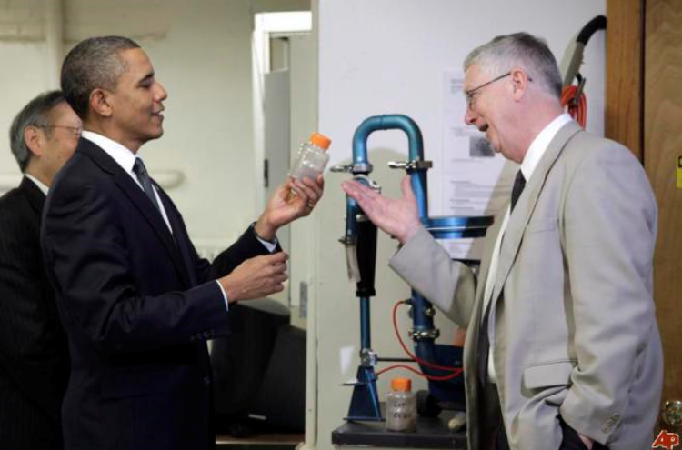
Building Summary
Thesis Objective
Mechanical Depth
Structural Breadth
Electrical Breadth
Evaluation & Conclusion
  City of Chicago Study
  Overall Evaluation
  Acknowledgements
Acknowledgements
  Primera Engineers
  Professor Freihaut
  Penn State AE Faculty and Staff
  Friends and Family
  And of course, President Obama
Michael Gramarossa Northeastern Illinois University’s El Centro Mechanical Option

Slide 48
Questions?
CBC
IBC/IMC
Summary of Savings | Energy Savings |  | Annual Cost Savings |  | Emission Savings
 | % | kBtu/year | % | $/year | % | lbs. CO_{2e}/yr
NEIU El Centro | 6.70% | 232,000 | 2.90% | $1,850 | 2.42% | 33,600
City of Chicago | 6.70% | 10.4 billion | 2.90% | $87 million | 2.42% | 1.5 billion
Michael Gramarossa Northeastern Illinois University’s El Centro Mechanical Option

Slide 49

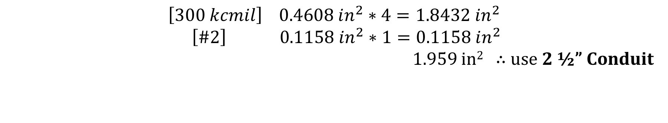
Electrical Appendix
System | Equipment | V/PH/Hz | FLA | MOCP | kVA | Wire (Copper) (THWN) | Ground (Copper) | Conduit (EMT)
Existing | RTU-1 | 460/3/60 | 149 | 150 A | 124 | (4) #2/0 | #6 | 2"
 | RTU-2 | 460/3/60 | 149 | 150 A | 124 | (4) #2/0 | #6 | 2"
 | CU-1 | 460/3/60 | 227 | 250 A | 189 | (4) 350 kcmil | #4 | 3 1/2"
 | CU-2 | 460/3/60 | 227 | 250 A | 189 | (4) 350 kcmil | #4 | 3 1/2"
New | RTU-1 | 460/3/60 | 257 | 300 A | 214 | (4) 300 kcmil | #4 | 2 1/2"
 | RTU-2 | 460/3/60 | 257 | 300 A | 214 | (4) 300 kcmil | #4 | 2 1/2"
System | Panel Label | Equipment Served | Voltage | FLA | kVA | MOCP | Feeder Size (Copper, THWN, EMT)
Existing | DPM3-1 | RTU-1 & RTU-2 | 480/277 | 298 | 248 | 600 A | (2) sets: 4-350 kcmil, #1/0 Grd, 3 1/2" C
New | DPM3-1 | RTU-1 & RTU-2 | 480/277 | 514 | 428 | 800 A | (3) sets: 4-300 kcmil, #2 Grd, 2 1/2" C
Table 27 – Existing and New Feeder Sizing for RTUs
$$\left[300 kcmil\right] 0.4608 in^{2}∗4=1.8432 in^{2}$$
$$\left[\#2\right] 0.1158 in^{2}∗1=0.1158 in^{2}$$
1.959 in² ∴ use 2 ½” Conduit
Table 26 – Existing and New Branch Wire Sizing for RTUs
$$\left[300 kcmil\right] 0.4608 in^{2}∗4=1.8432 in^{2}$$
$$\left[\#4\right] 0.0824 in^{2}∗1=0.0824 in^{2}$$
1.9256 in² ∴ use 2 ½” Conduit
Michael Gramarossa Northeastern Illinois University’s El Centro Mechanical Option

Slide 50
City of Chicago Appendix
Total Amount Chicago Spends on Building Energy ($) | Potential Savings (%) | Potential Savings ($)
$3 billion | 2.90% | $87 million
Rank | City | Country | No. of Skyscrapers
1 | Hong Kong | China | 302
2 | New York City | United States | 235
3 | Dubai | United Arab Emirates | 148
4 | Shanghai | China | 126
5 | Chicago | United States | 115
6 | Tokyo | Japan | 112
7 | Chongqing | China | 94
8 | Guangzhou | China | 93
9 | Shenzhen | China | 83
10 | Singapore | Singapore | 79
Unit | Total Pollutants Produced by Chicago Buildings (CO_{2e}/year) | Potential Savings (%) | Potential Savings (CO_{2e}/year)
lbs. CO_{2e}/year | 63 billion lbs. | 2.42% | 1.5 billion lbs.
tons CO_{2e}/year | 31.6 million tons | 2.42% | 765,000 tons
Equivalent of Cars on the Road per year | 7.6 million cars | 2.42% | 184,000 cars
Total Amount of Energy Used by Chicago Buildings (kBtu/year) | Potential Savings (%) | Potential Savings ($/year)
155 billion kBtu | 6.70% | 10.4 billion kBtu
Building Type | kBTU/ft²/yr
Large Office | 43
Medium Office | 48
Small Office | 51
Warehouse | 24
Stand-alone Retail | 81
Strip Mall | 85
Primary School | 65
Secondary School | 76
Supermarket | 195
Quick Service Restaurant | 657
Hospital | 148
Outpatient Facility | 271
Small Hotel | 80
Large Hotel | 138
Mid-Rise Apartment | 47
NEIU El Centro* | 62
Michael Gramarossa Northeastern Illinois University’s El Centro Mechanical Option

