Slide 1
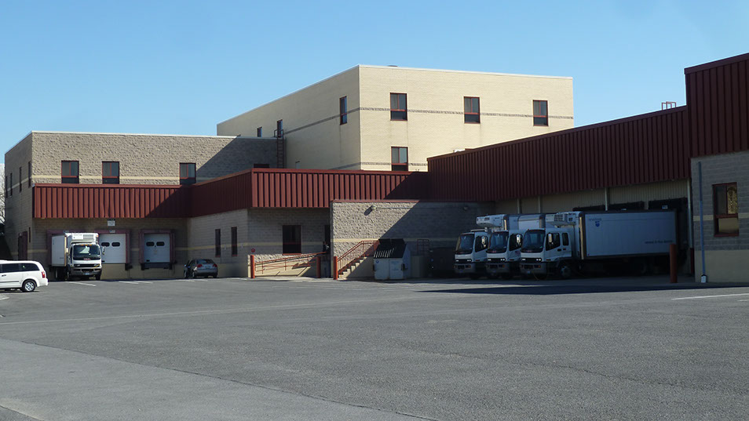

The Housing and Food Service Warehouse and Bakery Expansion
Penn State AE
Senior Capstone Project
Joseph Rutt
Construction Option
Advisor: anumba
April 13th, 2016

Slide 2



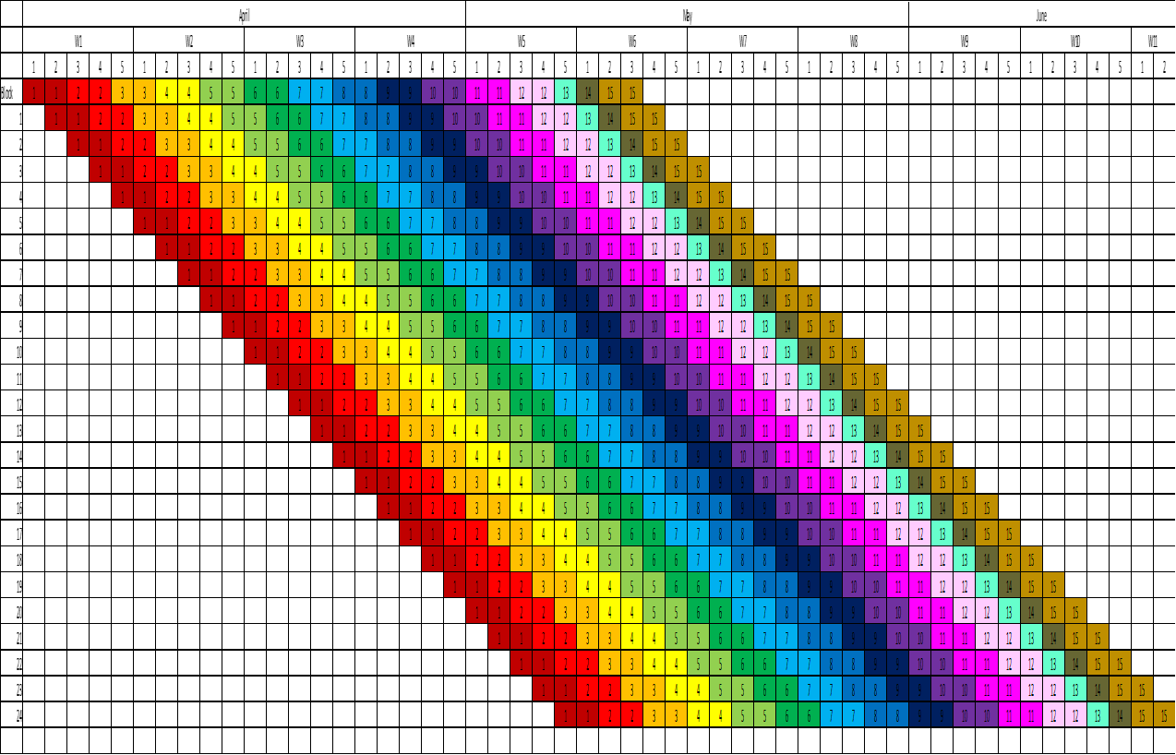
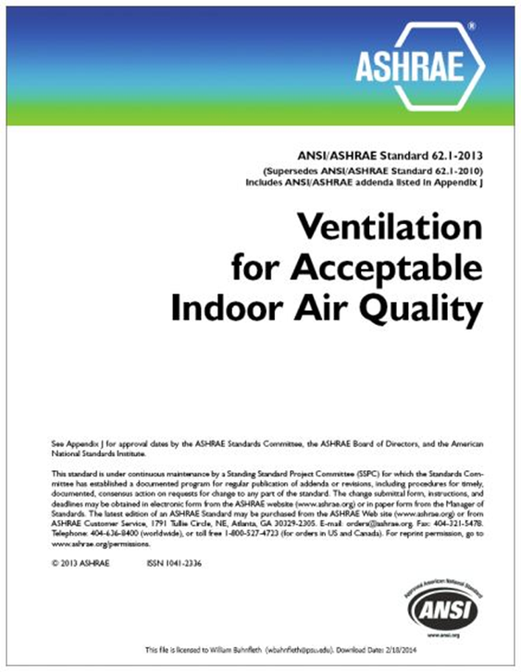
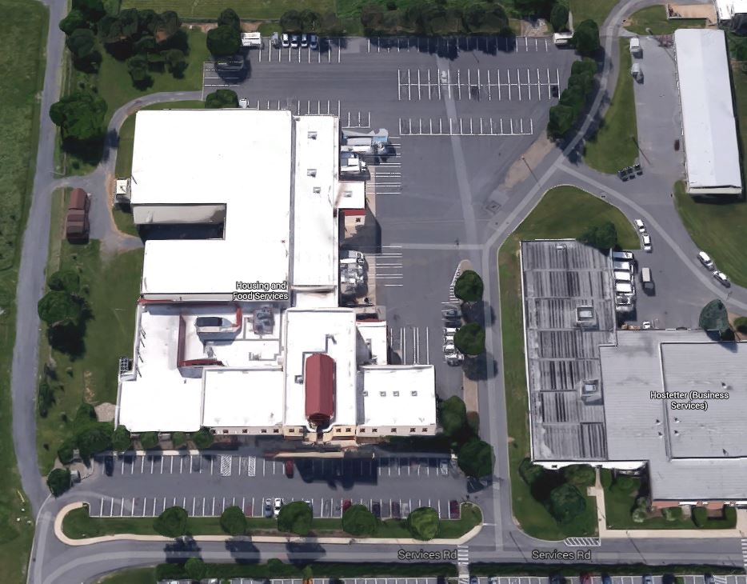
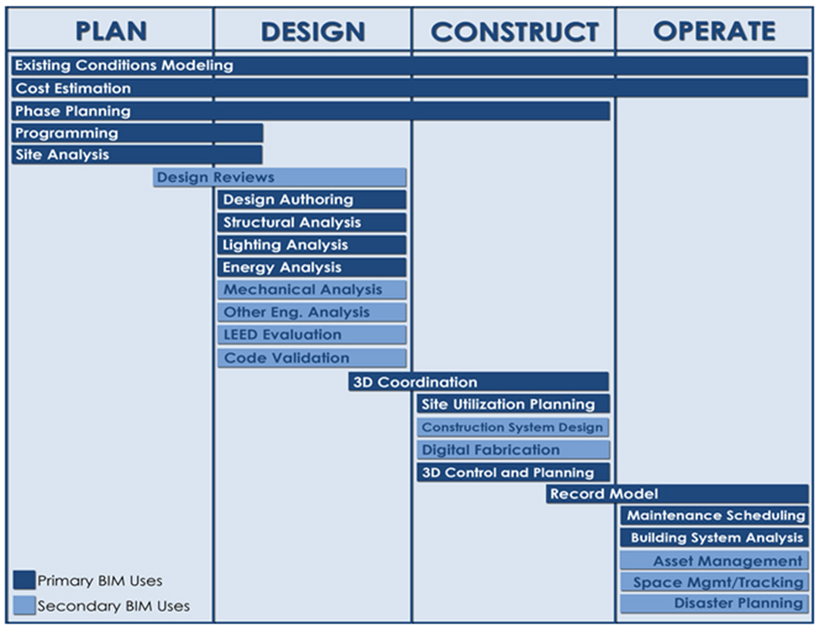

Introduction
The HFS Warehouse and Bakery
Addition & Renovation
Joseph Rutt│ Construction Option
`
Presentation Outline:
I. Introduction
II. Project Overview
III. Analysis #1: Rooftop Solar Panels
  In-Place vs. Virtual Mockups
  Virtual Mockup Development
  Virtual Mockup Implementation
  Conclusion & Recommendation
IV. Analysis #2: Façade Prefabrication
  Current vs. Prefabricated Façade
  Mechanical Breadth Analysis
  Schedule, Cost & Site Logistics
  Conclusion & Recommendations
V. Analysis #3: Revaluating Composite Slab
  Lightweight vs. Normal Concrete
  Structural Breadth Analysis
  Project Impacts
  Conclusion & Recommendations
VI. Final Recommendations
VII. Acknowledgements
Presentation Outline:
I. Introduction
II. Project Overview
III. Analysis #1: SIPS Analysis
IV. Analysis #2: BIM Utilization
V. Analysis #3: Indoor Air Quality
VI. Analysis #4: LEED Certification
VII. Final Recommendations
VIII. Acknowledgements
Analysis 1 │ SIPS Analysis
Analysis 3 │Indoor Air Quality
Project Overview
Analysis 2 │BIM Utilization
Analysis 4 │LEED Certification
ASHRAE
Googlemaps.com
The Pennsylvania State University BIM Execution Planning Guide
LEED USGBC
April 13, 2016

Slide 3
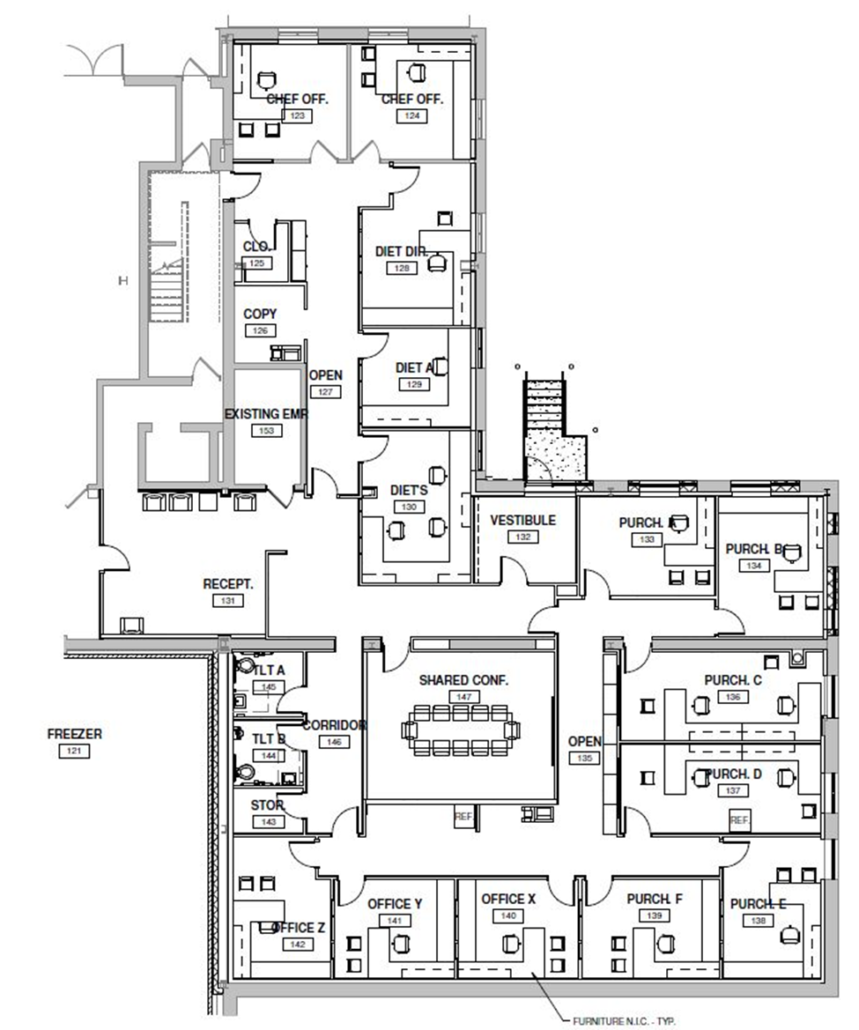
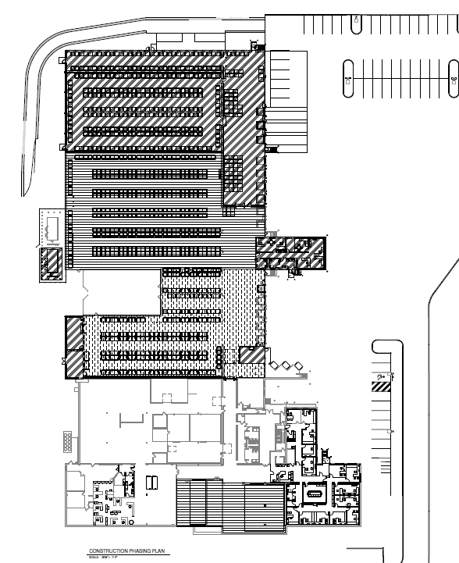
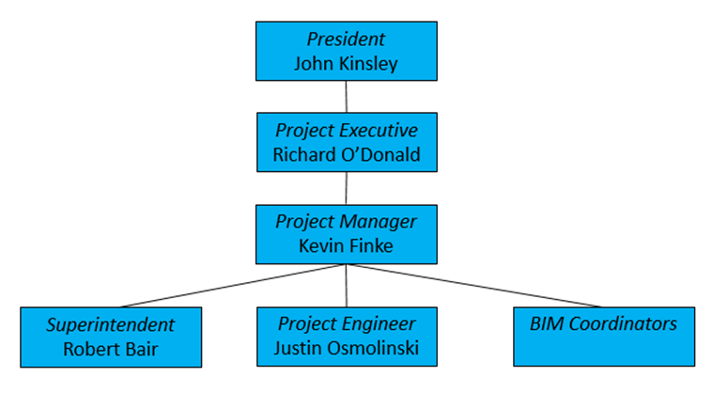
Project Background
The HFS Warehouse and Bakery
Addition & Renovation
Joseph Rutt│ Construction Option
Presentation Outline:
I. Introduction
II. Project Overview
III. Analysis #1: Virtual Mockups
  In-Place vs. Virtual Mockups
  Virtual Mockup Development
  Virtual Mockup Implementation
  Conclusion & Recommendation
IV. Analysis #2: Façade Prefabrication
  Current vs. Prefabricated Façade
  Mechanical Breadth Analysis
  Schedule, Cost & Site Logistics
  Conclusion & Recommendations
V. Analysis #3: Revaluating Composite Slab
  Lightweight vs. Normal Concrete
  Structural Breadth Analysis
  Project Impacts
  Conclusion & Recommendations
VI. Final Recommendations
VII. Acknowledgements
Presentation Outline:
I. Introduction
II. Project Overview
  Project Background
III. Analysis #1: SIPS Analysis
IV. Analysis #2: BIM Utilization
V. Analysis #3: Indoor Air Quality
VI. Analysis #4: LEED Certification
VII. Final Recommendations
VIII. Acknowledgements
Kinsley Construction
Building Information:
  Original Size 94,000SF
  44,500SF renovation of existing building
  25,000SF Warehouse addition
  Approximately $13 Million Project
  March 2015 – March 2016
  Design Build
April 13, 2016
Notes:
4 classroom school in 1870
Addition in 1950s to k-8
Closed in 2008 due to high cost of hvac

Slide 4
The HFS Warehouse and Bakery
Addition & Renovation
Joseph Rutt│ Construction Option
Presentation Outline:
I. Introduction
II. Project Overview
III. Analysis #1: Virtual Mockups
  In-Place vs. Virtual Mockups
  Virtual Mockup Development
  Virtual Mockup Implementation
  Conclusion & Recommendation
IV. Analysis #2: Façade Prefabrication
  Current vs. Prefabricated Façade
  Mechanical Breadth Analysis
  Schedule, Cost & Site Logistics
  Conclusion & Recommendations
V. Analysis #3: Revaluating Composite Slab
  Lightweight vs. Normal Concrete
  Structural Breadth Analysis
  Project Impacts
  Conclusion & Recommendations
VI. Final Recommendations
VII. Acknowledgements
Presentation Outline:
I. Introduction
II. Project Overview
III. Analysis #1: SIPS Analysis
  Problem Identification
  Schedule Matrix
  Feasibility Analysis
  Recommendation
IV. Analysis #2: BIM Utilization
V. Analysis #3: Indoor Air Quality
VI. Analysis #4: LEED Certification
VII. Final Recommendations
VIII. Acknowledgements
Analysis #1
SIPS Analysis
April 13, 2016

Slide 5
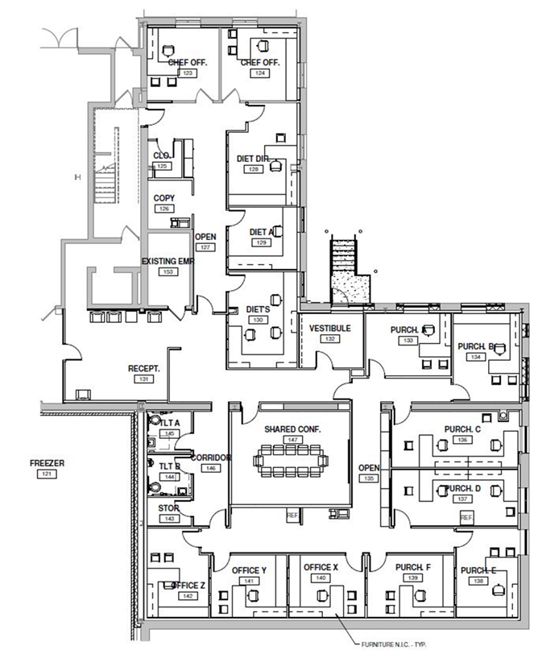
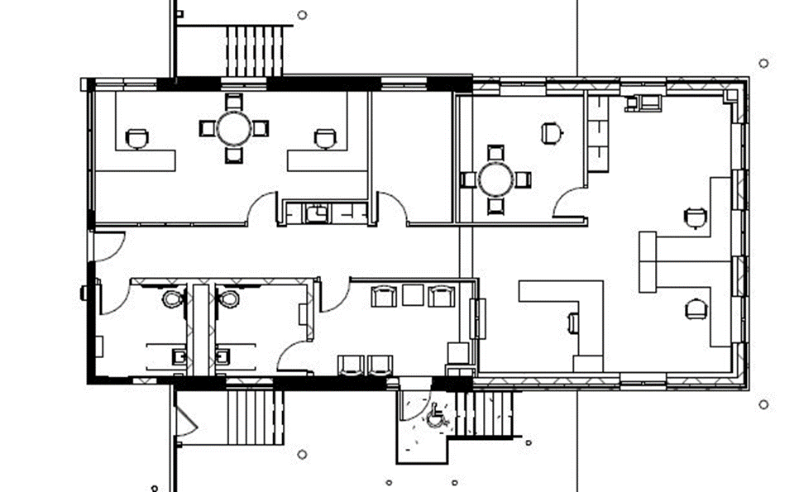
SIPS Schedule
The HFS Warehouse and Bakery
Addition & Renovation
Joseph Rutt│ Construction Option
Presentation Outline:
I. Introduction
II. Project Overview
III. Analysis #1: Virtual Mockups
  In-Place vs. Virtual Mockups
  Virtual Mockup Development
  Virtual Mockup Implementation
  Conclusion & Recommendation
IV. Analysis #2: Façade Prefabrication
  Current vs. Prefabricated Façade
  Mechanical Breadth Analysis
  Schedule, Cost & Site Logistics
  Conclusion & Recommendations
V. Analysis #3: Revaluating Composite Slab
  Lightweight vs. Normal Concrete
  Structural Breadth Analysis
  Project Impacts
  Conclusion & Recommendations
VI. Final Recommendations
VII. Acknowledgements
Presentation Outline:
I. Introduction
II. Project Overview
III. Analysis #1: SIPS Analysis
  Problem Identification
  Schedule Matrix
  Feasibility Analysis
  Recommendation
IV. Analysis #2: BIM Utilization
V. Analysis #3: Indoor Air Quality
VI. Analysis #4: LEED Certification
VII. Final Recommendations
VIII. Acknowledgements
Problem Identification:
  Cannot occupy office space during renovations
  Renovations during two different phases
Proposed Solution:
  SIPS Analysis of office renovation
Research Goal:
  Decrease time to renovate offices
  Schedule Matrix
April 13, 2016
Notes:
7 apts for 30% below medium income
20 for 50%
21 for 60%
5 for homeless

Slide 6
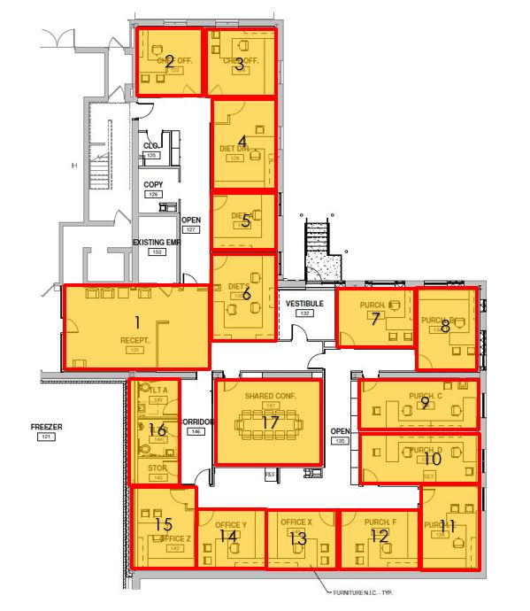
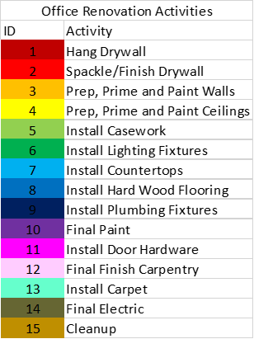
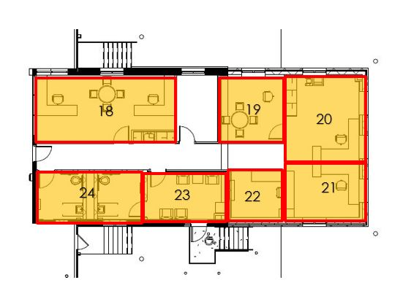
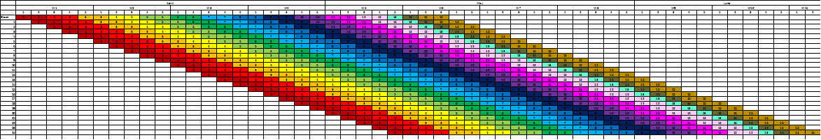
Schedule Matrix
The HFS Warehouse and Bakery
Addition & Renovation
Joseph Rutt│ Construction Option
Presentation Outline:
I. Introduction
II. Project Overview
III. Analysis #1: Virtual Mockups
  In-Place vs. Virtual Mockups
  Virtual Mockup Development
  Virtual Mockup Implementation
  Conclusion & Recommendation
IV. Analysis #2: Façade Prefabrication
  Current vs. Prefabricated Façade
  Mechanical Breadth Analysis
  Schedule, Cost & Site Logistics
  Conclusion & Recommendations
V. Analysis #3: Revaluating Composite Slab
  Lightweight vs. Normal Concrete
  Structural Breadth Analysis
  Project Impacts
  Conclusion & Recommendations
VI. Final Recommendations
VII. Acknowledgements
Presentation Outline:
I. Introduction
II. Project Overview
III. Analysis #1: SIPS Analysis
  Problem Identification
  Schedule Matrix
  Feasibility Analysis
  Recommendation
IV. Analysis #2: BIM Utilization
V. Analysis #3: Indoor Air Quality
VI. Analysis #4: LEED Certification
VII. Final Recommendations
VIII. Acknowledgements
April 13, 2016

Slide 7
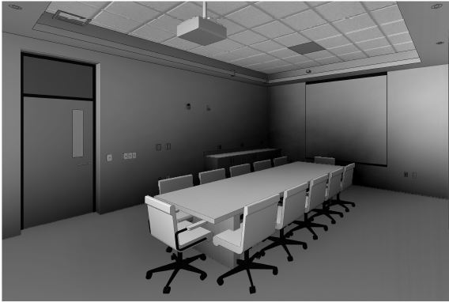
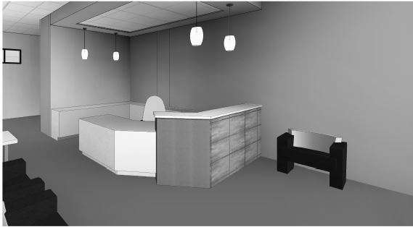
Feasibility Analysis
The HFS Warehouse and Bakery
Addition & Renovation
Joseph Rutt│ Construction Option
Presentation Outline:
I. Introduction
II. Project Overview
III. Analysis #1: Virtual Mockups
  In-Place vs. Virtual Mockups
  Virtual Mockup Development
  Virtual Mockup Implementation
  Conclusion & Recommendation
IV. Analysis #2: Façade Prefabrication
  Current vs. Prefabricated Façade
  Mechanical Breadth Analysis
  Schedule, Cost & Site Logistics
  Conclusion & Recommendations
V. Analysis #3: Revaluating Composite Slab
  Lightweight vs. Normal Concrete
  Structural Breadth Analysis
  Project Impacts
  Conclusion & Recommendations
VI. Final Recommendations
VII. Acknowledgements
Presentation Outline:
I. Introduction
II. Project Overview
III. Analysis #1: SIPS Analysis
  Problem Identification
  Schedule Matrix
  Feasibility Analysis
  Recommendation
IV. Analysis #2: BIM Utilization
V. Analysis #3: Indoor Air Quality
VI. Analysis #4: LEED Certification
VII. Final Recommendations
VIII. Acknowledgements
Schedule:
  About 5 weeks to completely finish one room
  Total of 10 weeks and 2 days to complete
  Finished 5 weeks ahead of the 16 week schedule
  Renovation of both office space during Phase 3
Provided by Kinsley Construction
Provided by Kinsley Construction
April 13, 2016

Slide 8
Recommendations
The HFS Warehouse and Bakery
Addition & Renovation
Joseph Rutt│ Construction Option
Presentation Outline:
I. Introduction
II. Project Overview
III. Analysis #1: Virtual Mockups
  In-Place vs. Virtual Mockups
  Virtual Mockup Development
  Virtual Mockup Implementation
  Conclusion & Recommendation
IV. Analysis #2: Façade Prefabrication
  Current vs. Prefabricated Façade
  Mechanical Breadth Analysis
  Schedule, Cost & Site Logistics
  Conclusion & Recommendations
V. Analysis #3: Revaluating Composite Slab
  Lightweight vs. Normal Concrete
  Structural Breadth Analysis
  Project Impacts
  Conclusion & Recommendations
VI. Final Recommendations
VII. Acknowledgements
Presentation Outline:
I. Introduction
II. Project Overview
III. Analysis #1: SIPS Analysis
  Problem Identification
  Schedule Matrix
  Feasibility Analysis
  Recommendation
IV. Analysis #2: BIM Utilization
V. Analysis #3: Indoor Air Quality
VI. Analysis #4: LEED Certification
VII. Final Recommendations
VIII. Acknowledgements
Recommendation:
  Implement the SIPS Analysis for office renovations
Potential Value Added:
  Occupant Satisfaction
  Organized trades
  Decreased schedule
Schedule Impact:
  Decreased schedule by 37 Days
Manpower
Schedule
16 Weeks
29
25
11 Weeks
April 13, 2016

Slide 9
The HFS Warehouse and Bakery
Addition & Renovation
Joseph Rutt│ Construction Option
Presentation Outline:
I. Introduction
II. Project Overview
III. Analysis #1: Virtual Mockups
  In-Place vs. Virtual Mockups
  Virtual Mockup Development
  Virtual Mockup Implementation
  Conclusion & Recommendation
IV. Analysis #2: Façade Prefabrication
  Current vs. Prefabricated Façade
  Mechanical Breadth Analysis
  Schedule, Cost & Site Logistics
  Conclusion & Recommendations
V. Analysis #3: Revaluating Composite Slab
  Lightweight vs. Normal Concrete
  Structural Breadth Analysis
  Project Impacts
  Conclusion & Recommendations
VI. Final Recommendations
VII. Acknowledgements
Presentation Outline:
I. Introduction
II. Project Overview
III. Analysis #1: SIPS Analysis
IV. Analysis #2: BIM Utilization
  Problem Identification
  Feasibility Analysis
  Recommendation
V. Analysis #3: Indoor Air Quality
VI. Analysis #4: LEED Certification
VII. Final Recommendations
VIII. Acknowledgements
Analysis #2
BIM Utilization
April 13, 2016

Slide 10
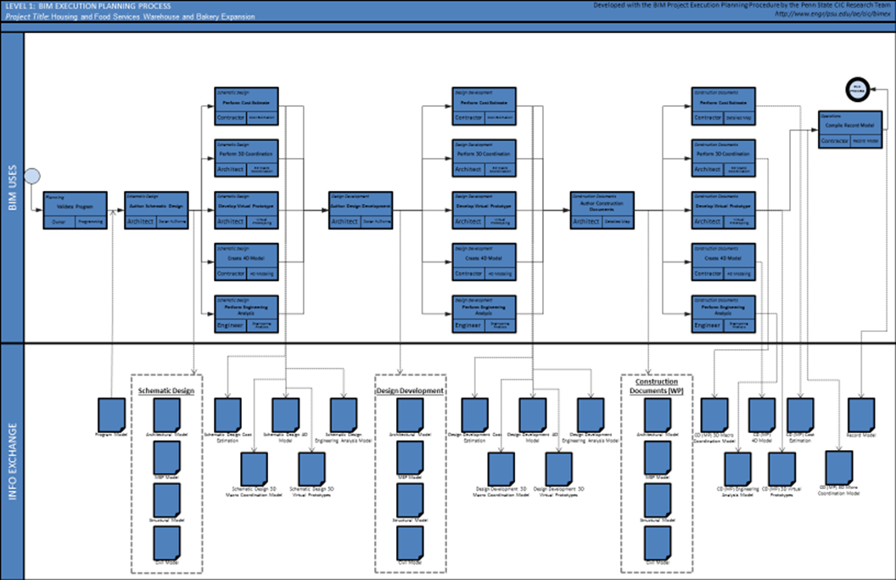
BIM Utilization
The HFS Warehouse and Bakery
Addition & Renovation
Joseph Rutt│ Construction Option
Presentation Outline:
I. Introduction
II. Project Overview
III. Analysis #1: SIPS Analysis
IV. Analysis #2: BIM Utilization
  Problem Identification
  Feasibility Analysis
  Recommendation
V. Analysis #3: Indoor Air Quality
VI. Analysis #4: LEED Certification
VII. Final Recommendations
VIII. Acknowledgements
Problem Identification:
  BIM was not used on this project
  Many RFI’s and ASI’s
  Large contingency held
Proposed Solution:
  3D and 4D coordination
Potential Outcomes:
  Cost of creating 3D and 4D model is too high
    outweighs the costs saved from the use of BIM.
  Amount of time saved by limiting RFI’s is substantial and therefore BIM should be utilized.
  Amount of time added by the creation of the 3D and 4D model is more than the time saved.
April 13, 2016

Slide 11
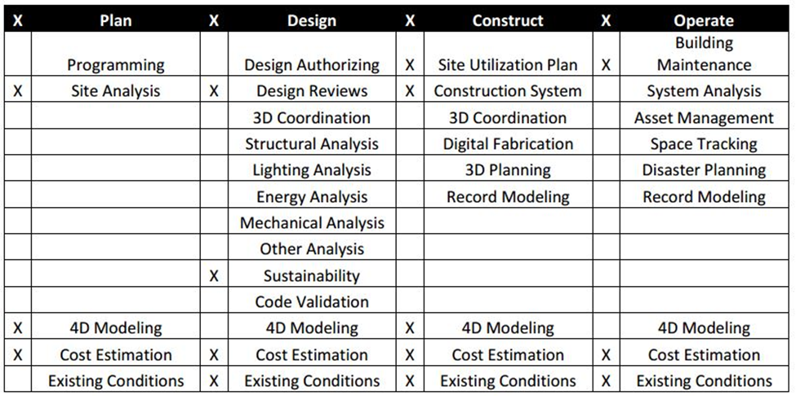
Feasibility Analysis
The HFS Warehouse and Bakery
Addition & Renovation
Joseph Rutt│ Construction Option
Presentation Outline:
I. Introduction
II. Project Overview
III. Analysis #1: SIPS Analysis
IV. Analysis #2: BIM Utilization
  Problem Identification
  Feasibility Analysis
  Recommendation
V. Analysis #3: Indoor Air Quality
VI. Analysis #4: LEED Certification
VII. Final Recommendations
VIII. Acknowledgements
Predicted Outcome
  3D model relieves issues with as-built drawings
  Eliminate RFI’s and ASI’s
  4D model sequence phases and create maps for construction site
Tasks:
  Create a 3D model of existing building
  Utilize clash detection
  4D model of warehouse bay and storage
April 13, 2016

Slide 12
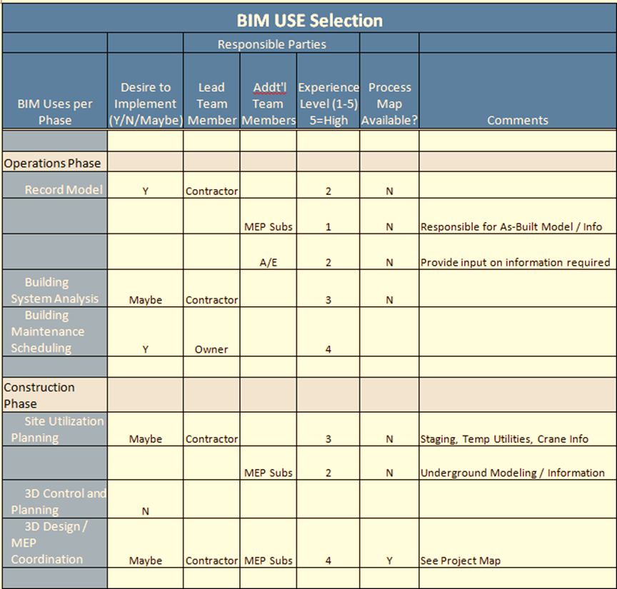
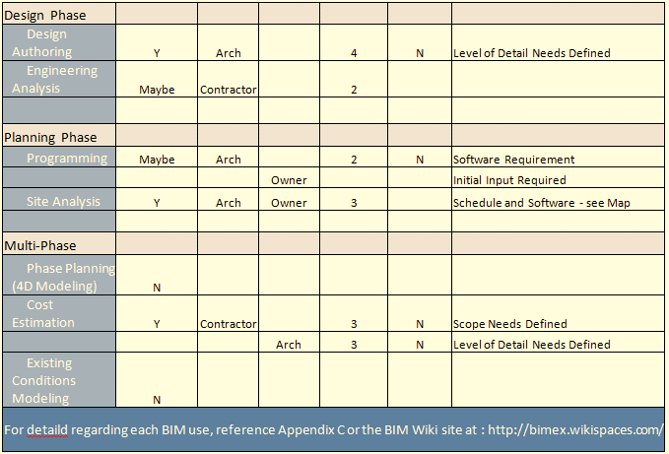
Recommendation
The HFS Warehouse and Bakery
Addition & Renovation
Joseph Rutt│ Construction Option
Presentation Outline:
I. Introduction
II. Project Overview
III. Analysis #1: SIPS Analysis
IV. Analysis #2: BIM Utilization
  Problem Identification
  Feasibility Analysis
  Recommendation
V. Analysis #3: Indoor Air Quality
VI. Analysis #4: LEED Certification
VII. Final Recommendations
VIII. Acknowledgements
Recommendation:
  BIM is recommended for this project
  Reduces problems with as-built model
  Reduces RFI’s and ASI’s
April 13, 2016

Slide 13
The HFS Warehouse and Bakery
Addition & Renovation
Joseph Rutt│ Construction Option
Presentation Outline:
I. Introduction
II. Project Overview
III. Analysis #1: Virtual Mockups
  In-Place vs. Virtual Mockups
  Virtual Mockup Development
  Virtual Mockup Implementation
  Conclusion & Recommendation
IV. Analysis #2: Façade Prefabrication
  Current vs. Prefabricated Façade
  Mechanical Breadth Analysis
  Schedule, Cost & Site Logistics
  Conclusion & Recommendations
V. Analysis #3: Revaluating Composite Slab
  Lightweight vs. Normal Concrete
  Structural Breadth Analysis
  Project Impacts
  Conclusion & Recommendations
VI. Final Recommendations
VII. Acknowledgements
Presentation Outline:
I. Introduction
II. Project Overview
III. Analysis #1: SIPS Analysis
IV. Analysis #2: BIM Utilization
V. Analysis #3: Indoor Air Quality
  Problem Identification
  Feasibility Analysis
  Recommendation
  Mechanical Breadth
VI. Analysis #4: LEED Certification
VII. Final Recommendations
VIII. Acknowledgements
Analysis #3
Indoor Air Quality
April 13, 2016

Slide 14

Indoor Air Quality
The HFS Warehouse and Bakery
Addition & Renovation
Joseph Rutt│ Construction Option
Presentation Outline:
I. Introduction
II. Project Overview
III. Analysis #1: Virtual Mockups
  In-Place vs. Virtual Mockups
  Virtual Mockup Development
  Virtual Mockup Implementation
  Conclusion & Recommendation
IV. Analysis #2: Façade Prefabrication
  Current vs. Prefabricated Façade
  Mechanical Breadth Analysis
  Schedule, Cost & Site Logistics
  Conclusion & Recommendations
V. Analysis #3: Revaluating Composite Slab
  Lightweight vs. Normal Concrete
  Structural Breadth Analysis
  Project Impacts
  Conclusion & Recommendations
VI. Final Recommendations
VII. Acknowledgements
Presentation Outline:
I. Introduction
II. Project Overview
III. Analysis #1: SIPS Analysis
IV. Analysis #2: BIM Utilization
V. Analysis #3: Indoor Air Quality
  Problem Identification
  Feasibility Analysis
  Recommendation
  Mechanical Breadth
VI. Analysis #4: LEED Certification
VII. Final Recommendations
VIII. Acknowledgements
Problem Identification:
  Poor air quality can effect occupant’s health
Proposed Solution:
  Increase the quality of air for the occupants
Research Goal:
  Find breathing zone outdoor airflow
  Air distribution effectiveness
  Zone outdoor airflow
Unit H – Office Space
ASHRAE Standard 62.1 - 2013
April 13, 2016

Slide 15
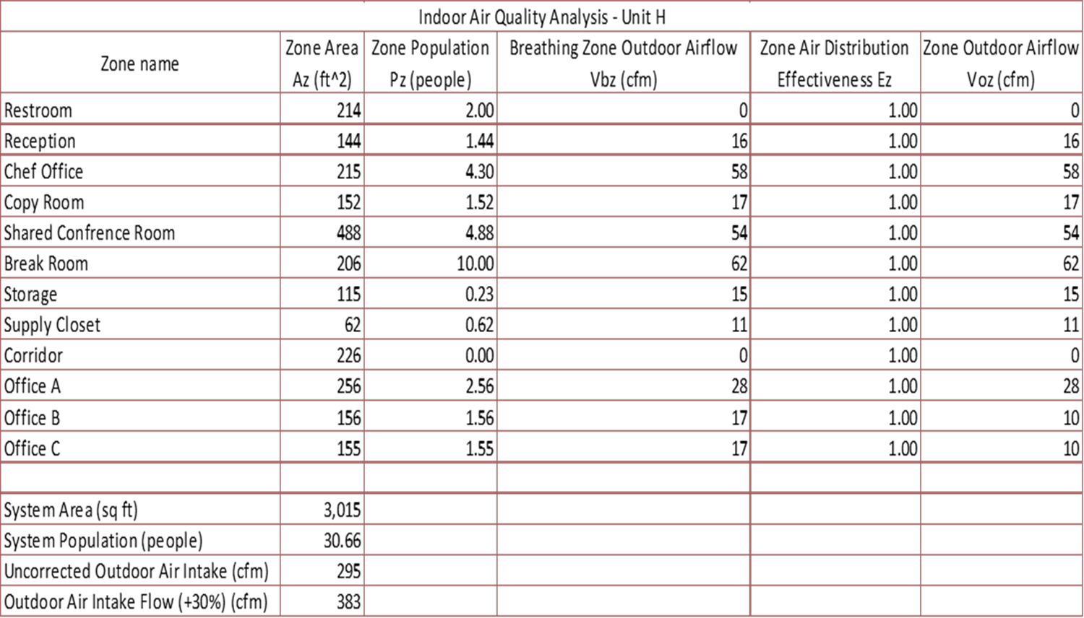
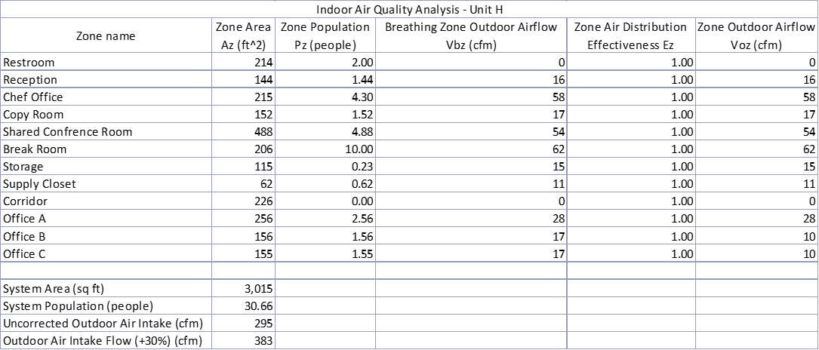
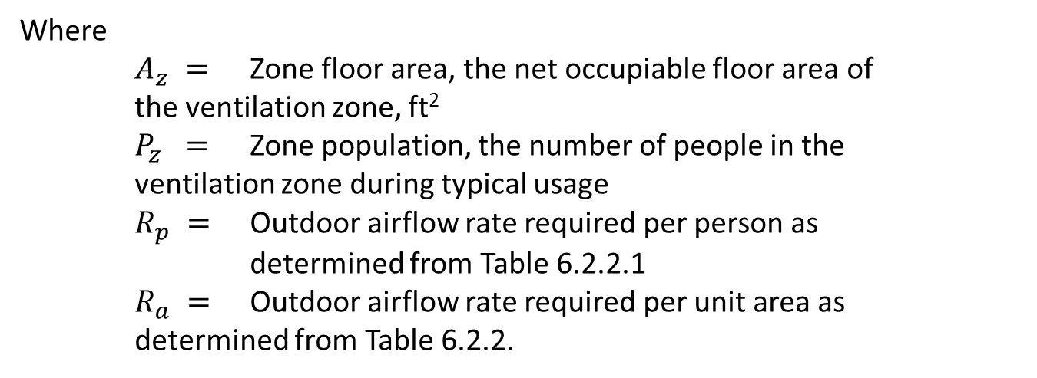
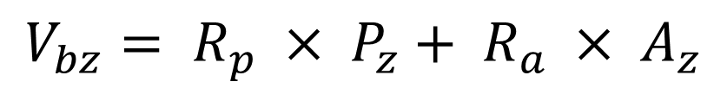
Indoor Air Quality
The HFS Warehouse and Bakery
Addition & Renovation
Joseph Rutt│ Construction Option
Presentation Outline:
I. Introduction
II. Project Overview
III. Analysis #1: Virtual Mockups
  In-Place vs. Virtual Mockups
  Virtual Mockup Development
  Virtual Mockup Implementation
  Conclusion & Recommendation
IV. Analysis #2: Façade Prefabrication
  Current vs. Prefabricated Façade
  Mechanical Breadth Analysis
  Schedule, Cost & Site Logistics
  Conclusion & Recommendations
V. Analysis #3: Revaluating Composite Slab
  Lightweight vs. Normal Concrete
  Structural Breadth Analysis
  Project Impacts
  Conclusion & Recommendations
VI. Final Recommendations
VII. Acknowledgements
Presentation Outline:
I. Introduction
II. Project Overview
III. Analysis #1: SIPS Analysis
IV. Analysis #2: BIM Utilization
V. Analysis #3: Indoor Air Quality
  Problem Identification
  Feasibility Analysis
  Recommendation
  Mechanical Breadth
VI. Analysis #4: LEED Certification
VII. Final Recommendations
VIII. Acknowledgements
Calculating Breathing Zone Outdoor Air Flow (V_{bz}):
$$V_{bz}= R_{p} × P_{z}+ R_{a} × A_{z}$$
Where
$A_{z} =$ Zone floor area, the net occupiable floor area of the ventilation zone, ft²
$P_{z} =$ Zone population, the number of people in the ventilation zone during typical usage
$R_{p} =$ Outdoor airflow rate required per person as determined from Table 6.2.2.1
$R_{a} =$ Outdoor airflow rate required per unit area as determined from Table 6.2.2.
April 13, 2016

Slide 16
Indoor Air Quality
The HFS Warehouse and Bakery
Addition & Renovation
Joseph Rutt│ Construction Option
Presentation Outline:
I. Introduction
II. Project Overview
III. Analysis #1: Virtual Mockups
  In-Place vs. Virtual Mockups
  Virtual Mockup Development
  Virtual Mockup Implementation
  Conclusion & Recommendation
IV. Analysis #2: Façade Prefabrication
  Current vs. Prefabricated Façade
  Mechanical Breadth Analysis
  Schedule, Cost & Site Logistics
  Conclusion & Recommendations
V. Analysis #3: Revaluating Composite Slab
  Lightweight vs. Normal Concrete
  Structural Breadth Analysis
  Project Impacts
  Conclusion & Recommendations
VI. Final Recommendations
VII. Acknowledgements
Presentation Outline:
I. Introduction
II. Project Overview
III. Analysis #1: SIPS Analysis
IV. Analysis #2: BIM Utilization
V. Analysis #3: Indoor Air Quality
  Problem Identification
  Feasibility Analysis
  Recommendation
  Mechanical Breadth
VI. Analysis #4: LEED Certification
VII. Final Recommendations
VIII. Acknowledgements
Determine Zone Air Distribution Effectiveness (E_{z}):
E_{z} is determined using Table 6.2.2.2 in Standard 62.1
April 13, 2016

Slide 17

Indoor Air Quality
The HFS Warehouse and Bakery
Addition & Renovation
Joseph Rutt│ Construction Option
Presentation Outline:
I. Introduction
II. Project Overview
III. Analysis #1: Virtual Mockups
  In-Place vs. Virtual Mockups
  Virtual Mockup Development
  Virtual Mockup Implementation
  Conclusion & Recommendation
IV. Analysis #2: Façade Prefabrication
  Current vs. Prefabricated Façade
  Mechanical Breadth Analysis
  Schedule, Cost & Site Logistics
  Conclusion & Recommendations
V. Analysis #3: Revaluating Composite Slab
  Lightweight vs. Normal Concrete
  Structural Breadth Analysis
  Project Impacts
  Conclusion & Recommendations
VI. Final Recommendations
VII. Acknowledgements
Presentation Outline:
I. Introduction
II. Project Overview
III. Analysis #1: SIPS Analysis
IV. Analysis #2: BIM Utilization
V. Analysis #3: Indoor Air Quality
  Problem Identification
  Feasibility Analysis
  Recommendation
  Mechanical Breadth
VI. Analysis #4: LEED Certification
VII. Final Recommendations
VIII. Acknowledgements
Calculating Zone Outdoor Airflow (V_{oz}):
$$V_{oz}= \frac{V_{bz}}{E_{z}}$$
April 13, 2016

Slide 18
Recommendation
The HFS Warehouse and Bakery
Addition & Renovation
Joseph Rutt│ Construction Option
Presentation Outline:
I. Introduction
II. Project Overview
III. Analysis #1: Virtual Mockups
  In-Place vs. Virtual Mockups
  Virtual Mockup Development
  Virtual Mockup Implementation
  Conclusion & Recommendation
IV. Analysis #2: Façade Prefabrication
  Current vs. Prefabricated Façade
  Mechanical Breadth Analysis
  Schedule, Cost & Site Logistics
  Conclusion & Recommendations
V. Analysis #3: Revaluating Composite Slab
  Lightweight vs. Normal Concrete
  Structural Breadth Analysis
  Project Impacts
  Conclusion & Recommendations
VI. Final Recommendations
VII. Acknowledgements
Presentation Outline:
I. Introduction
II. Project Overview
III. Analysis #1: SIPS Analysis
IV. Analysis #2: BIM Utilization
V. Analysis #3: Indoor Air Quality
  Problem Identification
  Feasibility Analysis
  Recommendation
  Mechanical Breadth
VI. Analysis #4: LEED Certification
VII. Final Recommendations
VIII. Acknowledgements
Conclusion:
Uncorrected Outdoor Air Intake: 295 CFM
Outdoor Air Intake Flow (+30%): 383 CFM
The mechanical system requires an additional 383 CFM of outdoor air to reach the requirement for the LEED Credit.
April 13, 2016

Slide 19
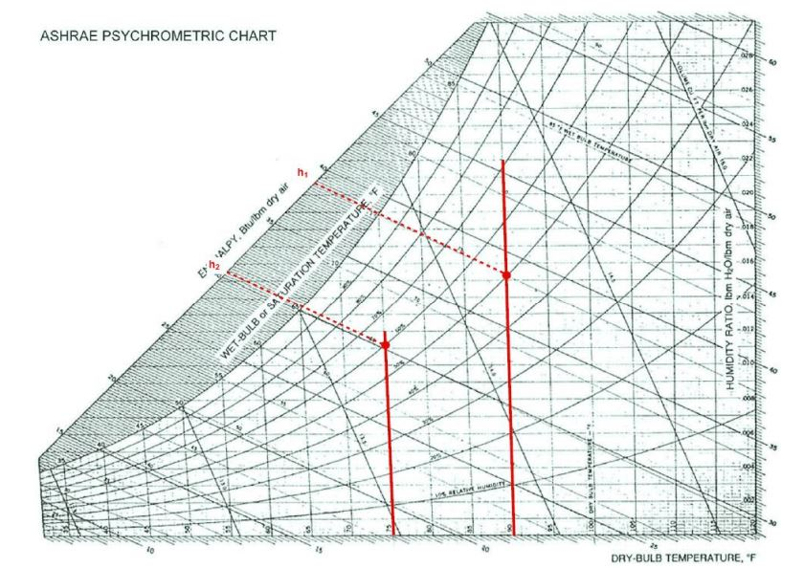
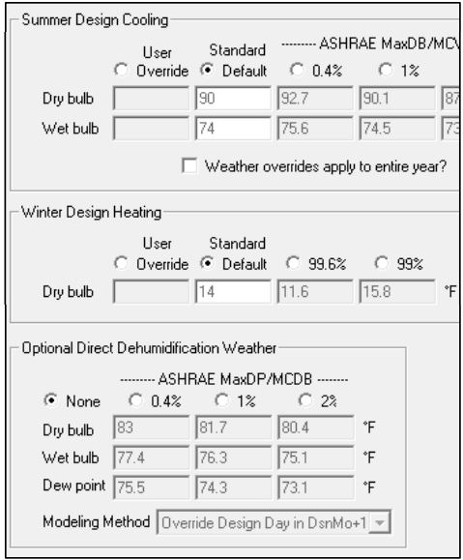
Mechanical Breadth
The HFS Warehouse and Bakery
Addition & Renovation
Joseph Rutt│ Construction Option
Presentation Outline:
I. Introduction
II. Project Overview
III. Analysis #1: Virtual Mockups
  In-Place vs. Virtual Mockups
  Virtual Mockup Development
  Virtual Mockup Implementation
  Conclusion & Recommendation
IV. Analysis #2: Façade Prefabrication
  Current vs. Prefabricated Façade
  Mechanical Breadth Analysis
  Schedule, Cost & Site Logistics
  Conclusion & Recommendations
V. Analysis #3: Revaluating Composite Slab
  Lightweight vs. Normal Concrete
  Structural Breadth Analysis
  Project Impacts
  Conclusion & Recommendations
VI. Final Recommendations
VII. Acknowledgements
Presentation Outline:
I. Introduction
II. Project Overview
III. Analysis #1: SIPS Analysis
IV. Analysis #2: BIM Utilization
V. Analysis #3: Indoor Air Quality
  Problem Identification
  Feasibility Analysis
  Recommendation
  Mechanical Breadth
VI. Analysis #4: LEED Certification
VII. Final Recommendations
VIII. Acknowledgements
Determining the cooling load for Unit H:
The cooling load the design parameters for Summer Design Cooling are:
90.1 Dry bulb
74.5 Wet bulb
Relative humidity of 60%
Indoor temperature of 75° F.
𝑞̇(𝑏𝑡𝑢) = 4.5 𝐶𝐹𝑀 𝛥ℎ
𝑞̇(𝑏𝑡𝑢) = 4.5 (383) (38.8 − 30.4)
𝑞̇(𝑏𝑡𝑢) = 14,477.4 𝑏𝑡𝑢ℎ = 𝟏𝟒. 𝟓 𝒎𝒃𝒉
April 13, 2016

Slide 20
Mechanical Breadth
The HFS Warehouse and Bakery
Addition & Renovation
Joseph Rutt│ Construction Option
Presentation Outline:
I. Introduction
II. Project Overview
III. Analysis #1: Virtual Mockups
  In-Place vs. Virtual Mockups
  Virtual Mockup Development
  Virtual Mockup Implementation
  Conclusion & Recommendation
IV. Analysis #2: Façade Prefabrication
  Current vs. Prefabricated Façade
  Mechanical Breadth Analysis
  Schedule, Cost & Site Logistics
  Conclusion & Recommendations
V. Analysis #3: Revaluating Composite Slab
  Lightweight vs. Normal Concrete
  Structural Breadth Analysis
  Project Impacts
  Conclusion & Recommendations
VI. Final Recommendations
VII. Acknowledgements
Presentation Outline:
I. Introduction
II. Project Overview
III. Analysis #1: SIPS Analysis
IV. Analysis #2: BIM Utilization
V. Analysis #3: Indoor Air Quality
  Problem Identification
  Feasibility Analysis
  Recommendation
  Mechanical Breadth
VI. Analysis #4: LEED Certification
VII. Final Recommendations
VIII. Acknowledgements
Determine the heating load for Unit H:
From the Psychrometric Chart:
h1 = 38.8 btu/lbm
h2 = 30.4 btu/lbm
𝑞̇ 𝑠𝑒𝑛𝑠 = 1.08 𝐶𝐹𝑀 𝛥𝑇
𝑞̇ 𝑠𝑒𝑛𝑠 = 1.08 (383) (75 − 15.8)
𝑞̇ 𝑠𝑒𝑛𝑠 = 24,487.5 𝑏𝑡𝑢ℎ = 𝟐𝟒. 𝟓 𝒎𝒃𝒉
The heating load above is added to the current load of 100 mbh for a total of 124.5 mbh load for Unit H
April 13, 2016

Slide 21
Mechanical Breadth
The HFS Warehouse and Bakery
Addition & Renovation
Joseph Rutt│ Construction Option
Presentation Outline:
I. Introduction
II. Project Overview
III. Analysis #1: Virtual Mockups
  In-Place vs. Virtual Mockups
  Virtual Mockup Development
  Virtual Mockup Implementation
  Conclusion & Recommendation
IV. Analysis #2: Façade Prefabrication
  Current vs. Prefabricated Façade
  Mechanical Breadth Analysis
  Schedule, Cost & Site Logistics
  Conclusion & Recommendations
V. Analysis #3: Revaluating Composite Slab
  Lightweight vs. Normal Concrete
  Structural Breadth Analysis
  Project Impacts
  Conclusion & Recommendations
VI. Final Recommendations
VII. Acknowledgements
Presentation Outline:
I. Introduction
II. Project Overview
III. Analysis #1: SIPS Analysis
IV. Analysis #2: BIM Utilization
V. Analysis #3: Indoor Air Quality
  Problem Identification
  Feasibility Analysis
  Recommendation
  Mechanical Breadth
VI. Analysis #4: LEED Certification
VII. Final Recommendations
VIII. Acknowledgements
Recommendation:
  100% outdoor air system
  Cost of change is low and may be negligible
  Provides occupants with a higher quality work environment
𝑞̇(𝑏𝑡𝑢) = 14,477.4 𝑏𝑡𝑢ℎ = 𝟏𝟒. 𝟓 𝒎𝒃𝒉
𝑞̇ 𝑠𝑒𝑛𝑠 = 24,487.5 𝑏𝑡𝑢ℎ = 𝟐𝟒. 𝟓 𝒎𝒃𝒉
Total of 124.5 mbh load for Unit H
April 13, 2016

Slide 22
The HFS Warehouse and Bakery
Addition & Renovation
Joseph Rutt│ Construction Option
Presentation Outline:
I. Introduction
II. Project Overview
III. Analysis #1: Virtual Mockups
  In-Place vs. Virtual Mockups
  Virtual Mockup Development
  Virtual Mockup Implementation
  Conclusion & Recommendation
IV. Analysis #2: Façade Prefabrication
  Current vs. Prefabricated Façade
  Mechanical Breadth Analysis
  Schedule, Cost & Site Logistics
  Conclusion & Recommendations
V. Analysis #3: Revaluating Composite Slab
  Lightweight vs. Normal Concrete
  Structural Breadth Analysis
  Project Impacts
  Conclusion & Recommendations
VI. Final Recommendations
VII. Acknowledgements
Presentation Outline:
I. Introduction
II. Project Overview
III. Analysis #1: SIPS Analysis
IV. Analysis #2: BIM Utilization
V. Analysis #3: Indoor Air Quality
VI. Analysis #4: LEED Certification
  Problem Identification
  Feasibility Analysis
  Recommendation
VII. Final Recommendations
VIII. Acknowledgements
Analysis #4
LEED Certification
April 13, 2016

Slide 23
LEED Certification
The HFS Warehouse and Bakery
Addition & Renovation
Joseph Rutt│ Construction Option
Presentation Outline:
I. Introduction
II. Project Overview
III. Analysis #1: Virtual Mockups
  In-Place vs. Virtual Mockups
  Virtual Mockup Development
  Virtual Mockup Implementation
  Conclusion & Recommendation
IV. Analysis #2: Façade Prefabrication
  Current vs. Prefabricated Façade
  Mechanical Breadth Analysis
  Schedule, Cost & Site Logistics
  Conclusion & Recommendations
V. Analysis #3: Revaluating Composite Slab
  Lightweight vs. Normal Concrete
  Structural Breadth Analysis
  Project Impacts
  Conclusion & Recommendations
VI. Final Recommendations
VII. Acknowledgements
Presentation Outline:
I. Introduction
II. Project Overview
III. Analysis #1: SIPS Analysis
IV. Analysis #2: BIM Utilization
V. Analysis #3: Indoor Air Quality
VI. Analysis #4: LEED Certification
  Problem Identification
  Feasibility Analysis
  Recommendation
VII. Final Recommendations
VIII. Acknowledgements
Problem Identification:
  No considerations to pursue LEED Certification
  Project is capable of achieving at least 40 points
Proposed Solution:
  Acquire at minimum 40 points to become a LEED Certified building
Research Goal:
  Benefits lifespan of project
  Lower operating costs
  Reduced project waste
  Energy conservation
  Reduced greenhouse gas emissions
  Tax rebates
April 13, 2016

Slide 24
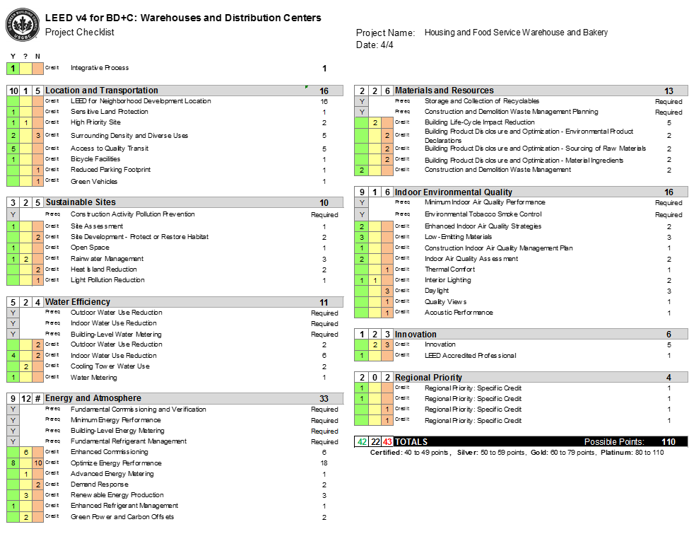
LEED Certification
The HFS Warehouse and Bakery
Addition & Renovation
Joseph Rutt│ Construction Option
Presentation Outline:
I. Introduction
II. Project Overview
III. Analysis #1: Virtual Mockups
  In-Place vs. Virtual Mockups
  Virtual Mockup Development
  Virtual Mockup Implementation
  Conclusion & Recommendation
IV. Analysis #2: Façade Prefabrication
  Current vs. Prefabricated Façade
  Mechanical Breadth Analysis
  Schedule, Cost & Site Logistics
  Conclusion & Recommendations
V. Analysis #3: Revaluating Composite Slab
  Lightweight vs. Normal Concrete
  Structural Breadth Analysis
  Project Impacts
  Conclusion & Recommendations
VI. Final Recommendations
VII. Acknowledgements
Presentation Outline:
I. Introduction
II. Project Overview
III. Analysis #1: SIPS Analysis
IV. Analysis #2: BIM Utilization
V. Analysis #3: Indoor Air Quality
VI. Analysis #4: LEED Certification
  Problem Identification
  Feasibility Analysis
  Recommendation
VII. Final Recommendations
VIII. Acknowledgements
April 13, 2016

Slide 25

Recommendation
The HFS Warehouse and Bakery
Addition & Renovation
Joseph Rutt│ Construction Option
Presentation Outline:
I. Introduction
II. Project Overview
III. Analysis #1: Virtual Mockups
  In-Place vs. Virtual Mockups
  Virtual Mockup Development
  Virtual Mockup Implementation
  Conclusion & Recommendation
IV. Analysis #2: Façade Prefabrication
  Current vs. Prefabricated Façade
  Mechanical Breadth Analysis
  Schedule, Cost & Site Logistics
  Conclusion & Recommendations
V. Analysis #3: Revaluating Composite Slab
  Lightweight vs. Normal Concrete
  Structural Breadth Analysis
  Project Impacts
  Conclusion & Recommendations
VI. Final Recommendations
VII. Acknowledgements
Presentation Outline:
I. Introduction
II. Project Overview
III. Analysis #1: SIPS Analysis
IV. Analysis #2: BIM Utilization
V. Analysis #3: Indoor Air Quality
VI. Analysis #4: LEED Certification
  Problem Identification
  Feasibility Analysis
  Recommendation
VII. Final Recommendations
VIII. Acknowledgements
Components:
  Integrative Process – 1 point
  Location & Transportation – 10 points
  Sustainable Site – 3 points
  Water Efficiency – 5 points
  Energy & Atmosphere – 9 points
  Material & Resources – 2 points
  Indoor Environmental Quality – 9 points
  Innovation – 1 point
  Regional Priority – 2 points
  Total points: 42
  LEED Certified
Recommendation:
  Pursue the lowest LEED Certification with a minimum of 40 points
April 13, 2016

Slide 26
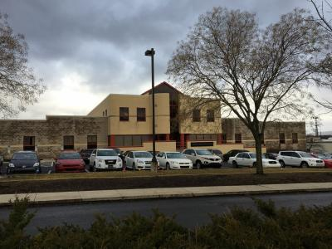
Conclusion
The HFS Warehouse and Bakery
Addition & Renovation
Joseph Rutt│ Construction Option
Presentation Outline:
I. Introduction
II. Project Overview
III. Analysis #1: SIPS Analysis
IV. Analysis #2: BIM Utilization
V. Analysis #3: Indoor Air Quality
VI. Analysis #4: LEED Certification
VII. Final Recommendations
VIII. Acknowledgements
Analysis 1 │ SIPS Analysis
Analysis 3 │Indoor Air Quality
Implement the SIPS Analysis for office renovations
  Occupant Satisfaction
  Organized trades
  Decreased schedule
Implementation of the mechanical system is recommended to achieve the LEED credit
Analysis 2 │BIM Utilization
Analysis 4 │LEED Certification
BIM is recommended for this project
  Reduces problems with as-built model
  Reduces RFI’s and ASI’s
There are at least 42 possible points for this building, strongly recommend pursuit of LEED Certified Building
Provided by Kinsley Construction
April 13, 2016

Slide 27







Acknowledgements
The HFS Warehouse and Bakery
Addition & Renovation
Joseph Rutt│ Construction Option
Presentation Outline:
I. Introduction
II. Project Overview
III. Analysis #1: Virtual Mockups
  In-Place vs. Virtual Mockups
  Virtual Mockup Development
  Virtual Mockup Implementation
  Conclusion & Recommendation
IV. Analysis #2: Façade Prefabrication
  Current vs. Prefabricated Façade
  Mechanical Breadth Analysis
  Schedule, Cost & Site Logistics
  Conclusion & Recommendations
V. Analysis #3: Revaluating Composite Slab
  Lightweight vs. Normal Concrete
  Structural Breadth Analysis
  Project Impacts
  Conclusion & Recommendations
VI. Final Recommendations
VII. Acknowledgements
Presentation Outline:
I. Introduction
II. Project Overview
III. Analysis #1: SIPS Analysis
IV. Analysis #2: BIM Utilization
V. Analysis #3: Indoor Air Quality
VI. Analysis #4: LEED Certification
VII. Final Recommendations
VIII. Acknowledgements
Special Thanks to:
My Family & Friends
Kevin Finke – Kinsley Construction
Justin Osmolinski – Kinsley Construction
PACE Industry Members
Industry Acknowledgements:
Architectural Engineering Faculty:
Dr. Chimay Anumba (Advisor)
April 13, 2016

Slide 28
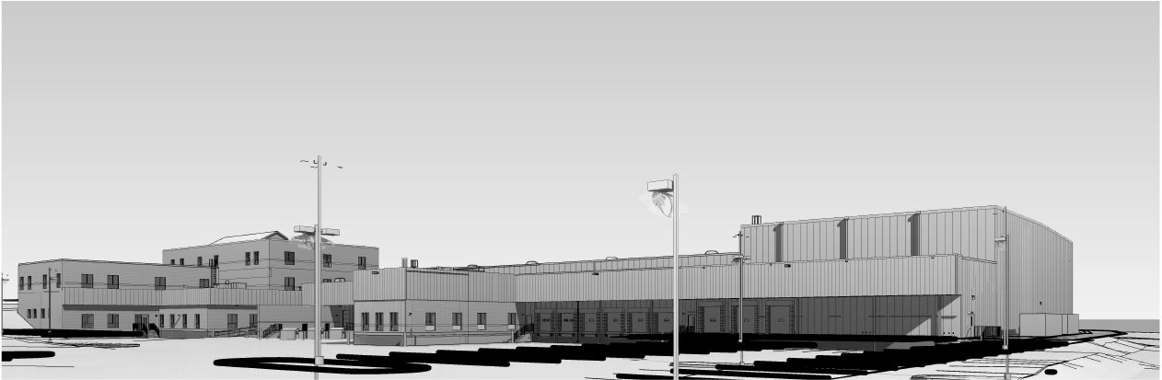
Thank You
The HFS Warehouse and Bakery
Addition & Renovation
Joseph Rutt│ Construction Option
Presentation Outline:
I. Introduction
II. Project Overview
III. Analysis #1: Virtual Mockups
  In-Place vs. Virtual Mockups
  Virtual Mockup Development
  Virtual Mockup Implementation
  Conclusion & Recommendation
IV. Analysis #2: Façade Prefabrication
  Current vs. Prefabricated Façade
  Mechanical Breadth Analysis
  Schedule, Cost & Site Logistics
  Conclusion & Recommendations
V. Analysis #3: Revaluating Composite Slab
  Lightweight vs. Normal Concrete
  Structural Breadth Analysis
  Project Impacts
  Conclusion & Recommendations
VI. Final Recommendations
VII. Acknowledgements
Questions & Comments
April 13, 2016
Provided by Kinsley Construction

