Slide 1
Ft. Detrick Defense Medical Logistics Center
Building Systems Redesign

Slide 2
Outline
  Background
  Existing Mechanical Systems
  Redesign Summary
  Redesign Goals
  Mechanical Depth Study
  Architectural/Site Breadth Study
  Electrical Breadth Study
  Conclusions and Recommendations

Slide 3

Background
Size
129,960 ft²
Cost
$26.5 Million
Function
Office
Occupants
Top Medical Planning Organizations within the Department of Defense, representing the Army, Navy, Air Force, and Marines

Slide 4
Background
AT/FP
Anti-Terrorism/Force Protection
SPiRiT
Sustainable Project Rating Tool

Slide 5
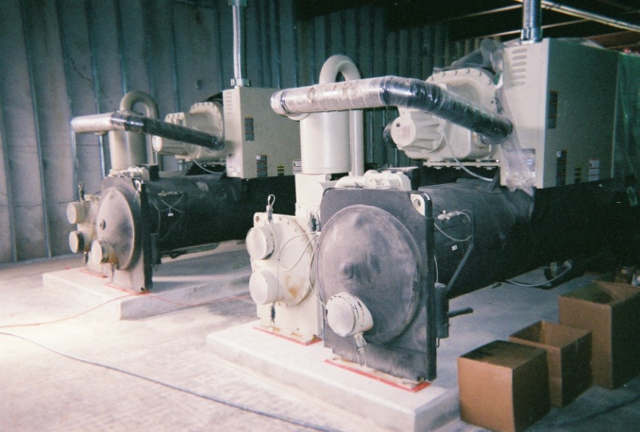
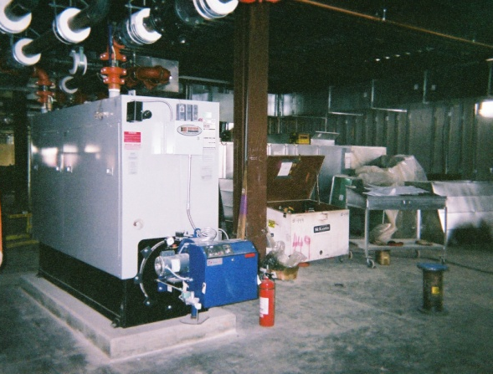
Existing Mechanical System
Chilled Water System
2 Water-Cooled Chillers at 220 tons each
42°F Leaving Water Temperature
Serves Cooling Coils of AHU-1 thru 6
Personal Photo Taken 2/23/08
Hot Water System
2 Gas-Fired Boilers at 2160 MBH each
Serves AHU heating coils, VAV reheat coils, and Unit Heaters
Personal Photo Taken 2/23/08

Slide 6
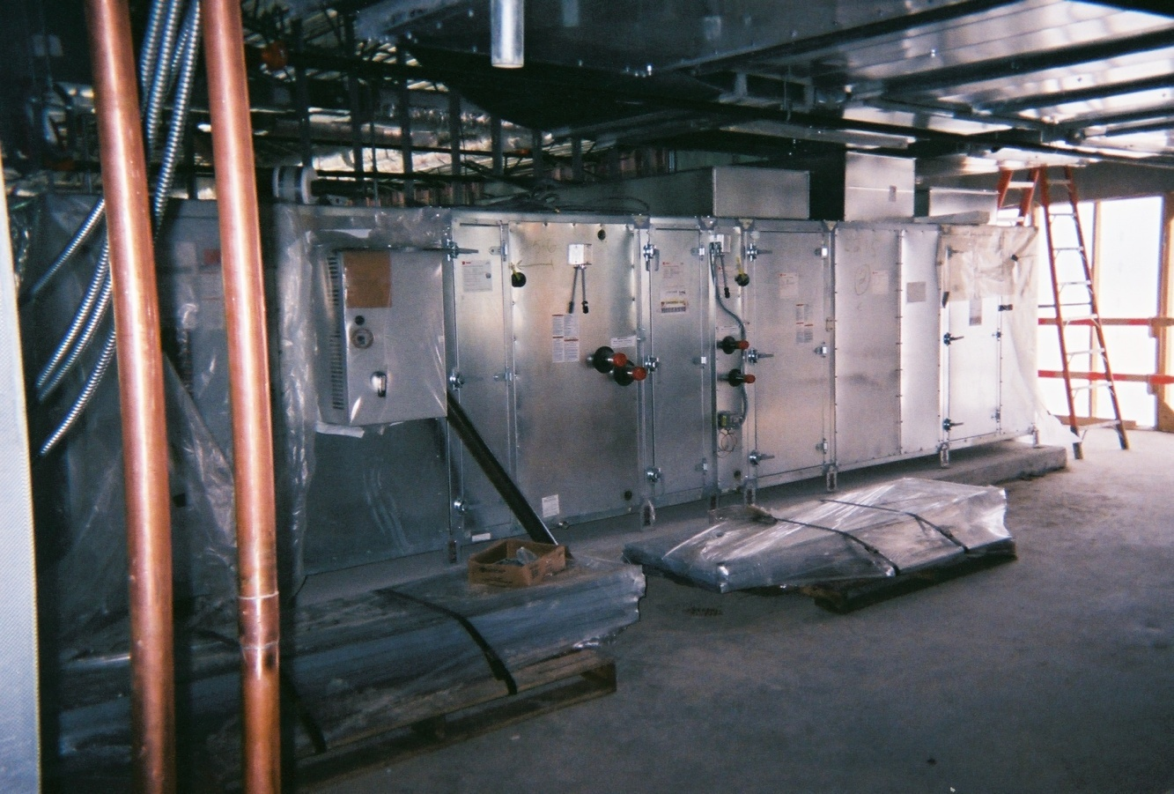
Existing Mechanical System
Airside
6 VAV Air Handling Units
Water Heating and Cooling Coils
VAV Hot Water Reheat Boxes
Personal Photo Taken 2/23/08

Slide 7
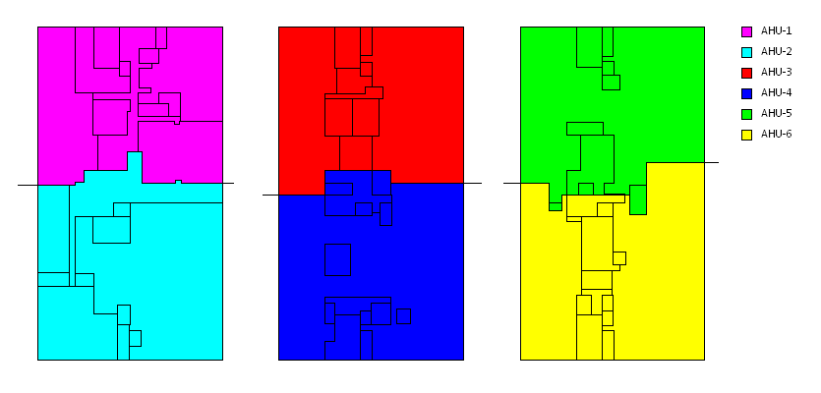
Existing Mechanical System
First Floor
Second Floor
Third Floor

Slide 8
Redesign Goals
Decrease Space
Increase Energy Efficiency
Maintain Affordability
Maintain Occupant Safety
Improve Sustainability

Slide 9
Redesign Summary
Mechanical Depth Study
  DOAS/Chilled Beams/High-Induction Diffusers
Architectural/Site Breadth Study
  Constructed Wetland for On-Site Wastewater Treatment
Electrical Breadth Study
  Impact of Mechanical Redesign on Electrical System

Slide 10
Dedicated Outdoor Air System (DOAS)
Mechanical Depth Study
Enthalpy Wheel
  Recovers Energy
  Save on Utility Cost
Innovent Dedicated Outdoor Air Unit

Slide 11
Dedicated Outdoor Air System (DOAS)
Mechanical Depth Study
100% Outdoor Air
  Smaller Volume of Air Required
  Contaminants Not Recirculated
Outdoor Air Savings from DOAS-1
 | Vot (current design) | Vot 100% OA (∑Voz) | Difference
AHU-1 | 4460 | 2843
AHU-3 | 4975 | 2235
AHU-5 | 4670 | 2120
Total | 14,105 | 7198 | 6907
Outdoor Air Savings from DOAS-2
 | Vot (current design) | Vot 100% OA (∑Voz) | Difference
AHU-2 | 4210 | 1773
AHU-4 | 4550 | 2092
AHU-6 | 4985 | 2584
Total | 13,745 | 6449 | 7296

Slide 12
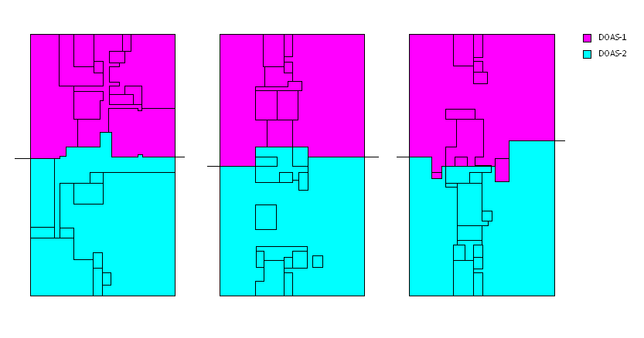
Mechanical Depth Study

Slide 13
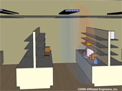
Mechanical Depth Study
Chilled Beams
Passive System
  Cool by Convection and Radiation
  Remove Sensible Loads
  No Additional Energy to Operate
http://www.aeieng.com/services/sustainable/chilledbeam.htm

Slide 14
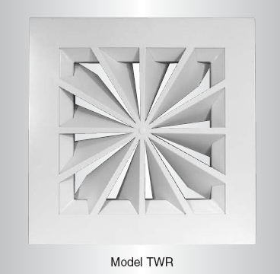
Mechanical Depth Study
High-Induction Diffusers
Cooling Supply Air Temperature = 48°F
  Diffusers encourage mixing of air
  Prevent “dumping” of cold air
Nailor High-Induction Diffuser

Slide 15
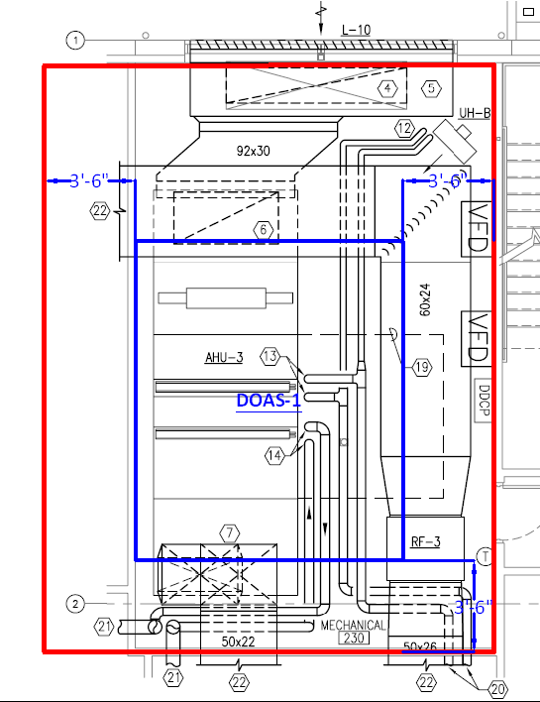
Mechanical Depth Study
Goal 1 – Decrease Space
Existing System
  6 Mechanical Rooms
  5.2% Lost Rentable Space
Redesigned System
  2 Mechanical Rooms
  3.3% Lost Rentable Space
Owner saves 2392 ft² – 2% of Total Area

Slide 16
Mechanical Depth Study
Goal 2 – Increase Energy Efficiency

Slide 17
Mechanical Depth Study
Goal 2 – Increase Energy Efficiency

Slide 18
Mechanical Depth Study
Goal 3 – Maintain Affordability
Existing System Energy Cost: $164,529/year
Redesigned System Energy Cost: $136,252/year
Yearly Savings: $28,277
Utility Rates - Baltimore Gas and Electric
Utility Type | Rate Type | Summer Charge | Winter Charge
Electric Consumption | On Peak | $0.07/kWh | $0.055/kWh
Electric Consumption | Off Peak | $0.044/kWh | $0.04/kWh
Electric Demand | On Peak | $10.22/kW | $4.94/kW
Electric Demand | Off Peak | $4.94/kW | $4.94/kW
Gas Consumption | - | $0.4165/therm

Slide 19
Mechanical Depth Study
Goal 3 – Maintain Affordability
Initial Cost Comparison
Equipment | Existing System | Redesign DOAS/CB | Difference
Diffusers (493) | $20,460 | $21,300 | -$840
VAV Boxes (164) | $87,740 | $ - | $87,740
Chilled Beams (1460) | $ - | $276,750 | -$276,750
VAV AHUs (6) | $187,800 | $ - | $187,800
DOAS Units (2) | $ - | $86,000 | -$86,000
Total | $296,000 | $384,050 | -$88,050
Existing System First Cost: $296,000
Redesigned System First Cost: $384,050
First Cost Increase: $88,050

Slide 20
Mechanical Depth Study
Goal 3 – Maintain Affordability
Existing System Life Cycle Cost: $1,696,733
Redesigned System First Cost: $1,544,041
20-Year Life Cycle Cost Savings: $152,692
  Payback Period: only 3.9 years

Slide 21
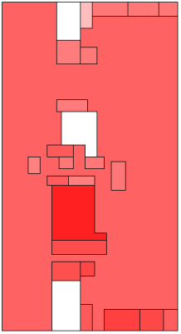
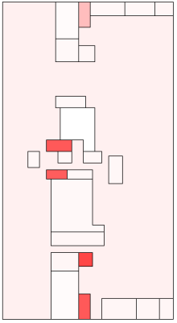
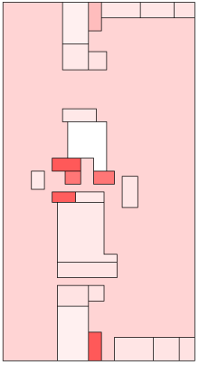
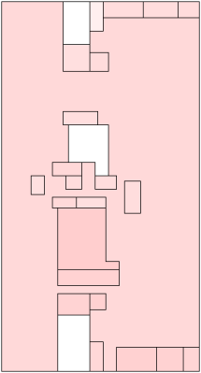
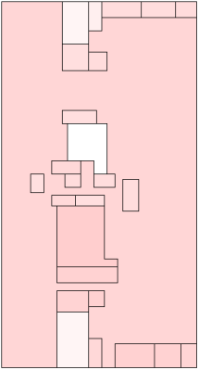
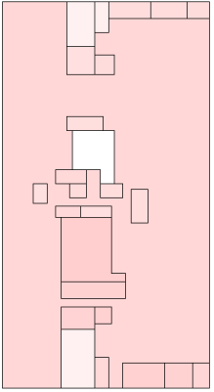
Mechanical Depth Study
Goal 4 – Maintain Occupant Safety
1st Floor 2nd Floor 3rd Floor
Simulation of contaminant released in outdoor air intake (star)
Concentration of contaminants 30 minutes following release
Existing system has higher initial concentration on first floor
  Smaller Zones
  Rest of contamination due to leakage
Existing System
Redesigned System

Slide 22
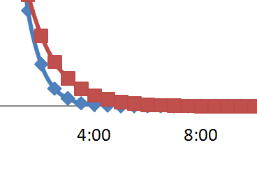

Mechanical Depth Study
Goal 4 – Maintain Occupant Safety
Redesign takes approximately 2 hours longer to clear the building

Slide 23
Mechanical Depth Study
Goal 4 – Maintain Occupant Safety
Acute Exposure Guideline Level (AEGL)
  Describe risk from one-time exposure to contaminants
Contaminant selected arbitrarily, only intended to display relative concentration between 2 cases
Redesign never reaches dangerous level – 2 hour difference is not critical

Slide 24
Mechanical Depth Study
Goal 5 – Improve Sustainability
Existing System
Redesigned System
43 points – SPiRiT Silver
Need 7 points for SPiRiT Gold
Uses 17.2% less energy than baseline system
1 point awarded for every 2.5% reduction of energy
6 more points can be obtained, but still need one more…

Slide 25
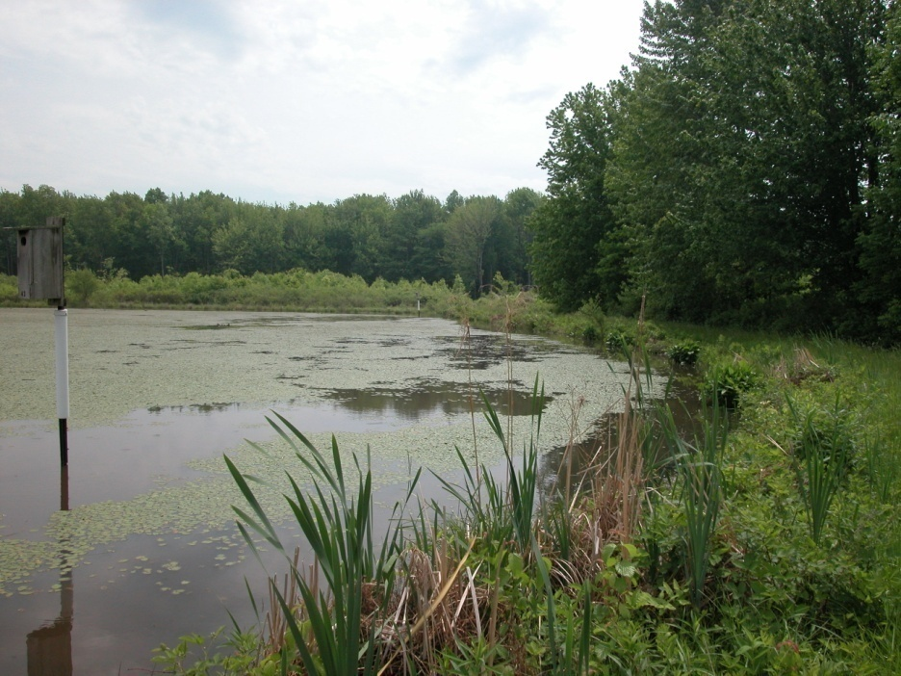
Architectural/Site Breadth Study
Goal 5 – Improve Sustainability
Constructed Wetland
Satisfies SPiRiT credit 2.C2 – Innovative use of wastewater technology
Use planting beds of wetland vegetation to treat noxious effluents/sewage
Free water surface – most affordable
http://www.dep.state.pa.us/Images/

Slide 26
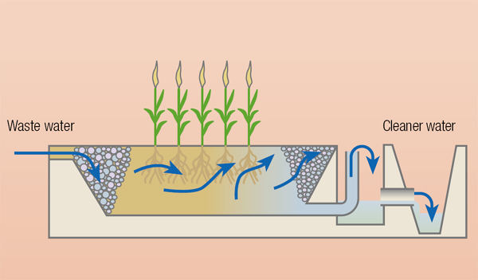
Architectural/Site Breadth Study
Goal 5 – Improve Sustainability
http://www.unep.org/geo/yearbook/yb2003/images/fresh_img_g_40.jpg

Slide 27
Architectural/Site Breadth Study
Goal 5 – Improve Sustainability
Constructed Wetland
Construction Cost Summary - FWS Constructed Wetland
Excavation/Compaction | $8,668.80
Soil/Gravel | $2,786.40
Liner | $12,267.90
Plants | $5,495.40
Plumbing | $9,481.50
Total | $38,700.00
Building uses 24,300 gal/day (max. occupancy)
4300 ft², 3 ft deep
Adds $38,700 to first cost

Slide 28
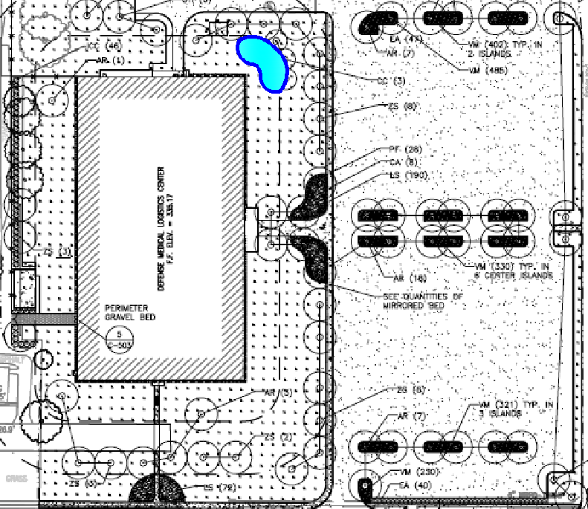
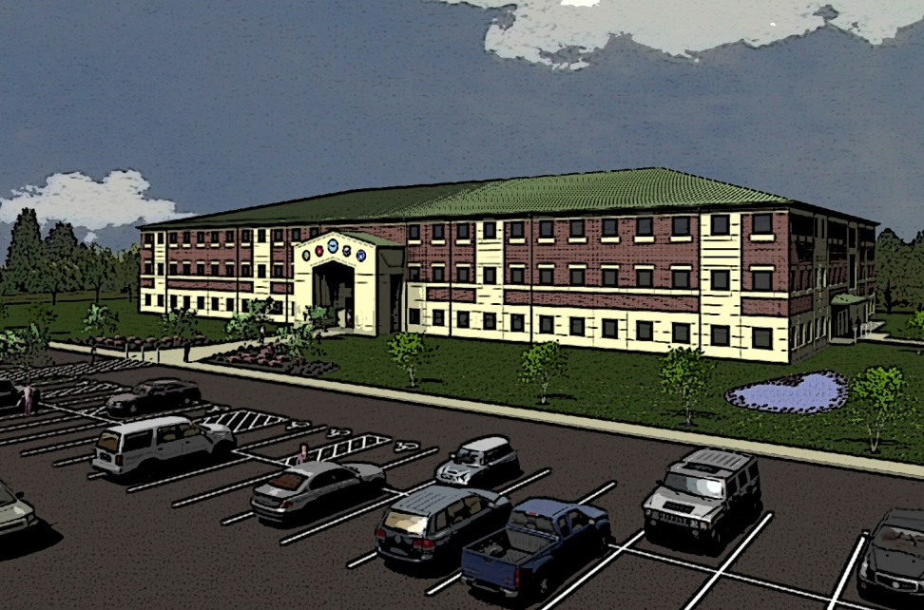
Architectural/Site Breadth Study
Goal 5 – Improve Sustainability

Slide 29
Electrical Breadth Study
Goal 3 – Maintain Affordability
Cost of Electrical Additions
Added | Qty. | Cost per 100 LF | LF | Total Cost
#10 Wire | 6 | 59.50 | 36 | $129
25 A Breaker | 6 | - | - | $4,074
 |  |  | Total | $4,203
Equipment reduction means power reduction
Panelboard DP5 can be eliminated
Reduces first cost by $17,065
Total cost additions from breadth: $21,635
Cost of Electrical Subtractions
Subtracted | Qty. | Cost per 100 LF | LF | Total Cost
#3 Wire | 6 | 196.00 | 100 | $1,176
#4 Wire | 12 | 166.50 | 64 | $1,279
#12 Wire | 18 | 47.90 | 128 | $1,104
70 A Breaker | 6 | - | - | $4,818
80 A Breaker | 12 | - | - | $4,818
15 A Breaker | 18 | - | - | $4,074
Panel DP5 | 1 | - | - | $4,000
 |  |  | Total | $21,268

Slide 30
Conclusions and Recommendations
Total First Cost of Redesign: $384,050 + $21,635 = $405,685
Total 20-Year Life Cycle Cost Savings: $131,058
  Payback period still only 5.2 years
Owner would pay $109,685 more up-front, but would save $131,058 after 20 years

Slide 31
Conclusions and Recommendations
Goals Met:
Decrease Space
  YES. DOAS units take up 2% less space than existing AHUs
Increase Energy Efficiency
  YES. Smaller quantity of air to condition; Enthalpy wheel provides energy recovery
Maintain Affordability
  YES. Higher first cost pays back in 5.2 years with savings on energy.
Maintain Occupant Safety
  YES. DOAS takes longer to clear the building, but the building never reaches a critical level.
Improve Sustainability
  YES. 6 credits from mechanical redesign + 1 credit from wetland = 7 credits needed for SPiRiT Gold.

Slide 32
Acknowledgements
  Project Sponsor: Lou Mittleman
  Dave Casciano
  Todd Garing
  Darren Anderson
  John Morris
  Michael Schwarz
Faculty Advisor: Dr. William Bahnfleth
Justin Bem
Mike Royer
Nick Kutchi
Lou and Julie Ferraro
Brian Hoover

Slide 33
Questions?
Goals Met:
Decrease Space
  YES. DOAS units take up 2% less space than existing AHUs
Increase Energy Efficiency
  YES. Smaller quantity of air to condition; Enthalpy wheel provides energy recovery
Maintain Affordability
  YES. Higher first cost pays back in 5.2 years with savings on energy.
Maintain Occupant Safety
  YES. DOAS takes longer to clear the building, but the building never reaches a critical level.
Improve Sustainability
  YES. 6 credits from mechanical redesign + 1 credit from wetland = 7 credits needed for SPiRiT Gold.

