Slide 1
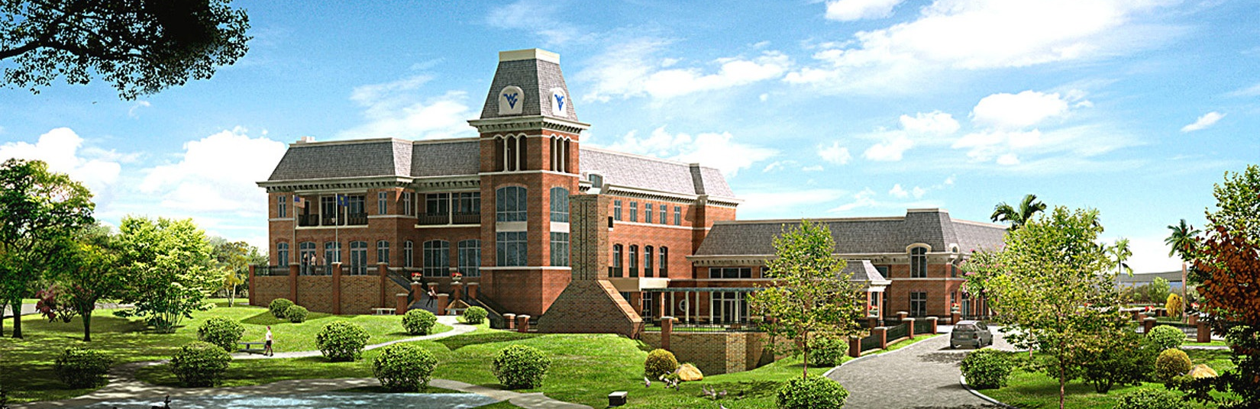
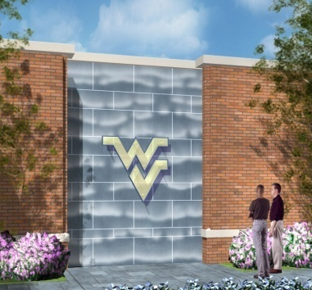
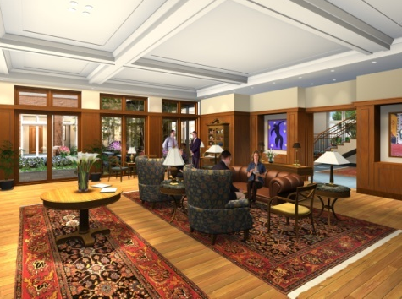
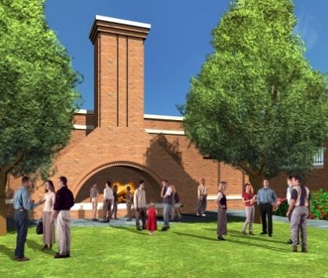
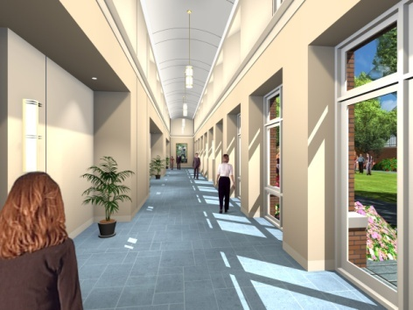
West Virginia University Alumni Center
Gregory Smithmyer | Mechanical Option | Penn State University | April 15, 2009 | Advisor: Dr. Srebric

Slide 2
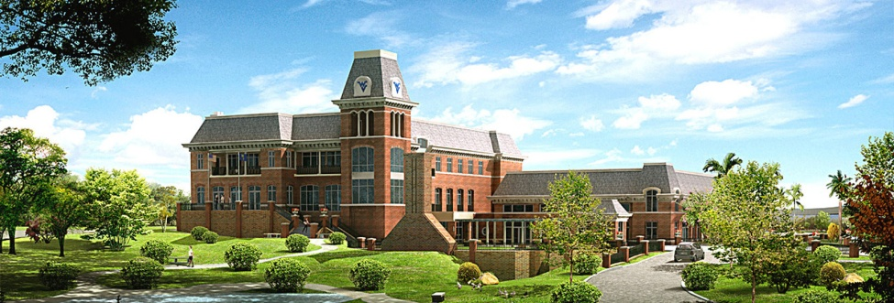
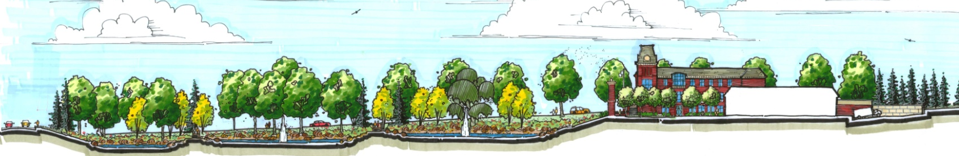
Existing Building Summary
WVU Alumni Center
Project Information
Existing Building Summary
Existing
Owner:
Location:
Size:
Date of Construction:
Cost:
Project Delivery Method:
Stories:
WVU Alumni Association
Morgantown, WV
48,000 Square Feet
June 2007-August 2008
$12 Million
Design-Bid-Build
3 (Bell Tower Extends to 4th)
Goals
Redesign Goals
Mechanical Redesign
Mechanical
Construction Breadth
Construction
Electrical
Electrical Breadth
Cost Analysis
Life-Cycle Cost Analysis
Gregory Smithmyer | Mechanical Option | Penn State University | April 15, 2009
Results and Conclusion
Conclusion

Slide 3
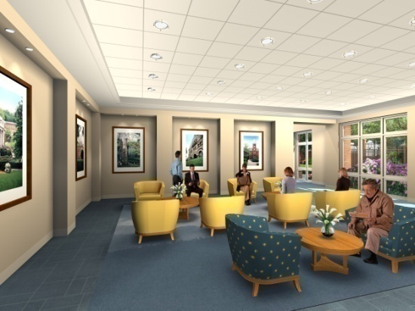
Existing Building Summary
First Floor
  Lobby
  Pre-Event Lounge
  Mechanical Room
  Commercial Kitchen
  Grand Ballroom
Existing
Goals
Second Floor
  Club Room/Lounge
  (4) Meeting Rooms
Mechanical
Construction
Third Floor
  Board Room
  Meeting Room
  Open Office Plan
  Enclosed Offices
Electrical
Cost Analysis
Gregory Smithmyer | Mechanical Option | Penn State University | April 15, 2009
Conclusion

Slide 4
Existing Building Summary
Original Mechanical System
Existing
Cooling
  Central plant with 2 air-cooled R-22 screw chillers
  35% ethylene glycol mix to AHU cooling coils
Goals
Mechanical
Heating
  Central plant with 2 natural gas boilers
  3000 MBH Input, 2400 MBH Output
  Hot water to AHU heating coils
  Hot water to VAV reheat
Construction
Electrical
Cost Analysis
Gregory Smithmyer | Mechanical Option | Penn State University | April 15, 2009
Conclusion

Slide 5
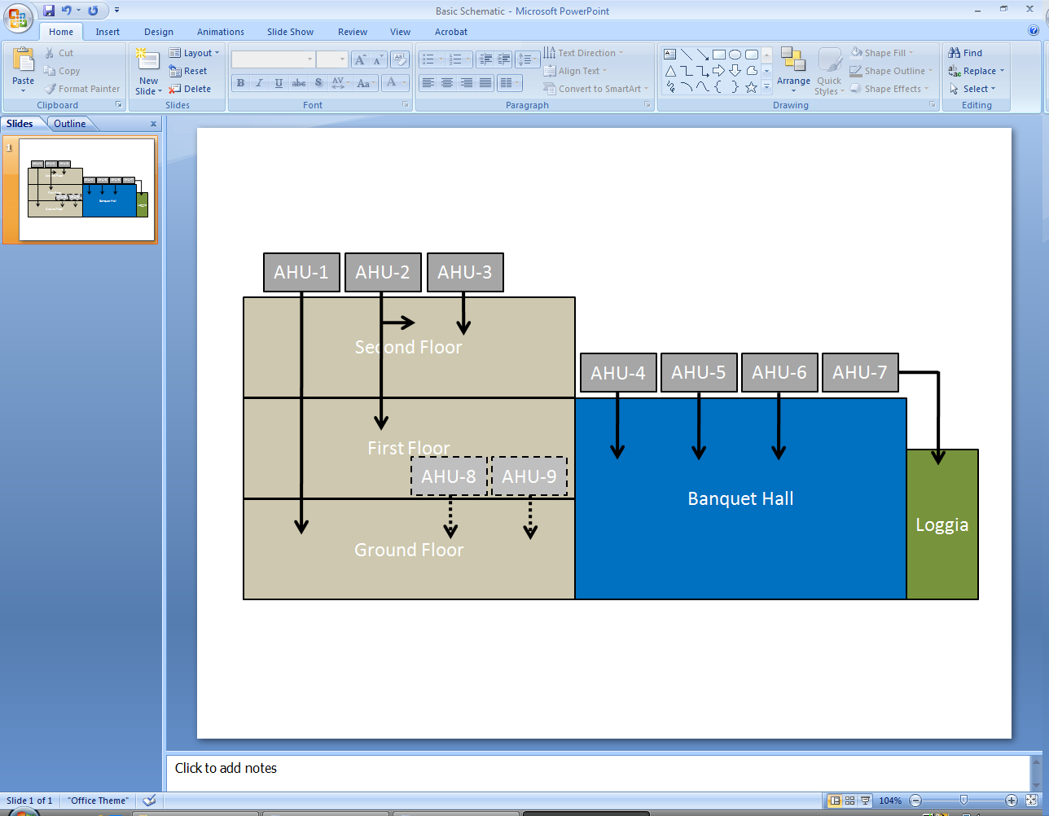
Existing Building Summary
As-Designed Mechanical System
Existing
Kitchen and Storage
  AHU-8: Single zone, constant volume
  AHU-9: 100% OA, make-up
Lobbies, hallways and office areas
  Direct expansion cooling
  Natural gas heat
  VAV with electric reheat
Ballroom and Loggia
  Direct expansion cooling
  Natural gas heat
  Single zone, constant volume
Goals
Mechanical
Construction
Electrical
Cost Analysis
Gregory Smithmyer | Mechanical Option | Penn State University | April 15, 2009
Conclusion

Slide 6
Existing Building Summary
Redesign Goals
Mechanical System
  Reduction in annual energy costs
  Low 20-year life-cycle cost
  Short return on investment
Existing
Existing Building Summary
Existing
Existing Building Summary
Goals
Redesign Goals
Goals
Redesign Goals
Construction
  Meet needs of mechanical system
  Lowest capital cost possible
  Minimal construction schedule impact
Mechanical Redesign
Mechanical
Construction Breadth
Construction
Electrical
  Minimize changes to electrical distribution system
  Minimize cost impact of changing mechanical loads
Electrical Breadth
Electrical
Cost Analysis
Life-Cycle Cost Analysis
Gregory Smithmyer | Mechanical Option | Penn State University | April 15, 2009
Conclusion
Results and Conclusion

Slide 7
Redesign Goals
Mechanical Redesign
Systems to be Replaced
Existing Building Summary
Existing
Redesign Goals
Goals
Redesign Goals
Goals
Mechanical
Mechanical
Mechanical Redesign
Mechanical Redesign
Construction Breadth
Construction
Electrical Breadth
Electrical
Cost Analysis
Life-Cycle Cost Analysis
Gregory Smithmyer | Mechanical Option | Penn State University | April 15, 2009
Conclusion
Results and Conclusion

Slide 8
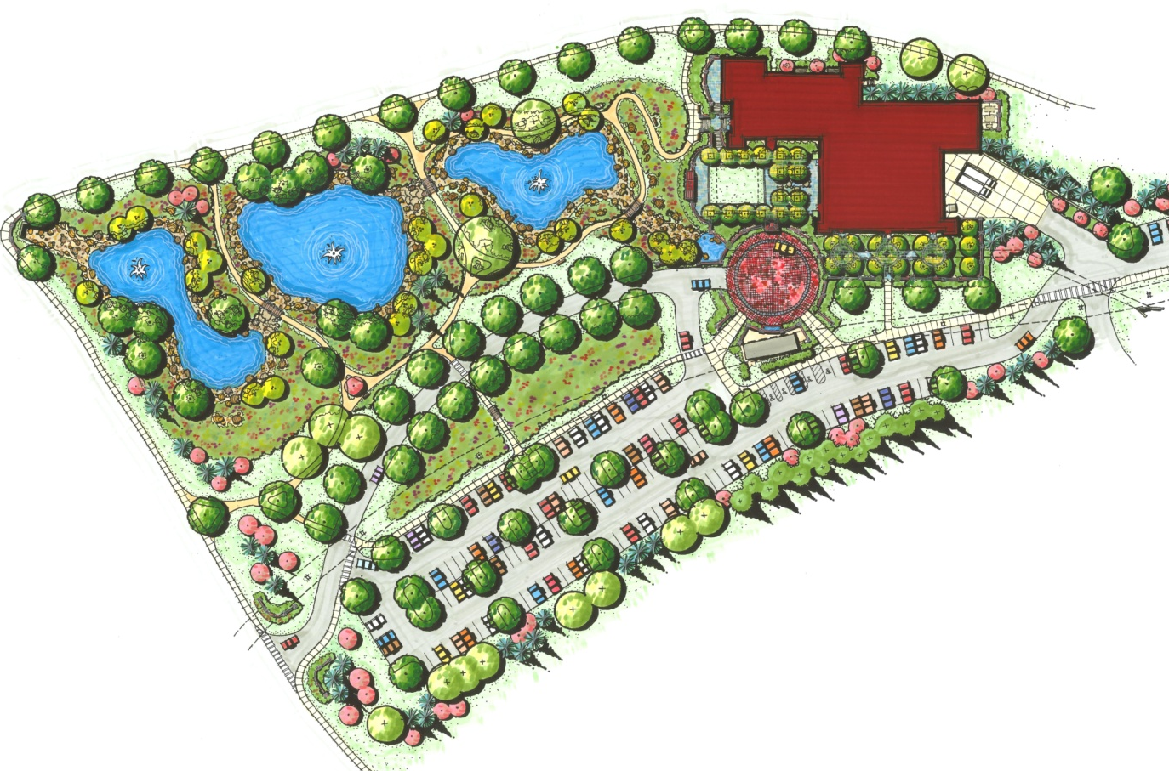
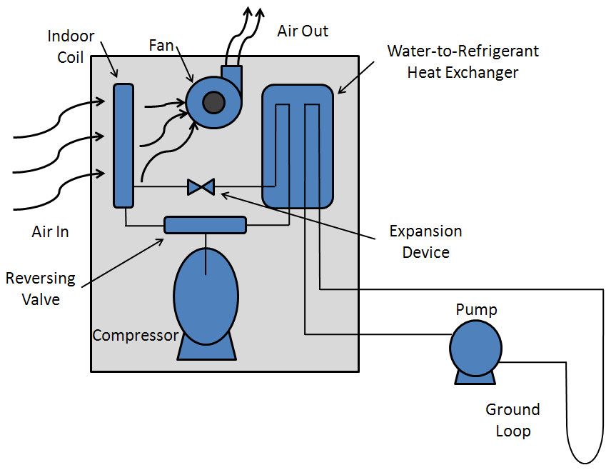
Mechanical Redesign
Ground Source Heat Pump System
Existing
Goals
Mechanical
Construction
Electrical
Cost Analysis
Gregory Smithmyer | Mechanical Option | Penn State University | April 15, 2009
Conclusion

Slide 9
Mechanical Redesign
Dedicated Outdoor Air System
Existing
OA
Goals
EA
OA
Unit
EA
Conditioned Space
Mechanical
RA
Construction
MA
SA
Heat Pump
Electrical
Cost Analysis
Gregory Smithmyer | Mechanical Option | Penn State University | April 15, 2009
Conclusion

Slide 10
Mechanical Redesign
Energy Recovery-Cooling
Existing
Goals
70.8°F
55 gr/lb
Mechanical
ε_{s} = 64%
ε_{l} = 61%
Construction
87°F
74.7°F
100 gr/lb
72 gr/lb
Electrical
W₃ = W₁ – ε_{l} (W₁ – W₂)
t₃ = t₁ – ε_{s} (t₁ – t₂)
Cost Analysis
Gregory Smithmyer | Mechanical Option | Penn State University | April 15, 2009
Conclusion

Slide 11
Mechanical Redesign
Equipment Costs
Existing
30 Water-to-Air Heat Pumps Instead of 26 VAV Boxes
Goals
ClimateMaster Model | Number of Units | Average EER | Total Cost
50PSH024 | 11 | 17 | $77,275
50PTH038 | 5 | 15.85 | $42,000
50PTH049 | 7 | 18.1 | $76,825
50PTH064 | 7 | 18 | $83,825
 | Total Heat Pump Cost |  | $279,925
Mechanical
Construction
Electrical
Cost Analysis
Gregory Smithmyer | Mechanical Option | Penn State University | April 15, 2009
Conclusion

Slide 12
Mechanical Redesign
Equipment Costs
Existing
7 Dedicated Outdoor Units Instead of 7 Existing AHU’s
Unit Designation | Latent Load (MBH) | Carrier Model Number | Cost
DOAU-1 | 64.6 | 62DA14 | $16,847
DOAU-2 | 179.4 | 62DA20 | $20,582
DOAU-3 | 59 | 62DA07 | $13,650
DOAU-4 | 92.5 | 62DA14 | $17,121
DOAU-5 | 92.5 | 62DA15 | $17,121
DOAU-6 | 92.5 | 62DA16 | $17,121
DOAU-7 | 100.2 | 62DA09 | $15,875
 |  | Total AHU Cost | $118,317
Goals
Mechanical
Construction
Electrical
Cost Analysis
Gregory Smithmyer | Mechanical Option | Penn State University | April 15, 2009
Conclusion

Slide 13
Mechanical Redesign
Annual Energy Analysis
Existing
$70,505
$70,505
$67,580
$67,580
Energy Cost Savings
  29% over LEED
  26% over As-Designed
  20% over Original Design
$62,761
$62,761
Goals
$49,910
$49,910
Mechanical
Emissions Savings (CO₂, SO₂, No_{x})
  12.5% over LEED
  11.7% over As-Designed
  8.5% over Original Design
Construction
Electrical
Cost Analysis
Gregory Smithmyer | Mechanical Option | Penn State University | April 15, 2009
Conclusion

Slide 14


Mechanical Redesign
Ground Loop Length Calculation
Existing
Goals
Mechanical
Construction
Heating and Cooling Loads
Electrical
Ground and Water Temperatures
Ground Resistance Factors
Cost Analysis
Gregory Smithmyer | Mechanical Option | Penn State University | April 15, 2009
Conclusion

Slide 15
Mechanical Redesign
Ground Loop Length Calculation
Existing
Heating Length
  Entering Water Temp: 35°F
  Exiting Water Temp: 45°F
  Heating Load: 945 MBH
  Total Length = 25,852 FT
Goals
CRITICAL LENGTH
Mechanical
Cooling Length
  Entering Water Temp: 85°F
  Exiting Water Temp: 75°F
  Cooling Load: 892 MBH
  Total Length = 19,858 FT
Construction
Electrical
Cost Analysis
Gregory Smithmyer | Mechanical Option | Penn State University | April 15, 2009
Conclusion

Slide 16
Mechanical Redesign
Construction Breadth
Construction Cost Optimization
Existing Building Summary
Existing
Borehole Field Cost Considerations
  Borehole drill rig
    Different rigs to dig different depths
  HDPE piping and fusing
  Borehole grouting
  Miscellaneous site costs
Redesign Goals
Goals
Mechanical Redesign
Mechanical
Mechanical
Mechanical Redesign
Construction
Construction Breadth
Construction Breadth
Construction
Electrical Breadth
Electrical
Cost Analysis
Life-Cycle Cost Analysis
Gregory Smithmyer | Mechanical Option | Penn State University | April 15, 2009
Conclusion
Results and Conclusion

Slide 17
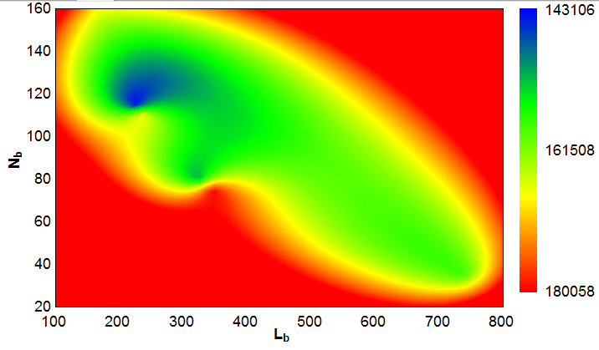
Construction Breadth
Construction Cost Optimization
Existing
Goals
Mechanical
Construction
Construction
115 Boreholes
225 ft Deep
$143,096
Electrical
Cost Analysis
Gregory Smithmyer | Mechanical Option | Penn State University | April 15, 2009
Conclusion

Slide 18
Construction Breadth
Construction Cost Optimization
Existing
Goals
Mechanical
Construction
Construction
~46,000 Square Feet
Electrical
Cost Analysis
Gregory Smithmyer | Mechanical Option | Penn State University | April 15, 2009
Conclusion

Slide 19
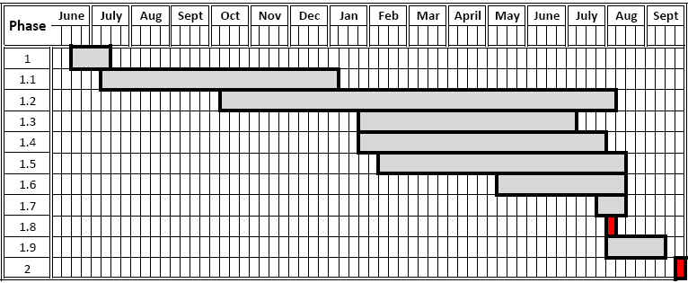
Construction Breadth
Schedule Optimization
Existing
Goals
Mechanical
Construction
Construction
Existing Activities
  1.1 – Structural Erection (6 Months)
  1.2 – Rough-in and Landscaping
  1.3 - Interior Finishes
  1.4 – Electrical Fit-out
  1.5 – Plumbing and Mechanical Fit out (3.5 Months)
  1.6 – Misc. Finishes
Electrical
Cost Analysis
Gregory Smithmyer | Mechanical Option | Penn State University | April 15, 2009
Conclusion

Slide 20
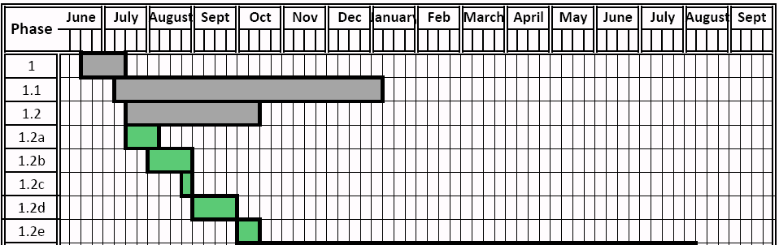
Construction Breadth
Schedule Optimization
Existing
Activities to be Added
  1.2a - Test Bore Construction and Testing (3 weeks)
  1.2b - Site Grading and Sediment Control (4 weeks)
  1.2c - Bore field Set-up (1 week)
  1.2d - Borehole Drilling (4 weeks)
  1.2e - Ground Loop Piping and Grouting (2 weeks)
Goals
Mechanical
Construction
Construction
Electrical
Cost Analysis
Gregory Smithmyer | Mechanical Option | Penn State University | April 15, 2009
Conclusion

Slide 21
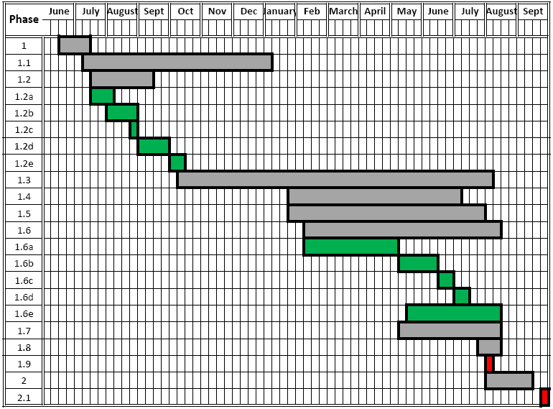
Construction Breadth
Schedule Optimization
Existing
Activities to be Added
  1.6a - Interior Piping and Equipment Installation (12 weeks)
  1.6b - Heat Pump Connections (5 weeks)
  1.6c - Flush and Test Ground Loops (2 weeks)
  1.6d - Testing and Air Balancing (2 weeks)
  1.6e - Plumbing Fit-out (12 weeks)
Goals
Mechanical
Construction
Construction
Electrical
Cost Analysis
Gregory Smithmyer | Mechanical Option | Penn State University | April 15, 2009
Conclusion

Slide 22
Construction Breadth
Electrical Breadth
Equipment Removed/Added
Existing Building Summary
Existing
Removed
  7 AHU circuits
  18 VAV box circuits
Redesign Goals
Goals
Added
  7 DOAU circuits
  14 Heat Pump Circuits
Mechanical Redesign
Mechanical
Construction
Construction Breadth
Construction Breadth
Construction
Electrical
Electrical Breadth
Electrical Breadth
Electrical
Cost Analysis
All loads are 3 Phase, 480V
Life-Cycle Cost Analysis
Gregory Smithmyer | Mechanical Option | Penn State University | April 15, 2009
Conclusion
Results and Conclusion

Slide 23
Electrical Breadth
Electrical Cost Adjustments
Conductor Costs
Existing
Breaker Costs
Conduit Costs
Conductor/Ground Size | Cost Per 100 Linear Ft | FT Wire | Cost
#2 | $122.50 | 1032 | $1,264.20
#1 | $195.00 | 258 | $503.10
#4 | $97.50 | -1290 | -$1,257.75
#10 | $46.00 | -289 | -$132.94
 | Total Conductor Cost: |  | $376.61
Conduit Size | Cost Per 100 Linear Ft | FT Wire | Cost
3/4" | $4.35 | -72 | -$3.13
1-1/4" | $5.75 | -258 | -$14.84
1-1/2" | $6.30 | 258 | $16.25
 | Total Conduit Cost: |  | -$1.71
Breaker Size | Cost per | # | Cost
90A/3P | $535.00 | 4 | $2,140.00
70A/3P | $511.00 | -5 | -$2,555.00
110A/3P | $555.00 | 1 | $555.00
20A/3P | $454.00 | -2 | -$908.00
 | Total Breaker Cost: |  | -$768.00
Goals
Mechanical
Construction
Electrical
Total Savings = $392.49
Electrical
Cost Analysis
Gregory Smithmyer | Mechanical Option | Penn State University | April 15, 2009
Conclusion

Slide 24
Electrical Breadth
Voltage Drop Check
Existing
Equipment Connected | Conductor Size | Length (FT) | Amps | Voltage Drop per 1000 Amp-FT | Line to Line Voltage Drop | % Voltage Drop | Less than 3%?
DOAU-1 | #2 | 52 | 75 | 0.20 | 1.32 | 0.28% | Yes
DOAU-2 | #1 | 67 | 95 | 0.16 | 1.78 | 0.37% | Yes
DOAU-3 | #2 | 58 | 75 | 0.20 | 1.51 | 0.31% | Yes
DOAU-4 | #2 | 95 | 75 | 0.20 | 2.47 | 0.51% | Yes
DOAU-5 | #2 | 125 | 75 | 0.20 | 3.24 | 0.68% | Yes
DOAU-6 | #2 | 155 | 75 | 0.20 | 4.02 | 0.84% | Yes
DOAU-7 | #1 | 130 | 100 | 0.16 | 3.60 | 0.75% | Yes
Goals
Mechanical
Construction
Assumed PF of 90%
Electrical
Electrical
All Below 3%
%VD=(L)(VD/1000 ft)(1.73)/(480)
Cost Analysis
Gregory Smithmyer | Mechanical Option | Penn State University | April 15, 2009
Conclusion

Slide 25
Electrical Breadth
Life-Cycle Cost Analysis
20-Year Life-Cycle Cost
Existing Building Summary
Existing
Costs Included
  Construction, installation, equipment costs
  Annual energy costs
  Annual preventive maintenance costs
  Scheduled replacement costs
Redesign Goals
Goals
Mechanical Redesign
Mechanical
Construction Breadth
Construction
Electrical
Electrical Breadth
Electrical Breadth
Electrical
Life-Cycle Cost Analysis
Cost Analysis
Cost Analysis
Life-Cycle Cost Analysis
Gregory Smithmyer | Mechanical Option | Penn State University | April 15, 2009
Conclusion
Results and Conclusion

Slide 26
Life-Cycle Cost Analysis
20-Year Life-Cycle Cost
Existing
As-Designed
  Capital Cost = $1.42 million
  Maintenance and Repair Costs = $218,000
  Energy Costs = $1.35 million
Goals
Re-Design
  Capital Cost = $1.52 million
  Maintenance and Repair Costs = $96,000
  Energy Costs = $1.00 million
Mechanical
Construction
Life-Cycle Savings = $380,000
Electrical
Payback Period = 4.99 Years
Cost Analysis
Cost Analysis
Gregory Smithmyer | Mechanical Option | Penn State University | April 15, 2009
Conclusion

Slide 27
Life-Cycle Cost Analysis
20-Year Life-Cycle Cost
Existing
Original Design
  Capital Cost = $1.47 million
  Maintenance and Repair Costs = $202,000
  Energy Costs = $1.26 million
Goals
Re-Design
  Capital Cost = $1.52 million
  Maintenance and Repair Costs = $96,000
  Energy Costs = $1.00 million
Mechanical
Construction
Life-Cycle Savings = $318,000
Electrical
Payback Period = 2.83 Years
Cost Analysis
Cost Analysis
Gregory Smithmyer | Mechanical Option | Penn State University | April 15, 2009
Conclusion

Slide 28
Life-Cycle Cost Analysis
Results and Conclusion
Results and Conclusion
Existing Building Summary
Existing
Recommended Over Original Design
  $45,000 increase in capital cost
  $13,000 reduction in annual energy cost
  Payback period of 2.83 years
Redesign Goals
Goals
Mechanical Redesign
Mechanical
Recommended Over Existing Design
  $100,000 increase in capital cost
  $17,500 reduction in annual energy cost
  Payback period of 4.99 years
  Minimal impact on construction time
  Minimal impact on electrical system
Construction Breadth
Construction
Electrical Breadth
Electrical
Cost Analysis
Cost Analysis
Life-Cycle Cost Analysis
Life-Cycle Cost Analysis
Gregory Smithmyer | Mechanical Option | Penn State University | April 15, 2009
Conclusion
Conclusion
Results and Conclusion
Results and Conclusion

Slide 29
Results and Conclusion
Existing
Goals
Questions?
Mechanical
Construction
Electrical
Cost Analysis
Gregory Smithmyer | Mechanical Option | Penn State University | April 15, 2009
Conclusion
Conclusion

Slide 30
Mechanical Redesign
Energy Recovery-Heating
Existing
Goals
66°F
Mechanical
ε_{s} = 64%
ε_{l} = 61%
Construction
10°F
46°F
Electrical
W₃ = W₁ – ε_{l} (W₁ – W₂)
t₃ = t₁ – ε_{s} (t₁ – t₂)
Cost Analysis
Gregory Smithmyer | Mechanical Option | Penn State University | April 15, 2009
Conclusion

Slide 31
Mechanical Redesign
Monthly Electric and Gas Costs
Existing
Electrical Cost Savings
  $377/month over Original Design
  $721/month over As-Designed
Goals
Mechanical
Gas Cost Savings
  $694/month over Original Design
  $751/month over As-Designed
Construction
Electrical
Cost Analysis
Gregory Smithmyer | Mechanical Option | Penn State University | April 15, 2009
Conclusion

Slide 32
Mechanical Redesign
Ductwork and Insulation Savings
Existing
Assumptions
  185 lbs of sheet metal per ton of cooling
  104 SF of insulation per ton of cooling
Goals
As-Designed
  202 tons of cooling
  Ductwork = $117,450
  Insulation = $73,080
Mechanical
Construction
Re-Design
  57 tons of cooling
  Ductwork = $109,000
  Insulation = $61,950
Electrical
Total Savings = $19,580
Cost Analysis
Gregory Smithmyer | Mechanical Option | Penn State University | April 15, 2009
Conclusion

Slide 33
Construction Breadth
Construction Cost Optimization
Existing
Goals
Mechanical
Construction
Construction
Electrical
Cost Analysis
Gregory Smithmyer | Mechanical Option | Penn State University | April 15, 2009
Conclusion

Slide 34
Construction Breadth
Construction Cost Optimization
Existing
Equipment and Material Assumptions
  1” HDPE Piping = $1.32 per linear foot
  HDPE fusing at 40 ft intervals, $20/fuse, $50/day rental
  Borehole drill
    Deeper than 325 ft = $16,000/week, 900 ft/day
    225 ft – 325 ft = $14,000/week, 1200 ft/day
    Less than 225 ft = $11,500/week, 1800 ft/day
  Grouting = $5,780 for all combinations
  Site costs ranges from $20,000 to $32,500
Goals
Mechanical
Construction
Construction
Electrical
Cost Analysis
Gregory Smithmyer | Mechanical Option | Penn State University | April 15, 2009
Conclusion

Slide 35
Electrical Breadth
Assumptions
Existing
Demand Factor Assumptions
  Lighting = 1
  Receptacles = 0.5
  Motors = 0.3
  Miscellaneous = 1
  Kitchen = 1
  Data = 0.5
  A/C = 1
Goals
Mechanical
Construction
Electrical
Electrical
Cost Analysis
Gregory Smithmyer | Mechanical Option | Penn State University | April 15, 2009
Conclusion

