Slide 1
Structural Redesign of the Army National Guard Readiness Center
Presented By:
Amanda C. Farace
Faculty Consultant:
Dr. Thomas Boothby
The Department of Architectural Engineering
The Pennsylvania State University
April 13, 2010

Slide 2
Presentation Outline
Presentation Outline
Introduction & Building Overview
Introduction
Location
Building Statistics
Existing Structural Conditions
Structural Depth Analysis
Proposal Summary
Design Goals
Gravity System Redesign
Lateral System Redesign
Progressive Collapse Design
Breadth Studies
Construction Management Analysis
Acoustical Analysis
Recommendations & Conclusions
Questions
Introduction & Building Overview
Introduction
Location
Building Statistics
Existing Structural Conditions
Structural Depth Analysis
Breadth Studies
Recommendations & Conclusions
Questions
Amanda C. Farace
Army National Guard Readiness Center

Slide 3
Presentation Outline
Introduction
Introduction & Building Overview
Introduction
Location
Building Statistics
Existing Structural Conditions
Structural Depth Analysis
Breadth Studies
Recommendations & Conclusions
Questions
Introduction
Location
Amanda C. Farace
Army National Guard Readiness Center

Slide 4
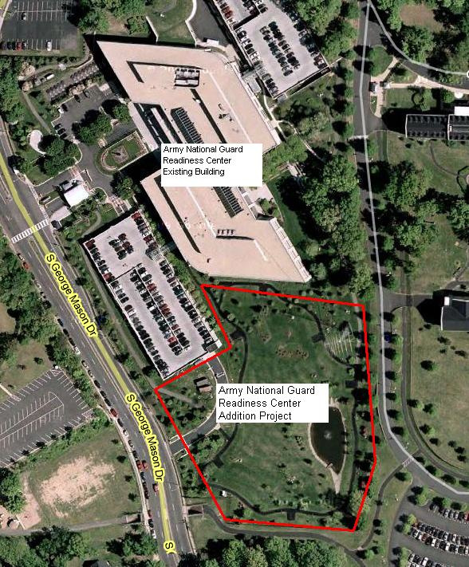
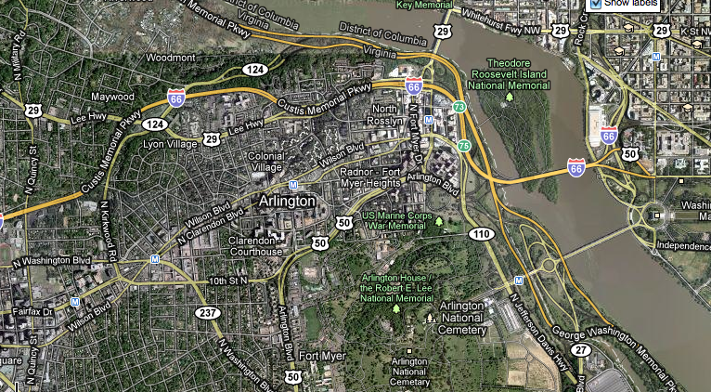
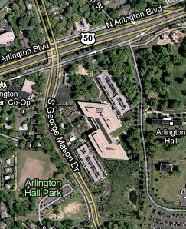
Presentation Outline
Location
111 S. George Mason Dr., Arlington, Virginia
Approximately 5 miles outside of Washington D.C.
On the same site as the location of the current Army National Guard Building
Introduction & Building Overview
Introduction
Location
Building Statistics
Existing Structural Conditions
Structural Depth Analysis
Breadth Studies
Recommendations & Conclusions
Questions
15 acre site
Includes a 248,000 square foot existing facility, two 3-2tory parking garages, and several small out buildings.
Amanda C. Farace
Army National Guard Readiness Center

Slide 5
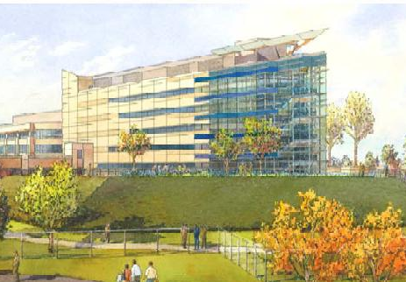
Presentation Outline
Building Statistics
Joint Headquarters Administrative Building
5 Stories Above Grade and 3 Below
Includes Offices, Training Areas, Auditorium and more
Square Footage
251,000 Gross Square footage
Architecture
Unique Triangular shape
Façade mimics existing building
Project Duration
December 2008-March 2011
Project Delivery Method
Design-Bid-Build
Cost
$100 Million
Anticipated to Achieve LEED Silver Rating
Introduction & Building Overview
Introduction
Location
Building Statistics
Existing Structural Conditions
Structural Depth Analysis
Breadth Studies
Recommendations & Conclusions
Questions
Amanda C. Farace
Army National Guard Readiness Center

Slide 6
Presentation Outline
Introduction
Introduction & Building Overview
Introduction
Location
Building Statistics
Existing Structural Conditions
Structural Depth Analysis
Breadth Studies
Recommendations & Conclusions
Questions
Introduction
Existing Structural Conditions
Amanda C. Farace
Army National Guard Readiness Center

Slide 7
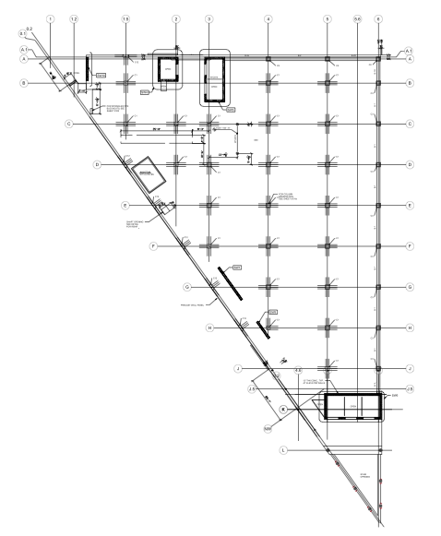
Presentation Outline
Existing Gravity System
Floor System
9” Two-way reinforced concrete flat slab
Column strips and edge beams
f’_{c}=4,000 psi
Typical No. 6 and No. 8 reinforcement
Columns
Cast-in-place reinforced normal weight concrete
Typical 22” x 22”
Typical No. 8 reinforcement
Typical No. 3 ties
Foundation
32” concrete mat slab
Existing Structural Plan
Introduction & Building Overview
Introduction
Location
Building Statistics
Existing Structural Conditions
Structural Depth Analysis
Breadth Studies
Recommendations & Conclusions
Questions
Amanda C. Farace
Army National Guard Readiness Center

Slide 8
Presentation Outline
Existing Lateral System
Location of Shear Walls:
Introduction & Building Overview
Introduction
Location
Building Statistics
Existing Structural Conditions
Structural Depth Analysis
Breadth Studies
Recommendations & Conclusions
Questions
Lateral System
Ordinary reinforced concrete shear walls
12” Thickness
Both North-South and East-West direction
f’_{c}=4,500 psi
Located around elevator cores and stairwells as well as along the corridor of the long side
Amanda C. Farace
Army National Guard Readiness Center

Slide 9
Presentation Outline
Structural Depth Analysis
Introduction & Building Overview
Structural Depth Analysis
Proposal Summary
Design Goals
Gravity System Redesign
Lateral System Redesign
Progressive Collapse Design
Breadth Studies
Recommendations & Conclusions
Questions
Structural Depth Study
Proposal Summary
Amanda C. Farace
Army National Guard Readiness Center

Slide 10
Presentation Outline
Proposal Summary
Depth Study
Redesign of the structural system to include a steel framing system as opposed to the existing cast-in-place concrete structure in order to compare the structural systems to determine which building material is more beneficial.
Gravity System
Composite metal decking with composite beams and steel columns
Lateral System
Ordinary-Moment Resisting Frames
Progressive Collapse Design
Breadth Topics
Construction Management Analysis
Acoustics Analysis
Introduction & Building Overview
Structural Depth Analysis
Proposal Summary
Design Goals
Gravity System Redesign
Lateral System Redesign
Progressive Collapse Design
Breadth Studies
Recommendations & Conclusions
Questions
Amanda C. Farace
Army National Guard Readiness Center

Slide 11
Presentation Outline
Design Goals
Respect the existing layout and architectural features of the building
Choose a single lateral system and layout that will work effectively
Design the structural steel system for progressive collapse mitigation
Design a structural steel system that reduces overall building costs
Reduce the construction schedule by designing a steel structural system that is more efficient to erect
Introduction & Building Overview
Structural Depth Analysis
Proposal Summary
Design Goals
Gravity System Redesign
Lateral System Redesign
Progressive Collapse Design
Breadth Studies
Recommendations & Conclusions
Questions
Amanda C. Farace
Army National Guard Readiness Center

Slide 12
Presentation Outline
Structural Depth Analysis
Introduction & Building Overview
Structural Depth Analysis
Proposal Summary
Design Goals
Gravity System Redesign
Lateral System Redesign
Progressive Collapse Design
Breadth Studies
Recommendations & Conclusions
Questions
Structural Depth Study
Gravity System Redesign
Amanda C. Farace
Army National Guard Readiness Center

Slide 13
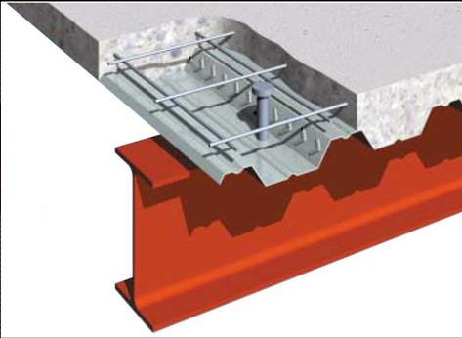
Presentation Outline
Gravity System Redesign
Beam, Girder, and Slab Design
Composite metal deck with concrete slab
3VLI, 19” gage metal deck
3 ½” Concrete Slab
Advantages:
Slab design meets 3 hour fire rating
No shoring is required
Quicker and Easier to erect
Disadvantages:
Infill beams are required
Deeper floor assembly
Typical Bay Sizes:
Introduction & Building Overview
Structural Depth Analysis
Proposal Summary
Design Goals
Gravity System Redesign
Lateral System Redesign
Progressive Collapse Design
Breadth Studies
Recommendations & Conclusions
Questions
28’
28’
25’
Concrete Slab
Welded Wire Fabric
Shear Stud
Steel Deck
Steel Beam
Amanda C. Farace
Army National Guard Readiness Center

Slide 14
Presentation Outline
Gravity System Redesign
Beam, Girder, and Slab Design
Infill Beams and Girders
Composite members
Typical beams: W12’s
Typical Girders: W18’s
Advantages:
Lighter than concrete
Span long and irregular bays
Erected Quicker than concrete
Disadvantages:
Require Fireproofing
Deeper floor assembly
Typical Floor Layout:
Introduction & Building Overview
Structural Depth Analysis
Proposal Summary
Design Goals
Gravity System Redesign
Lateral System Redesign
Progressive Collapse Design
Breadth Studies
Recommendations & Conclusions
Questions
W18 x 35
W12 x 14
W12 x 14
W12 x 14
W18 x 35
Amanda C. Farace
Army National Guard Readiness Center

Slide 15
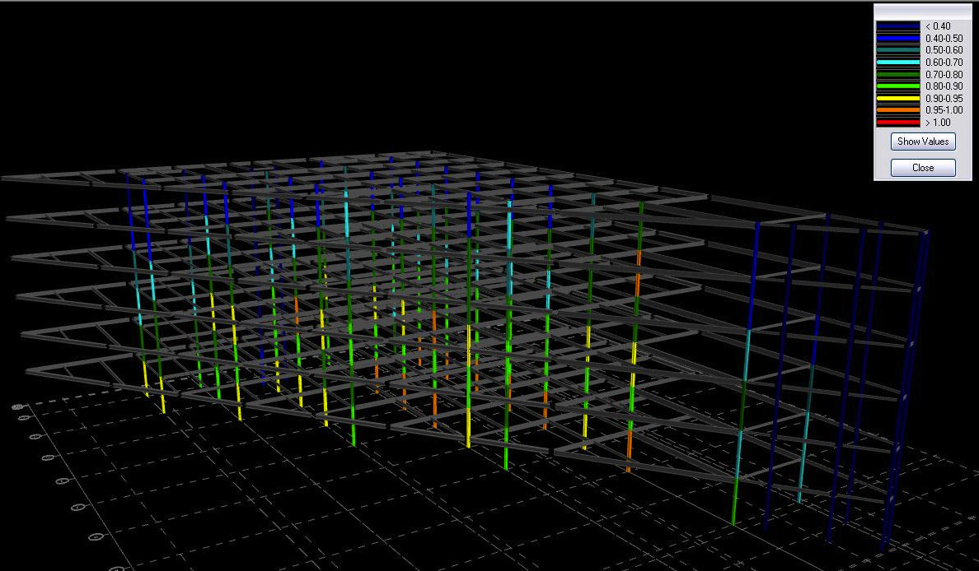
Presentation Outline
Gravity System Redesign
Column Design
Typical size: W10’s
Live load reduction used in accordance with ASCE 7-05
Spliced at every other level
Optimized to increase the redundancy of shapes
Advantages:
Lighter than concrete
No affect on existing architecture
Erected Quicker than concrete
Disadvantages:
Require Fireproofing
RAM Model – Interaction Diagrams:
Introduction & Building Overview
Structural Depth Analysis
Proposal Summary
Design Goals
Gravity System Redesign
Lateral System Redesign
Progressive Collapse Design
Breadth Studies
Recommendations & Conclusions
Questions
Amanda C. Farace
Army National Guard Readiness Center

Slide 16
Presentation Outline
Structural Depth Analysis
Introduction & Building Overview
Structural Depth Analysis
Proposal Summary
Design Goals
Gravity System Redesign
Lateral System Redesign
Progressive Collapse Design
Breadth Studies
Recommendations & Conclusions
Questions
Structural Depth Study
Lateral System Redesign
Amanda C. Farace
Army National Guard Readiness Center

Slide 17
Presentation Outline
Lateral System Redesign
Lateral System Design Loads
Wind Loads
Location Parameters for Arlington, VA
ASCE 7-05, Chapter 6
Design Method 2 – Analytical Method
Controls lateral design in both East-West and North-South directions
Wind Forces in East-West Direction:
Introduction & Building Overview
Structural Depth Analysis
Proposal Summary
Design Goals
Gravity System Redesign
Lateral System Redesign
Progressive Collapse Design
Breadth Studies
Recommendations & Conclusions
Questions
Wind Forces in North-South Direction:
Amanda C. Farace
Army National Guard Readiness Center

Slide 18
Presentation Outline
Lateral System Redesign
Lateral System Design Loads
Seismic Loads
Ground Parameters for site location
ASCE 7-05, Chapters 11 & 12
Equivalent Lateral Force Analysis Method
Introduction & Building Overview
Structural Depth Analysis
Proposal Summary
Design Goals
Gravity System Redesign
Lateral System Redesign
Progressive Collapse Design
Breadth Studies
Recommendations & Conclusions
Questions
Seismic Forces:
Amanda C. Farace
Army National Guard Readiness Center

Slide 19
Presentation Outline
Lateral System Redesign
Serviceability Standards
Allowable Drift & Displacement
Wind
< h/400
Seismic
< 0.020h_{x}
Values taken from RAM model and compared to allowable drift and displacement values
Serviceability Controls in the East-West Direction
Drift in East-West Direction:
Introduction & Building Overview
Structural Depth Analysis
Proposal Summary
Design Goals
Gravity System Redesign
Lateral System Redesign
Progressive Collapse Design
Breadth Studies
Recommendations & Conclusions
Questions
Displacement in East-West Direction:
Amanda C. Farace
Army National Guard Readiness Center

Slide 20
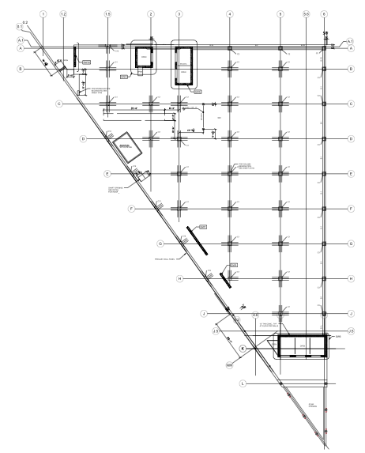
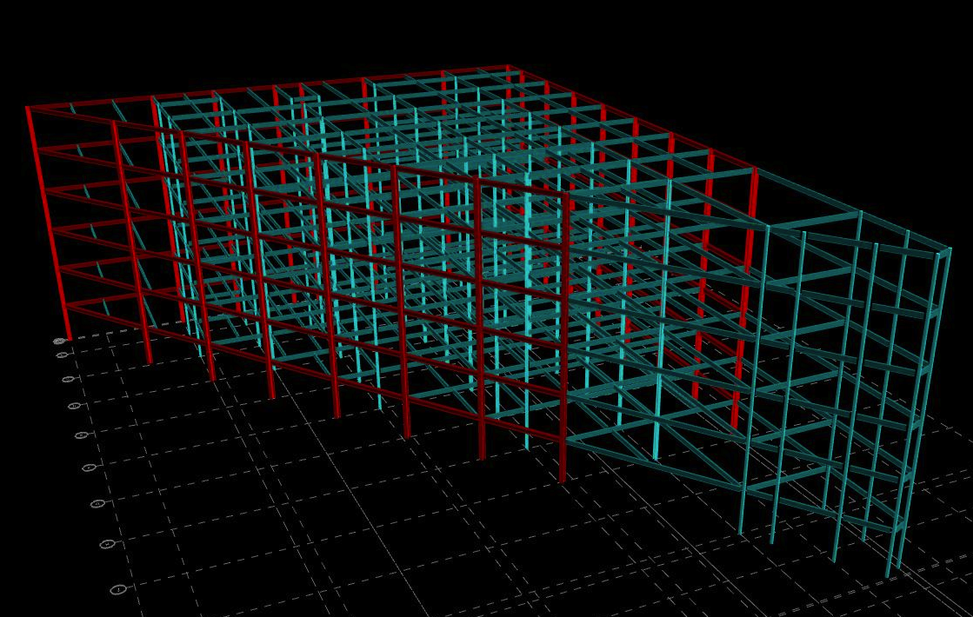
Presentation Outline
Lateral System Redesign
Steel Moment Resisting Frames
Located around the perimeter of the building
Controlled by wind loads in north-south direction and serviceability in east-west direction
Optimized to increase the redundancy of shapes
Advantages:
Lighter than concrete
Minimal affect on existing architecture
Erected Quicker than concrete
Disadvantages:
Require Fireproofing
Expensive connections
Deep Members
Location of Moment Frames:
Introduction & Building Overview
Structural Depth Analysis
Proposal Summary
Design Goals
Gravity System Redesign
Lateral System Redesign
Progressive Collapse Design
Breadth Studies
Recommendations & Conclusions
Questions
RAM Model:
Green Elements – Gravity Members
Red Elements – Lateral Members
Amanda C. Farace
Army National Guard Readiness Center

Slide 21
Presentation Outline
Structural Depth Analysis
Introduction & Building Overview
Structural Depth Analysis
Proposal Summary
Design Goals
Gravity System Redesign
Lateral System Redesign
Progressive Collapse Design
Breadth Studies
Recommendations & Conclusions
Questions
Structural Depth Study
Progressive Collapse Design
Amanda C. Farace
Army National Guard Readiness Center

Slide 22
Presentation Outline
Progressive Collapse Design
Definition of Progressive Collapse
Commentary found in ASCE 7-05 defines progressive collapse as…
“the spread of an initial local failure from element to element, eventually resulting in the collapse of an entire structure of a disproportionately large part of it.”
ASCE and material specific codes do not provide explicit and enforceable requirements
Introduction & Building Overview
Structural Depth Analysis
Proposal Summary
Design Goals
Gravity System Redesign
Lateral System Redesign
Progressive Collapse Design
Breadth Studies
Recommendations & Conclusions
Questions
General Services Administration (GSA)
Progressive Collapse Analysis and Design Guidelines (2003)
Department of Defense (DoD)
Unified Facilities Criteria – Design of Buildings to Resist with Progressive Collapse (UFC 4-023-03)
Amanda C. Farace
Army National Guard Readiness Center

Slide 23
Presentation Outline
Progressive Collapse Design
Analysis 1 - Direct Design Approach:
Localizes building failure by requiring the structure be capable of bridging over missing structural elements
GSA Guidelines
Threat Level – High Level of Protection
Assumes instantaneous loss of critical column
Plastic Analysis using virtual work method
Load Combination: 2(DL+0.25LL)
Demand Capacity Ratios (DCR) for each member
Plastic Hinge Formation:
Introduction & Building Overview
Structural Depth Analysis
Proposal Summary
Design Goals
Gravity System Redesign
Lateral System Redesign
Progressive Collapse Design
Breadth Studies
Recommendations & Conclusions
Questions
Q_{UD}=Demand Capacity
Q_{CE}=Expected Capacity
Amanda C. Farace
Army National Guard Readiness Center

Slide 24
Presentation Outline
Progressive Collapse Design
Analysis 1 - Direct Design Approach:
Localizes building failure by requiring the structure be capable of bridging over missing structural elements
GSA Guidelines
Threat Level – High Level of Protection
Assumes instantaneous loss of critical column
Plastic Analysis using virtual work method
Load Combination: 2(DL+0.25LL)
Demand Capacity Ratios (DCR) for each member
Bays Designed:
Introduction & Building Overview
Structural Depth Analysis
Proposal Summary
Design Goals
Gravity System Redesign
Lateral System Redesign
Progressive Collapse Design
Breadth Studies
Recommendations & Conclusions
Questions
Q_{UD}=Demand Capacity
Q_{CE}=Expected Capacity
Amanda C. Farace
Army National Guard Readiness Center

Slide 25
Presentation Outline
Progressive Collapse Design
Analysis 1 - Direct Design Approach:
Localizes building failure by requiring the structure be capable of bridging over missing structural elements
GSA Guidelines
Threat Level – High Level of Protection
Assumes instantaneous loss of critical column
Plastic Analysis using virtual work method
Load Combination: 2(DL+0.25LL)
Demand Capacity Ratios (DCR) for each member
Member Sizes:
Introduction & Building Overview
Structural Depth Analysis
Proposal Summary
Design Goals
Gravity System Redesign
Lateral System Redesign
Progressive Collapse Design
Breadth Studies
Recommendations & Conclusions
Questions
W21 x 44
W21 x 44
W 14 x 257
W21 x 73
W21 x 73
W 14 x 257
W27 x 102
W27 x 102
W 14 x 257
W33 x 118
W33 x 118
W 14 x 257
Q_{UD}=Demand Capacity
Q_{CE}=Expected Capacity
W33 x 152
W33 x 152
W 14 x 257
Amanda C. Farace
Army National Guard Readiness Center

Slide 26
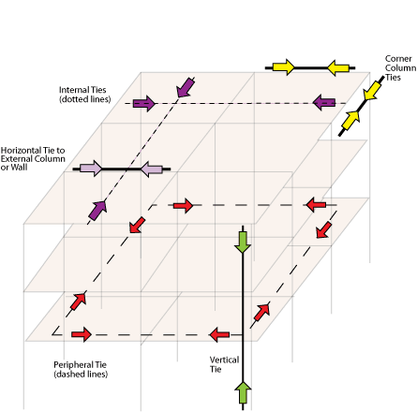
Presentation Outline
Progressive Collapse Design
Analysis 2 - Indirect Method:
Requires consideration of strength, continuity, and ductility of connections for resisting progressive collapse
DoD Guidelines
Threat Level – Low Level of Protection (LLOP)
Requires the structure be mechanically tied
Peripheral Ties
Internal Ties
Ties to Columns
Vertical Ties
Horizontal Ties
Typical Moment connections can meet these requirements
Tie Forces:
Introduction & Building Overview
Structural Depth Analysis
Proposal Summary
Design Goals
Gravity System Redesign
Lateral System Redesign
Progressive Collapse Design
Breadth Studies
Recommendations & Conclusions
Questions
Amanda C. Farace
Army National Guard Readiness Center

Slide 27
Presentation Outline
Progressive Collapse Design
Analysis 2 - Indirect Method:
Requires consideration of strength, continuity, and ductility of connections for resisting progressive collapse
DoD Guidelines
Threat Level – Low Level of Protection (LLOP)
Requires the structure be mechanically tied
Peripheral Ties
Internal Ties
Ties to Columns
Vertical Ties
Horizontal Ties
Typical Moment connections can meet these requirements
Tie Force Requirement Equations:
Internal Tie Forces = 0.5(1.2DL+1.6LL)S_{t}L₁
Peripheral Tie Forces = 0.25(1.2 DL+1.6LL)S_{t}L₁
Column Ties:
Horizontal Tie Forces
Vertical Tie Forces = (A_{TRIB})(1.2DL+1.6LL)
Introduction & Building Overview
Structural Depth Analysis
Proposal Summary
Design Goals
Gravity System Redesign
Lateral System Redesign
Progressive Collapse Design
Breadth Studies
Recommendations & Conclusions
Questions
Amanda C. Farace
Army National Guard Readiness Center

Slide 28
Presentation Outline
Breadth Studies
Introduction & Building Overview
Structural Depth Analysis
Breadth Studies
Construction Management Analysis
Acoustical Analysis
Recommendations & Conclusions
Questions
Breadth Studies
Construction Management Analysis
Amanda C. Farace
Army National Guard Readiness Center

Slide 29
Presentation Outline
Construction Management Analysis
Cost Analysis
Existing Concrete Structure Costs
Proposed Steel Structure Costs
Introduction & Building Overview
Structural Depth Analysis
Breadth Studies
Construction Management Analysis
Acoustical Analysis
Recommendations & Conclusions
Questions
Amanda C. Farace
Army National Guard Readiness Center

Slide 30
Presentation Outline
Construction Management Analysis
Introduction & Building Overview
Structural Depth Analysis
Breadth Studies
Construction Management Analysis
Acoustical Analysis
Recommendations & Conclusions
Questions
Schedule Analysis
Existing Concrete Structure Costs
5 Construction Zones
Floor to Floor Construction
Multiple crews used for forming
Approximately 67 Days per Floor
Total Construction: 337 Days
Amanda C. Farace
Army National Guard Readiness Center

Slide 31
Presentation Outline
Construction Management Analysis
Introduction & Building Overview
Structural Depth Analysis
Breadth Studies
Construction Management Analysis
Acoustical Analysis
Recommendations & Conclusions
Questions
Schedule Analysis
Proposed Steel Structure Costs
5 Construction Zones
Floor to Floor Construction
Single crews used
Approximately 28 Days per Floor
Total Construction: 171 Days
Amanda C. Farace
Army National Guard Readiness Center

Slide 32
Presentation Outline
Construction Management Analysis
Results
Reduced schedule by 166 days
Saved Approximately $125,000
Introduction & Building Overview
Structural Depth Analysis
Breadth Studies
Construction Management Analysis
Acoustical Analysis
Recommendations & Conclusions
Questions
Amanda C. Farace
Army National Guard Readiness Center

Slide 33
Presentation Outline
Breadth Studies
Introduction & Building Overview
Structural Depth Analysis
Breadth Studies
Construction Management Analysis
Acoustical Analysis
Recommendations & Conclusions
Questions
Breadth Studies
Acoustical Analysis
Amanda C. Farace
Army National Guard Readiness Center

Slide 34
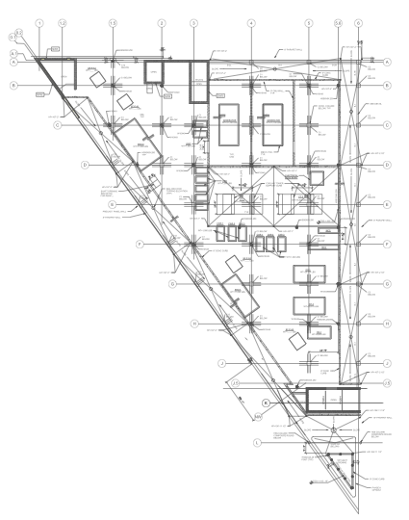
Presentation Outline
Acoustical Analysis
Area under Cooling Towers:
Due to reduction in the concrete thickness possible acoustical issues may be induced
Noise transmission from the mechanical penthouse to the office spaces on Level 5T must be checked
The area under two cooling towers was considered
Introduction & Building Overview
Structural Depth Analysis
Breadth Studies
Construction Management Analysis
Acoustical Analysis
Recommendations & Conclusions
Questions
Amanda C. Farace
Army National Guard Readiness Center

Slide 35
Presentation Outline
Acoustical Analysis
Due to reduction in the concrete thickness possible acoustical issues may be induced
Noise transmission from the mechanical penthouse to the office spaces on Level 5T must be checked
The area under two cooling towers was considered
Existing Floor System:
9” Concrete slab
Additional 6” concrete below the equipment base
Proposed Floor System:
3 VLI metal deck with 3 ½” concrete slab
Additional 6” concrete below the equipment base
Introduction & Building Overview
Structural Depth Analysis
Breadth Studies
Construction Management Analysis
Acoustical Analysis
Recommendations & Conclusions
Questions
Existing Penthouse Floor System
Proposed Penthouse Floor System
Amanda C. Farace
Army National Guard Readiness Center

Slide 36
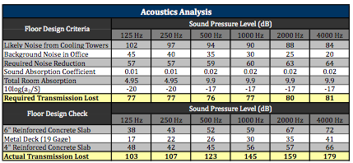
Presentation Outline
Acoustical Analysis
Results
The proposed floor system is adequate in restricting sound penetration
No additional acoustical materials are required
Introduction & Building Overview
Structural Depth Analysis
Breadth Studies
Construction Management Analysis
Acoustical Analysis
Recommendations & Conclusions
Questions
Amanda C. Farace
Army National Guard Readiness Center

Slide 37
Presentation Outline
Conclusions
Introduction & Building Overview
Structural Depth Analysis
Breadth Studies
Recommendations & Conclusions
Design Goal Analysis
Recommendations
Acknowledgements
Questions
Recommendations & Evaluation
Amanda C. Farace
Army National Guard Readiness Center

Slide 38
Presentation Outline
Design Goals
Respect the existing layout and architectural features of the building
Choose a single lateral system and layout that will work effectively
Design the structural steel system for progressive collapse mitigation
Design a structural steel system that reduces overall building costs
Reduce the construction schedule by designing a steel structural system that is more efficient to erect
Introduction & Building Overview
Structural Depth Analysis
Breadth Studies
Recommendations & Conclusions
Design Goal Analysis
Recommendations
Acknowledgements
Questions
Amanda C. Farace
Army National Guard Readiness Center

Slide 39
Presentation Outline
Recommendations
Introduction & Building Overview
Structural Depth Analysis
Breadth Studies
Recommendations & Conclusions
Design Goal Analysis
Recommendations
Acknowledgements
Questions
The proposed steel framing and moment frames would be a feasible alternative to the existing cast-in-place concrete structure for the Army National Guard Readiness Center
Amanda C. Farace
Army National Guard Readiness Center

Slide 40
Presentation Outline
Acknowledgements
I would like to thank the following individuals for their assistance in the completion of this thesis
Tompkins Builders, Inc
Everyone working on the Army National Guard Readiness Center Addition
Army National Guard
LTC Rodney Graham
The Pennsylvania State University
Thesis Consultants
- Dr. Thomas Boothby
- Professor Kevin M. Parfitt
- Professor Robert Holland
The entire Architectural Engineering Department and Professors at Penn State for their support and guidance over the years
Family and Friends
A special thank you to family, friends, and peers for the much needed support and help they have provided. It would have been a difficult process without their love and understanding throughout this process.
Introduction & Building Overview
Structural Depth Analysis
Breadth Studies
Recommendations & Conclusions
Design Goal Analysis
Recommendations
Acknowledgements
Questions
Amanda C. Farace
Army National Guard Readiness Center

Slide 41
Presentation Outline
Questions
Introduction & Building Overview
Structural Depth Analysis
Breadth Studies
Recommendations & Conclusions
Questions
Amanda C. Farace
Army National Guard Readiness Center

