Slide 1
Manoa Elementary School
Amanda Cronauer
Faculty Advisor: Dr. William Bahnfleth
14 April 2010

Slide 2
Presentation Overview
Spring 2010
Project Background
Existing Mechanical Summary
Design Objectives
Alternative Descriptions
Ground Source Heat Pumps
Air Source Heat Pumps
System Comparison
Final Recommendations
Amanda Cronauer │ Mechanical Option

Slide 3
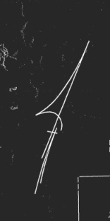
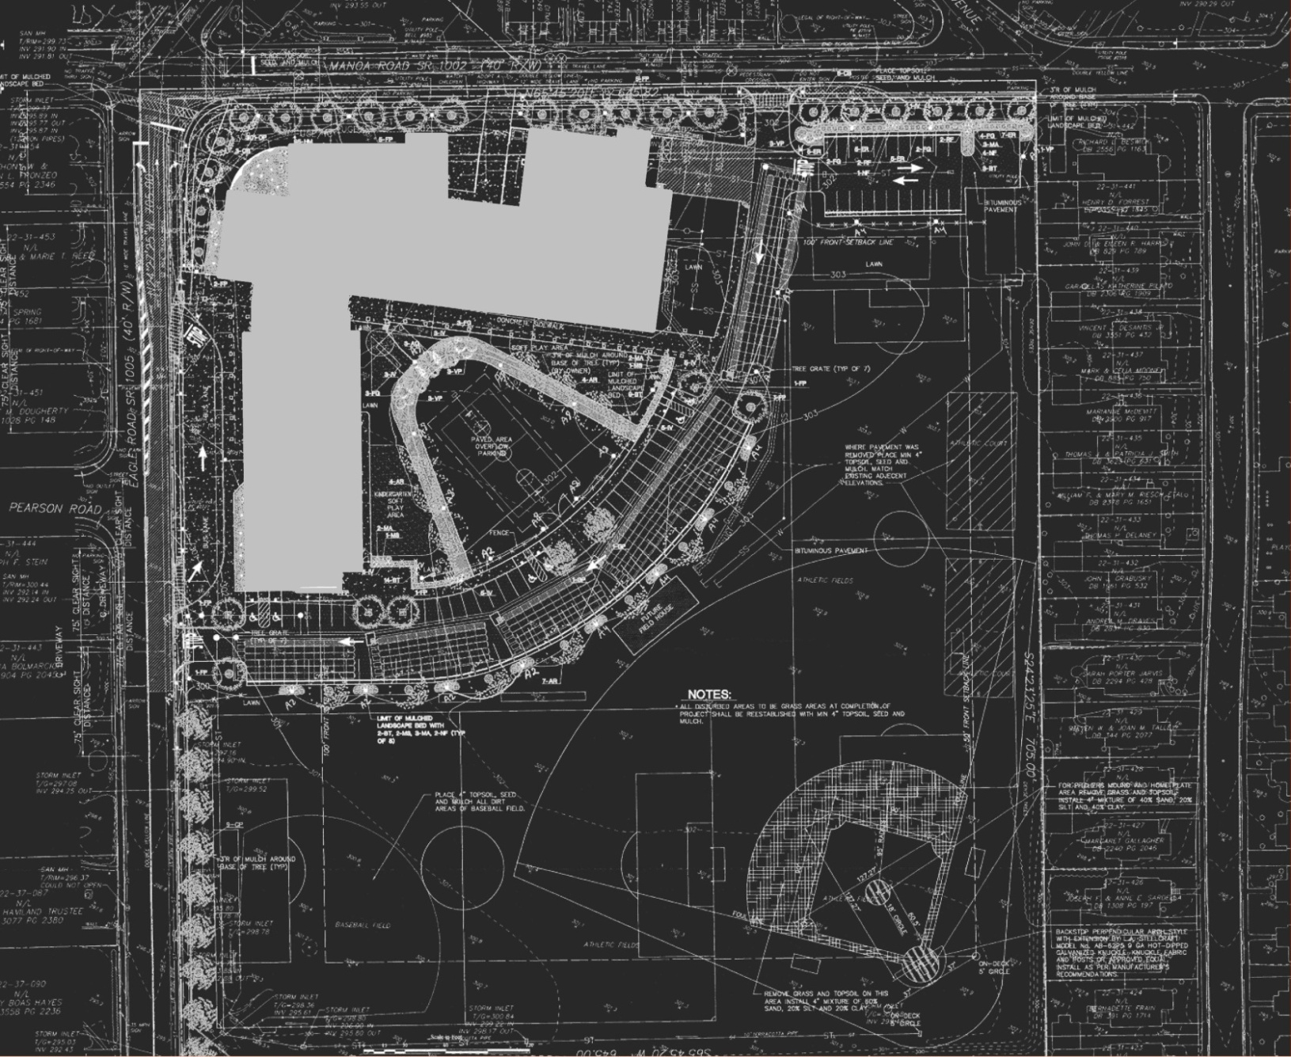
Project Background
Project Background
Existing Mechanical Summary
Design Objectives
Alternative Descriptions
Ground Source Heat Pumps
Air Source Heat Pumps
System Comparison
Final Recommendations
Spring 2010
Project Information:
Project Size: 85,355 sf
Location: Havertown, PA
Cost: $21.2 million
Stories: Classroom [3], Administration [1]
Construction Dates: May 2007-November 2008
Delivery Method: Design-Bid-Build
Project Team:
Owner: Haverford School District
Architect: McKissick Associates Architects
General Contractor: John S. McManus, Inc.
Structural Engineer: Baker Ingram & Associates, Inc.
MEP Engineer: H.F. Lenz Company
Amanda Cronauer │ Mechanical Option

Slide 4
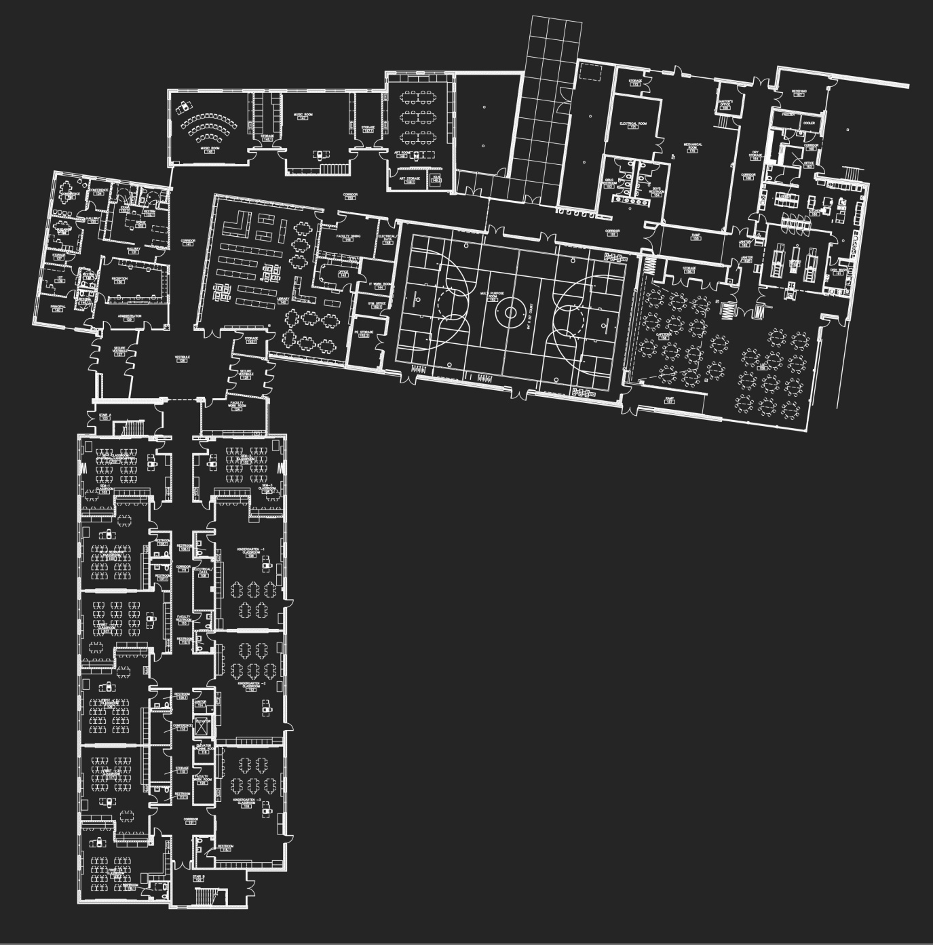
Building Layout
Project Background
Existing Mechanical Summary
Design Objectives
Alternative Descriptions
Ground Source Heat Pumps
Air Source Heat Pumps
System Comparison
Final Recommendations
Spring 2010
Amanda Cronauer │ Mechanical Option

Slide 5
Building Layout
Project Background
Existing Mechanical Summary
Design Objectives
Alternative Descriptions
Ground Source Heat Pumps
Air Source Heat Pumps
System Comparison
Final Recommendations
Spring 2010
Amanda Cronauer │ Mechanical Option

Slide 6
Building Layout
Project Background
Existing Mechanical Summary
Design Objectives
Alternative Descriptions
Ground Source Heat Pumps
Air Source Heat Pumps
System Comparison
Final Recommendations
Spring 2010
Amanda Cronauer │ Mechanical Option

Slide 7
Building Layout
Project Background
Existing Mechanical Summary
Design Objectives
Alternative Descriptions
Ground Source Heat Pumps
Air Source Heat Pumps
System Comparison
Final Recommendations
Spring 2010
Amanda Cronauer │ Mechanical Option

Slide 8
Building Layout
Project Background
Existing Mechanical Summary
Design Objectives
Alternative Descriptions
Ground Source Heat Pumps
Air Source Heat Pumps
System Comparison
Final Recommendations
Spring 2010
Amanda Cronauer │ Mechanical Option

Slide 9
Building Layout
Project Background
Existing Mechanical Summary
Design Objectives
Alternative Descriptions
Ground Source Heat Pumps
Air Source Heat Pumps
System Comparison
Final Recommendations
Spring 2010
Amanda Cronauer │ Mechanical Option

Slide 10
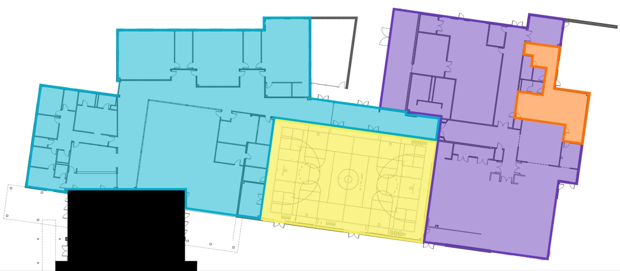
Existing Mechanical System
Project Background
Existing Mechanical Summary
Design Objectives
Alternative Descriptions
Ground Source Heat Pumps
Air Source Heat Pumps
System Comparison
Final Recommendations
Spring 2010
Classroom Wing:
[2] Rooftop Variable Air Volume Units
Direct Expansion Cooling
Hot Water Perimeter Heating
Energy Recovery Ventilators
[2] Air Cooled Condensing Units
AHU-3
AHU-5
AHU-4
Administration Wing:
Rooftop VAV Unit with Energy Recovery Ventilator [AHU-3]
[2] Rooftop Constant Volume Units
Direct Expansion Cooling
Hot Water Heating
[3] Air Cooled Condensing Units
AHU-2
AHU-1
Third Floor
Second Floor
Amanda Cronauer │ Mechanical Option
First
Floor

Slide 11
Design Objectives
Project Background
Existing Mechanical Summary
Design Objectives
Alternative Descriptions
Ground Source Heat Pumps
Air Source Heat Pumps
System Comparison
Final Recommendations
Spring 2010
Improve System Performance
  Energy Consumption
  Emissions
  Total System Cost
Comparison of Proposed System Performance
Amanda Cronauer │ Mechanical Option

Slide 12
Alternatives
Project Background
Existing Mechanical Summary
Design Objectives
Alternative Descriptions
Ground Source Heat Pumps
Air Source Heat Pumps
System Comparison
Final Recommendations
Spring 2010
Ground Source Heat Pumps:
[+] Decentralized System
[+] Higher System Efficiencies
[+] Lower Greenhouse Gas Emissions
[-] Increased Construction Costs
[-] Impact of Loop on Ecosystem
Air Source Heat Pumps:
[+] Decentralized System
[+] Higher System Efficiencies
[+] Lower Greenhouse Gas Emissions
[+] No Extensive Excavation
[-] Utilizes Electricity
Dedicated Outdoor Air:
[+] Reduce Load on Heat Pumps
[+] Smaller
[-] Utilizes Electricity
Amanda Cronauer │ Mechanical Option

Slide 13
Vertical Loop Analysis
Project Background
Existing Mechanical Summary
Design Objectives
Alternative Descriptions
Ground Source Heat Pumps
Air Source Heat Pumps
System Comparison
Final Recommendations
Spring 2010
Vertical Loop Analysis
  Systems to be Replaced
  Assumptions
  Loop Sizing
  Loop Optimization [Construction Management Breadth]
  Results
Horizontal Loop Analysis
  Systems to be Replaced
  Assumptions
  Loop Sizing
  Results
Systems to be Replaced:
Series Fan Powered Boxes → Heat Pump
Rooftop Air Handling Units → Dedicated Outdoor Air Unit
Amanda Cronauer │ Mechanical Option

Slide 14
Vertical Loop Analysis
Project Background
Existing Mechanical Summary
Design Objectives
Alternative Descriptions
Ground Source Heat Pumps
Air Source Heat Pumps
System Comparison
Final Recommendations
Spring 2010
Vertical Loop Analysis
  Systems to be Replaced
  Assumptions
  Loop Sizing
  Loop Optimization [Construction Management Breadth]
  Results
Horizontal Loop Analysis
  Systems to be Replaced
  Assumptions
  Loop Sizing
  Results
Assumptions:
Zoning
Heat Pumps
DOAS Units
Amanda Cronauer │ Mechanical Option

Slide 15
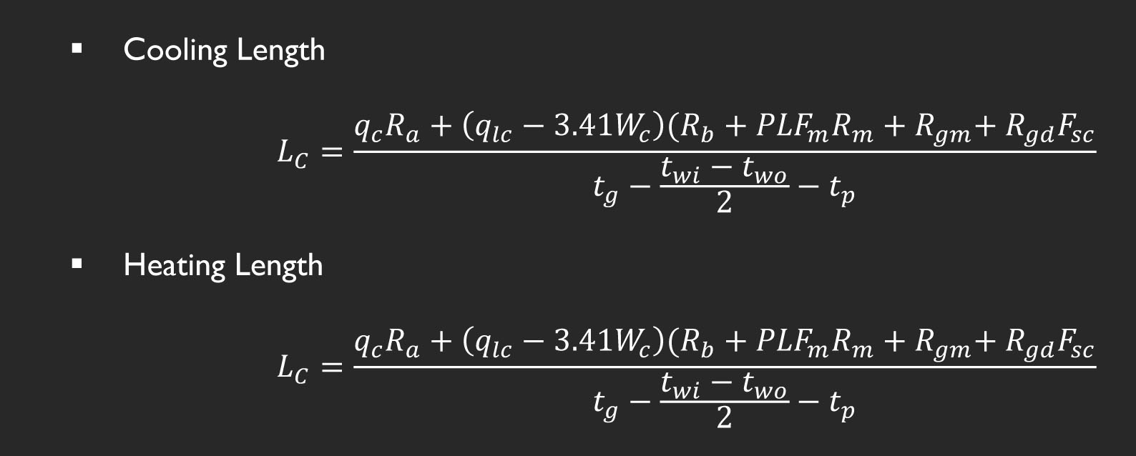
Vertical Loop Analysis
Project Background
Existing Mechanical Summary
Design Objectives
Alternative Descriptions
Ground Source Heat Pumps
Air Source Heat Pumps
System Comparison
Final Recommendations
Spring 2010
Vertical Loop Analysis
  Systems to be Replaced
  Assumptions
  Loop Sizing
  Loop Optimization [Construction Management Breadth]
  Results
Horizontal Loop Analysis
  Systems to be Replaced
  Assumptions
  Loop Sizing
  Results
Loop Sizing:
Amanda Cronauer │ Mechanical Option

Slide 16
Vertical Loop Analysis
Project Background
Existing Mechanical Summary
Design Objectives
Alternative Descriptions
Ground Source Heat Pumps
Air Source Heat Pumps
System Comparison
Final Recommendations
Spring 2010
Vertical Loop Analysis
  Systems to be Replaced
  Assumptions
  Loop Sizing
  Loop Optimization [Construction Management Breadth]
  Results
Horizontal Loop Analysis
  Systems to be Replaced
  Assumptions
  Loop Sizing
  Results
Loop Sizing:
Amanda Cronauer │ Mechanical Option

Slide 17
Vertical Loop Analysis
Project Background
Existing Mechanical Summary
Design Objectives
Alternative Descriptions
Ground Source Heat Pumps
Air Source Heat Pumps
System Comparison
Final Recommendations
Spring 2010
Vertical Loop Analysis
  Systems to be Replaced
  Assumptions
  Loop Sizing
  Loop Optimization [Construction Management Breadth]
  Results
Horizontal Loop Analysis
  Systems to be Replaced
  Assumptions
  Loop Sizing
  Results
Loop Sizing:
Amanda Cronauer │ Mechanical Option

Slide 18
Vertical Loop Analysis
Project Background
Existing Mechanical Summary
Design Objectives
Alternative Descriptions
Ground Source Heat Pumps
Air Source Heat Pumps
System Comparison
Final Recommendations
Spring 2010
Vertical Loop Analysis
  Systems to be Replaced
  Assumptions
  Loop Sizing
  Loop Optimization [Construction Management Breadth]
  Results
Horizontal Loop Analysis
  Systems to be Replaced
  Assumptions
  Loop Sizing
  Results
Goals:
Meet Mechanical Load
Minimize Construction Cost
Amanda Cronauer │ Mechanical Option

Slide 19
Vertical Loop Analysis
Project Background
Existing Mechanical Summary
Design Objectives
Alternative Descriptions
Ground Source Heat Pumps
Air Source Heat Pumps
System Comparison
Final Recommendations
Spring 2010
Vertical Loop Analysis
  Systems to be Replaced
  Assumptions
  Loop Sizing
  Loop Optimization [Construction Management Breadth]
  Results
Horizontal Loop Analysis
  Systems to be Replaced
  Assumptions
  Loop Sizing
  Results
Assumptions:
Piping → 1” High Density Polyethylene [HDPE]
  $0.53 per linear foot
  40 foot lengths
  $4.79 per weld
  $40.25 per day for welding machine
Grout→ Constant Price of $5,937 regardless
Miscellaneous Site Costs → Specified by Number of Boreholes
Borehole Driller
Amanda Cronauer │ Mechanical Option

Slide 20
Vertical Loop Analysis
Project Background
Existing Mechanical Summary
Design Objectives
Alternative Descriptions
Ground Source Heat Pumps
Air Source Heat Pumps
System Comparison
Final Recommendations
Spring 2010
Vertical Loop Analysis
  Systems to be Replaced
  Assumptions
  Loop Sizing
  Loop Optimization [Construction Management Breadth]
  Results
Horizontal Loop Analysis
  Systems to be Replaced
  Assumptions
  Loop Sizing
  Results
Results:
Amanda Cronauer │ Mechanical Option

Slide 21
Vertical Loop Analysis
Project Background
Existing Mechanical Summary
Design Objectives
Alternative Descriptions
Ground Source Heat Pumps
Air Source Heat Pumps
System Comparison
Final Recommendations
Spring 2010
Vertical Loop Analysis
  Systems to be Replaced
  Assumptions
  Loop Sizing
  Loop Optimization [Construction Management Breadth]
  Results
Horizontal Loop Analysis
  Systems to be Replaced
  Assumptions
  Loop Sizing
  Results
Results:
Amanda Cronauer │ Mechanical Option

Slide 22
Vertical Loop Analysis
Project Background
Existing Mechanical Summary
Design Objectives
Alternative Descriptions
Ground Source Heat Pumps
Air Source Heat Pumps
System Comparison
Final Recommendations
Spring 2010
Vertical Loop Analysis
  Systems to be Replaced
  Assumptions
  Loop Sizing
  Loop Optimization [Construction Management Breadth]
  Results
Horizontal Loop Analysis
  Systems to be Replaced
  Assumptions
  Loop Sizing
  Results
Results:
[115] Boreholes
[218] feet per borehole
$86,889 Total Installed Cost
Amanda Cronauer │ Mechanical Option

Slide 23
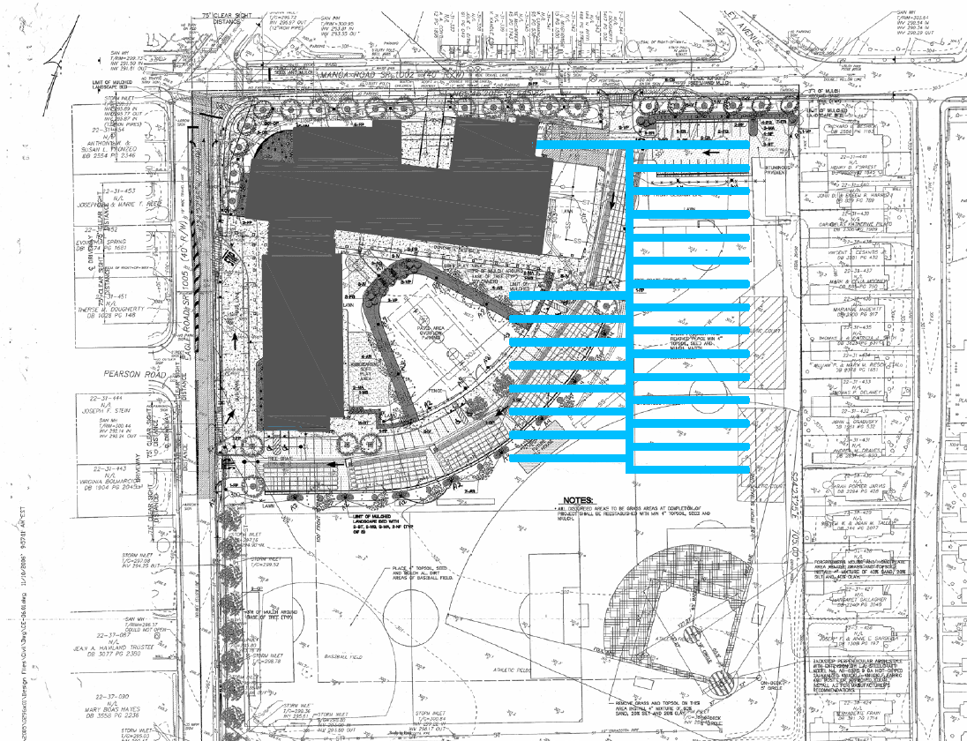
Vertical Loop Analysis
Project Background
Existing Mechanical Summary
Design Objectives
Alternative Descriptions
Ground Source Heat Pumps
Air Source Heat Pumps
System Comparison
Final Recommendations
Spring 2010
Vertical Loop Analysis
  Systems to be Replaced
  Assumptions
  Loop Sizing
  Loop Optimization [Construction Management Breadth]
  Results
Horizontal Loop Analysis
  Systems to be Replaced
  Assumptions
  Loop Sizing
  Results
Amanda Cronauer │ Mechanical Option

Slide 24
Vertical Loop Analysis
Project Background
Existing Mechanical Summary
Design Objectives
Alternative Descriptions
Ground Source Heat Pumps
Air Source Heat Pumps
System Comparison
Final Recommendations
Spring 2010
Vertical Loop Analysis
  Systems to be Replaced
  Assumptions
  Loop Sizing
  Loop Optimization [Construction Management Breadth]
  Results
Horizontal Loop Analysis
  Systems to be Replaced
  Assumptions
  Loop Sizing
  Results
Amanda Cronauer │ Mechanical Option

Slide 25
Vertical Loop Analysis
Project Background
Existing Mechanical Summary
Design Objectives
Alternative Descriptions
Ground Source Heat Pumps
Air Source Heat Pumps
System Comparison
Final Recommendations
Spring 2010
Vertical Loop Analysis
  Systems to be Replaced
  Assumptions
  Loop Sizing
  Loop Optimization [Construction Management Breadth]
  Results
Horizontal Loop Analysis
  Systems to be Replaced
  Assumptions
  Loop Sizing
  Results
Amanda Cronauer │ Mechanical Option

Slide 26
Vertical Loop Analysis
Project Background
Existing Mechanical Summary
Design Objectives
Alternative Descriptions
Ground Source Heat Pumps
Air Source Heat Pumps
System Comparison
Final Recommendations
Spring 2010
25% Reduction = 7/19 LEED Points [EA Credit 1]
Vertical Loop Analysis
  Systems to be Replaced
  Assumptions
  Loop Sizing
  Loop Optimization [Construction Management Breadth]
  Results
Horizontal Loop Analysis
  Systems to be Replaced
  Assumptions
  Loop Sizing
  Results
Amanda Cronauer │ Mechanical Option

Slide 27
Vertical Loop Analysis
Project Background
Existing Mechanical Summary
Design Objectives
Alternative Descriptions
Ground Source Heat Pumps
Air Source Heat Pumps
System Comparison
Final Recommendations
Spring 2010
Vertical Loop Analysis
  Systems to be Replaced
  Assumptions
  Loop Sizing
  Loop Optimization [Construction Management Breadth]
  Results
Horizontal Loop Analysis
  Systems to be Replaced
  Assumptions
  Loop Sizing
  Results
Simple Payback Period:
Design:
[5] Rooftop AHU’s =$280,000
[5] ACCU’s= $12,000
Utility= $112,893
Redesign:
[67] Heat Pumps= $420,050
[5] DOAS Units= $82,042
Vertical Loop= $86,889
Utility=$94,129
Simple Payback Period: 10.76 years
Amanda Cronauer │ Mechanical Option

Slide 28
Vertical Loop Analysis
Project Background
Existing Mechanical Summary
Design Objectives
Alternative Descriptions
Ground Source Heat Pumps
Air Source Heat Pumps
System Comparison
Final Recommendations
Spring 2010
Vertical Loop Analysis
  Systems to be Replaced
  Assumptions
  Loop Sizing
  Loop Optimization [Construction Management Breadth]
  Results
Horizontal Loop Analysis
  Systems to be Replaced
  Assumptions
  Loop Sizing
  Results
Simple Payback Period:
Design:
[5] Rooftop AHU’s =$280,000
[5] ACCU’s= $12,000
Utility= $112,893
Ductwork= $319,850
Redesign:
[67] Heat Pumps= $420,050
[5] DOAS Units= $82,042
Vertical Loop= $86,889
Ductwork= $74,531
Utility= $94,129
Simple Payback Period: 1.2 years
Amanda Cronauer │ Mechanical Option

Slide 29
Horizontal Loop Analysis
Project Background
Existing Mechanical Summary
Design Objectives
Alternative Descriptions
Ground Source Heat Pumps
Air Source Heat Pumps
System Comparison
Final Recommendations
Spring 2010
Vertical Loop Analysis
  Systems to be Replaced
  Assumptions
  Loop Sizing
  Loop Optimization [Construction Management Breadth]
  Results
Horizontal Loop Analysis
  Systems to be Replaced
  Assumptions
  Loop Sizing
  Results
Systems to be Replaced:
Series Fan Powered Boxes → Heat Pump
Rooftop Air Handling Units → Dedicated Outdoor Air Unit
Amanda Cronauer │ Mechanical Option

Slide 30
Horizontal Loop Analysis
Project Background
Existing Mechanical Summary
Design Objectives
Alternative Descriptions
Ground Source Heat Pumps
Air Source Heat Pumps
System Comparison
Final Recommendations
Spring 2010
Vertical Loop Analysis
  Systems to be Replaced
  Assumptions
  Loop Sizing
  Loop Optimization [Construction Management Breadth]
  Results
Horizontal Loop Analysis
  Systems to be Replaced
  Assumptions
  Loop Sizing
  Results
Assumptions:
Zoning
Heat Pumps
DOAS Units
Amanda Cronauer │ Mechanical Option

Slide 31
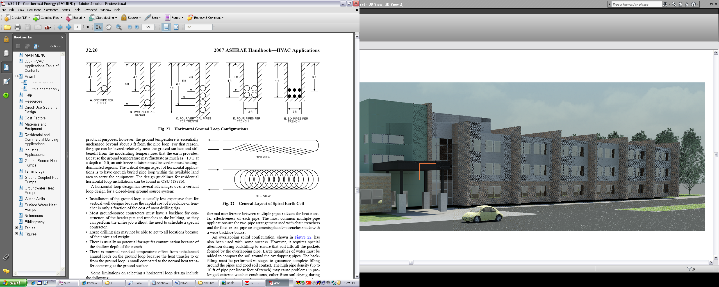
Horizontal Loop Analysis
Project Background
Existing Mechanical Summary
Design Objectives
Alternative Descriptions
Ground Source Heat Pumps
Air Source Heat Pumps
System Comparison
Final Recommendations
Spring 2010
Vertical Loop Analysis
  Systems to be Replaced
  Assumptions
  Loop Sizing
  Loop Optimization [Construction Management Breadth]
  Results
Horizontal Loop Analysis
  Systems to be Replaced
  Assumptions
  Loop Sizing
  Results
Assumptions:
Sizing Method Applicable
Horizontal, 6-Pipe Coil
Ground Temperature
Amanda Cronauer │ Mechanical Option

Slide 32
Horizontal Loop Analysis
Project Background
Existing Mechanical Summary
Design Objectives
Alternative Descriptions
Ground Source Heat Pumps
Air Source Heat Pumps
System Comparison
Final Recommendations
Spring 2010
Vertical Loop Analysis
  Systems to be Replaced
  Assumptions
  Loop Sizing
  Loop Optimization [Construction Management Breadth]
  Results
Horizontal Loop Analysis
  Systems to be Replaced
  Assumptions
  Loop Sizing
  Results
Results:
[150] foot per ton loop recommended
[17,925] feet of length required
Amanda Cronauer │ Mechanical Option

Slide 33
Horizontal Loop Analysis
Project Background
Existing Mechanical Summary
Design Objectives
Alternative Descriptions
Ground Source Heat Pumps
Air Source Heat Pumps
System Comparison
Final Recommendations
Spring 2010
Vertical Loop Analysis
  Systems to be Replaced
  Assumptions
  Loop Sizing
  Loop Optimization [Construction Management Breadth]
  Results
Horizontal Loop Analysis
  Systems to be Replaced
  Assumptions
  Loop Sizing
  Results
Amanda Cronauer │ Mechanical Option

Slide 34
Horizontal Loop Analysis
Project Background
Existing Mechanical Summary
Design Objectives
Alternative Descriptions
Ground Source Heat Pumps
Air Source Heat Pumps
System Comparison
Final Recommendations
Spring 2010
Vertical Loop Analysis
  Systems to be Replaced
  Assumptions
  Loop Sizing
  Loop Optimization [Construction Management Breadth]
  Results
Horizontal Loop Analysis
  Systems to be Replaced
  Assumptions
  Loop Sizing
  Results
Amanda Cronauer │ Mechanical Option

Slide 35
Horizontal Loop Analysis
Project Background
Existing Mechanical Summary
Design Objectives
Alternative Descriptions
Ground Source Heat Pumps
Air Source Heat Pumps
System Comparison
Final Recommendations
Spring 2010
12% Reduction = 1/19 LEED Point [EA Credit 1]
Vertical Loop Analysis
  Systems to be Replaced
  Assumptions
  Loop Sizing
  Loop Optimization [Construction Management Breadth]
  Results
Horizontal Loop Analysis
  Systems to be Replaced
  Assumptions
  Loop Sizing
  Results
Amanda Cronauer │ Mechanical Option

Slide 36
Horizontal Loop Analysis
Project Background
Existing Mechanical Summary
Design Objectives
Alternative Descriptions
Ground Source Heat Pumps
Air Source Heat Pumps
System Comparison
Final Recommendations
Spring 2010
Vertical Loop Analysis
  Systems to be Replaced
  Assumptions
  Loop Sizing
  Loop Optimization [Construction Management Breadth]
  Results
Horizontal Loop Analysis
  Systems to be Replaced
  Assumptions
  Loop Sizing
  Results
Simple Payback Period:
Design:
[5] Rooftop AHU’s =$280,000
[5] ACCU’s= $12,000
Utility= $112,893
Ductwork= $319,850
Redesign:
[67] Heat Pumps= $420,050
[5] DOAS Units= $82,042
Horizontal Loop= $76,898
Ductwork= $74,531
Utility= $109,764
Simple Payback Period: 0.95 years
Amanda Cronauer │ Mechanical Option

Slide 37
Air Source Heat Pumps
Project Background
Existing Mechanical Summary
Design Objectives
Alternative Descriptions
Ground Source Heat Pumps
Air Source Heat Pumps
System Comparison
Final Recommendations
Spring 2010
Analysis
  Systems to be Replaced
  Assumptions
  Results
Systems to be Replaced:
Series Fan Powered Boxes → Heat Pump
Rooftop Air Handling Units → Dedicated Outdoor Air Unit
Amanda Cronauer │ Mechanical Option

Slide 38
Air Source Heat Pumps
Project Background
Existing Mechanical Summary
Design Objectives
Alternative Descriptions
Ground Source Heat Pumps
Air Source Heat Pumps
System Comparison
Final Recommendations
Spring 2010
Analysis
  Systems to be Replaced
  Assumptions
  Results
Assumptions:
Zoning
Heat Pumps
DOAS Units
Amanda Cronauer │ Mechanical Option

Slide 39
Air Source Heat Pumps
Project Background
Existing Mechanical Summary
Design Objectives
Alternative Descriptions
Ground Source Heat Pumps
Air Source Heat Pumps
System Comparison
Final Recommendations
Spring 2010
Analysis
  Systems to be Replaced
  Assumptions
  Results
Amanda Cronauer │ Mechanical Option

Slide 40
Air Source Heat Pumps
Project Background
Existing Mechanical Summary
Design Objectives
Alternative Descriptions
Ground Source Heat Pumps
Air Source Heat Pumps
System Comparison
Final Recommendations
Spring 2010
Analysis
  Systems to be Replaced
  Assumptions
  Results
Amanda Cronauer │ Mechanical Option

Slide 41
Air Source Heat Pumps
Project Background
Existing Mechanical Summary
Design Objectives
Alternative Descriptions
Ground Source Heat Pumps
Air Source Heat Pumps
System Comparison
Final Recommendations
Spring 2010
17% Reduction = 3/19 LEED Points [EA Credit 1]
Analysis
  Systems to be Replaced
  Assumptions
  Results
Amanda Cronauer │ Mechanical Option

Slide 42
Air Source Heat Pumps
Project Background
Existing Mechanical Summary
Design Objectives
Alternative Descriptions
Ground Source Heat Pumps
Air Source Heat Pumps
System Comparison
Final Recommendations
Spring 2010
Analysis
  Systems to be Replaced
  Assumptions
  Results
Simple Payback Period:
Design:
[5] Rooftop AHU’s =$280,000
[5] ACCU’s= $12,000
Utility= $112,893
Ductwork= $319,850
Redesign:
[67] Heat Pumps= $211,403
[5] DOAS Units= $83,042
Ductwork= $74,531
Utility= $103,384
Simple Payback Period: 0.65 years
Amanda Cronauer │ Mechanical Option

Slide 43
System Comparison
Project Background
Existing Mechanical Summary
Design Objectives
Alternative Descriptions
Ground Source Heat Pumps
Air Source Heat Pumps
System Comparison
Final Recommendations
Spring 2010
Amanda Cronauer │ Mechanical Option

Slide 44
System Comparison
Project Background
Existing Mechanical Summary
Design Objectives
Alternative Descriptions
Ground Source Heat Pumps
Air Source Heat Pumps
System Comparison
Final Recommendations
Spring 2010
Amanda Cronauer │ Mechanical Option

Slide 45
System Comparison
Project Background
Existing Mechanical Summary
Design Objectives
Alternative Descriptions
Ground Source Heat Pumps
Air Source Heat Pumps
System Comparison
Final Recommendations
Spring 2010
Simple Payback Period:
Vertical Loop GSHP = [1.2] years
Horizontal Loop GSHP = [0.95] years
Air Source Heat Pump= [0.65] years
Amanda Cronauer │ Mechanical Option

Slide 46
Final Recommendations
Project Background
Existing Mechanical Summary
Design Objectives
Alternative Descriptions
Ground Source Heat Pumps
Air Source Heat Pumps
System Comparison
Final Recommendations
Spring 2010
Emissions and Fuel Consumption:
Vertical Ground Source Heat Pump
Lowest First Cost:
Air Source Heat Pump
Fastest Potential Payback:
Air Source Heat Pump
LEED Points:
Vertical Ground Source Heat Pump
Amanda Cronauer │ Mechanical Option

Slide 47
Questions
Special Thanks To:
  Paul Cronauer, H.F. Lenz Contact
  Verne McKissick, McKissick Architects Contact
  Dr. Bahnfleth, Faculty Advisor
  Penn State Architectural Engineering Mechanical Faculty
  Family and Friends for all their support
  Fellow AE Students
  Jonah, moral support
Spring 2010
Amanda Cronauer │ Mechanical Option

