Slide 1

Shaun Kreidel Structural Option
AE Senior Thesis Spring 2010
Faculty Consultant Dr. Linda Hanagan

Slide 2
Existing Building Overview
Existing Building Structural System
Project Goals
Structural Depth Study
Existing Building Information
Construction Management Breadth Study
Conclusions
Acknowledgements
Questions and Comments

Slide 3
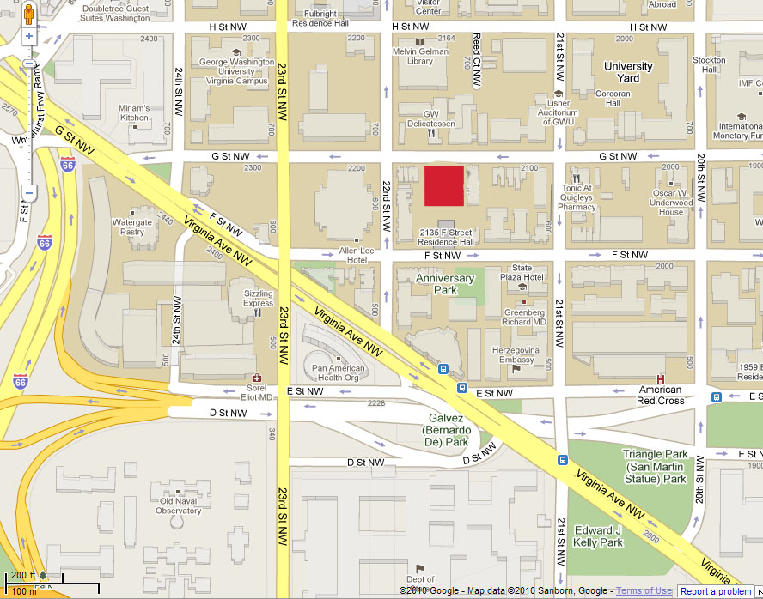

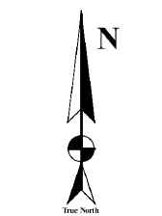
Existing Building Overview
Existing Building Structural System
Project Goals
Structural Depth Study
Construction Management Breadth Study
Conclusions
Acknowledgements
Questions and Comments
Location
2130 G Street, NW Washington, D.C
Foggy Bottom District
Building Statistics
Function l Educational
Occupant l District of Columbia Schools
Size l 68,000 sq. ft.
Stories l 4 stories (1 Below Grade)
Project Cost
$39.2 million

Slide 4
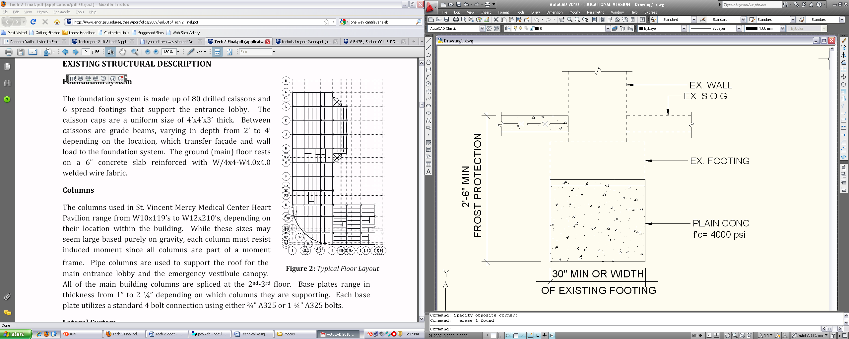
Existing Building Overview
Existing Building Structural System
Project Goals
Structural Depth Study
Construction Management Breadth Study
Conclusions
Acknowledgements
Questions and Comments
Existing Gravity System
Composite steel system
W10 to W33 sections
3 ¼” LWC over 2” 20 GA LOK composite steel floor decking
Existing Foundation System
Shallow foundation
Reinforced cast-in-place spread footings and grade beams
Existing footings of the school require underpinning

Slide 5
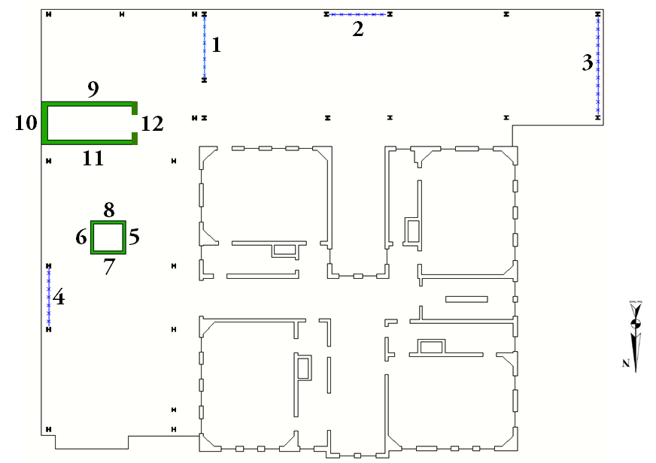
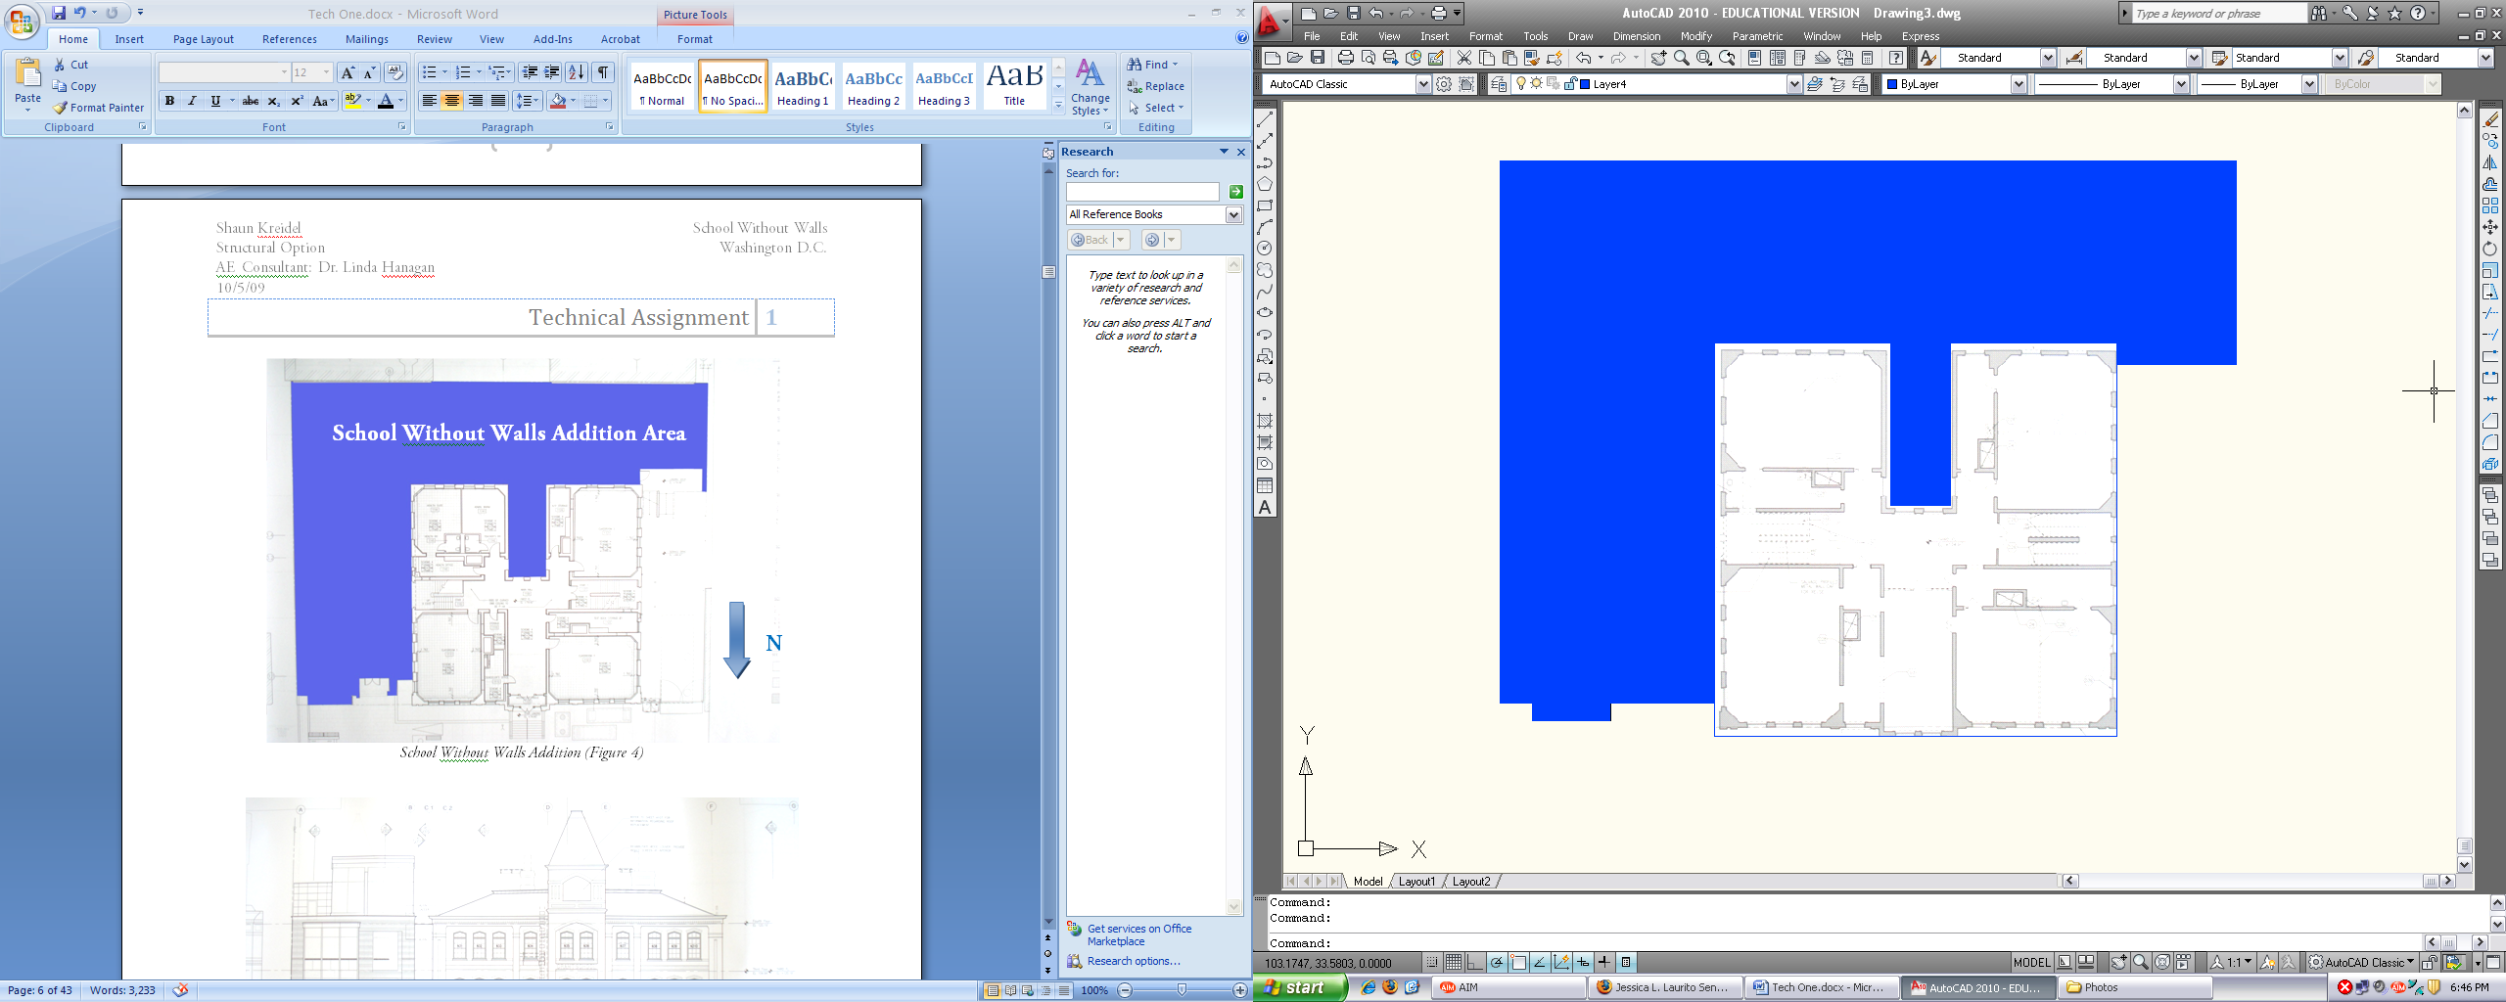
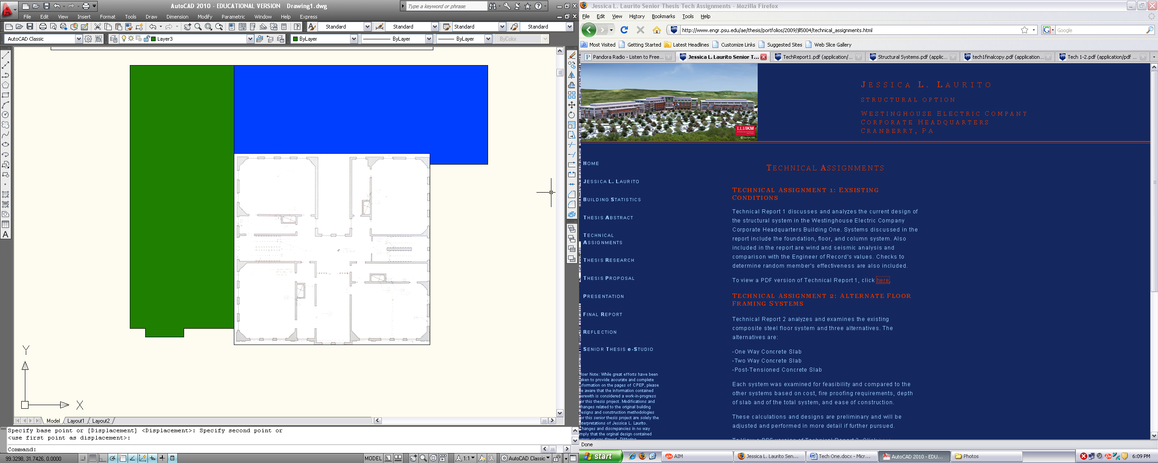
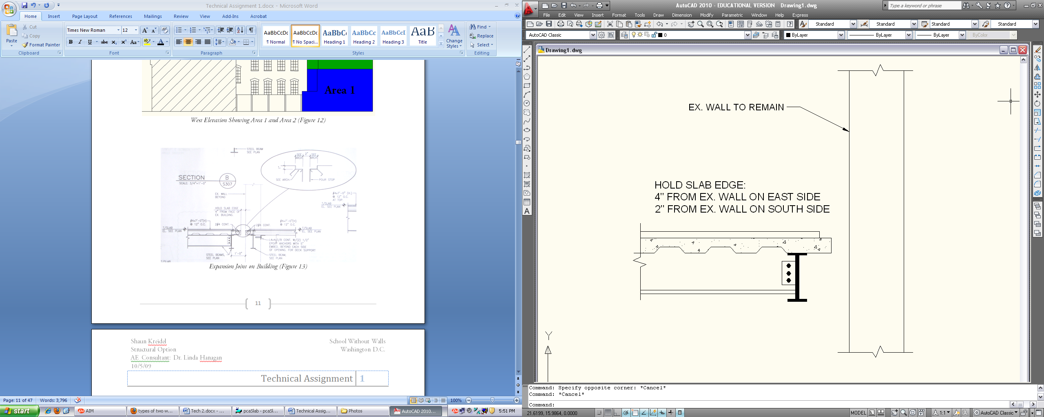
Existing Building Overview
Existing Building Structural System
Project Goals
Structural Depth Study
Construction Management Breadth Study
Conclusions
Acknowledgements
Questions and Comments
Area 1
Existing Lateral System
The addition is divided by an expansion joint
Joint creates total of three lateral systems
Referred to as “Area 1” and “Area 2” in this presentation
Braced frames and shear walls resist lateral loads
  Braced frames comprised of HSS square sections
  Shear Walls are 12” and 8” thick
School Without Walls Addition Area
Area 2

Slide 6
Existing Building Overview
Existing Building Structural System
Project Goals
Structural Depth Study
Construction Management Breadth Study
Conclusions
Acknowledgements
Questions and Comments
Project Goals

Slide 7
Existing Building Overview
Existing Building Structural System
Project Goals
Structural Depth Study
Construction Management Breadth Study
Conclusions
Acknowledgements
Questions and Comments
Problem Statement
wide flange beams which range from W10 to W33 sections
5 ¼” decking system
total floor depth amounts to 38 ¼”
welded moment connections required for cantilever

Slide 8
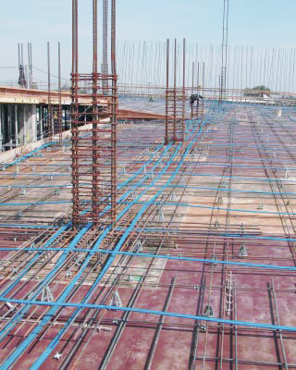
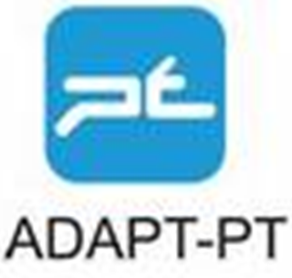


Existing Building Overview
Existing Building Structural System
Project Goals
Structural Depth Study
Construction Management Breadth Study
Conclusions
Acknowledgements
Questions and Comments
Structural Depth Study l Redesign gravity system
  Post tensioned slab and one way slab
  Limit total floor depth
Structural Depth Study l Redesign lateral system
  Remove shear walls and braced frames
  Concrete moment frames
Construction Management Breadth Study
  Cost effect of structural system change
  Schedule influence of new structural system
Architectural Breadth Study
  Aesthetic influence of dropped ceilings

Slide 9
Existing Building Overview
Existing Building Structural System
Project Goals
Structural Depth Study
Construction Management Breadth Study
Conclusions
Acknowledgements
Questions and Comments
Structural Depth Study

Slide 10
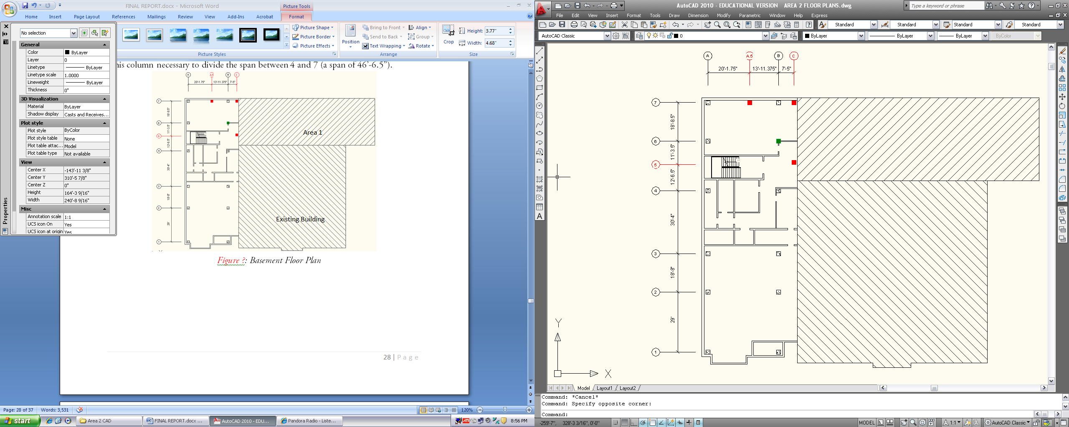
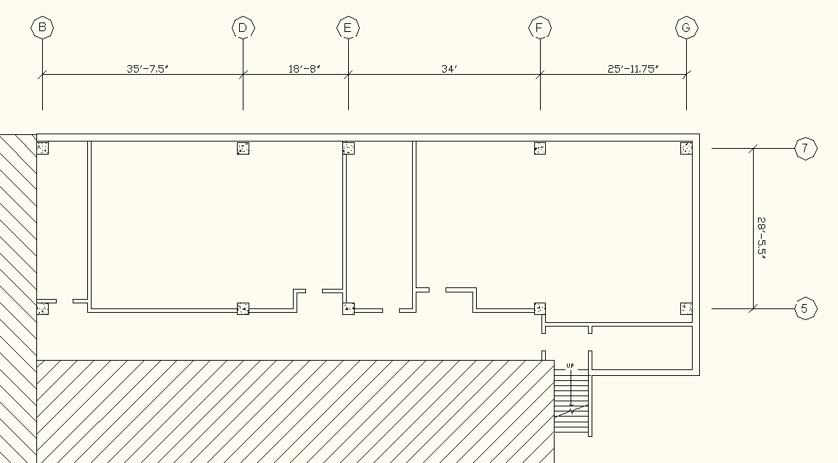
Existing Building Overview
Existing Building Structural System
Project Goals
Structural Depth Study
Construction Management Breadth Study
Conclusions
Acknowledgements
Questions and Comments
Floor Plan Alterations
Area 1
  Column lines G and 7 moved 6.25” towards the interior
  Column line 5 was moved 14.25” to south
Area 2
  Column line A shifted 14” to west and B shifted 16” to east
  Column lines 1 and 7 shifted 6” to south and north respectively
  Columns along A.5 and C
  were deleted
  Column located in green
  was added
Area 1
Area 1
Existing Building
Area 2
Existing Building

Slide 11
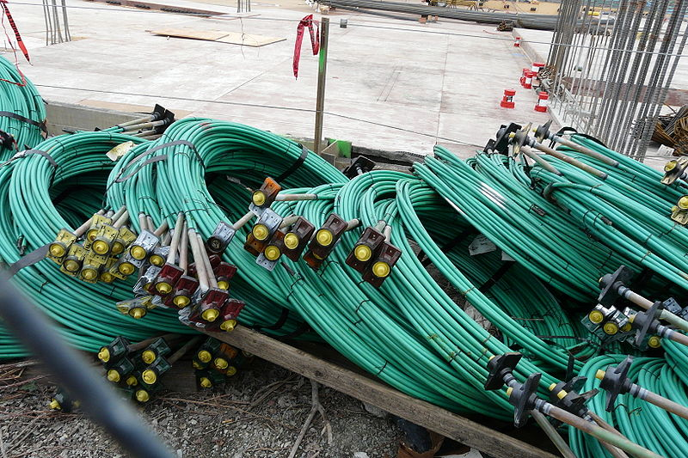
Existing Building Overview
Existing Building Structural System
Project Goals
Structural Depth Study
Construction Management Breadth Study
Conclusions
Acknowledgements
Questions and Comments
PT Overview
  Method of prestressing
  Tendon tensioned after concrete has hardened
  Chapter 18 of ACI 318-05
  Unbonded tendons
  Tendons fabricated with plastic sheathing and grease
  ½” diameter, 7 wire strands
Tendon Properties
Area= .153 in²
f_{pu}= 270 ksi
Estimated Prestress Loss= 15ksi
f_{se}= .7*( f_{pu} )- 15ksi= 174
P_{eff}=A* f_{se}= 26.6 kip/tendon
P/A: Max=300, Min=150

Slide 12
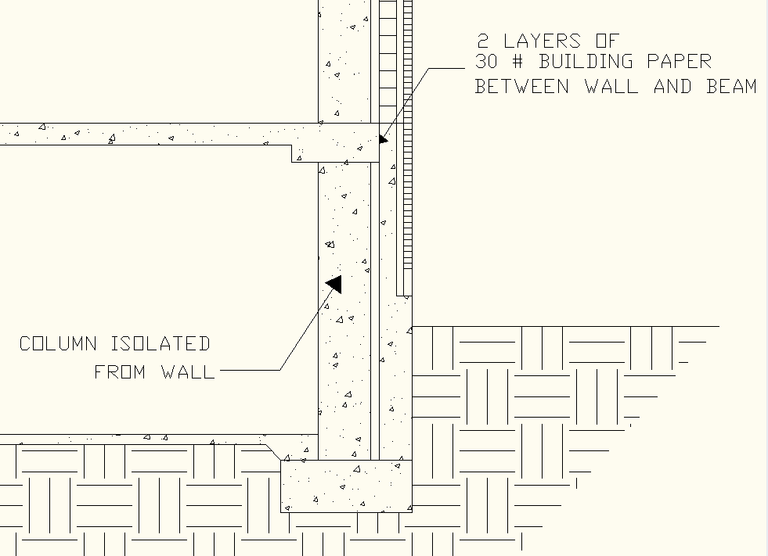
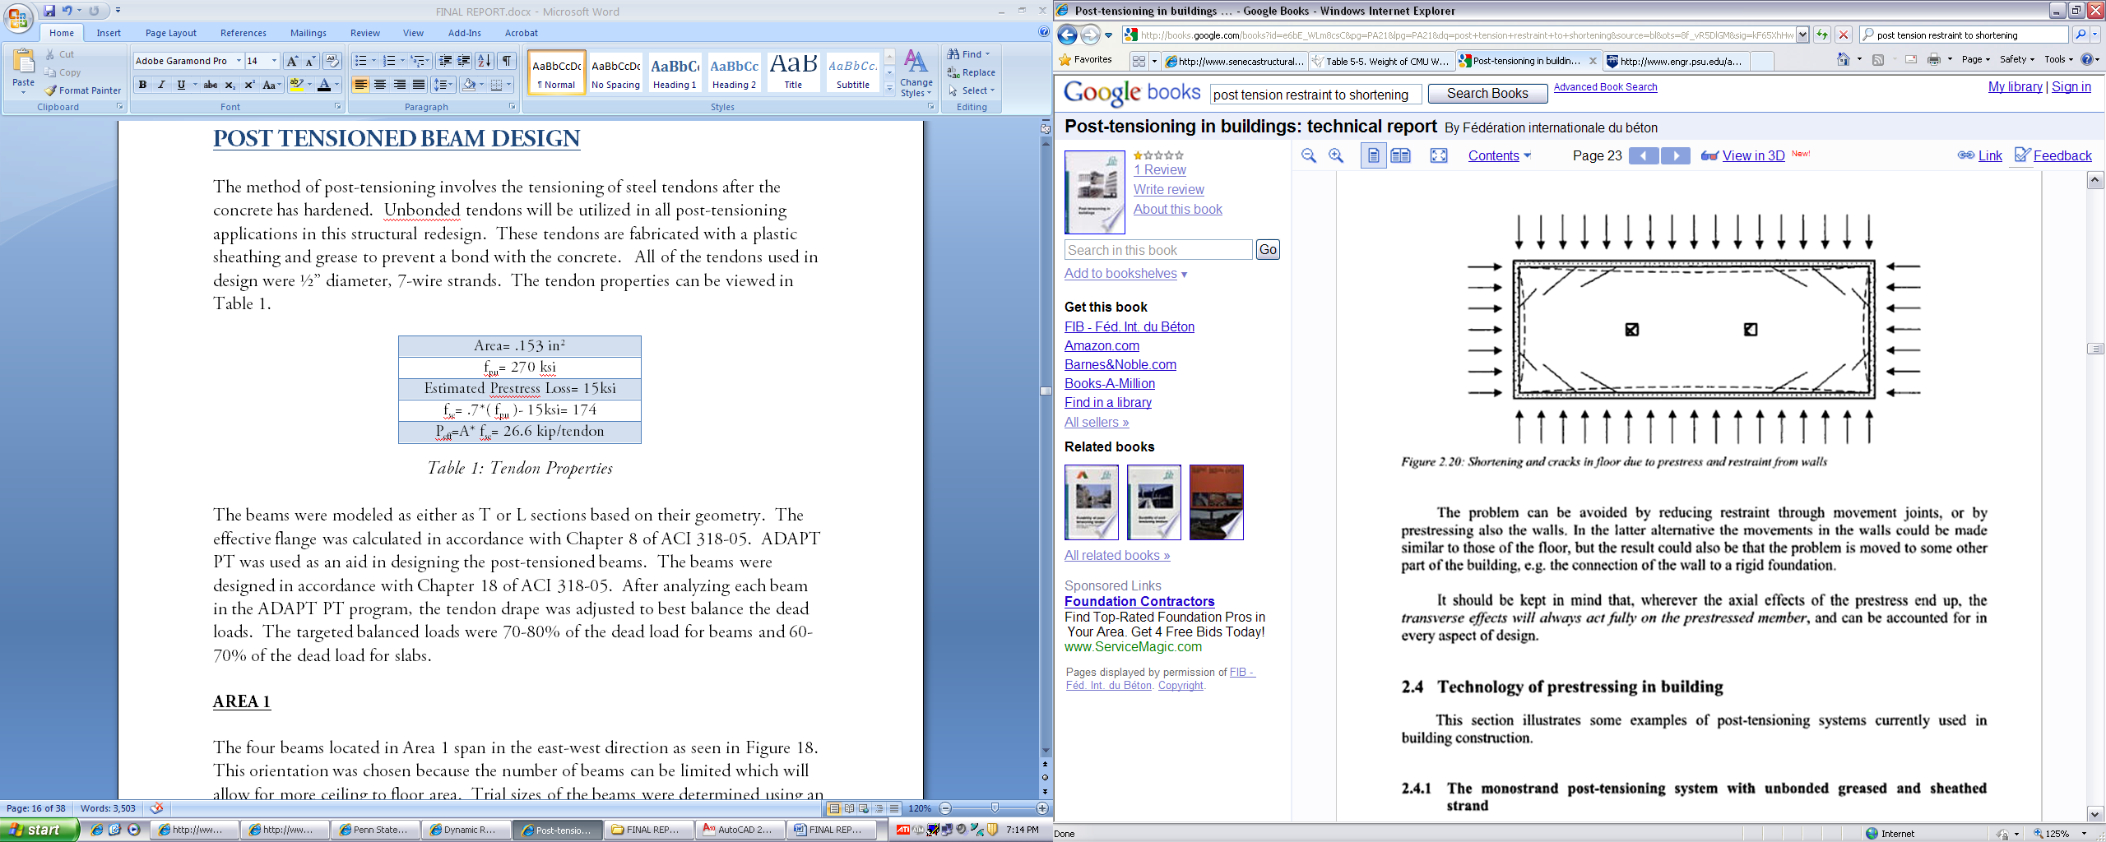
Existing Building Overview
Existing Building Structural System
Project Goals
Structural Depth Study
Construction Management Breadth Study
Conclusions
Acknowledgements
Questions and Comments
Shortening Restraint
Important to allow for the shortening of slab
Reduces the amount of cracking due to shrinkage
Isolate the slab from the foundation wall
Isolate the perimeter columns
Column lines were displaced from the foundation wall

Slide 13
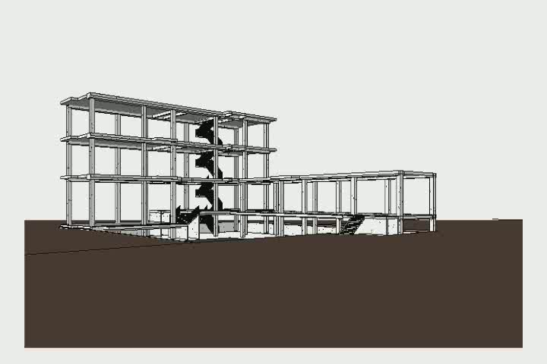
Existing Building Overview
Existing Building Structural System
Project Goals
Structural Depth Study
Construction Management Breadth Study
Conclusions
Acknowledgements
Questions and Comments

Slide 14
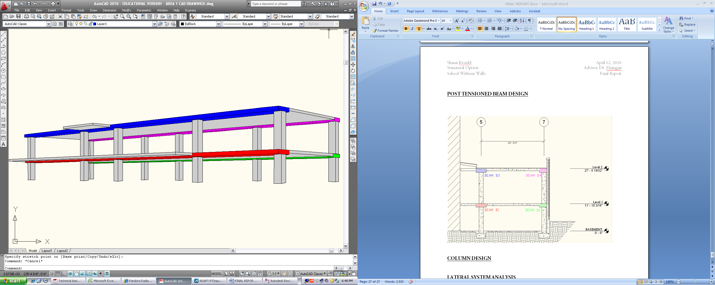
Existing Building Overview
Existing Building Structural System
Project Goals
Structural Depth Study
Construction Management Breadth Study
Conclusions
Acknowledgements
Questions and Comments
Beam Design
  Wide, shallow beams utilized
  Trial sizes of beams determined using an L/d ratio of 30
  Trial b/d ratio of 3
  Balanced dead loads targeted as 70-80% of dead load
  Effective flange calculated in accordance with Chapter 8 of ACI 318-05
  Used ADAPT-PT as an aid
  For this presentation, the beam in red will be discussed
  18”x56” beam
  5000 psi concrete

Slide 15
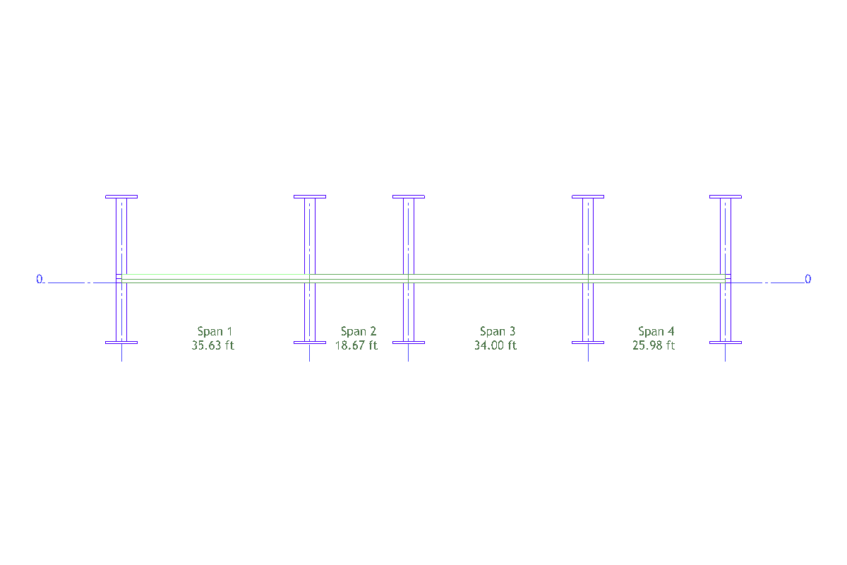
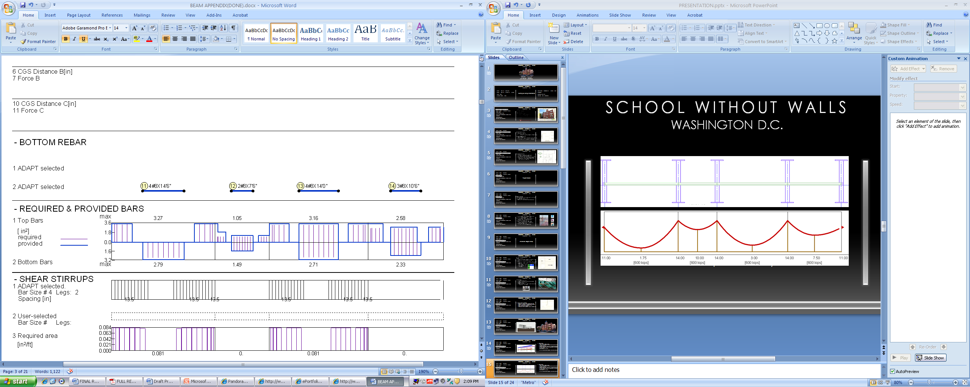
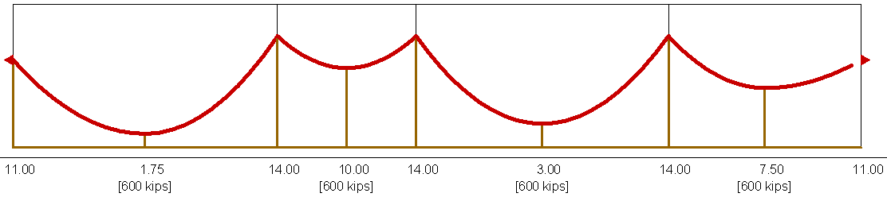
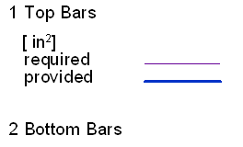
Existing Building Overview
Existing Building Structural System
Project Goals
Structural Depth Study
Construction Management Breadth Study
Conclusions
Acknowledgements
Questions and Comments
Beam Design
  Wide, shallow beams utilized
  Trial sizes of beams determined using an L/d ratio of 30
  Trial b/d ratio of 3
  Balanced dead loads targeted as 70-80% of dead load
  Effective flange calculated in accordance with Chapter 8 of ACI 318-05
  Used ADAPT-PT as an aid
  For this presentation, the beam in red will be discussed
  18”x56” beam
  5000 psi concrete
Span | Class | Type | W
 |  |  | k/ft2
ALL | LL | U | 0.100
ALL | SDL | U | 0.015
Live loads not reduced: 4.8.4 of ASCE 7-05: live loads of 100 lb/ft² or less shall not be reduced in public assembly areas.

Slide 16
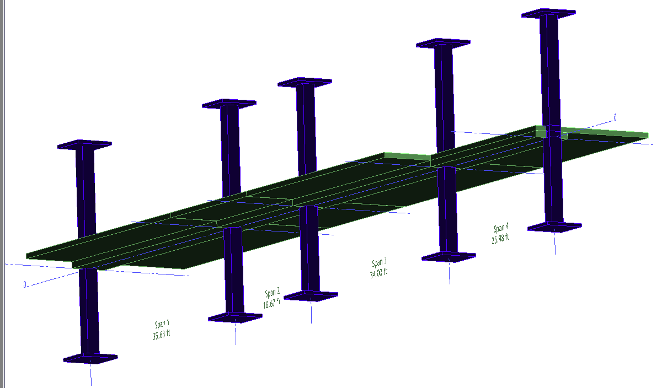
Beam Design Conclusions
  Area 1:
    18” thick beams supporting first floor
    20” thick beams supporting second floor/ roof terrace
    Interior beams 56” wide
    Exterior beams 40” wide
    5000 psi concrete
  Area 2:
    18” thick beams supporting first floor
    20” thick beams supporting remaining floors
    Interior beams 60” wide
    Exterior beams 40” wide
    5000 psi concrete
Existing Building Overview
Existing Building Structural System
Project Goals
Structural Depth Study
Construction Management Breadth Study
Conclusions
Acknowledgements
Questions and Comments

Slide 17
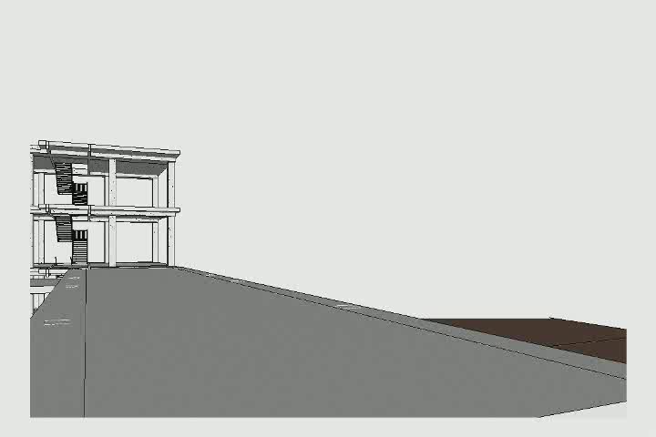
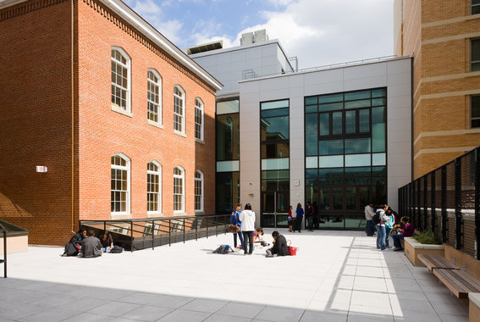
Existing Building Overview
Existing Building Structural System
Project Goals
Structural Depth Study
Construction Management Breadth Study
Conclusions
Acknowledgements
Questions and Comments

Slide 18
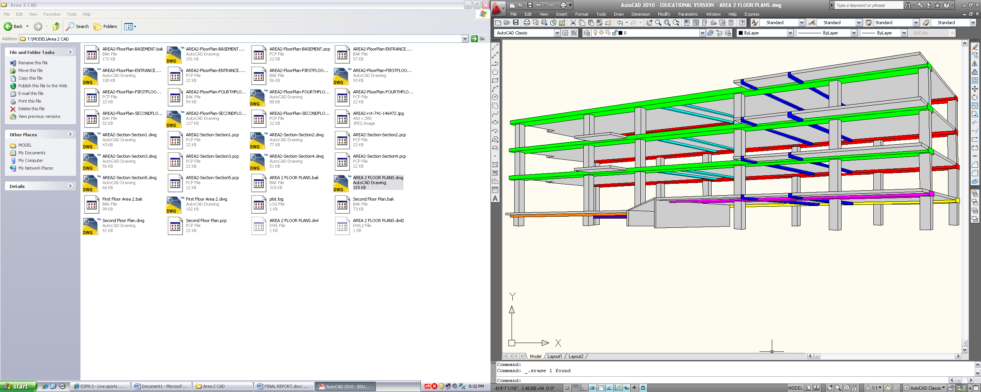
Existing Building Overview
Existing Building Structural System
Project Goals
Structural Depth Study
Construction Management Breadth Study
Conclusions
Acknowledgements
Questions and Comments
Slab Design
  One way post tensioned slab
  Spans in direction perpendicular to post tensioned beams
  Balanced dead loadstargeted as 60-70% of dead load
  Chapter 18 of ACI 318-05
  ADAPT PT used as an aid
  Unit strip method
  5000 psi concrete
  Transverse beams modeled into analysis
  Detailed for this presentation:
    Cantilever Slab
      10 “ thick

Slide 19
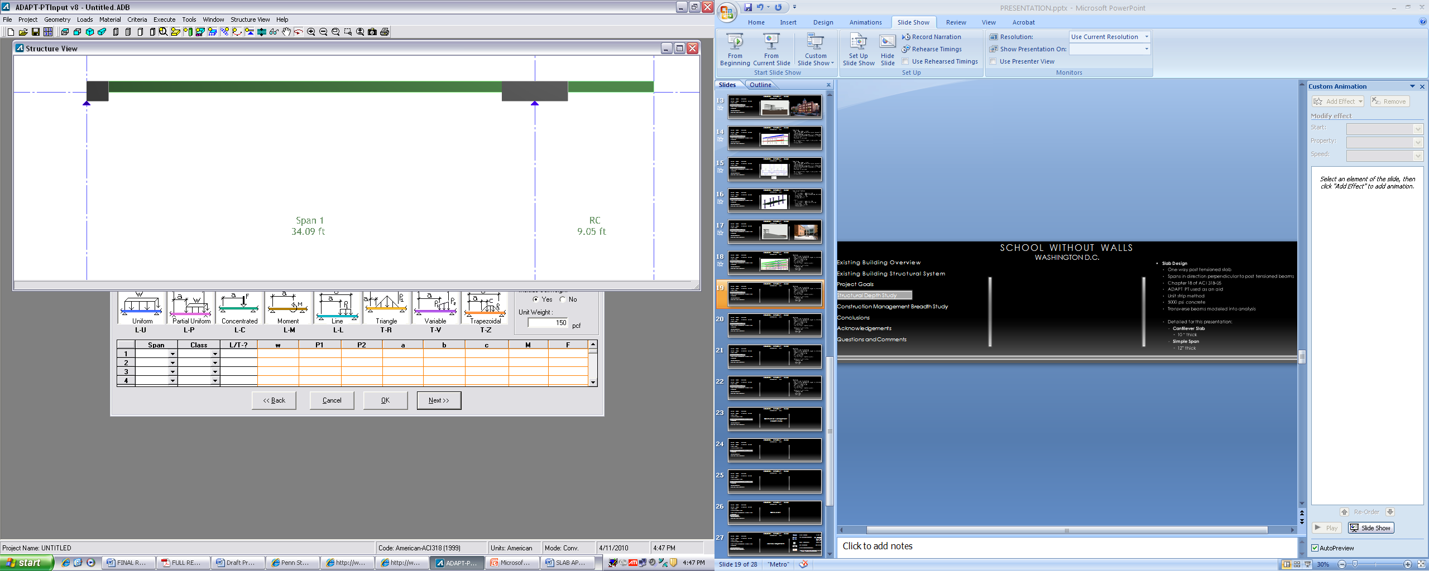
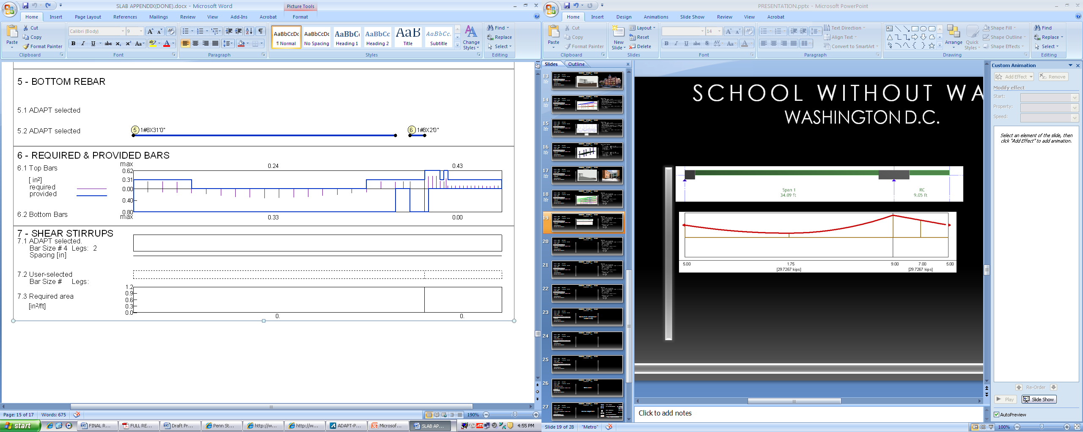
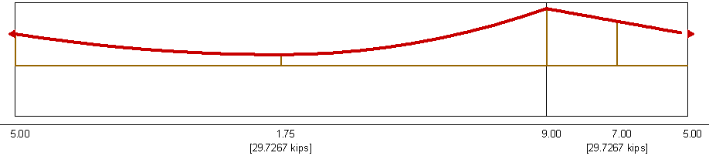
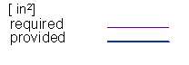
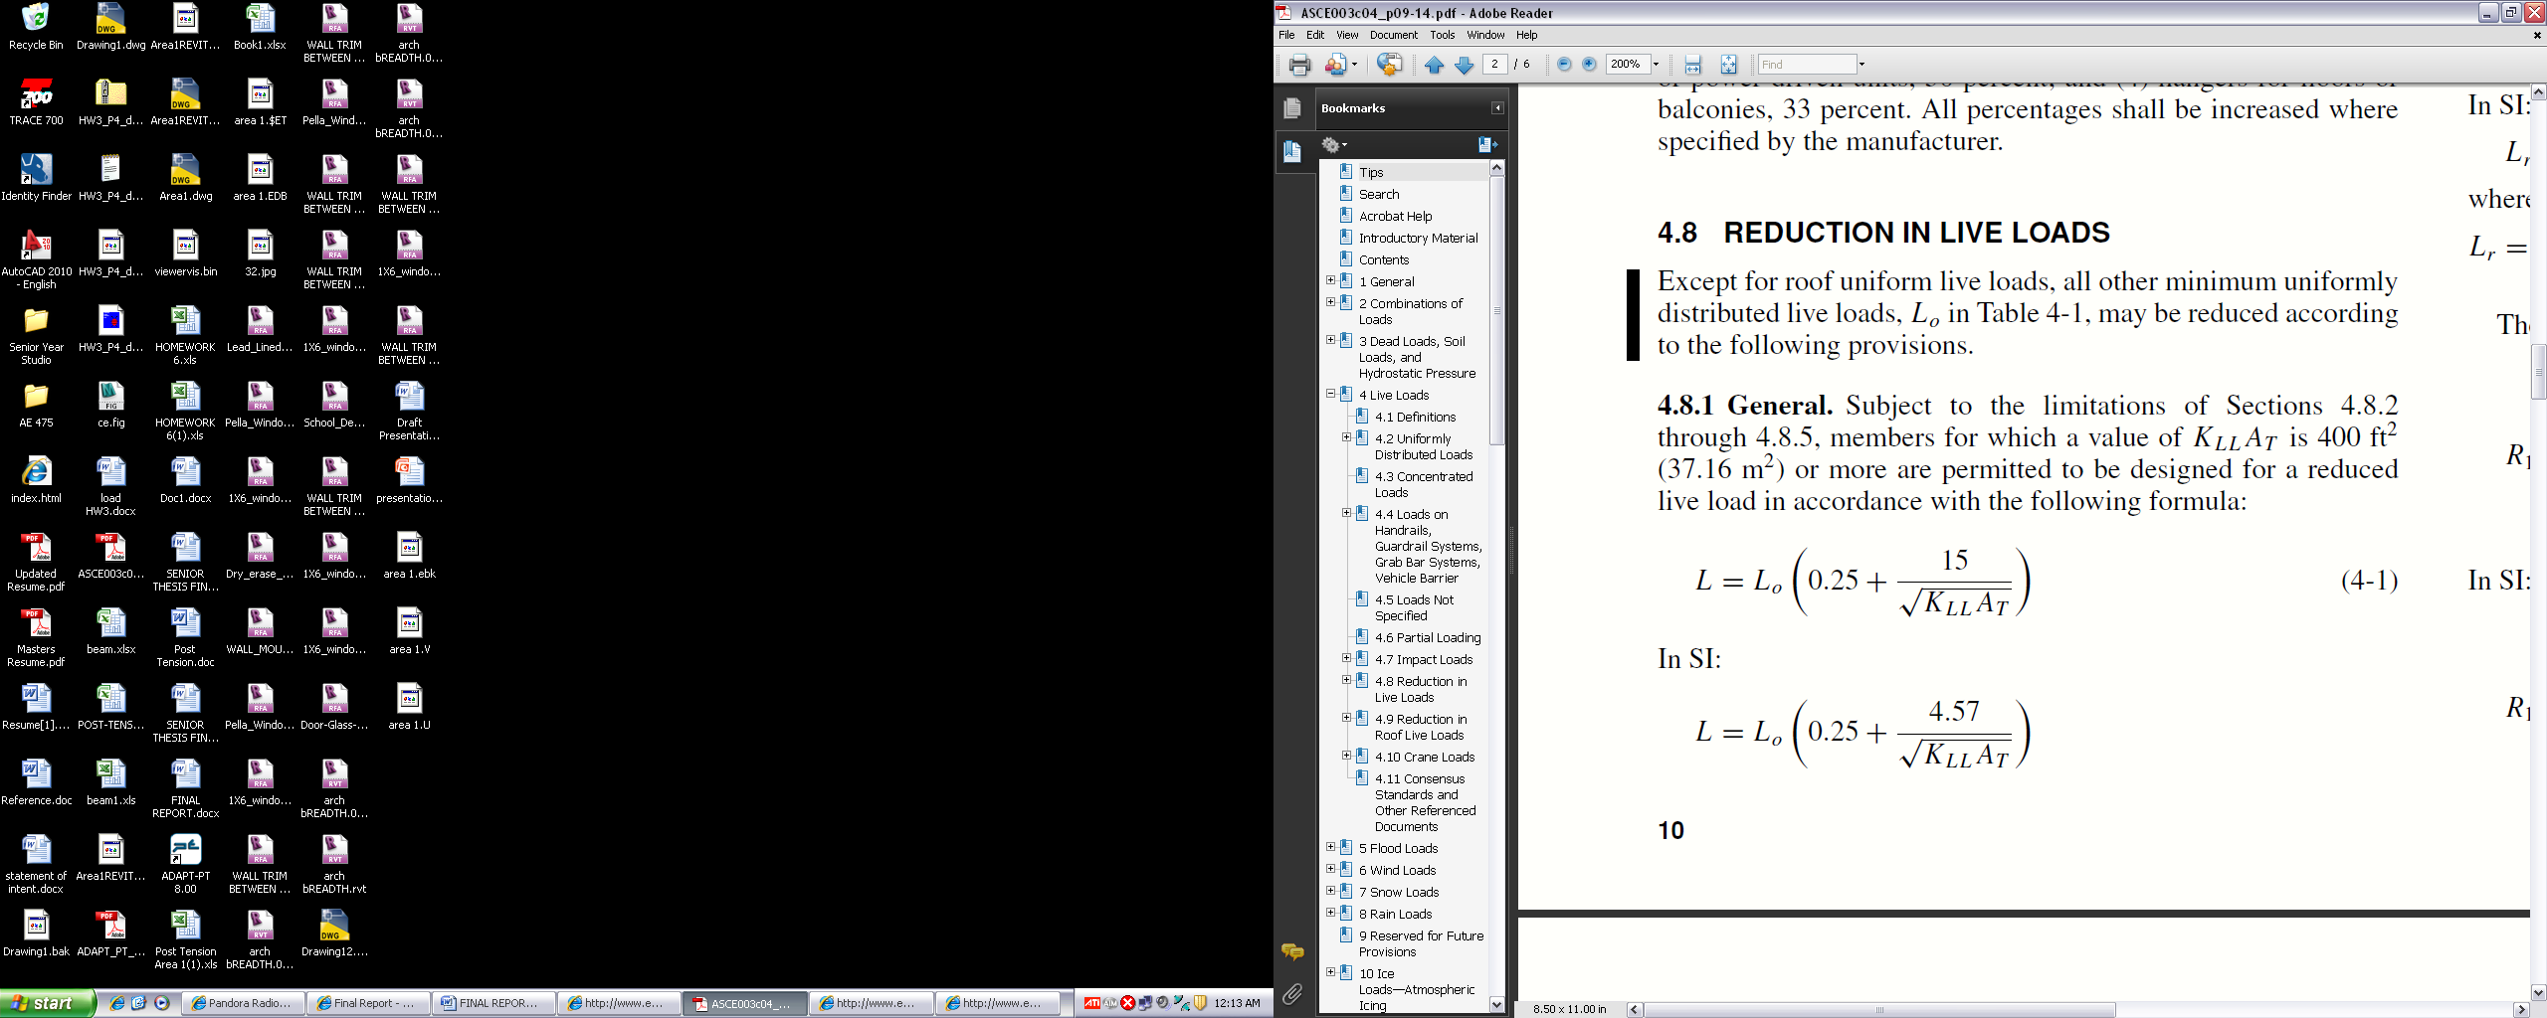
Existing Building Overview
Existing Building Structural System
Project Goals
Structural Depth Study
Construction Management Breadth Study
Conclusions
Acknowledgements
Questions and Comments
Slab Design
  One way post tensioned slab
  Spans in direction perpendicular to post tensioned beams
  Balanced dead loadstargeted as 60-70% of dead load
  Chapter 18 of ACI 318-05
  ADAPT PT used as an aid
  Unit strip method
  5000 psi concrete
  Transverse beams modeled into analysis
  Detailed for this presentation:
    Cantilever Slab
      10 “ thick
Span | Class | Type | W
 |  |  | k/ft2
ALL | LL | U | 0.050
ALL | SDL | U | 0.015
Reinforcement perpendicular to tendons:
As= .0018*b*h

Slide 20
Existing Building Overview
Existing Building Structural System
Project Goals
Structural Depth Study
Construction Management Breadth Study
Conclusions
Acknowledgements
Questions and Comments
Slab Design Conclusions
  Area 1:
    10” thick slab supporting first floor
    11” thick slab supporting second floor/ roof terrace
    5000 psi concrete
  Area 2:
    10” thick slab supporting first floor/ cantilevered areas
    12” thick slab supporting simple span areas
    Mildly reinforced slab to account for openings
    5000 psi concrete

Slide 21
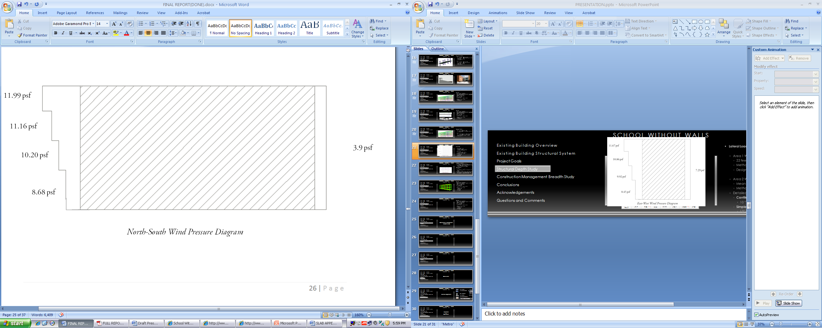
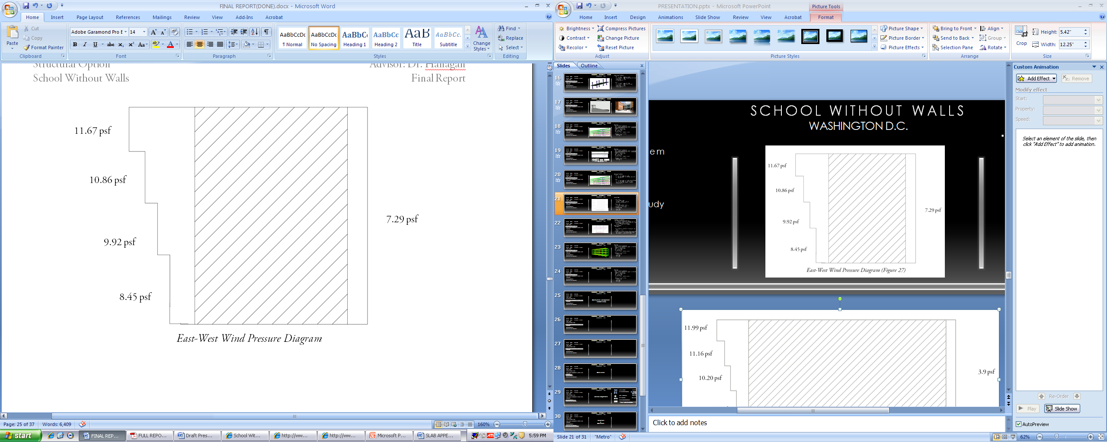
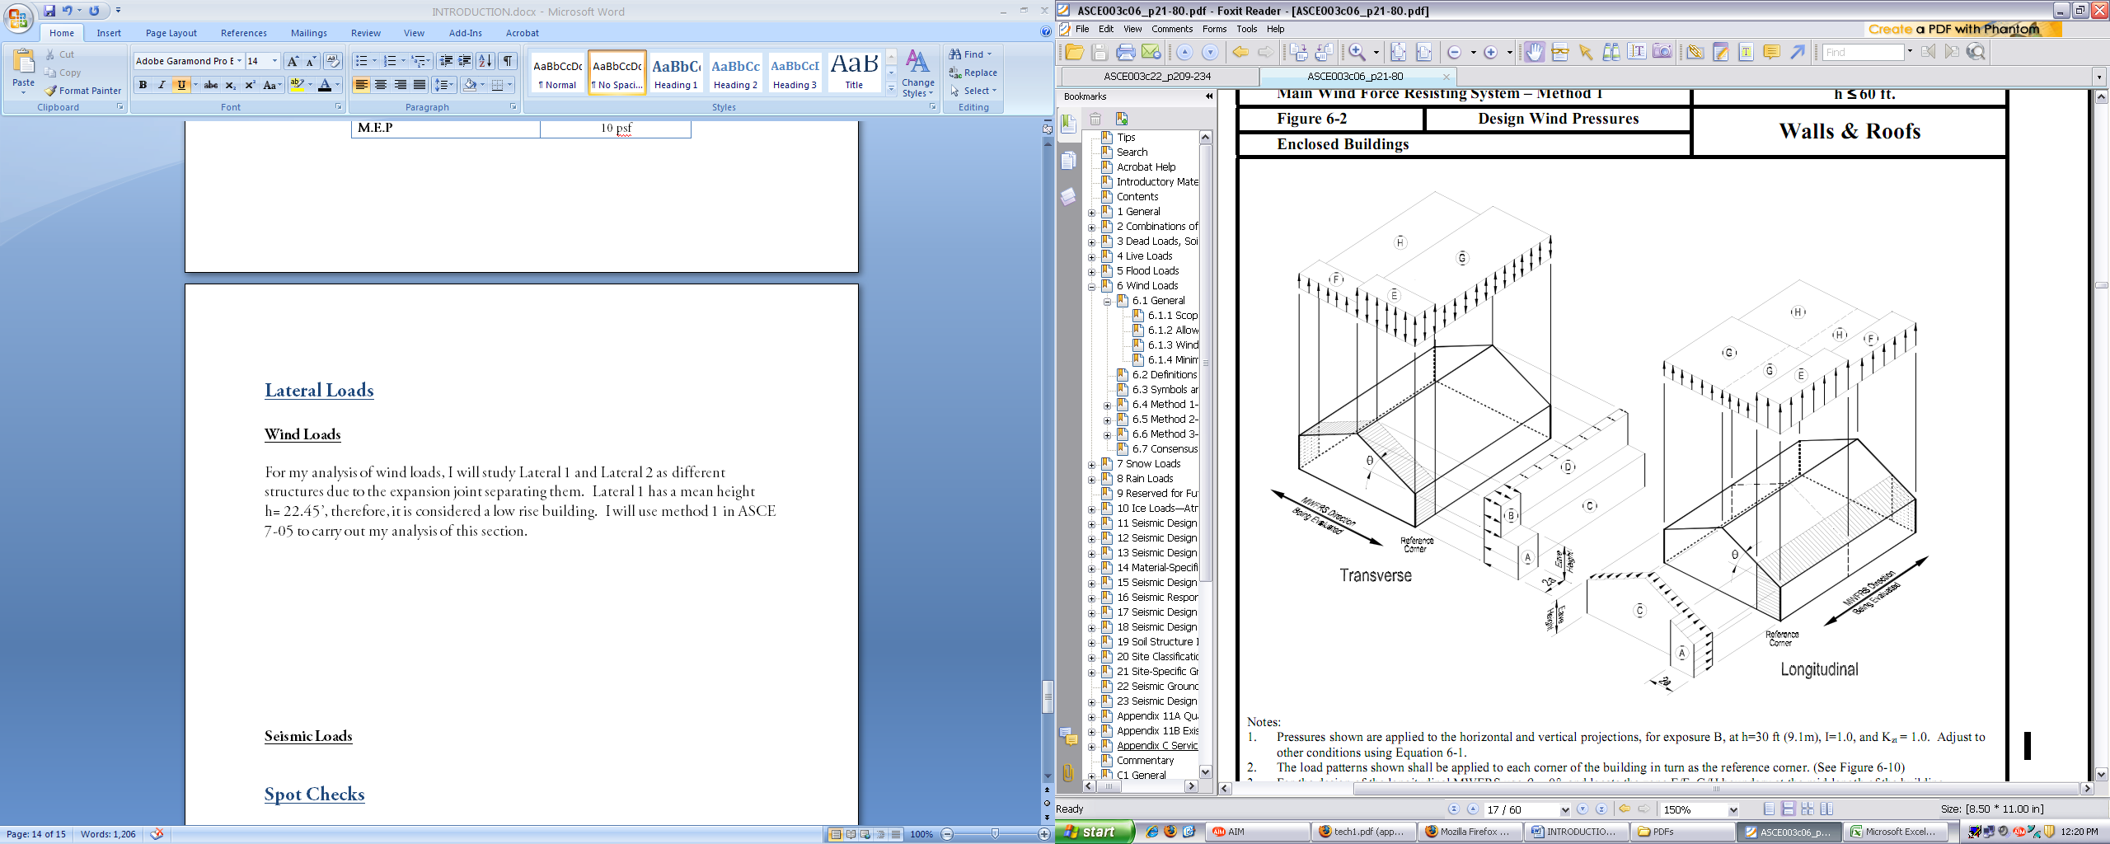
Existing Building Overview
Existing Building Structural System
Project Goals
Structural Depth Study
Construction Management Breadth Study
Conclusions
Acknowledgements
Questions and Comments
Lateral Loads
  Area 1 Wind
    22 feet above grade
    Method 1, Chapter 6, ASCE 7-05
    Designed for end zone pressure
  Area 2 Wind
    Mean height greater than 60’
    Method 2, Chapter 6, ASCE 7-05
Classification | Category
V, Basic Wind Speed (Fig. 6-1) | 90 mph
K_{d} (Table 6-4) | 0.85
I (Table 6-1) | 1.15
Occupancy Category (Table 1-1) | III
Exposure Category | B
K_{zt} (Topographic Factor) | 1
Horizontal Pressures (psf) |  |  |  | Vertical Pressures (psf)
A | B | C | D | E | F | G | H
12.8 | -6.7 | 8.5 | -4.0 | -15.4 | -8.8 | -10.7 | -6.8
Adjusted Pressures (psf) |  |  |  | Adjusted Pressures (psf)
14.7 | -7.7 | 9.8 | -4.6 | 17.71 | -10.1 | -12.3 | -7.8

Slide 22
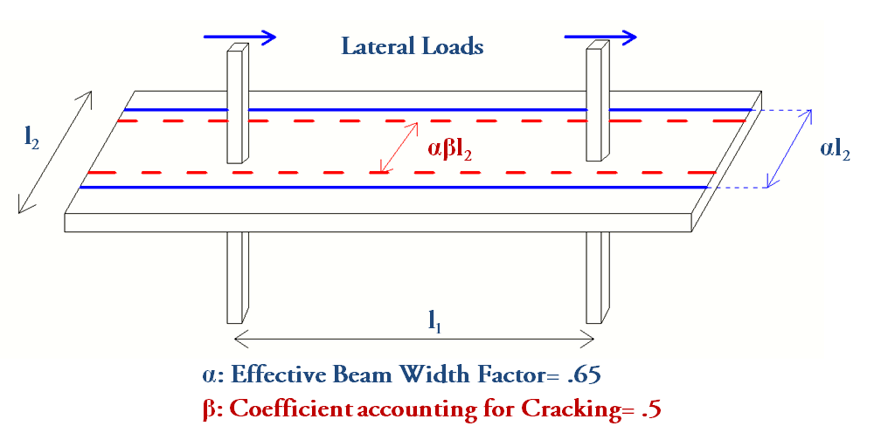
Foundations Consideration
  Considered, however not redesigned
  Assumed that spread footings still adequate for Area 1
  Increased building weight will require change for Area 2
    Mat foundation possible alternative
    Vibration issue due to existing building
ETABS Assumptions
  Foundation
    Area 1 modeled as pin connection
    Area 2 modeled as fixed connection
  Section properties modified assuming cracked sections
    Beams: I_{eff}= .35I_{g}
    Columns: I_{eff}=.70I_{g}
  Calculate the effective width of the slab (Moment frame)
    ACI Journal entry referenced (Kang and Wallace)
    Slab modeled with rigid end zones at joints
Existing Building Overview
Existing Building Structural System
Project Goals
Structural Depth Study
Construction Management Breadth Study
Conclusions
Acknowledgements
Questions and Comments

Slide 23
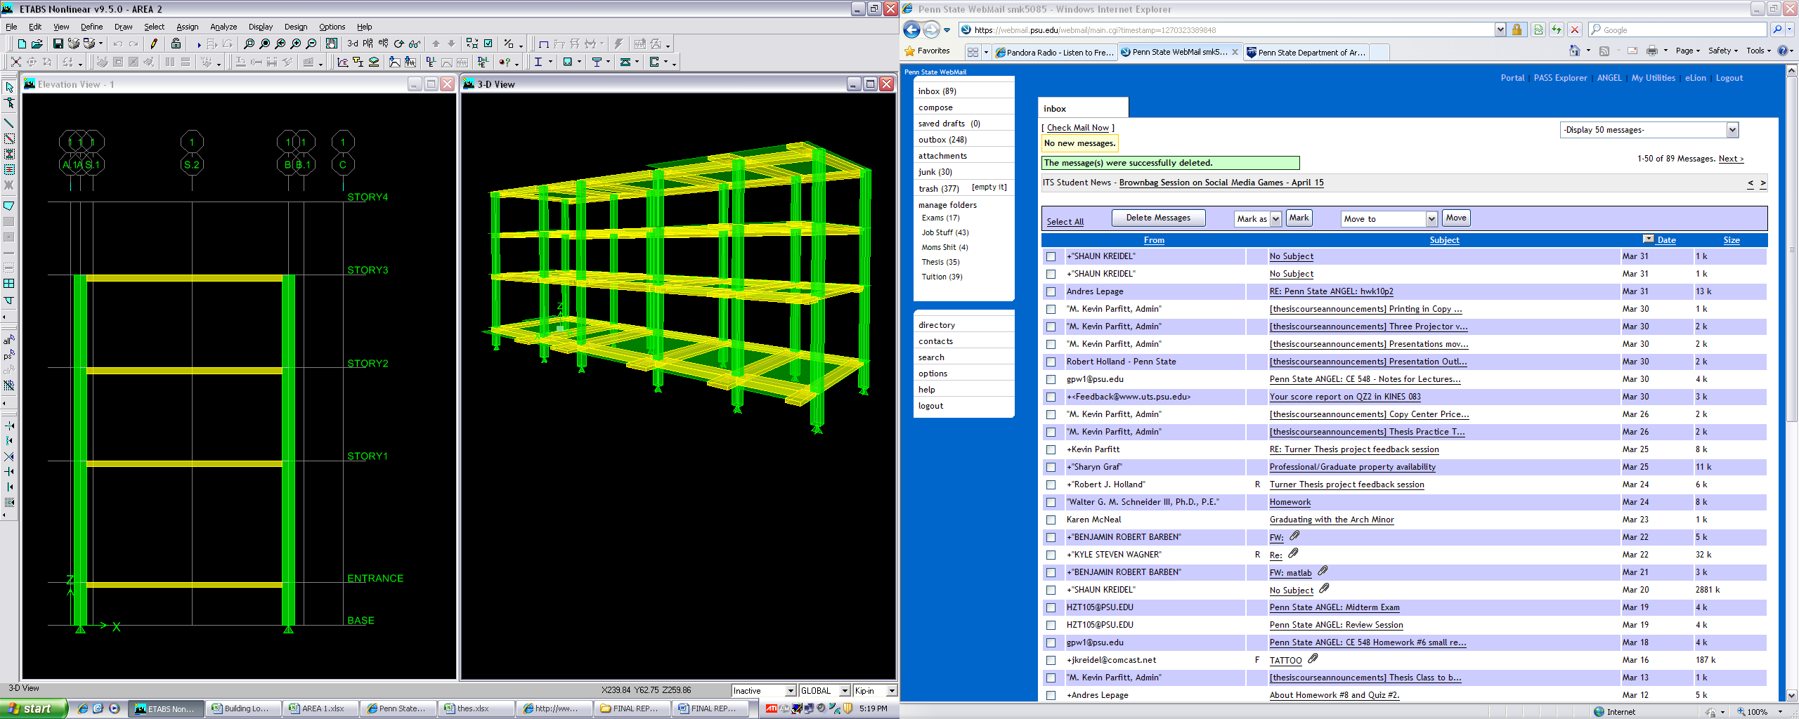
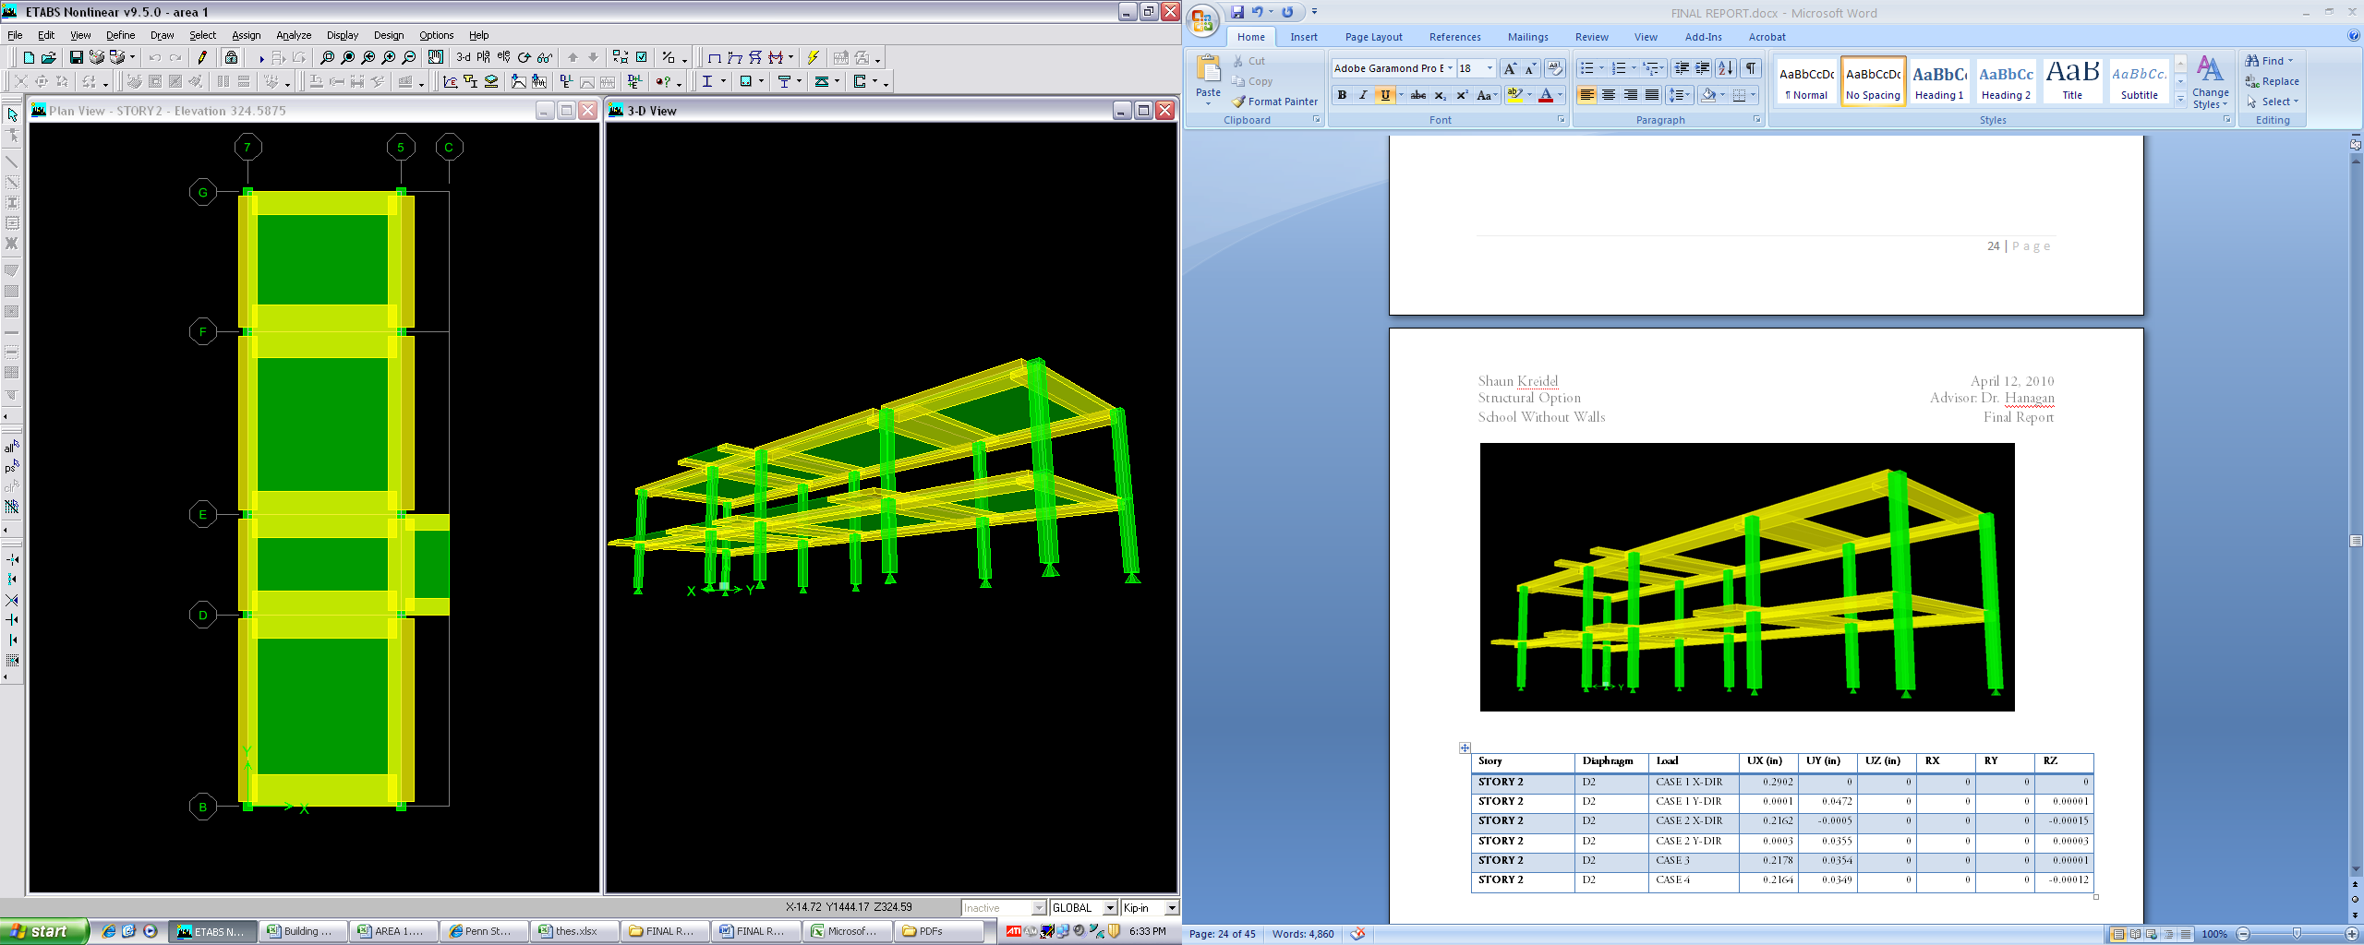
Lateral System Analysis
  Seismic and wind loads were applied
  Drift was compared
    Four wind cases (ASCE 7-05)
    Seismic loads
  Building drift limited to H/400
  Area 1:
    Columns measure 20”x20”
    Seismic loads control design in both directions
    Ux= .6515”
    Uy= .5129”
  Area 2:
    Columns measure 24”x24”
    Seismic loads control design in North-South direction
    Wind controls in the East-West direction
    Ux= 1.33”
    Uy= .7267”
Existing Building Overview
Existing Building Structural System
Project Goals
Structural Depth Study
Construction Management Breadth Study
Conclusions
Acknowledgements
Questions and Comments
Story | Diaphragm | Load | UX (in) | UY (in)
STORY4 | D4 | XWIND | 1.1218 | 0.0007
STORY4 | D4 | YWIND | -0.0012 | 0.1851
STORY4 | D4 | XQUAKE | 1.331 | 0.0016
STORY4 | D4 | YQUAKE | 0.0013 | 0.7267
STORY4 | D4 | CASE3 | 0.8405 | 0.1394
STORY4 | D4 | CASE2X | 0.8772 | 0.0033
STORY4 | D4 | CASE2Y | -0.0047 | 0.1386
STORY4 | D4 | CASE4 | 0.8725 | 0.1418
STORY3 | D3 | XWIND | 0.9105 | 0.0003
STORY3 | D3 | YWIND | -0.0008 | 0.1591
STORY3 | D3 | XQUAKE | 1.0466 | 0.0003
STORY3 | D3 | YQUAKE | 0.0007 | 0.6051
STORY3 | D3 | CASE3 | 0.6823 | 0.1196
STORY3 | D3 | CASE2X | 0.705 | -0.0002
STORY3 | D3 | CASE2Y | -0.0029 | 0.1194
STORY3 | D3 | CASE4 | 0.7021 | 0.1192
STORY2 | D2 | XWIND | 0.5796 | 0.0004
STORY2 | D2 | YWIND | -0.0003 | 0.1097
STORY2 | D2 | XQUAKE | 0.6395 | 0.0002
STORY2 | D2 | YQUAKE | 0.0003 | 0.4
STORY2 | D2 | CASE3 | 0.4345 | 0.0826
STORY2 | D2 | CASE2X | 0.4444 | -0.0008
STORY2 | D2 | CASE2Y | -0.0013 | 0.0824
STORY2 | D2 | CASE4 | 0.4431 | 0.0816
ENTRANCE | D1 | XWIND | 0.0622 | 0.0001
ENTRANCE | D1 | YWIND | 0 | 0.0116
ENTRANCE | D1 | XQUAKE | 0.0652 | 0
ENTRANCE | D1 | YQUAKE | 0 | 0.0401
ENTRANCE | D1 | CASE3 | 0.0466 | 0.0088
ENTRANCE | D1 | CASE2X | 0.0467 | -0.0006
ENTRANCE | D1 | CASE2Y | 0 | 0.0088
ENTRANCE | D1 | CASE4 | 0.0467 | 0.0082
Story | Diaphragm | Load | UX (in) | UY (in)
STORY2 | D2 | XWIND | 0.3308 | 0
STORY2 | D2 | YWIND | 0.0002 | 0.091
STORY2 | D2 | XQUAKE | 0.6515 | -0.0001
STORY2 | D2 | YQUAKE | 0 | 0.5129
STORY2 | D2 | CASE2X | 0.2461 | -0.0002
STORY2 | D2 | CASE2Y | 0.0004 | 0.0683
STORY2 | D2 | CASE3 | 0.2482 | 0.0682
STORY2 | D2 | CASE4 | 0.2464 | 0.0681
STORY1 | D1 | XWIND | 0.2121 | 0.0002
STORY1 | D1 | YWIND | 0.0003 | 0.0617
STORY1 | D1 | XQUAKE | 0.3827 | 0.0006
STORY1 | D1 | YQUAKE | 0.0003 | 0.3133
STORY1 | D1 | CASE2X | 0.1556 | -0.0033
STORY1 | D1 | CASE2Y | 0.0007 | 0.0467
STORY1 | D1 | CASE3 | 0.1593 | 0.0464
STORY1 | D1 | CASE4 | 0.1562 | 0.0434

Slide 24
Existing Building Overview
Existing Building Structural System
Project Goals
Structural Depth Study
Construction Management Breadth Study
Conclusions
Acknowledgements
Questions and Comments
Construction Management Breadth Study

Slide 25
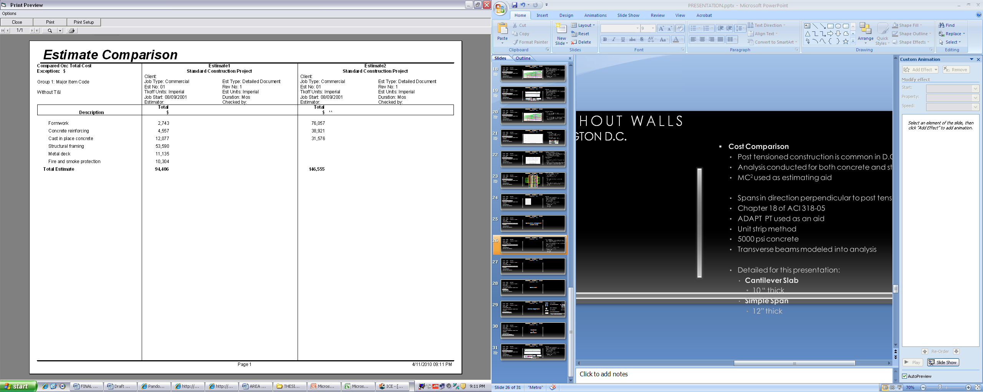
Existing Building Overview
Existing Building Structural System
Project Goals
Structural Depth Study
Construction Management Breadth Study
Conclusions
Acknowledgements
Questions and Comments
Cost Comparison
  Post tensioned construction is common in D.C. area
  Analysis conducted for both concrete and steel buildings
  MC² used as estimating aid
  Foundations neglected
  Area 1
    Concrete
      Cost is greater in concrete
      Greater formwork costs
      Post tension costs
    Steel
      Moment connections
      Fire protection
Existing Steel Structure
Concrete Structure

Slide 26
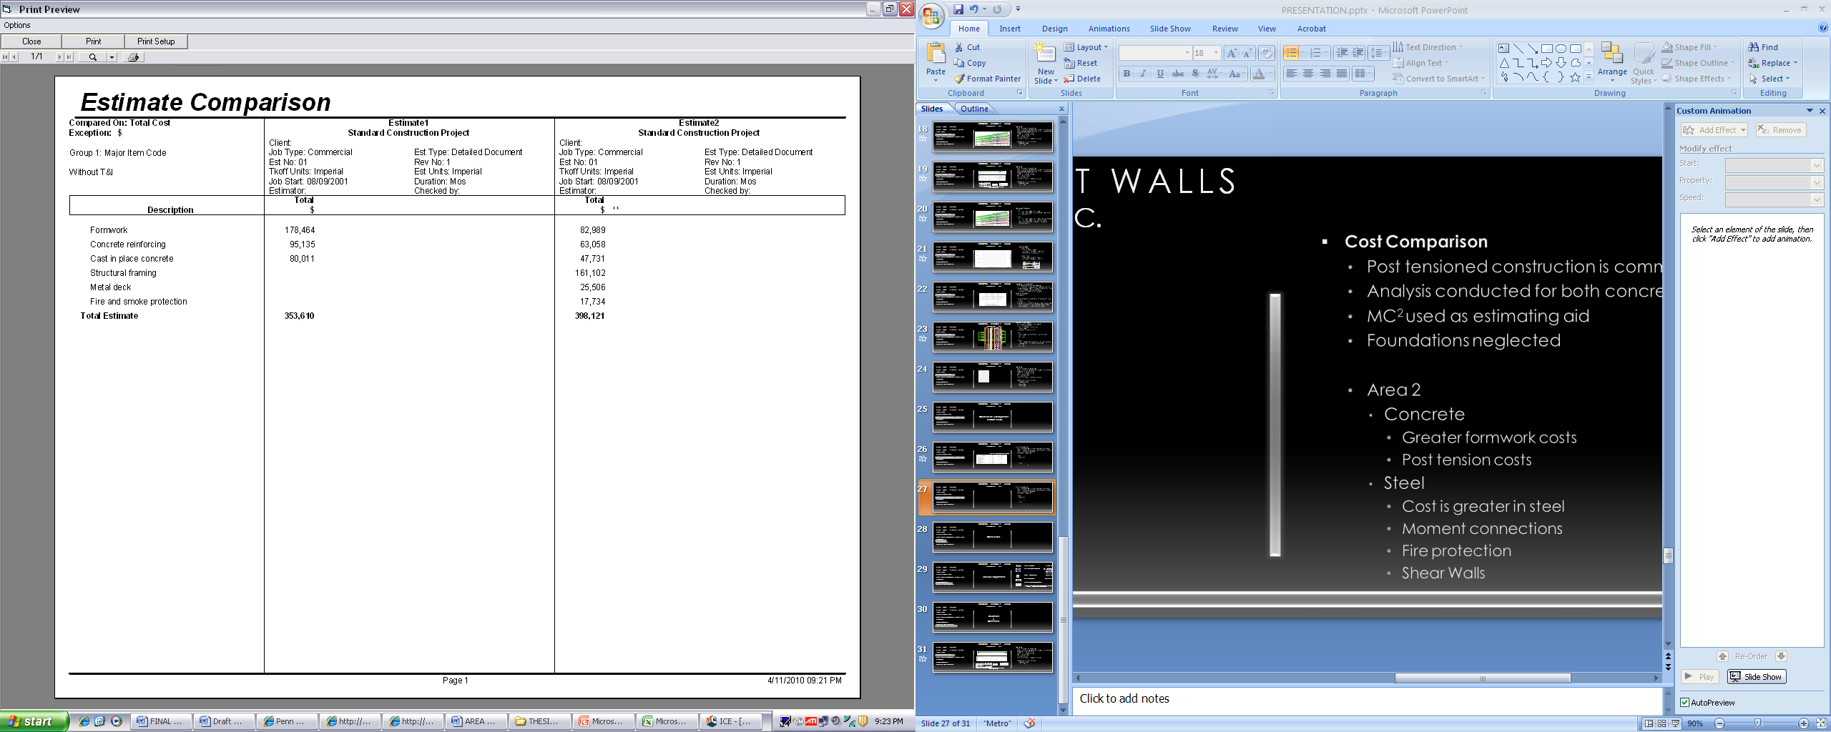
Existing Building Overview
Existing Building Structural System
Project Goals
Structural Depth Study
Construction Management Breadth Study
Conclusions
Acknowledgements
Questions and Comments
Cost Comparison
  Post tensioned construction is common in D.C. area
  Analysis conducted for both concrete and steel buildings
  MC² used as estimating aid
  Foundations neglected
  Area 2
    Concrete
      Greater formwork costs
      Post tension costs
    Steel
      Cost is greater in steel
      Moment connections
      Fire protection
      Shear Walls
Existing Steel Structure
Concrete Structure

Slide 27
Existing Building Overview
Existing Building Structural System
Project Goals
Structural Depth Study
Construction Management Breadth Study
Conclusions
Acknowledgements
Questions and Comments
  Floor system depth greatly reduced
    Post tension system: 20” beam depth
    Steel system: W10 to W33 shapes
    Allows for more room for MEP coordination
  Steel Moment connections eliminated
    Cantilevers are typically easier to construct in concrete
  Concrete moment frames utilized
    Total drift of the building was limited to H/400
    Shear walls eliminated
  Total cost of construction very similar for both construction types
    Labor and post tension costs offset by removal of shear walls, moment connections and fireproofing
  PT system is viable alternative to this project
Conclusions

Slide 28

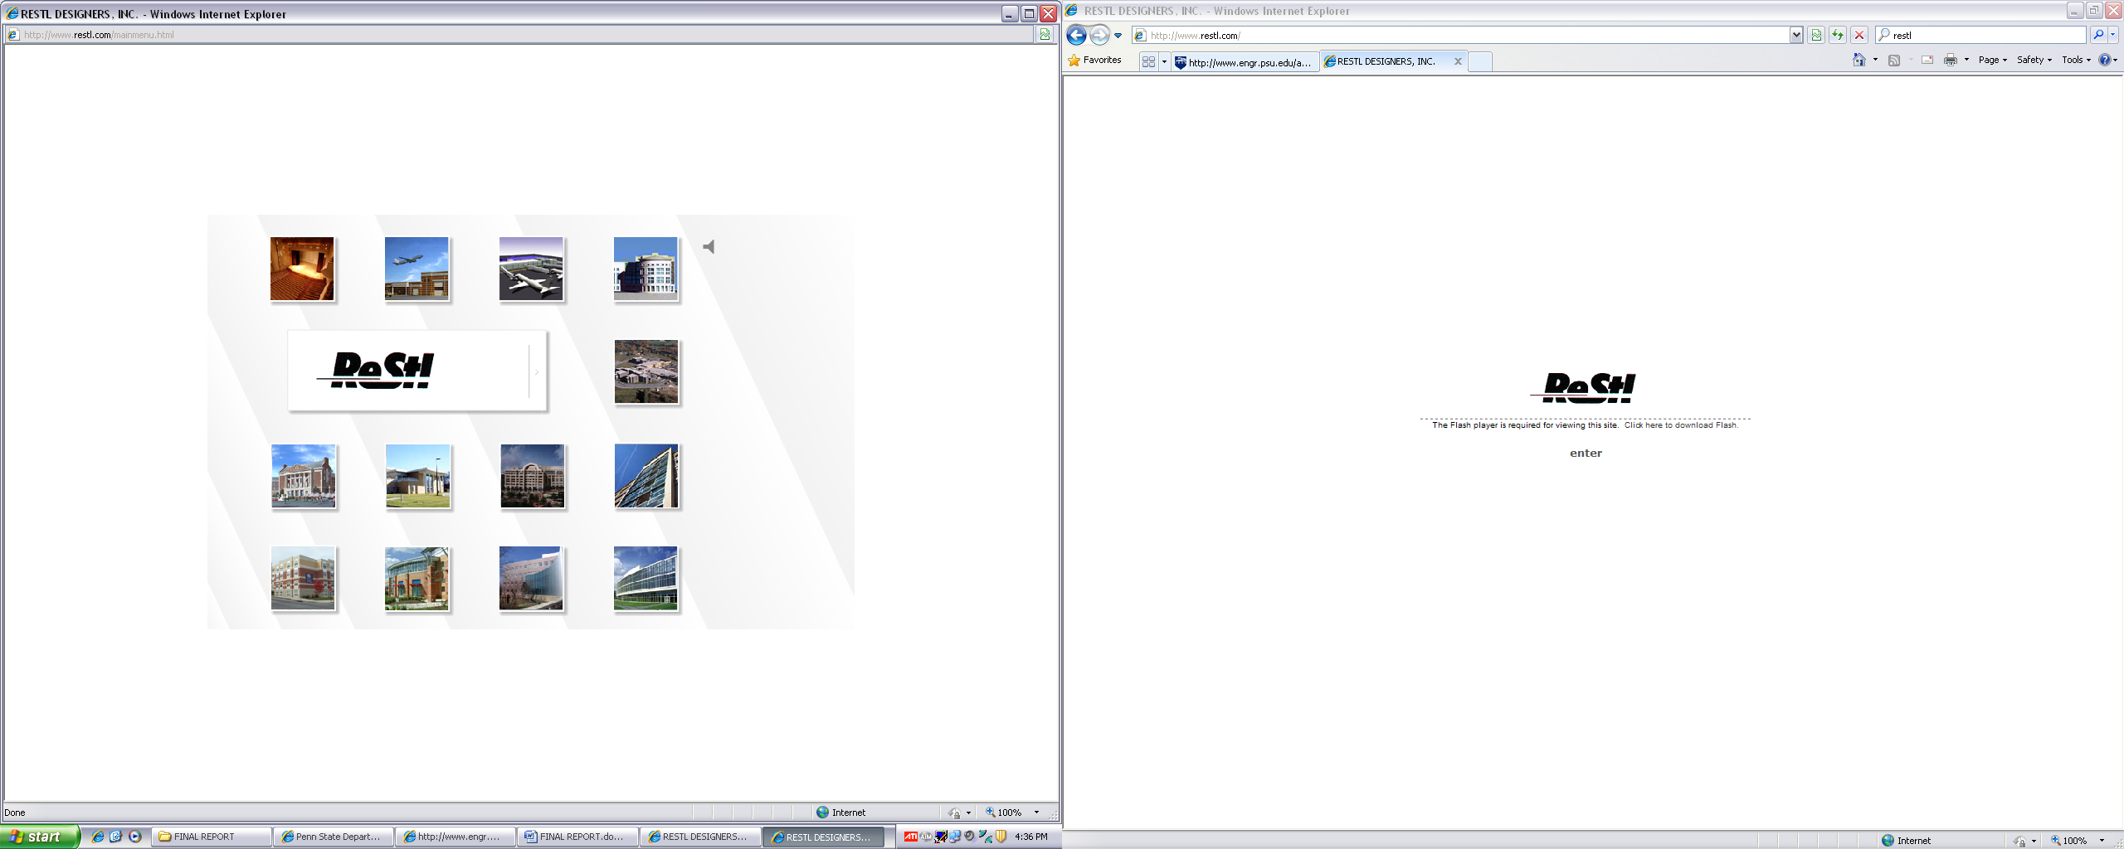

Turner Construction: Tiffany Moore
The Pennsylvania State University: Dr. Linda Hanagan
Dr. Andres Lepage
Dr. Ali Memari
Robert Holland
Kevin Parfitt
Holbert Apple Associates: Richard Apple
ReStl Designers Inc.: Adlai Luzuriaga
Ehrenkrantz Eckstut & Kuhn Architects
I would like to also thank all of my friends and family for their continuing support throughout the senior thesis process.
Existing Building Overview
Existing Building Structural System
Project Goals
Structural Depth Study
Construction Management Breadth Study
Conclusions
Acknowledgements
Questions and Comments
Acknowledgements

Slide 29
Existing Building Overview
Existing Building Structural System
Project Goals
Structural Depth Study
Construction Management Breadth Study
Conclusions
Acknowledgements
Questions and Comments
Questions
&
Comments

