Slide 1
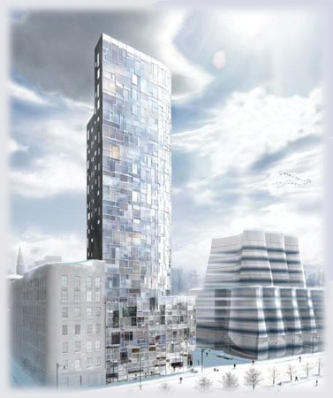
100 Eleventh Avenue
New York, New York
Tyler E. Graybill | Structural Option
AE Senior Thesis Presentation | April 12, 2010
Faculty Consultant: Professor Thomas E. Boothby
©www.archpartners.com

Slide 2
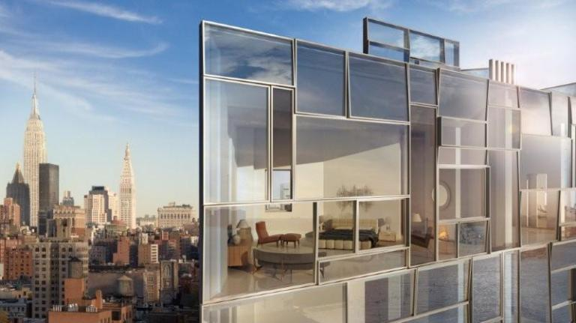
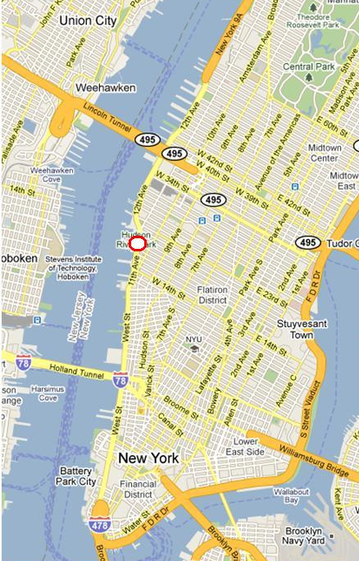


Presentation Outline
Introduction to 100 Eleventh Avenue
100 Eleventh Avenue
New York, New York
General Information
Introduction to 100 Eleventh Avenue
Proposal
  Problem Statement
  Proposed Solutions
Structural Depth I: PT Perimeter Slab Design
  Understanding Existing Design
  Alternate System Design Results
Structural Depth II: Transfer System Design
  Understanding Existing Design
  Alternate System Design Results
Construction Management Breadth
  PT Perimeter Slab
  Alternate Transfer System
Conclusions
22-story residential building
Location……………………….Manhattan’s West Chelsea District
Size…………………………….148,000 sf
Project Cost……………………Unreleased
The Players
- Design Architect…….………Jean Nouvel
- Executive Architect………….Beyer Blinder Belle
- Structural Consultant……….DeSimone Consulting Engineers
©www.archpartners.com
Acknowledgements
Questions & Comments
©www.archpartners.com
©www.arte-factory.com
Tyler E. Graybill | Structural Option

Slide 3
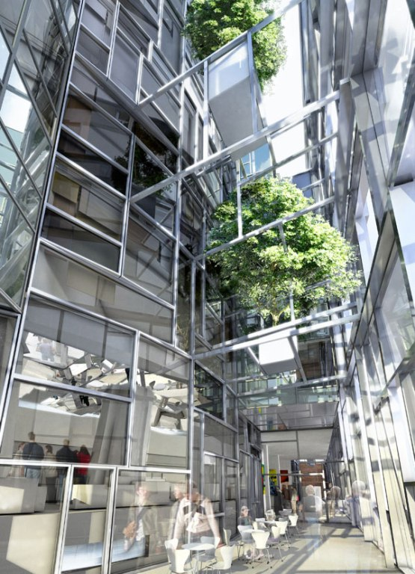
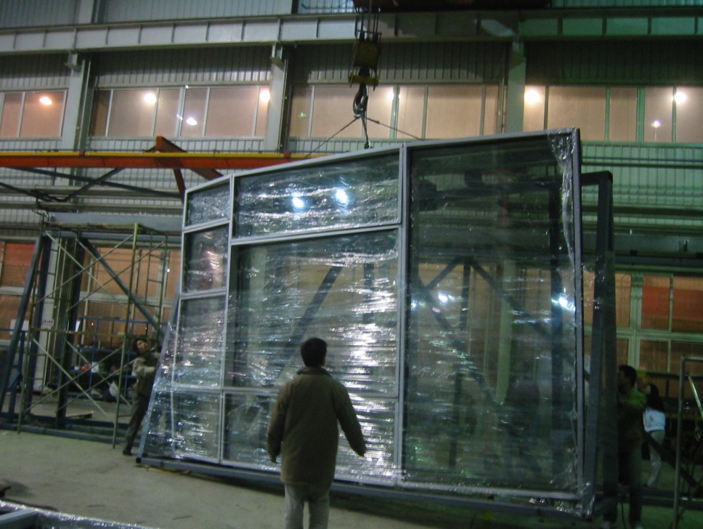

Presentation Outline
Introduction to 100 Eleventh Avenue
100 Eleventh Avenue
New York, New York
Architectural Design Concept
Introduction to 100 Eleventh Avenue
Proposal
  Problem Statement
  Proposed Solutions
Structural Depth I: PT Perimeter Slab Design
  Understanding Existing Design
  Alternate System Design Results
Structural Depth II: Transfer System Design
  Understanding Existing Design
  Alternate System Design Results
Construction Management Breadth
  PT Perimeter Slab
  Alternate Transfer System
Conclusions
Panelized curtain wall system
- 1650 windows uniquely sized and oriented
- Bottom six levels enclosed by a second facade
Building as a “vision machine”
Curved facade meant to contour the corner of 19th street and West Side Highway
Acknowledgements
Questions & Comments
©www.arte-factory.com
©www.archpartners.com
©www.arte-factory.com
Tyler E. Graybill | Structural Option

Slide 4
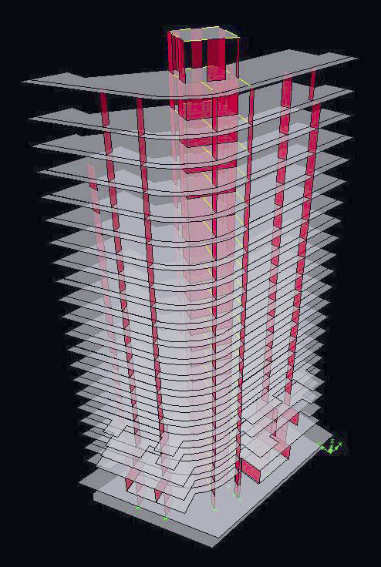
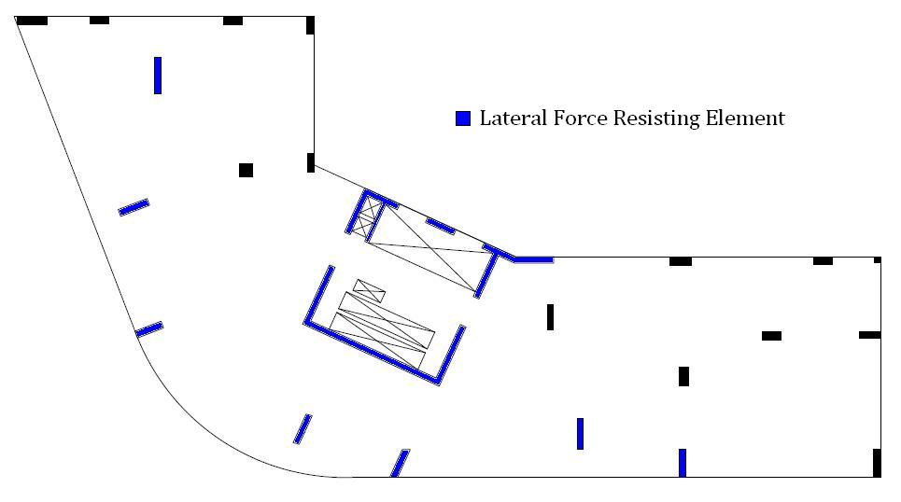
Presentation Outline
Introduction to 100 Eleventh Avenue
100 Eleventh Avenue
New York, New York
Existing Structural System
Introduction to 100 Eleventh Avenue
Proposal
  Problem Statement
  Proposed Solutions
Structural Depth I: PT Perimeter Slab Design
  Understanding Existing Design
  Alternate System Design Results
Structural Depth II: Transfer System Design
  Understanding Existing Design
  Alternate System Design Results
Construction Management Breadth
  PT Perimeter Slab
  Alternate Transfer System
Conclusions
Gravity System
- 9” thick two-way concrete flat plate floor system
- Concrete strength:
  Slab – 6 ksi
  Columns/Wall – 7-8 ksi
- Typical spans of 18’ to 23’
Lateral System
- 12” core shear walls, in combination with seven “long” columns
Typical Floor Plan (Levels 7-21)
Acknowledgements
Questions & Comments
©www.arte-factory.com
Tyler E. Graybill | Structural Option

Slide 5
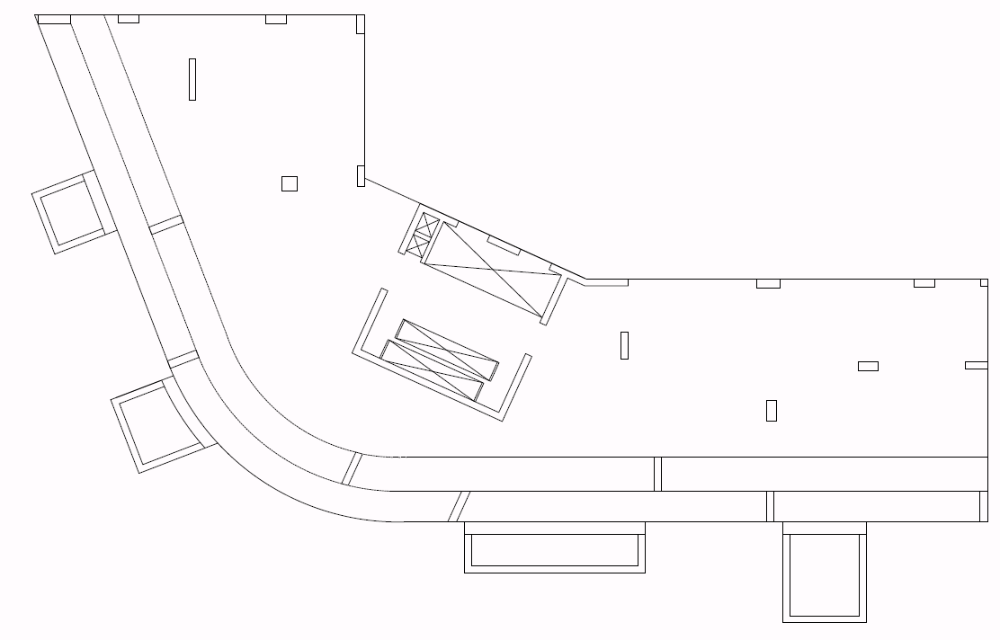
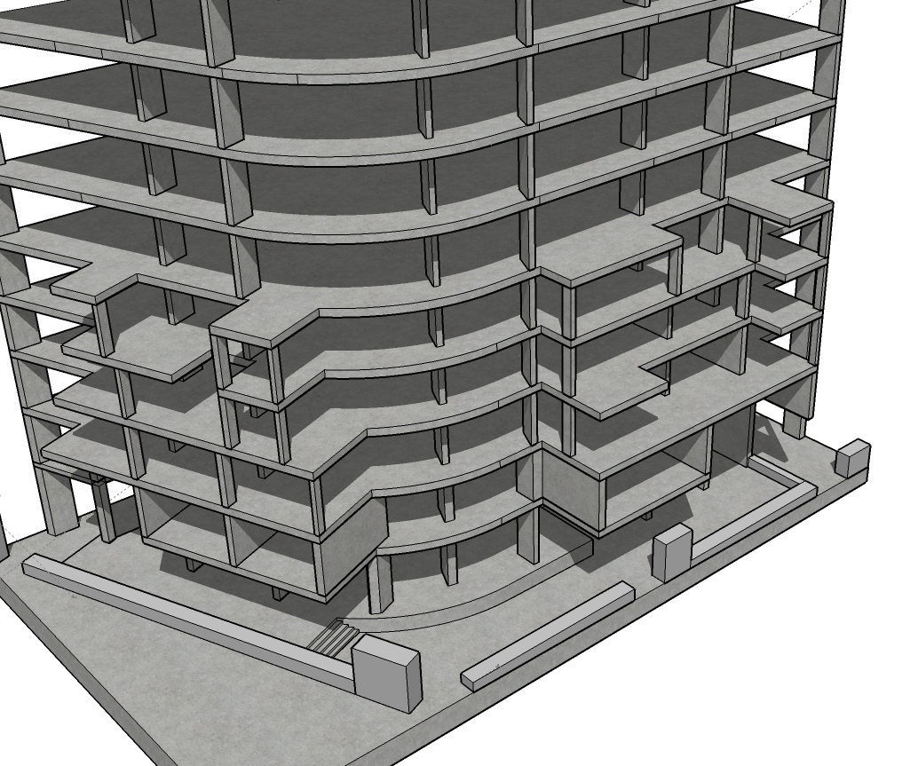
Presentation Outline
Introduction to 100 Eleventh Avenue
100 Eleventh Avenue
New York, New York
Existing Structural System
Introduction to 100 Eleventh Avenue
Proposal
  Problem Statement
  Proposed Solutions
Structural Depth I: PT Perimeter Slab Design
  Understanding Existing Design
  Alternate System Design Results
Structural Depth II: Transfer System Design
  Understanding Existing Design
  Alternate System Design Results
Construction Management Breadth
  PT Perimeter Slab
  Alternate Transfer System
Conclusions
Gravity System
- 9” thick two-way concrete flat plate floor system
- Concrete strength:
  Slab – 6 ksi
  Columns/Wall – 7-8 ksi
- Typical spans of 18’ to 23’
Lateral System
- 12” core shear walls, in combination with seven “long” columns
Intricate balcony system found at Levels 1 through 6
- Cantilevered columns at Level 2 allow for column free space at street-level atrium
6th Level
Acknowledgements
Questions & Comments
©www.arte-factory.com
Tyler E. Graybill | Structural Option

Slide 6
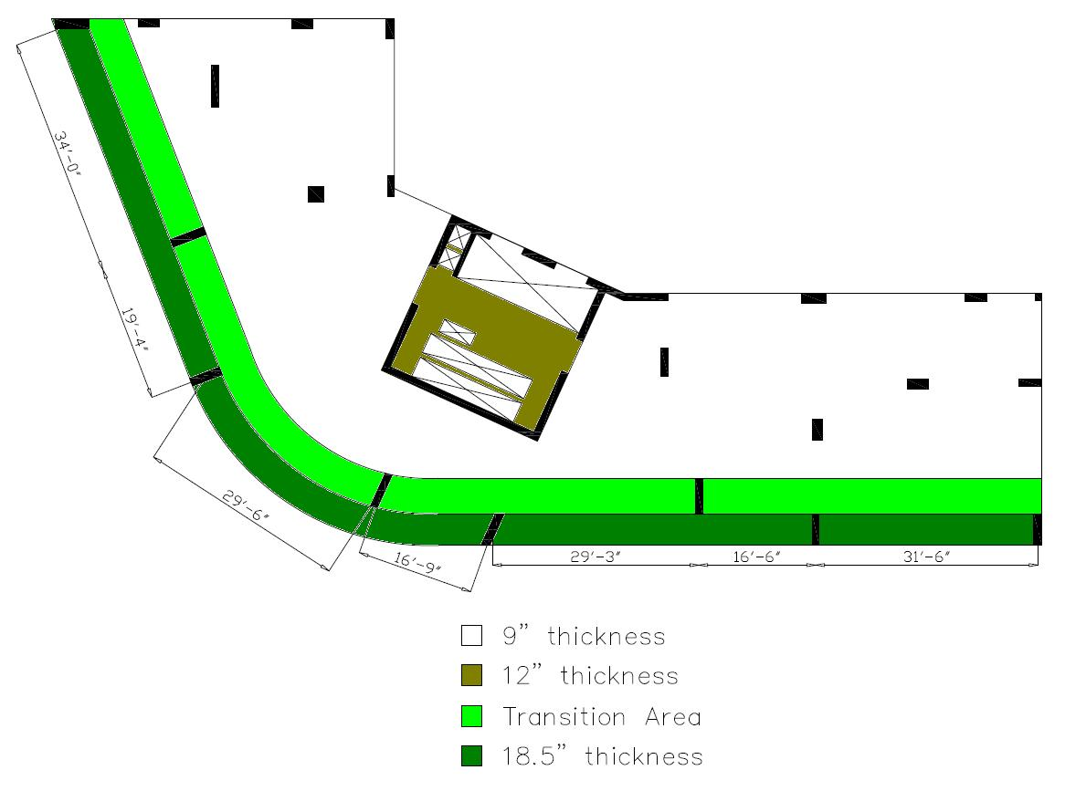
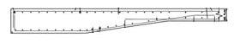
Presentation Outline
Problem Statement
100 Eleventh Avenue
New York, New York
Existing System – Perimeter Slab Strip
Introduction to 100 Eleventh Avenue
Proposal
  Problem Statement
  Proposed Solutions
Structural Depth I: PT Perimeter Slab Design
  Understanding Existing Design
  Alternate System Design Results
Structural Depth II: Transfer System Design
  Understanding Existing Design
  Alternate System Design Results
Construction Management Breadth
  PT Perimeter Slab
  Alternate Transfer System
Conclusions
Spans increase to maximum of 34 feet
Facade load of 500 lb/ft
As a result, slab thickens from 9” (typical) to 18.5” along 9.5’-wide portion of
perimeter
Advantages
- Practical means of meeting strength and deflection requirements
Disadvantages
- Negative effect on exposed ceiling appearance
- Decreased floor-to-ceiling height at perimeter
- Increased weight and material usage
Acknowledgements
Questions & Comments
©www.arte-factory.com
Tyler E. Graybill | Structural Option

Slide 7
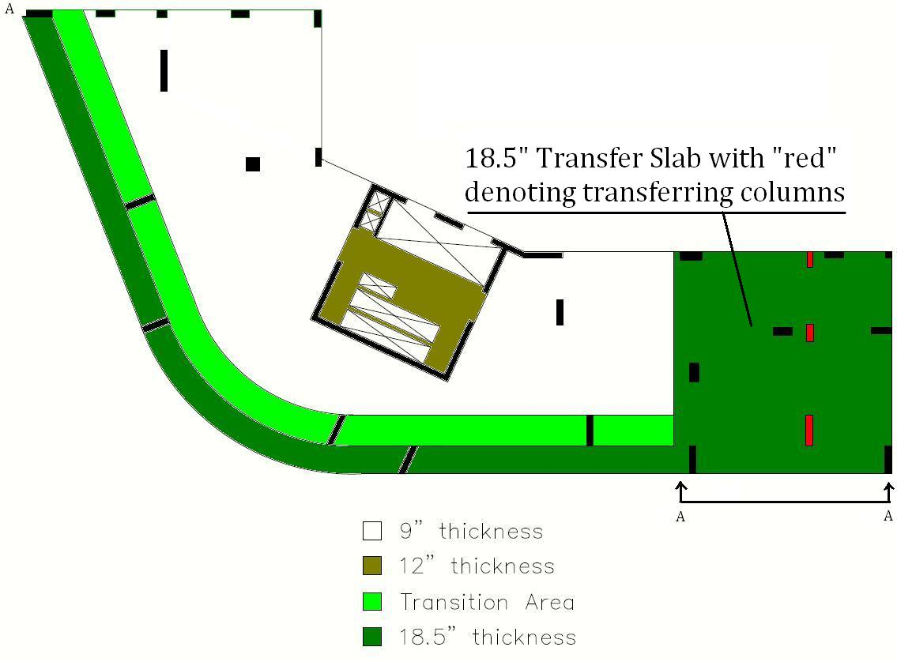
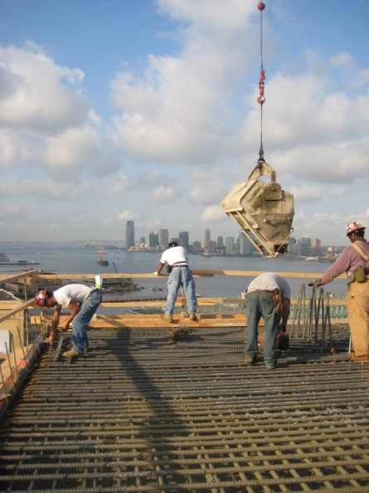
Presentation Outline
Problem Statement
100 Eleventh Avenue
New York, New York
Existing Systems – 19th Floor Transfer System
Introduction to 100 Eleventh Avenue
Proposal
  Problem Statement
  Proposed Solutions
Structural Depth I: PT Perimeter Slab Design
  Understanding Existing Design
  Alternate System Design Results
Structural Depth II: Transfer System Design
  Understanding Existing Design
  Alternate System Design Results
Construction Management Breadth
  PT Perimeter Slab
  Alternate Transfer System
Conclusions
3 columns transfer to accommodate a building setback of 13’
Forces transferred via 18.5” transfer slab, reinforced with #10’s @ 6” o.c. E.W.
(top and bottom of slab)
Advantages
- Easily formed
Disadvantages
- Very heavily reinforced
Acknowledgements
Questions & Comments
Section A-A
©www.arte-factory.com
Tyler E. Graybill | Structural Option

Slide 8
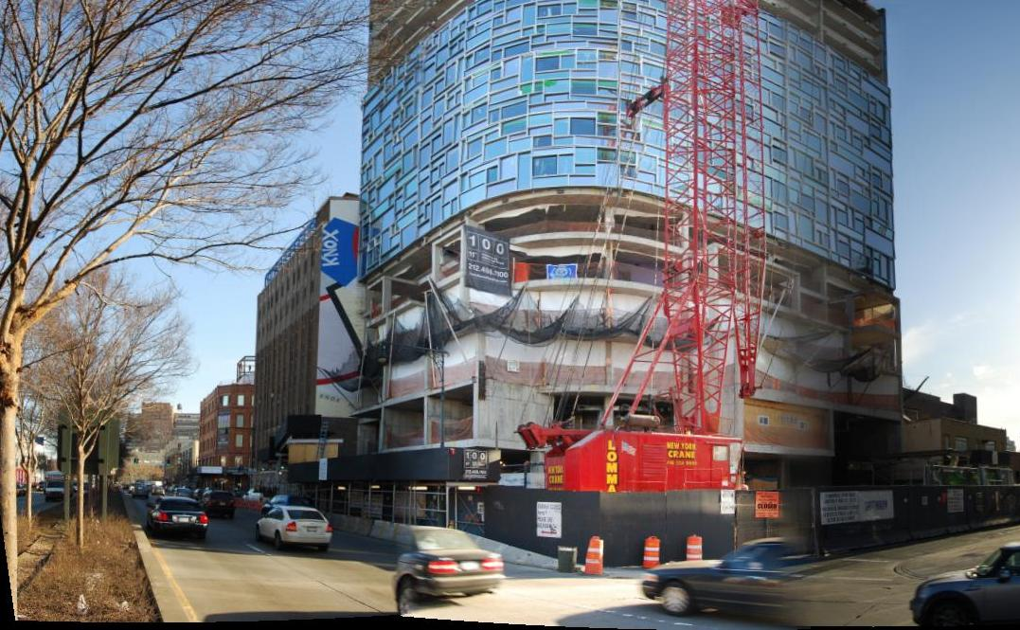
Presentation Outline
Proposed Solutions
100 Eleventh Avenue
New York, New York
Thickened Perimeter Slab Strip
Introduction to 100 Eleventh Avenue
Proposal
  Problem Statement
  Proposed Solutions
Structural Depth I: PT Perimeter Slab Design
  Understanding Existing Design
  Alternate System Design Results
Structural Depth II: Transfer System Design
  Understanding Existing Design
  Alternate System Design Results
Construction Management Breadth
  PT Perimeter Slab
  Alternate Transfer System
Conclusions
Post-tension 9.5’-wide slab strip
Goal of Design
- Reduce 18.5” perimeter slab strip to typical thickness of 9” without significant
increase in cost or schedule
19th Floor Transfer Slab
Design alternate system using transfer beams in lieu of transfer slab
Goal of Design
- Substantially reduce cost, weight and material usage of system without
significant impact on schedule
Acknowledgements
Questions & Comments
©www.arte-factory.com
Tyler E. Graybill | Structural Option

Slide 9
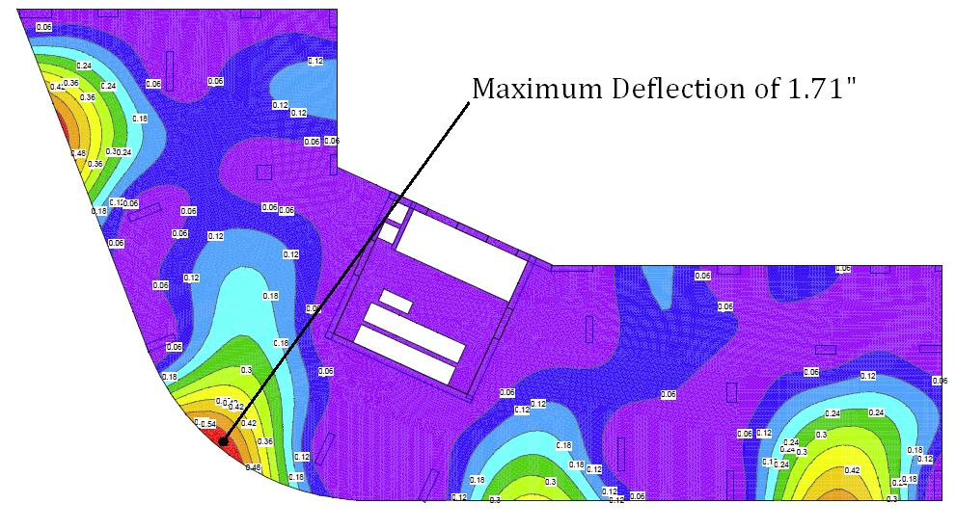
Presentation Outline
Depth I: PT Perimeter Slab Design
100 Eleventh Avenue
New York, New York
Understanding the Existing Design
Introduction to 100 Eleventh Avenue
Proposal
  Problem Statement
  Proposed Solutions
Structural Depth I: PT Perimeter Slab Design
  Understanding Existing Design
  Alternate System Design Results
Structural Depth II: Transfer System Design
  Understanding Existing Design
  Alternate System Design Results
Construction Management Breadth
  PT Perimeter Slab
  Alternate Transfer System
Conclusions
10” thickness required for flexural strength
Critical Deflection limitations used by structural consultants
- D ≤ 1” (for portions of slab supporting facade)
- D ≤ L/360 (immediate)
- D ≤ L/240 (total)
Conclusion: deflection limitations drove existing design
Typical Floor without Thickened Perimeter
Acknowledgements
Questions & Comments
©www.arte-factory.com
Tyler E. Graybill | Structural Option

Slide 10
Presentation Outline
Depth I: PT Perimeter Slab Design
100 Eleventh Avenue
New York, New York
Design Procedure
Introduction to 100 Eleventh Avenue
Proposal
  Problem Statement
  Proposed Solutions
Structural Depth I: PT Perimeter Slab Design
  Understanding Existing Design
  Alternate System Design Results
Structural Depth II: Transfer System Design
  Understanding Existing Design
  Alternate System Design Results
Construction Management Breadth
  PT Perimeter Slab
  Alternate Transfer System
Conclusions
Single design for typical floor of Levels 7 through 21
Levels 2 through 6 require individual attention
Design and analysis assumed curved perimeter to act as a single
equivalent frame
Acknowledgements
Questions & Comments
©www.arte-factory.com
Tyler E. Graybill | Structural Option

Slide 11
Presentation Outline
Depth I: PT Perimeter Slab Design
100 Eleventh Avenue
New York, New York
Utilizing RAM Concept
Introduction to 100 Eleventh Avenue
Proposal
  Problem Statement
  Proposed Solutions
Structural Depth I: PT Perimeter Slab Design
  Understanding Existing Design
  Alternate System Design Results
Structural Depth II: Transfer System Design
  Understanding Existing Design
  Alternate System Design Results
Construction Management Breadth
  PT Perimeter Slab
  Alternate Transfer System
Conclusions
A finite element method (FEM) analysis program for elevated slabs
- Linear elastic analysis
FEM (as opposed to more traditional Equivalent Frame Method) advantageous in
modeling highly irregular floors with no regular grid
Links FEM analysis with concrete code by defining “design strips”
Acknowledgements
Questions & Comments
Design Strips defined
©www.arte-factory.com
Tyler E. Graybill | Structural Option

Slide 12
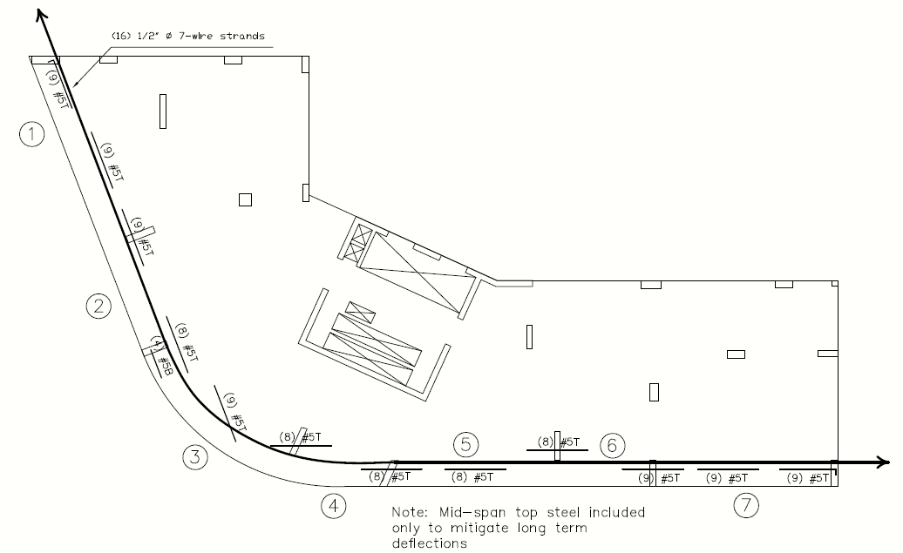
Presentation Outline
Depth I: PT Perimeter Slab Design
100 Eleventh Avenue
New York, New York
Design Results – Typical Floor
Introduction to 100 Eleventh Avenue
Proposal
  Problem Statement
  Proposed Solutions
Structural Depth I: PT Perimeter Slab Design
  Understanding Existing Design
  Alternate System Design Results
Structural Depth II: Transfer System Design
  Understanding Existing Design
  Alternate System Design Results
Construction Management Breadth
  PT Perimeter Slab
  Alternate Transfer System
Conclusions
(16) ½” Ø 7-wire strands
P/A = 416 psi
Acknowledgements
Questions & Comments
©www.arte-factory.com
Tyler E. Graybill | Structural Option

Slide 13
Presentation Outline
Depth I: PT Perimeter Slab Design
100 Eleventh Avenue
New York, New York
Design Results – Typical Floor
Introduction to 100 Eleventh Avenue
Proposal
  Problem Statement
  Proposed Solutions
Structural Depth I: PT Perimeter Slab Design
  Understanding Existing Design
  Alternate System Design Results
Structural Depth II: Transfer System Design
  Understanding Existing Design
  Alternate System Design Results
Construction Management Breadth
  PT Perimeter Slab
  Alternate Transfer System
Conclusions
Acknowledgements
Questions & Comments
©www.arte-factory.com
Tyler E. Graybill | Structural Option

Slide 14
Presentation Outline
Depth I: PT Perimeter Slab Design
100 Eleventh Avenue
New York, New York
Additional Considerations
Introduction to 100 Eleventh Avenue
Proposal
  Problem Statement
  Proposed Solutions
Structural Depth I: PT Perimeter Slab Design
  Understanding Existing Design
  Alternate System Design Results
Structural Depth II: Transfer System Design
  Understanding Existing Design
  Alternate System Design Results
Construction Management Breadth
  PT Perimeter Slab
  Alternate Transfer System
Conclusions
Tendons to be stressed from both ends
P/A > 300 psi
Counteracting curved tendons desire to “straighten out”
Acknowledgements
Questions & Comments
©www.arte-factory.com
Tyler E. Graybill | Structural Option

Slide 15
Presentation Outline
Depth I: PT Perimeter Slab Design
100 Eleventh Avenue
New York, New York
Design Results – Lower Floors
Introduction to 100 Eleventh Avenue
Proposal
  Problem Statement
  Proposed Solutions
Structural Depth I: PT Perimeter Slab Design
  Understanding Existing Design
  Alternate System Design Results
Structural Depth II: Transfer System Design
  Understanding Existing Design
  Alternate System Design Results
Construction Management Breadth
  PT Perimeter Slab
  Alternate Transfer System
Conclusions
Post-tensioned perimeter design complicated by balcony system
Two key issues:
(1) Proximity of neighboring buildings
Acknowledgements
Questions & Comments
6th Floor Plan
©www.arte-factory.com
Tyler E. Graybill | Structural Option

Slide 16
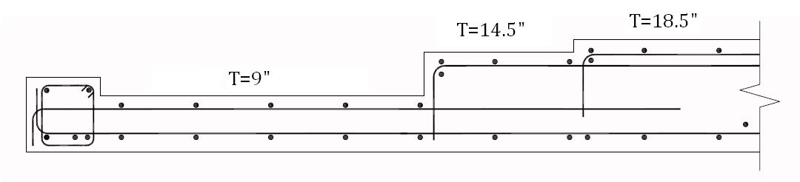
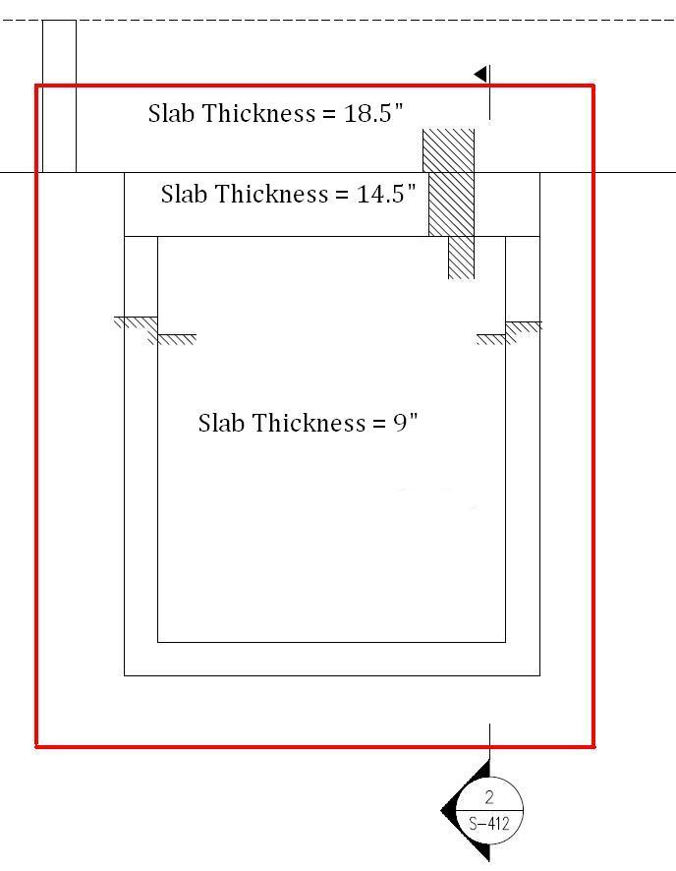
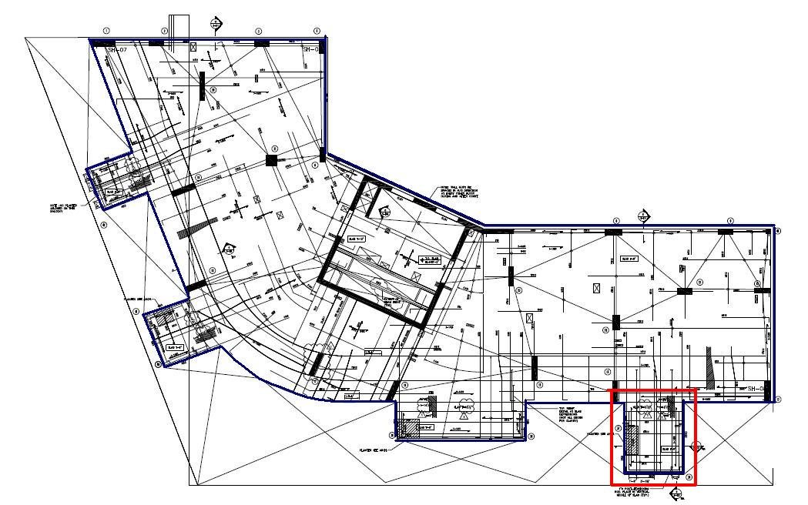
Presentation Outline
Depth I: PT Perimeter Slab Design
100 Eleventh Avenue
New York, New York
Design Results – Lower Floors
Introduction to 100 Eleventh Avenue
Proposal
  Problem Statement
  Proposed Solutions
Structural Depth I: PT Perimeter Slab Design
  Understanding Existing Design
  Alternate System Design Results
Structural Depth II: Transfer System Design
  Understanding Existing Design
  Alternate System Design Results
Construction Management Breadth
  PT Perimeter Slab
  Alternate Transfer System
Conclusions
Post-tensioned perimeter design complicated by balcony system
Two key issues:
Existing
(1) Proximity of neighboring buildings
(2) Balcony slab drops
PT 9” slab superimposed on existing
Acknowledgements
Questions & Comments
©www.arte-factory.com
Tyler E. Graybill | Structural Option

Slide 17
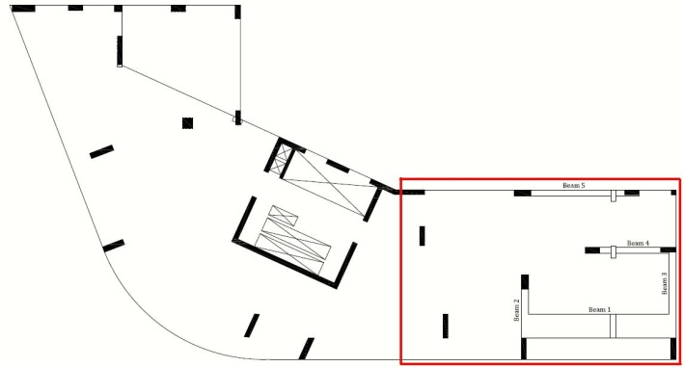
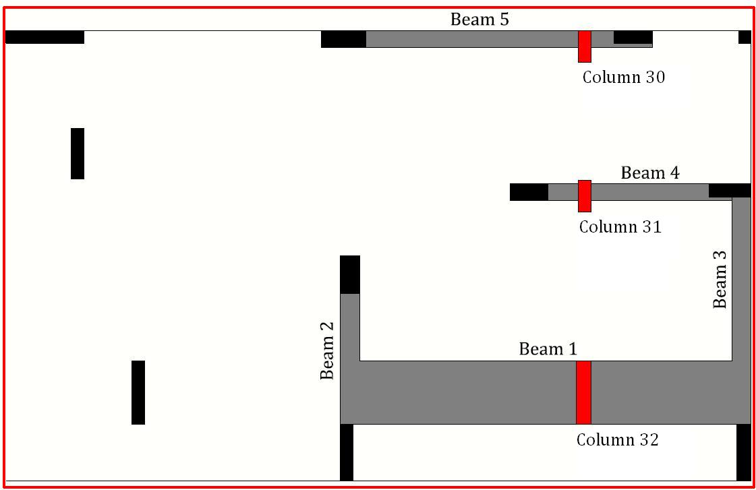
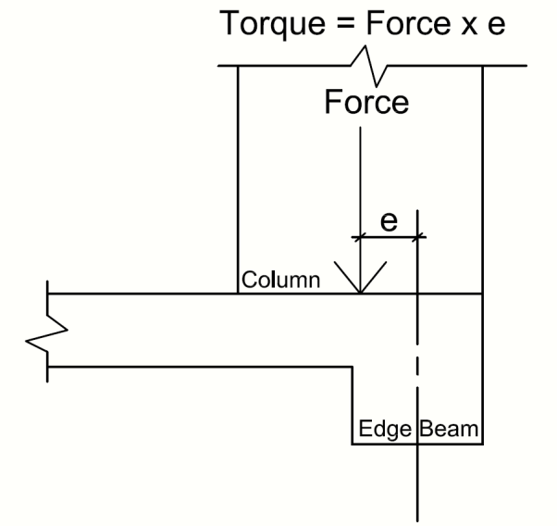
Presentation Outline
Depth II: Transfer System Design
100 Eleventh Avenue
New York, New York
Design Procedure
Introduction to 100 Eleventh Avenue
Proposal
  Problem Statement
  Proposed Solutions
Structural Depth I: PT Perimeter Slab Design
  Understanding Existing Design
  Alternate System Design Results
Structural Depth II: Transfer System Design
  Understanding Existing Design
  Alternate System Design Results
Construction Management Breadth
  PT Perimeter Slab
  Alternate Transfer System
Conclusions
(5) beams necessary to transfer Columns 30, 31 & 32
Design must satisfy (3) general requirements:
(1) Strength……………………….Flexure, Shear, Torsion
(2) Serviceability………………….Deflection
(3) Architectural………………….Beam depth limited to 18.5”
Consideration of Torsion
Acknowledgements
Questions & Comments
©www.arte-factory.com
Tyler E. Graybill | Structural Option

Slide 18
Presentation Outline
Depth II: Transfer System Design
100 Eleventh Avenue
New York, New York
Design Results
Introduction to 100 Eleventh Avenue
Proposal
  Problem Statement
  Proposed Solutions
Structural Depth I: PT Perimeter Slab Design
  Understanding Existing Design
  Alternate System Design Results
Structural Depth II: Transfer System Design
  Understanding Existing Design
  Alternate System Design Results
Construction Management Breadth
  PT Perimeter Slab
  Alternate Transfer System
Conclusions
Acknowledgements
Questions & Comments
©www.arte-factory.com
Tyler E. Graybill | Structural Option

Slide 19
Presentation Outline
Depth II: Transfer System Design
100 Eleventh Avenue
New York, New York
Design Results
Introduction to 100 Eleventh Avenue
Proposal
  Problem Statement
  Proposed Solutions
Structural Depth I: PT Perimeter Slab Design
  Understanding Existing Design
  Alternate System Design Results
Structural Depth II: Transfer System Design
  Understanding Existing Design
  Alternate System Design Results
Construction Management Breadth
  PT Perimeter Slab
  Alternate Transfer System
Conclusions
Acknowledgements
Questions & Comments
©www.arte-factory.com
Tyler E. Graybill | Structural Option

Slide 20

Presentation Outline
Depth II: Transfer System Design
100 Eleventh Avenue
New York, New York
Design Results
Introduction to 100 Eleventh Avenue
Proposal
  Problem Statement
  Proposed Solutions
Structural Depth I: PT Perimeter Slab Design
  Understanding Existing Design
  Alternate System Design Results
Structural Depth II: Transfer System Design
  Understanding Existing Design
  Alternate System Design Results
Construction Management Breadth
  PT Perimeter Slab
  Alternate Transfer System
Conclusions
Beam 1: D_{total} = 2.74”
D_{allowable} = L/240 = 1.58”
Beam 3: Section insufficient for combination
of shear and torsion (ACI 318 Eq. 11-19)
Acknowledgements
Questions & Comments
©www.arte-factory.com
Tyler E. Graybill | Structural Option

Slide 21
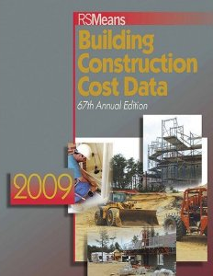
Presentation Outline
Breadth Studies
100 Eleventh Avenue
New York, New York
Breadth Topics
Introduction to 100 Eleventh Avenue
Proposal
  Problem Statement
  Proposed Solutions
Structural Depth I: PT Perimeter Slab Design
  Understanding Existing Design
  Alternate System Design Results
Structural Depth II: Transfer System Design
  Understanding Existing Design
  Alternate System Design Results
Construction Management Breadth
  PT Perimeter Slab
  Alternate Transfer System
Conclusions
Construction Management
- Importance ➔ help determine success of alternate designs
  Material Usage
  Cost
  Impact on Schedule
Shading
- Study of exterior shading strategy
- Not presented
RSMeans Building Construction Cost Data 2009
Acknowledgements
Questions & Comments
©www.arte-factory.com
Tyler E. Graybill | Structural Option

Slide 22
Presentation Outline
Construction Management Breadth
100 Eleventh Avenue
New York, New York
Perimeter Slab Design – Material Usage / Cost
Introduction to 100 Eleventh Avenue
Proposal
  Problem Statement
  Proposed Solutions
Structural Depth I: PT Perimeter Slab Design
  Understanding Existing Design
  Alternate System Design Results
Structural Depth II: Transfer System Design
  Understanding Existing Design
  Alternate System Design Results
Construction Management Breadth
  PT Perimeter Slab
  Alternate Transfer System
Conclusions
Superstructure over 5% lighter
Over $180,000 in savings
- $12,000 per floor (roughly 7% of existing floor cost)
High labor cost of installing tendons in NYC overcome
by significant material reduction
Acknowledgements
Questions & Comments
©www.arte-factory.com
Tyler E. Graybill | Structural Option
Notes:
Touch on use of PT in NYC and why, despite the city’s unfamiliarity with it, PT makes sense in this instance

Slide 23
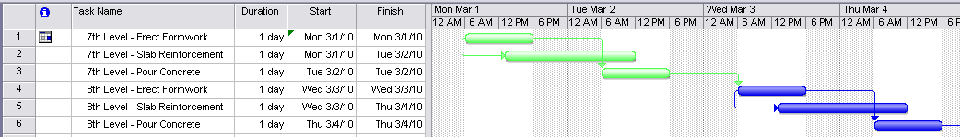
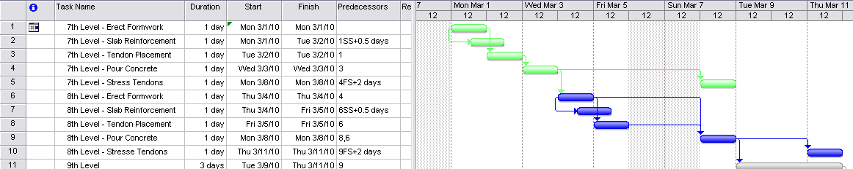
Presentation Outline
Construction Management Breadth
100 Eleventh Avenue
New York, New York
Perimeter Slab Design – Impact on Schedule
Introduction to 100 Eleventh Avenue
Proposal
  Problem Statement
  Proposed Solutions
Structural Depth I: PT Perimeter Slab Design
  Understanding Existing Design
  Alternate System Design Results
Structural Depth II: Transfer System Design
  Understanding Existing Design
  Alternate System Design Results
Construction Management Breadth
  PT Perimeter Slab
  Alternate Transfer System
Conclusions
Existing Design ➔ 2-day cycle (typical floors)
Levels 7 through 21 erected in 30 days
PT Design ➔ 3-day cycle
Tendon placement
- requires additional crew
- (1) additional day per floor
Levels 7 through 21 erected in 48 days
Existing Design – 2 day cycle
PT Design – 3 day cycle
Acknowledgements
Questions & Comments
©www.arte-factory.com
Tyler E. Graybill | Structural Option
Notes:
3-day cycle does not include come-back tensioning operation
Use of high early strength cement (Type III) allows for tendons to be tensioned 2 days after concrete is poured

Slide 24
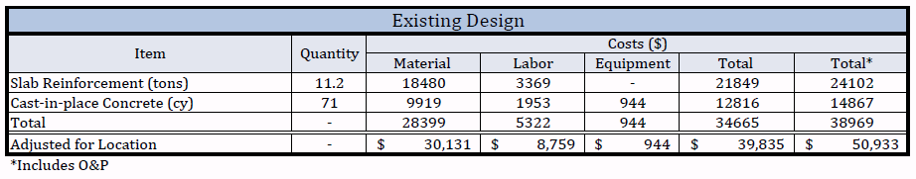
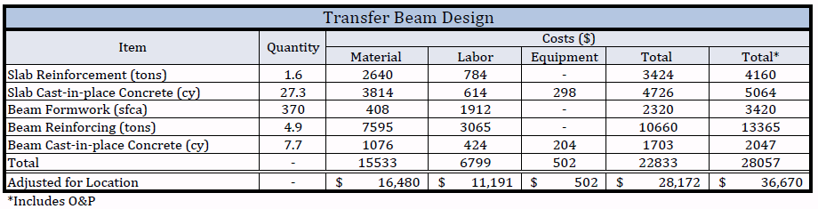
Presentation Outline
Construction Management Breadth
100 Eleventh Avenue
New York, New York
Transfer System Design – Material Usage / Cost
Introduction to 100 Eleventh Avenue
Proposal
  Problem Statement
  Proposed Solutions
Structural Depth I: PT Perimeter Slab Design
  Understanding Existing Design
  Alternate System Design Results
Structural Depth II: Transfer System Design
  Understanding Existing Design
  Alternate System Design Results
Construction Management Breadth
  PT Perimeter Slab
  Alternate Transfer System
Conclusions
Superstructure 0.3% lighter
$15,000 in savings
Increased cost of beam formwork counteracts savings in
material
Acknowledgements
Questions & Comments
©www.arte-factory.com
Tyler E. Graybill | Structural Option

Slide 25
Presentation Outline
Construction Management Breadth
100 Eleventh Avenue
New York, New York
Transfer System Design – Impact on Schedule
Introduction to 100 Eleventh Avenue
Proposal
  Problem Statement
  Proposed Solutions
Structural Depth I: PT Perimeter Slab Design
  Understanding Existing Design
  Alternate System Design Results
Structural Depth II: Transfer System Design
  Understanding Existing Design
  Alternate System Design Results
Construction Management Breadth
  PT Perimeter Slab
  Alternate Transfer System
Conclusions
Using RS Means output data:
Existing Design ➔ 3 days
- 2 days to place rebar
- 1 day for concrete pouring/finishing
Alternate Design ➔ 4.5 days
- (1) additional day for formwork
- (0.5) additional days for rebar placement
Acknowledgements
Questions & Comments
©www.arte-factory.com
Tyler E. Graybill | Structural Option

Slide 26
Presentation Outline
Overall Summary & Conclusions
100 Eleventh Avenue
New York, New York
Perimeter Slab Design
Introduction to 100 Eleventh Avenue
Proposal
  Problem Statement
  Proposed Solutions
Structural Depth I: PT Perimeter Slab Design
  Understanding Existing Design
  Alternate System Design Results
Structural Depth II: Transfer System Design
  Understanding Existing Design
  Alternate System Design Results
Construction Management Breadth
  PT Perimeter Slab
  Alternate Transfer System
Conclusions
Design Goals Revisited:
- Thickness successfully reduced to 9”
- Cost of design did not increase
- Impact on schedule bearable considering improvements
Conclusion:
Design is a satisfactory solution that improves the interior space
Acknowledgements
Questions & Comments
©www.arte-factory.com
Tyler E. Graybill | Structural Option
Notes:
Stress how reducing thickness is most important goal achieved, as it really improves the interior space
Consider timing these points with animations

Slide 27

Presentation Outline
Overall Summary & Conclusions
100 Eleventh Avenue
New York, New York
Transfer System Design
Introduction to 100 Eleventh Avenue
Proposal
  Problem Statement
  Proposed Solutions
Structural Depth I: PT Perimeter Slab Design
  Understanding Existing Design
  Alternate System Design Results
Structural Depth II: Transfer System Design
  Understanding Existing Design
  Alternate System Design Results
Construction Management Breadth
  PT Perimeter Slab
  Alternate Transfer System
Conclusions
Design Goals Revisited:
- Design requirements could not be met
- Insignificant savings in material, cost and weight
- Impact on schedule insignificant
Conclusion:
Even if design requirements could be satisfied, disadvantages far outweigh advantages
Acknowledgements
Questions & Comments
©www.arte-factory.com
Tyler E. Graybill | Structural Option
Notes:
Consider timing these points with animations

Slide 28



Presentation Outline
Overall Summary & Conclusions
100 Eleventh Avenue
New York, New York
Acknowledgements
Introduction to 100 Eleventh Avenue
Proposal
  Problem Statement
  Proposed Solutions
Structural Depth I: PT Perimeter Slab Design
  Understanding Existing Design
  Alternate System Design Results
Structural Depth II: Transfer System Design
  Understanding Existing Design
  Alternate System Design Results
Construction Management Breadth
  PT Perimeter Slab
  Alternate Transfer System
Conclusions
DeSimone Consulting Engineers
- Chris Cerino
- Matthieu Peuler
- Brian Byrnes
Holbert Apple Associates, Inc.
- Richard Apple
The Pennsylvania State University
- Professor Thomas Boothby
- Associate Professor M. Kevin Parfitt
- Associate Professor Robert Holland
Acknowledgements
Questions & Comments
©www.arte-factory.com
Tyler E. Graybill | Structural Option

Slide 29

Presentation Outline
Questions & Comments
100 Eleventh Avenue
New York, New York
Introduction to 100 Eleventh Avenue
Proposal
  Problem Statement
  Proposed Solutions
Structural Depth I: PT Perimeter Slab Design
  Understanding Existing Design
  Alternate System Design Results
Structural Depth II: Transfer System Design
  Understanding Existing Design
  Alternate System Design Results
Construction Management Breadth
  PT Perimeter Slab
  Alternate Transfer System
Conclusions
©www.archpartners.com
Acknowledgements
Questions & Comments
©www.arte-factory.com
Tyler E. Graybill | Structural Option

