Slide 1
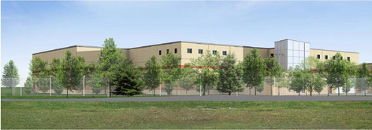
Unknown Data Center
Somewhere, USA
4.12.2011
Daniel Suter
Construction Management
AE Senior Thesis Presentation
The Pennsylvania State University

Slide 2
Agenda
Unknown Data Center
Somewhere, USA
Project Overview
Analysis One: Alternate Roof Systems
Electrical Breadth
Analysis Two: Façade Redesign
Structural Breadth
Analysis Three: Tablet PC’s
Conclusions
Questions
Daniel Suter | Construction Management | 4.12.2011
2

Slide 3
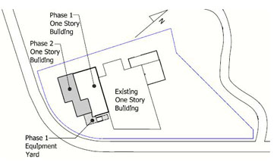
Agenda
Unknown Data Center
Somewhere, USA
PROJECT OVERVIEW
Project Overview
Analysis One: Alternate Roof Systems
Electrical Breadth
Analysis Two: Façade Redesign
Structural Breadth
Analysis Three: Tablet PC’s
Conclusions
Questions
Owner
Anonymous
Occupancy Type
Business
Size
17,445 SF
Cost
$ 50 Million (Design+Construction)
Construction Duration
December 2008 – August 2010
Delivery Method
Design-Bid-Build
Daniel Suter | Construction Management | 4.12.2011
3

Slide 4
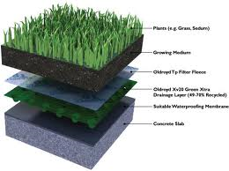
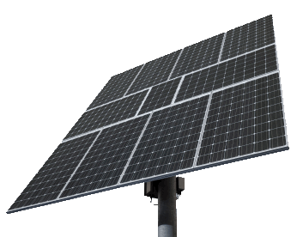
Agenda
Unknown Data Center
Somewhere, USA
ANALYSIS ONE – Alternate Roof System
Project Overview
Analysis One: Alternate Roof Systems
Electrical Breadth
Analysis Two: Façade Redesign
Structural Breadth
Analysis Three: Tablet PC’s
Conclusions
Questions
Opportunity
The Data Center’s roof construction primarily constructed with EPDM fully adhered to concrete slab on deck. On top of the EPDM is interlocking insulation board covered with UV protection fabric and is topped off with interlocking concrete pavers. This type of roof was selected for sound isolation purposes. The primary problem is that the owner is not utilizing the opportunity to implement green/solar roofing systems to increase to performance of his/hers building. In addition, the current roof constructed includes various amounts of materials and two different trades to construct this roof type.
Objective
The expected outcomes from this analysis will conclude that a PV panel roofing system will be more beneficial to the owner because of the type of building it is. The effects on duration and cost will be affected in a negative way, but the life cost cycle will make up for the longer duration and cost to the owner
Daniel Suter | Construction Management | 4.12.2011
4

Slide 5
Agenda
Unknown Data Center
Somewhere, USA
Structural Breadth
Project Overview
Analysis One: Alternate Roof Systems
Electrical Breadth
Analysis Two: Façade Redesign
Structural Breadth
Analysis Three: Tablet PC’s
Conclusions
Questions
Overview:
In attempt to redesign the current architectural precast panels. This analysis will include redesigning the 20 foot parapet walls, while collaborating with the architect. Different size beams and columns may arise through the structural calculations that will be performed.
3D Model Insert
Daniel Suter | Construction Management | 4.12.2011
5

