Slide 1
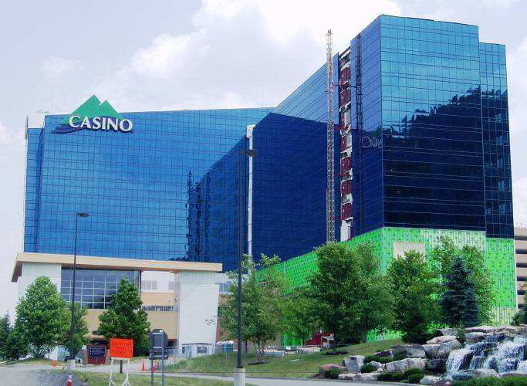
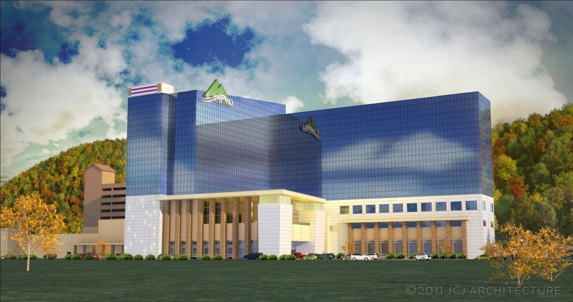
Nicholas Reed
Structural Option
Seneca Allegany Casino
Hotel Addition
AE Senior Thesis 2013
Courtesy of Jim Boje, PE

Slide 2
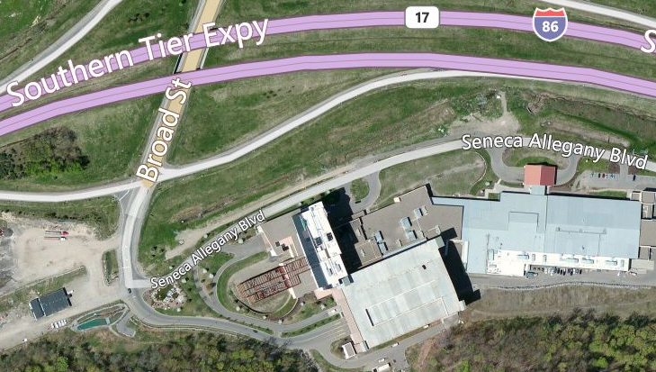
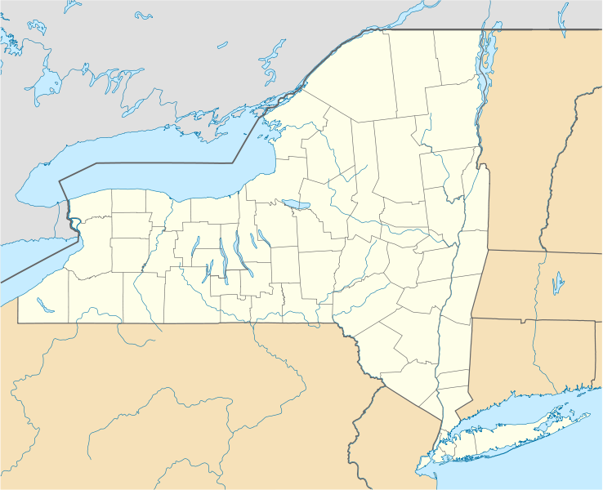

Building Introduction
Existing Structure
Thesis Goals
Structural Depth
Architectural Study
Conclusion
Q&A
Salamanca, NY
Bing Maps
Casino
Event Center
Hotel
Parking Deck
Wikipedia

Slide 3
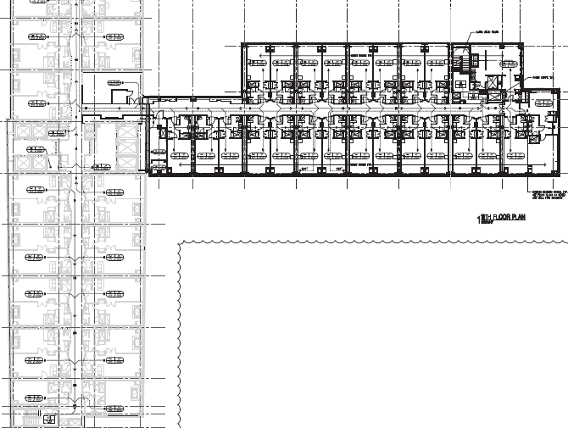
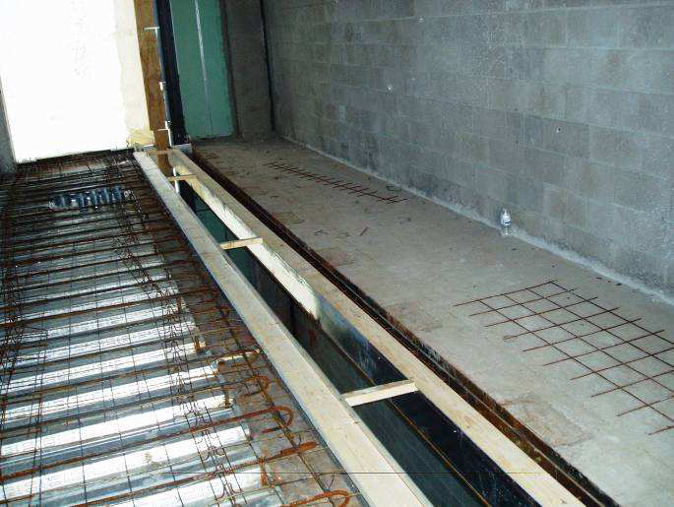
Building Introduction
Existing Structure
Thesis Goals
Structural Depth
Architectural Study
Conclusion
Q&A
Building Statistics
Project Team
11 stories
153 feet tall
165,000 sq. ft. (~15,000 per floor)
200 hotel rooms
Ties into existing hotel tower with expansion joint
Owner: Seneca Gaming Corporation
Architect: JCJ Architecture
Structural & Civil Site: Wendel
MEP: M/E Engineering P.C.
CM: Seneca Construction Management Corporation
JCJ Architecture
Courtesy of Jim Boje, PE

Slide 4
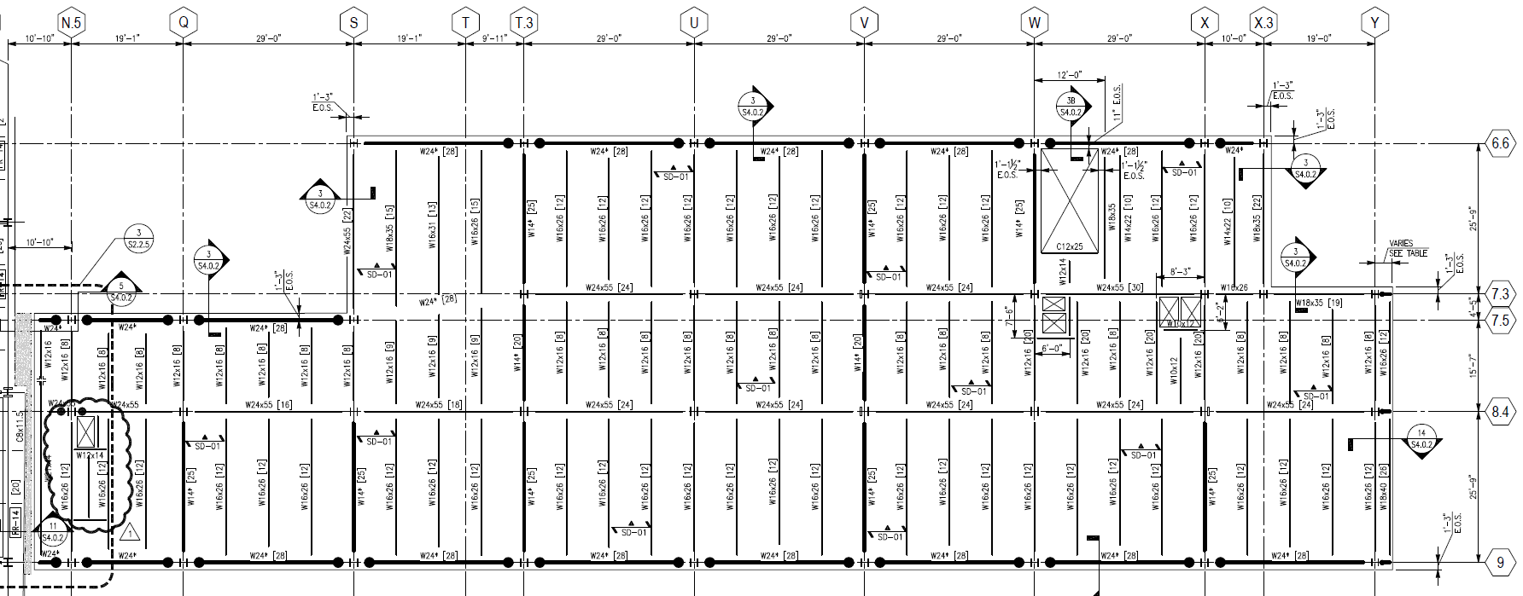
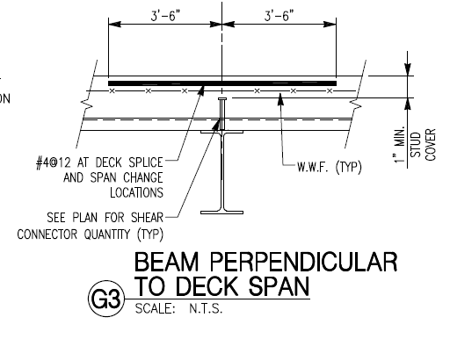
Existing Structure
Composite metal deck
20 gauge
Normal weight concrete, f’c 3500 psi
6.5” total depth
6x6 welded wire reinforcement
N
JCJ Architecture
Typical Floor Plan (4th floor to roof)
JCJ Architecture

Slide 5
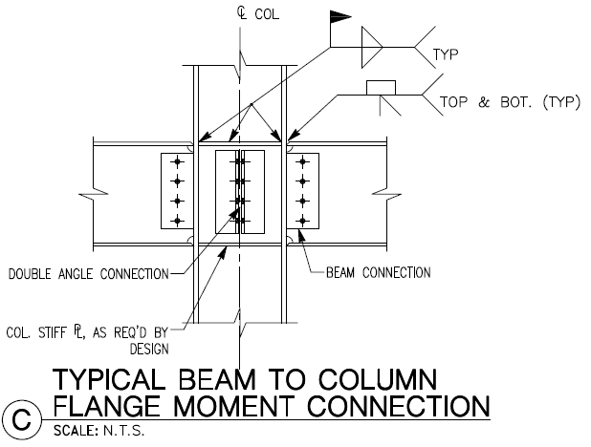
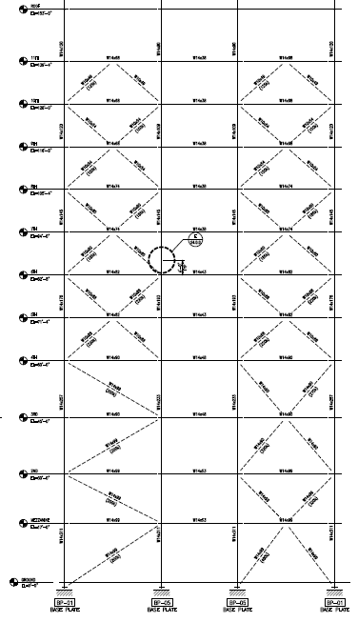
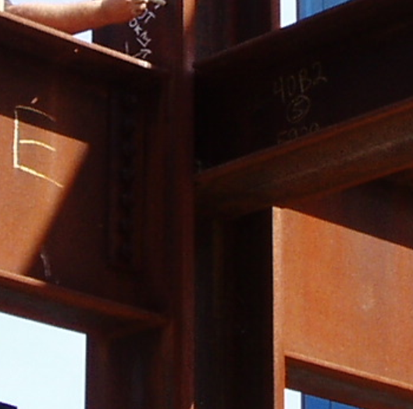
Lateral
Braced frames N-S (red)
Perimeter moment connections E-W (green)
N
JCJ Architecture
JCJ Architecture
Typical Floor Plan (4th floor to roof)
Courtesy of Jim Boje, PE
JCJ Architecture

Slide 6
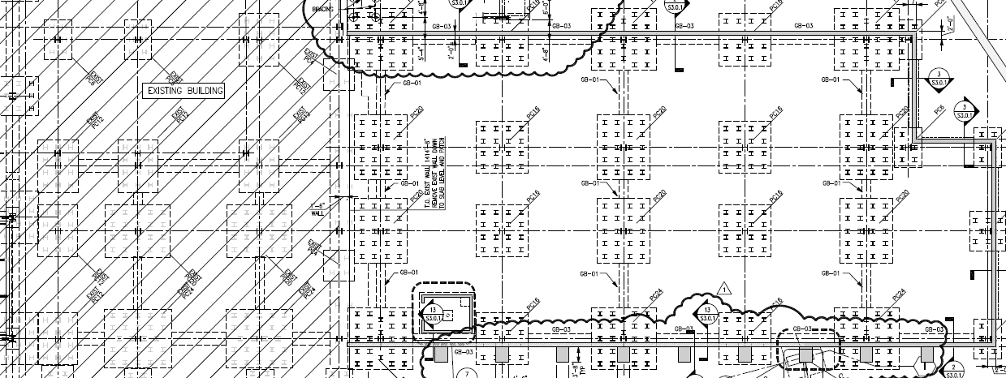
Foundation
Steel piles driven to bedrock
HP 12x53’s, 200 kip capacity
Varying pile cap sizes
Largest: 72” thick, #11 bars, 24 piles
Smallest: 50” thick, #9 bars, 6 piles
N
N
JCJ Architecture
JCJ Architecture

Slide 7
Foundation
Steel piles driven to bedrock
HP 12x53’s, 200 kip capacity
Varying pile cap sizes
Largest: 72” thick, #11 bars, 24 piles
Smallest: 50” thick, #9 bars, 6 piles
Outlined in red, 4th floor and above rest on existing structure
This area previously designed with new addition’s load in mind
N
N
JCJ Architecture
JCJ Architecture

Slide 8
Building Introduction
Existing Structure
Thesis Goals
Structural Depth
Architectural Study
Conclusion
Q&A
Structural
Architectural Study
Design and implement a staggered truss system to act as the gravity and N-S lateral system
  Replace metal deck with hollow-core precast concrete planks
  Determine preliminary member sizes then check with computer model
  Adjust truss members
  Trusses spanning entire width of hotel addition could impact interior spaces, requiring a look at possible redesigns of hotel rooms or overall building geometry
Construction Management Study
  Converting to an almost completely prefabricated structural system would impact the construction process, requiring a study of the site logistics during the erection process.
Advantages
  Remove interior columns
  Repetitive floor plan
  Faster construction
Potential Disadvantages
  Close coordination with other disciplines
  Fit with existing structure

Slide 9
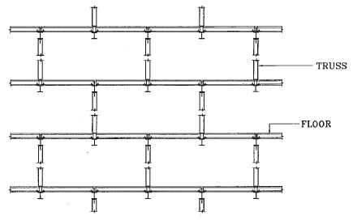
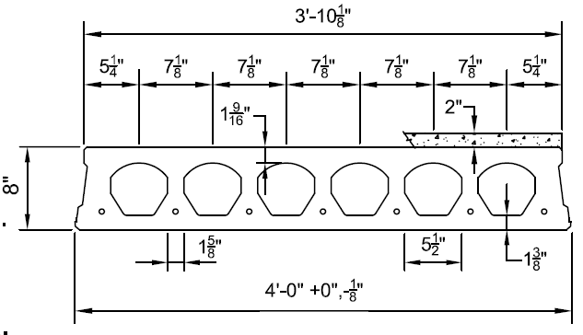
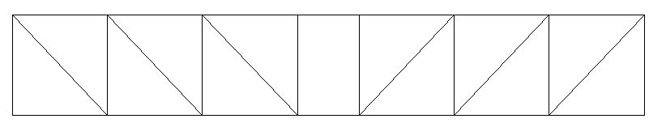
Building Introduction
Existing Structure
Thesis Goals
Structural Depth
Architectural Study
Conclusion
Q&A
Staggered Truss
  Staggering of truss locations per floor, eliminating need for interior columns
AISC Design Guide 14 – Staggered Truss Framing Systems provided procedure for hand calculations
Trusses encased within interior walls
Central Vierendeel panel for corridor
W-shape chords
HSS-shape verticals and diagonals
AISC Design Guide 14
  Section of Hollow-core planks used for floor system
Typical truss, spanning 71.5’ addition width and 7’ central corridor
Nitterhouse Concrete Products

Slide 10
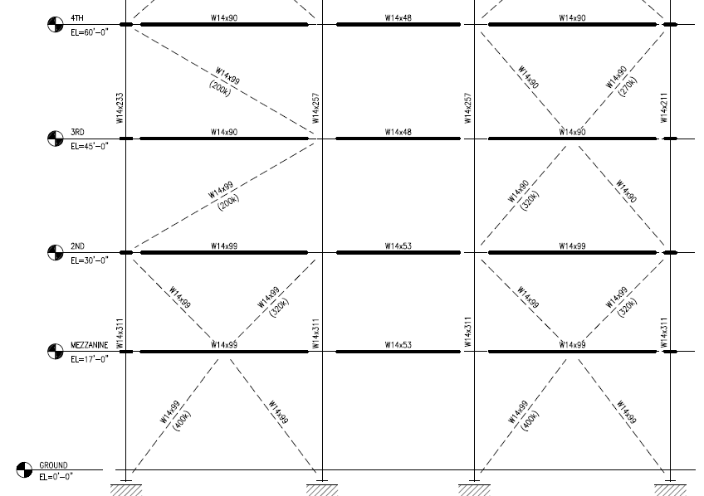
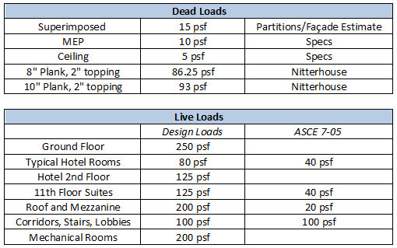
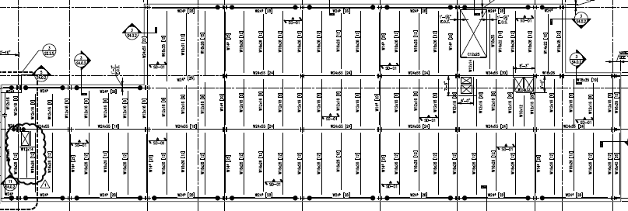
Member Design
15’
15’
13’
17’
N
JCJ Architecture
All design loads were used in calculations
Large live loads on certain floors required two sizes of hollow-core planks
  8”, (6) ½” Ø strands, 2” topping
  10”, (7) ½” Ø strands, 2” topping
Truss locations
JCJ Architecture
Lower 4 stories have varying floor heights
In order to better analyze truss members, these 4 stories and 11th story were adjusted to be 15’ in height

Slide 11
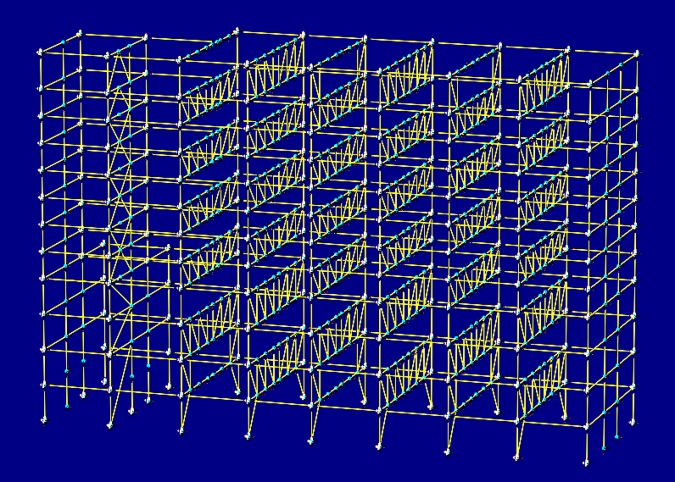
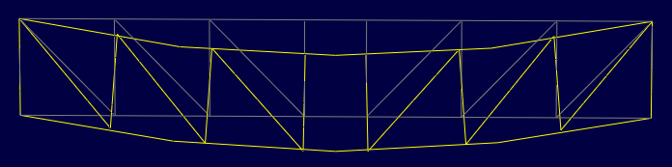
Member Design
Two separate truss designs were performed in order to determine preliminary member sizes
Small Truss (11’ 4” floor to floor height)
  Chords W10 x 33
  Diagonals and Verticals HSS9 x 7 x 5/8
Large Truss (15’ floor to floor height)
  Chords W10 x 60
  Diagonals and Verticals HSS14 x 10 x 5/8
Computer model used to check preliminary member size performance.
1.2D + 1.6L produced largest deflections
Deflection limit = l/240 = 3.6”
Large Truss δ = 0.85”
Small Truss δ = 1.60”
RAM Elements Model

Slide 12
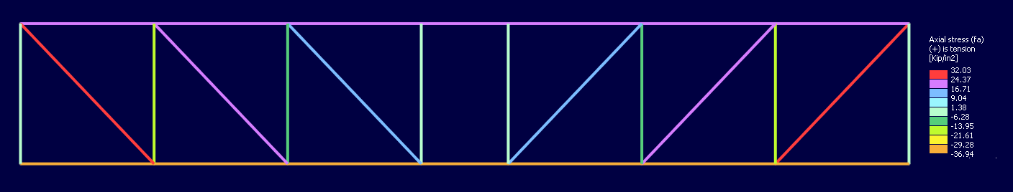
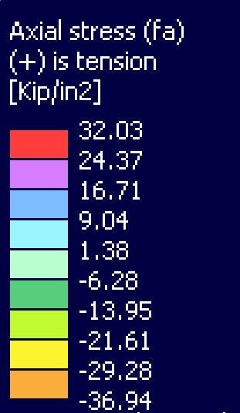
Member Design
Member were checked for appropriate tension and compression stress
Exterior diagonals found to take the most load as expected
Top chord and verticals in compression
Bottom chord and diagonals in tension
Computer model used to check preliminary member size performance.
1.2D + 1.6L produced largest deflections
Deflection limit = l/240 = 3.6”
Large Truss δ = 0.85”
Small Truss δ = 1.60”
RAM Elements Model

Slide 13
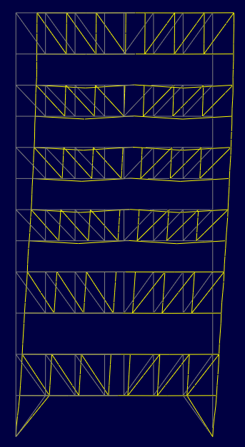
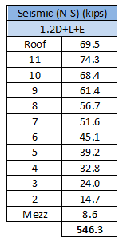
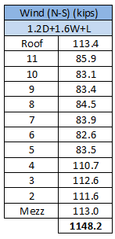
Lateral
Controlling load case 1.2D + 1.6W + L
H/500 at roof level = 3.7”
Deflection at roof from model = 0.67”
N-S direction found to be controlled by wind in
Technical Report 3
Seismic was checked with model to verify
RAM Elements Model

Slide 14
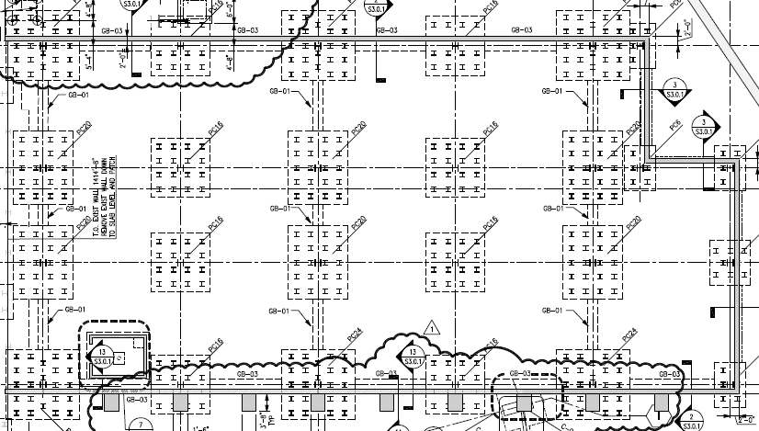
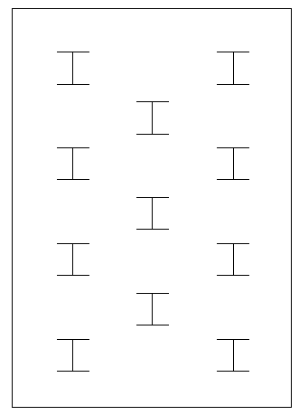
Foundation
Removal of interior columns required a foundation redesign
Total amount of existing piles = 424
New pile-cap: 53” thick, 11 piles (HP 12x53)
Redesign total ~ 126
Drastic reduction but existing addition designed with ASD
With RAM model, all first story columns found to be in compression, thus uplift was not an issue
New pile cap approximate geometry
CRSI 2008 design table in appendix slides
Long direction oriented N-S to better resist wind loads
N
JCJ Architecture

Slide 15
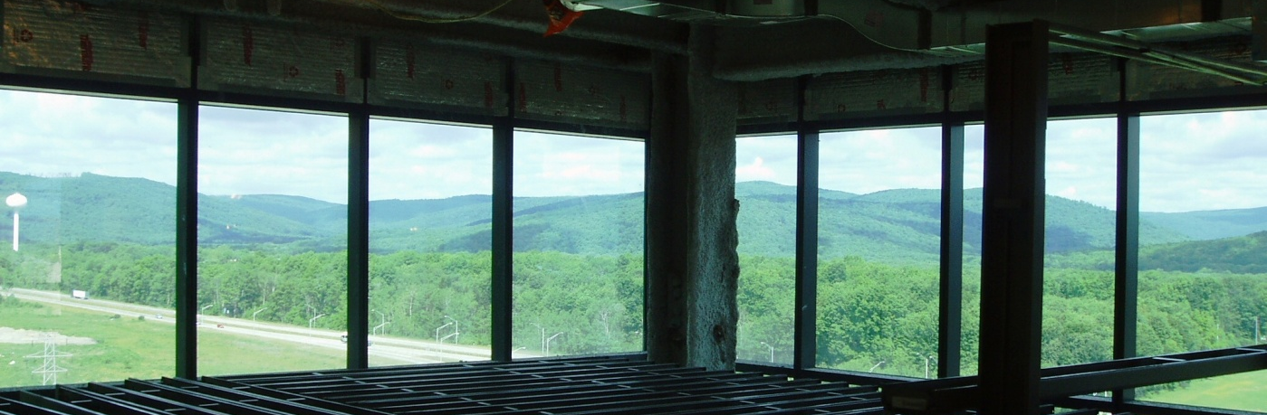
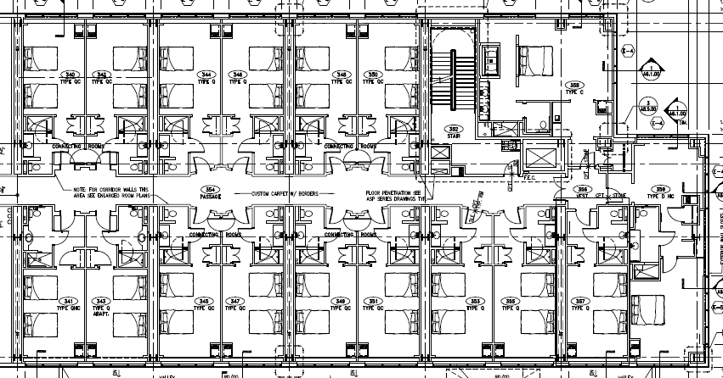
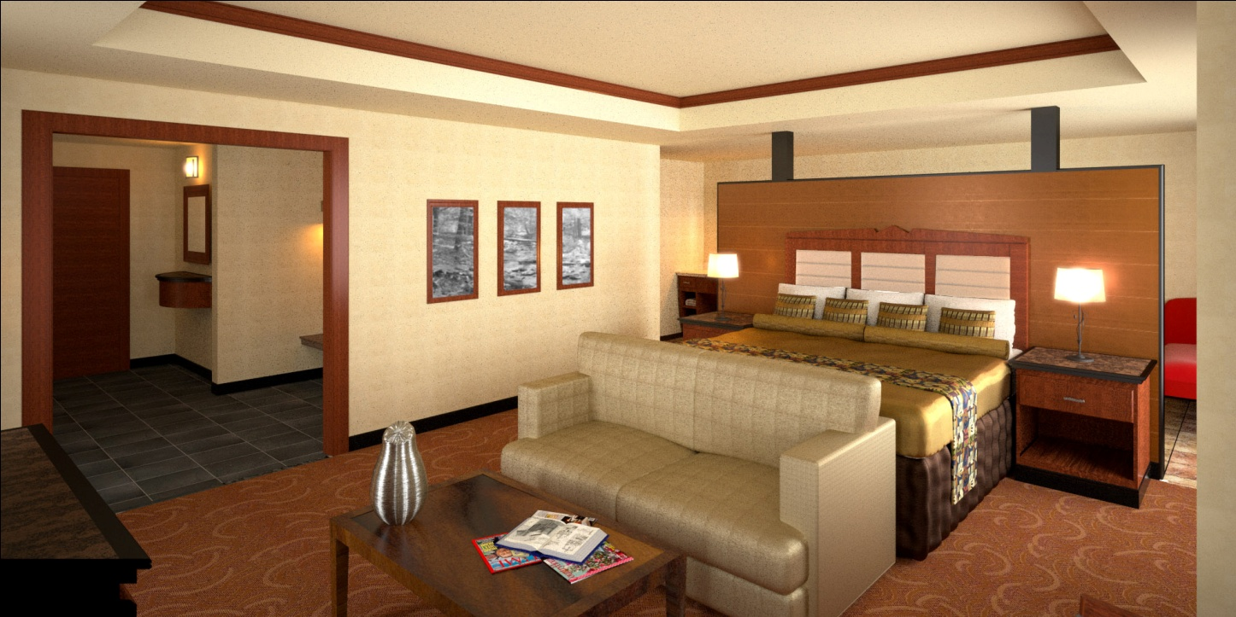
VIP Suite Conflict
Building Introduction
Existing Structure
Thesis Goals
Structural Depth
Architectural Study
Conclusion
Q&A
Courtesy of Jim Boje, PE
N
JCJ Architecture
3rd Floor Architectural Plan
JCJ Architecture

Slide 16
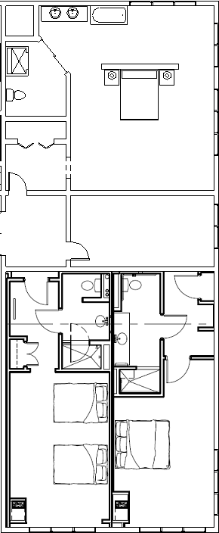
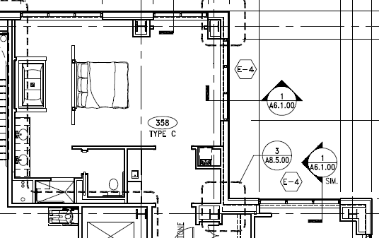
VIP Suite Conflict
  Squaring off corner produces extra floor space per floor
  3 alternative designs for the interior space were investigated
JCJ Architecture
N
  To avoid truss falling within master bedroom, notched corner is squared off to hide truss within wall
JCJ Architecture
3rd Floor Architectural Plan

Slide 17
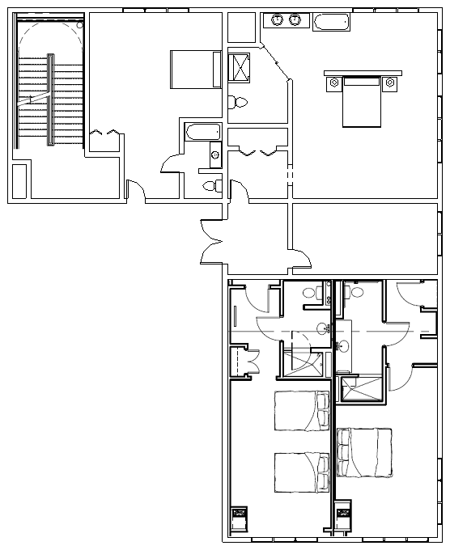
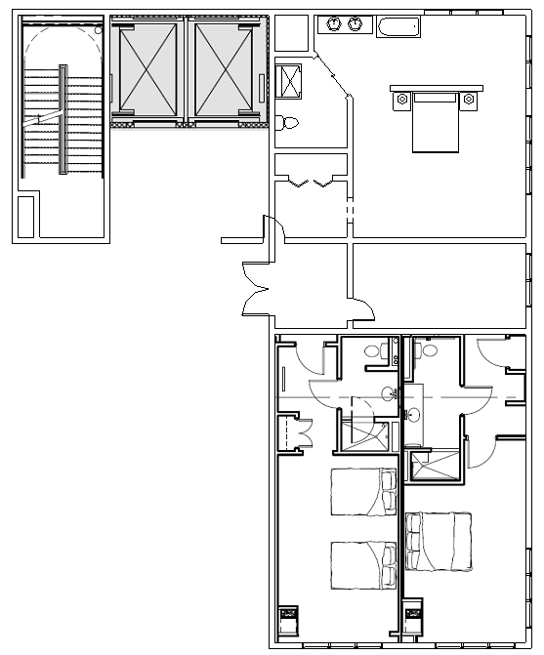
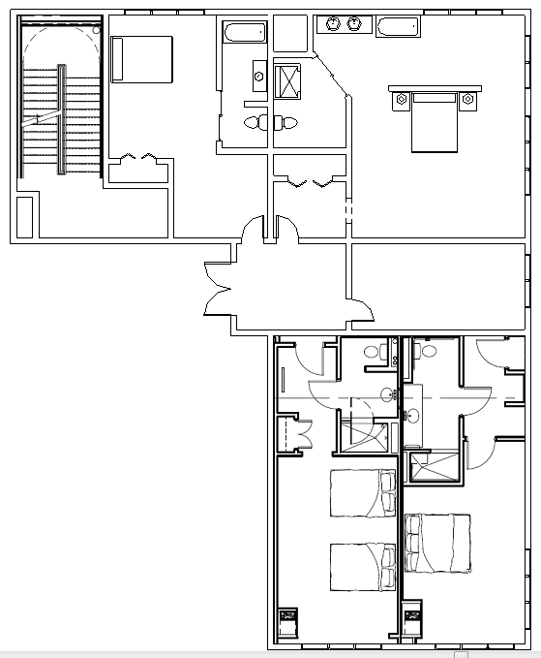
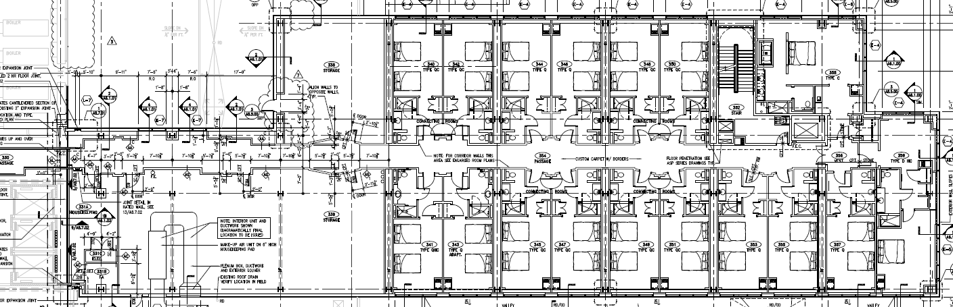
VIP Suite Conflict
New Hotel Room
  New elevator core, only elevators servicing new addition in existing hotel
  ~180’ from VIP Suite
  Trusses alone would most likely not support a stairwell and elevators
  Extra guest bedroom added to the VIP Suite, increasing overall suite and maintaining private entrance
  Small room again, does not add to overall hotel room amount
  A new hotel room, increasing the total amount of rooms from 200 to 211
  To maintain the vestibule leading to VIP Suite, new hotel room is almost half size of existing hotel rooms, with only one bed, difficulty aligning plumbing
Master Bedroom
Master Bedroom
Guest Room
Elevator Core
Master Bedroom
Guest Rooms
Guest Rooms
Guest Rooms
N

Slide 18
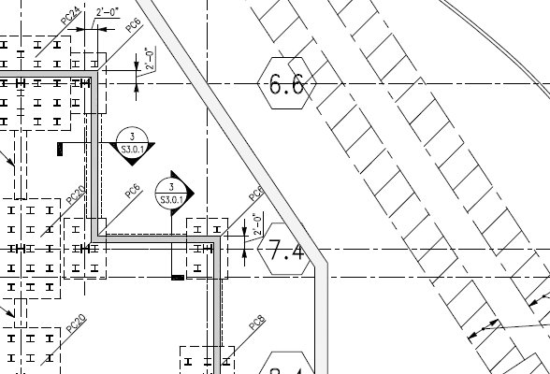
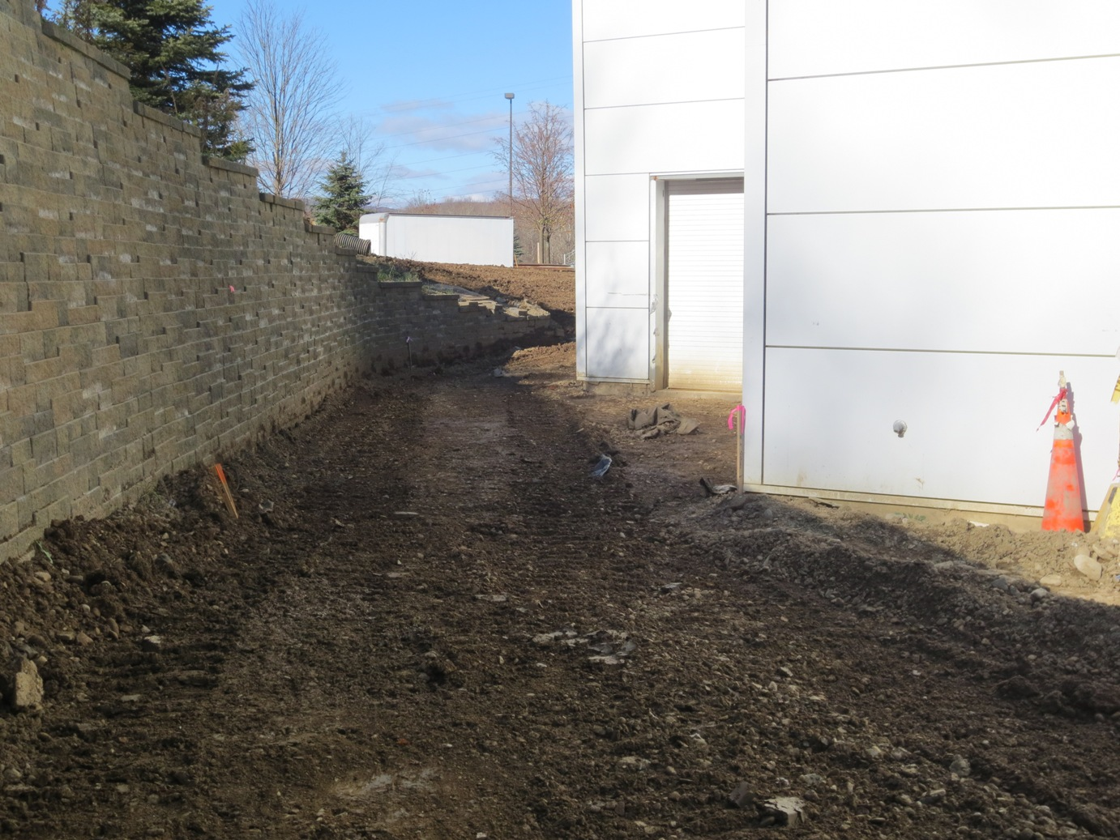
NE Corner Redesign Conflict
Retaining Wall
Drainage Pipes
N
JCJ Architecture
  Squaring off corner conflicts with existing retaining wall
  Demolishing retaining wall would require moving large drainage pipes
JCJ Architecture
Courtesy of Jim Boje, PE

Slide 19
  Structural
  Staggered truss system successfully designed to resist gravity loads and wind loads in the N-S direction
  Precast concrete planks viable replacement for floor
  Reduction of piles needed for foundation
  Gained a better understanding of truss design
  Architectural
  Squaring off NE corner allows for truss to hide within VIP Suite wall
  Creates more floor space
  Conflict with retaining wall and drainage pipes makes this specific building not a good candidate
Building Introduction
Existing Structure
Thesis Goals
Structural Depth
Architectural Study
Conclusion
Q&A
  Construction
  Reduction of piles would speed up schedule
  Prefabricated members would allow quicker erection
  MEP
  Close coordination with MEP design
  Truss conflicts with AHU on 3rd floor mechanical room (appendix slide)

Slide 20
Questions?
Courtesy of Jim Boje, PE

Slide 21
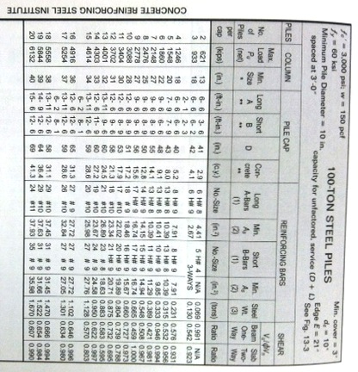
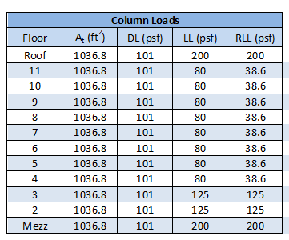
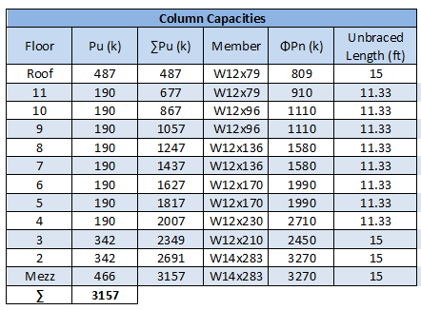

Slide 22
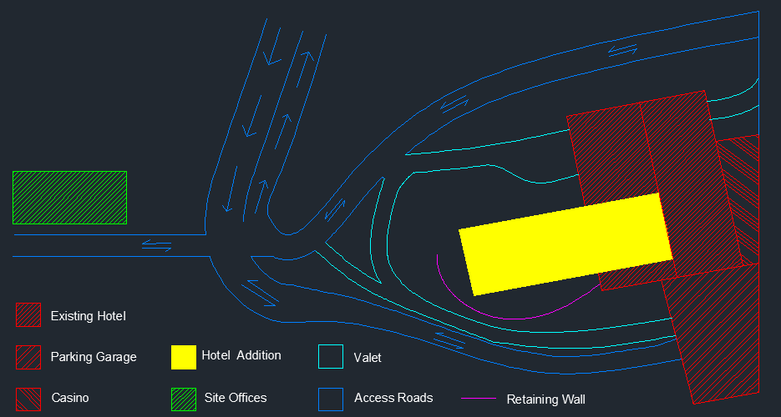
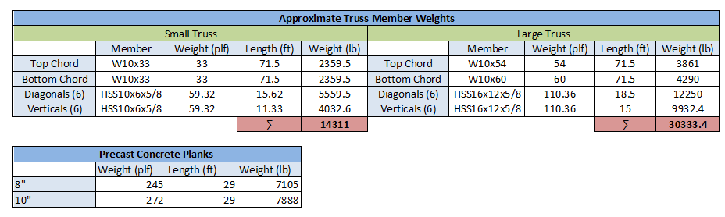
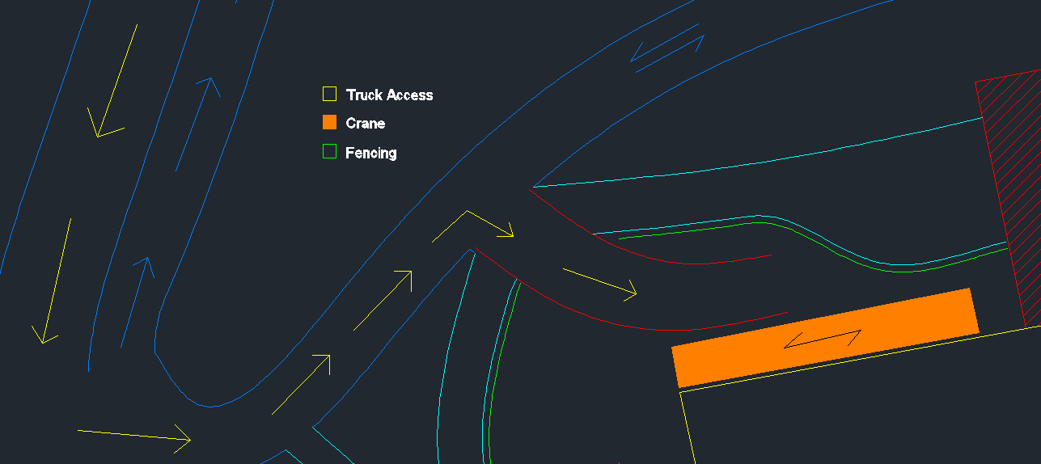
N

Slide 23
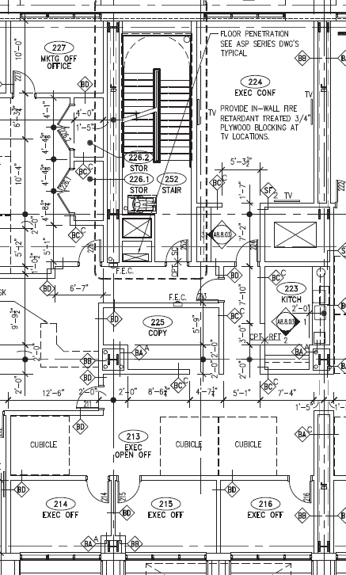
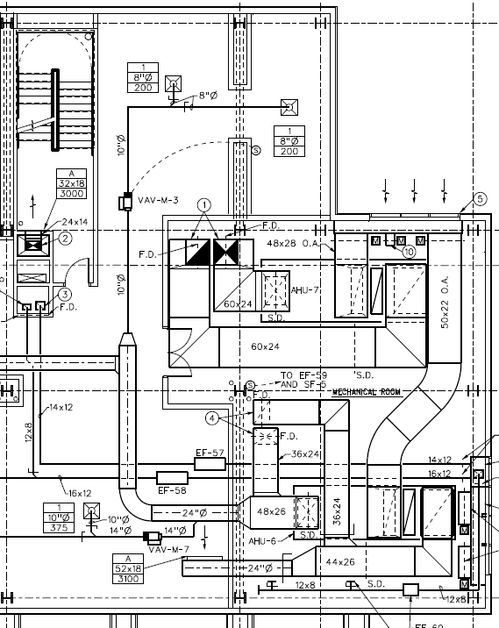
2nd Floor Offices
3rd Floor Mechanical Room

