Slide 1
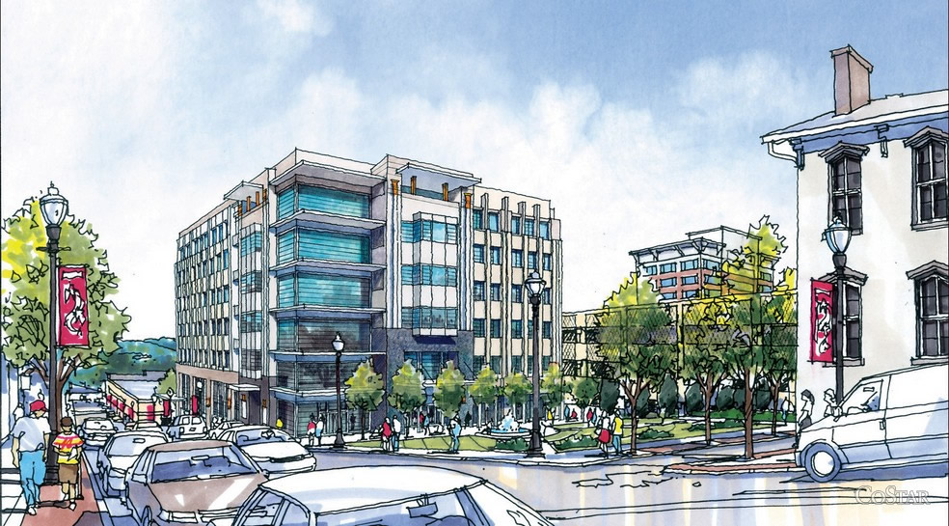
AE SENIOR THESIS
APRIL 14th, 2014
CHRIS DUARTE – STRUCTURAL
Dr. THOMAS BOOTHBY
ORCHARD
PLAZA

Slide 2
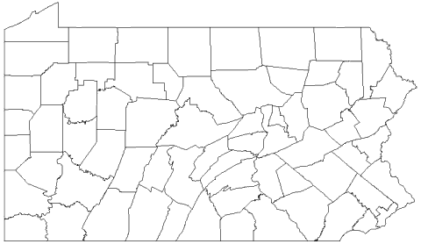
INTRODUCTION GRAVITY LATERAL REDESIGN DAYLIGHTING CONCLUSION
STATE COLLEGE
PITTSBURGH
PHILADELPHIA

Slide 3
INTRODUCTION GRAVITY LATERAL REDESIGN DAYLIGHTING CONCLUSION
SOUTHWEST PENNSYLVANIA
URBAN ENVIRONMENT
ADJACENT PARKING GARAGE
STATE COLLEGE
PITTSBURGH
PHILADELPHIA

Slide 4

INTRODUCTION GRAVITY LATERAL REDESIGN DAYLIGHTING CONCLUSION
SOUTHWEST PENNSYLVANIA
URBAN ENVIRONMENT
ADJACENT PARKING GARAGE
PROPERTY DEVELOPER
STATE COLLEGE
PITTSBURGH
PHILADELPHIA

Slide 5

INTRODUCTION GRAVITY LATERAL REDESIGN DAYLIGHTING CONCLUSION
SOUTHWEST PENNSYLVANIA
URBAN ENVIRONMENT
ADJACENT PARKING GARAGE
PROPERTY DEVELOPER
ARCHITECT
STATE COLLEGE
PITTSBURGH
PHILADELPHIA

Slide 6

INTRODUCTION GRAVITY LATERAL REDESIGN DAYLIGHTING CONCLUSION
SOUTHWEST PENNSYLVANIA
URBAN ENVIRONMENT
ADJACENT PARKING GARAGE
PROPERTY DEVELOPER
ARCHITECT
STATE COLLEGE
STRUCTURAL ENGINEER
PITTSBURGH
PHILADELPHIA

Slide 7

INTRODUCTION GRAVITY LATERAL REDESIGN DAYLIGHTING CONCLUSION
SOUTHWEST PENNSYLVANIA
URBAN ENVIRONMENT
ADJACENT PARKING GARAGE
PROPERTY DEVELOPER
ARCHITECT
STATE COLLEGE
STRUCTURAL ENGINEER
CIVIL ENGINEER
PITTSBURGH
PHILADELPHIA

Slide 8

INTRODUCTION GRAVITY LATERAL REDESIGN DAYLIGHTING CONCLUSION
SOUTHWEST PENNSYLVANIA
URBAN ENVIRONMENT
ADJACENT PARKING GARAGE
PROPERTY DEVELOPER
ARCHITECT
STATE COLLEGE
STRUCTURAL ENGINEER
CIVIL ENGINEER
PITTSBURGH
PHILADELPHIA
MEP ENGINEER

Slide 9
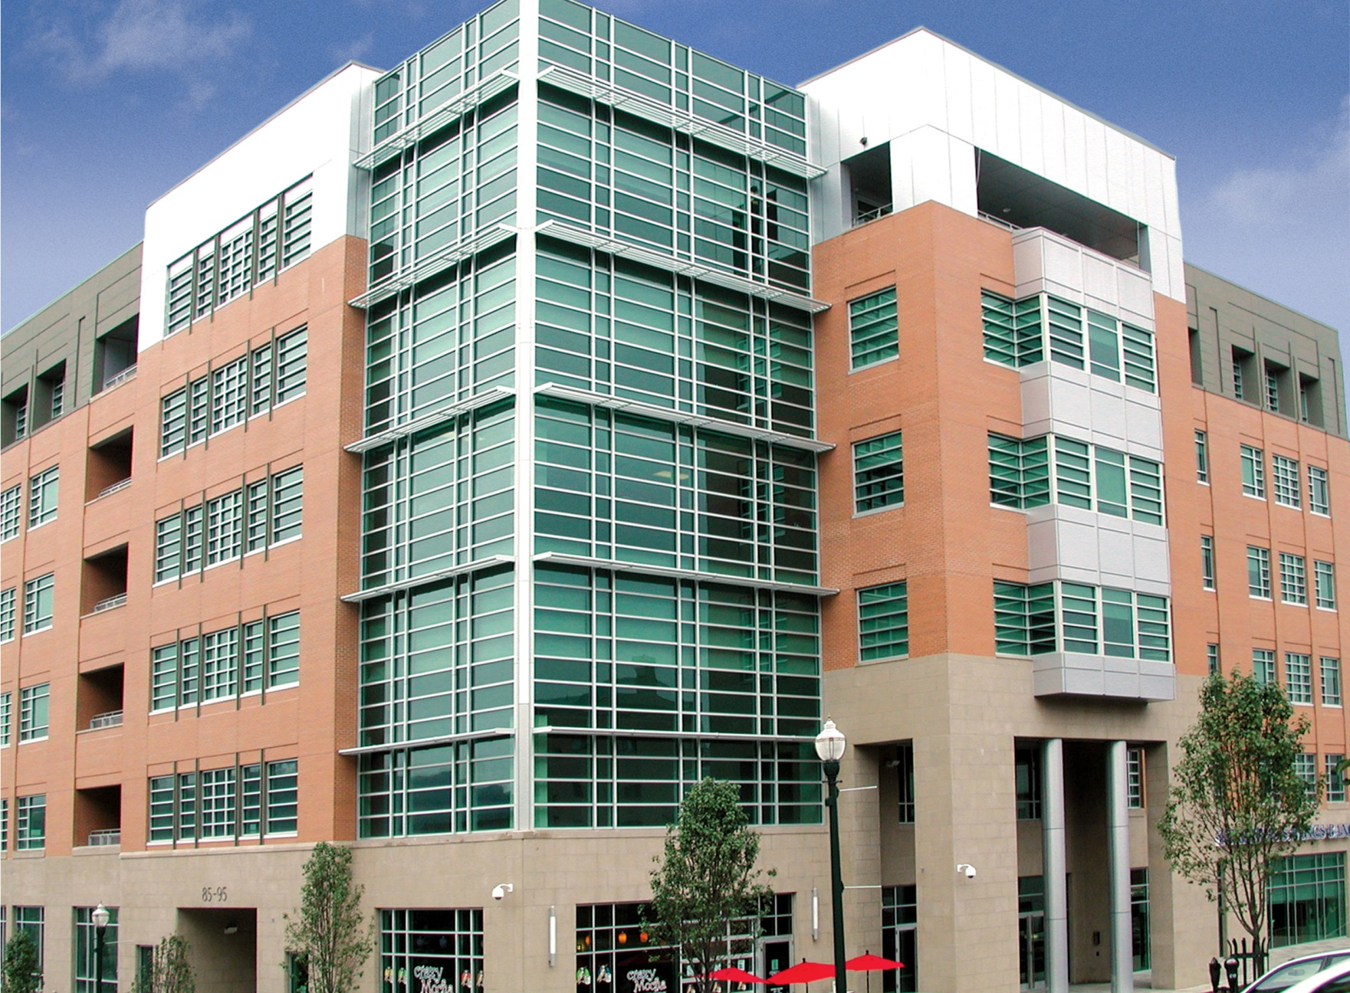
INTRODUCTION GRAVITY LATERAL REDESIGN DAYLIGHTING CONCLUSION
OCCUPANCY – OFFICE
LEVELS - 6
SIZE – 144,000 S.F.
COST - $18.5 MILLION
COMPLETED – DECEMBER 2006

Slide 10
INTRODUCTION GRAVITY LATERAL REDESIGN DAYLIGHTING CONCLUSION
OCCUPANCY – OFFICE
LEVELS - 6
SIZE – 144,000 S.F.
COST - $18.5 MILLION
COMPLETED – DECEMBER 2006
LIMESTONE BASE

Slide 11
INTRODUCTION GRAVITY LATERAL REDESIGN DAYLIGHTING CONCLUSION
OCCUPANCY – OFFICE
LEVELS - 6
SIZE – 144,000 S.F.
COST - $18.5 MILLION
COMPLETED – DECEMBER 2006
GLAZING & CURTAIN WALL
LIMESTONE BASE

Slide 12
INTRODUCTION GRAVITY LATERAL REDESIGN DAYLIGHTING CONCLUSION
OCCUPANCY – OFFICE
LEVELS - 6
SIZE – 144,000 S.F.
COST - $18.5 MILLION
COMPLETED – DECEMBER 2006
BRICK VENEER
GLAZING & CURTAIN WALL
LIMESTONE BASE

Slide 13
INTRODUCTION GRAVITY LATERAL REDESIGN DAYLIGHTING CONCLUSION
METAL PANELING
OCCUPANCY – OFFICE
LEVELS - 6
SIZE – 144,000 S.F.
COST - $18.5 MILLION
COMPLETED – DECEMBER 2006
BRICK VENEER
GLAZING & CURTAIN WALL
LIMESTONE BASE

Slide 14
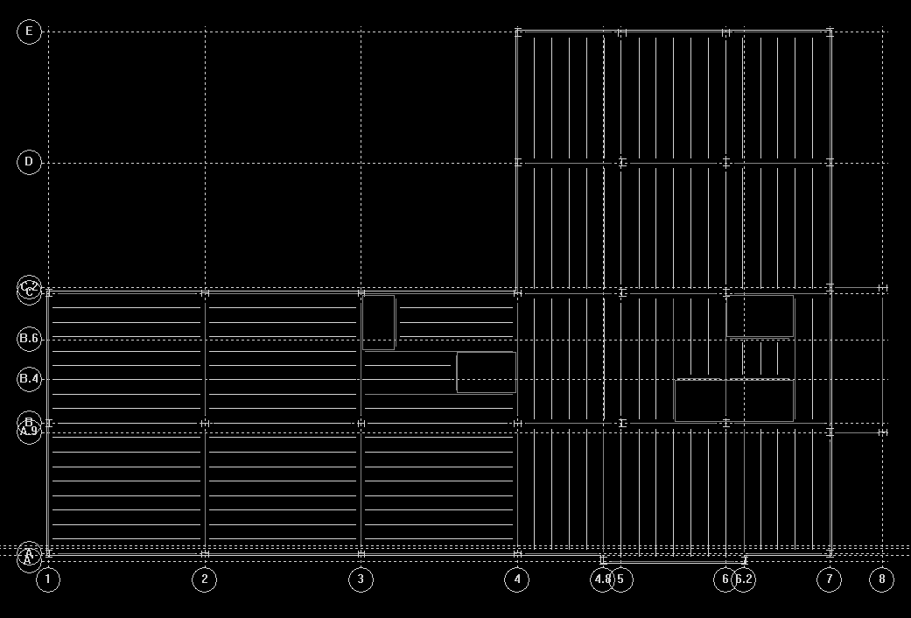
INTRODUCTION GRAVITY LATERAL REDESIGN DAYLIGHTING CONCLUSION
TYPICAL BAYS CONSIDERED
N
- 35’ x 42’ 28’ x 35’ -

Slide 15
INTRODUCTION GRAVITY LATERAL REDESIGN DAYLIGHTING CONCLUSION
TYPICAL BAYS CONSIDERED
N
- 35’ x 42’ 28’ x 35’ -

Slide 16
INTRODUCTION GRAVITY LATERAL REDESIGN DAYLIGHTING CONCLUSION
TYPICAL BAYS CONSIDERED
N
N
- 35’ x 42’ 28’ x 35’ -
DECKING REGIONS
- N-S E-W-

Slide 17
INTRODUCTION GRAVITY LATERAL REDESIGN DAYLIGHTING CONCLUSION
EXISTING ECCENTRIC FRAMES
N
- FULL HEIGHT FRAMES
- GROUND LEVEL FRAMES

Slide 18
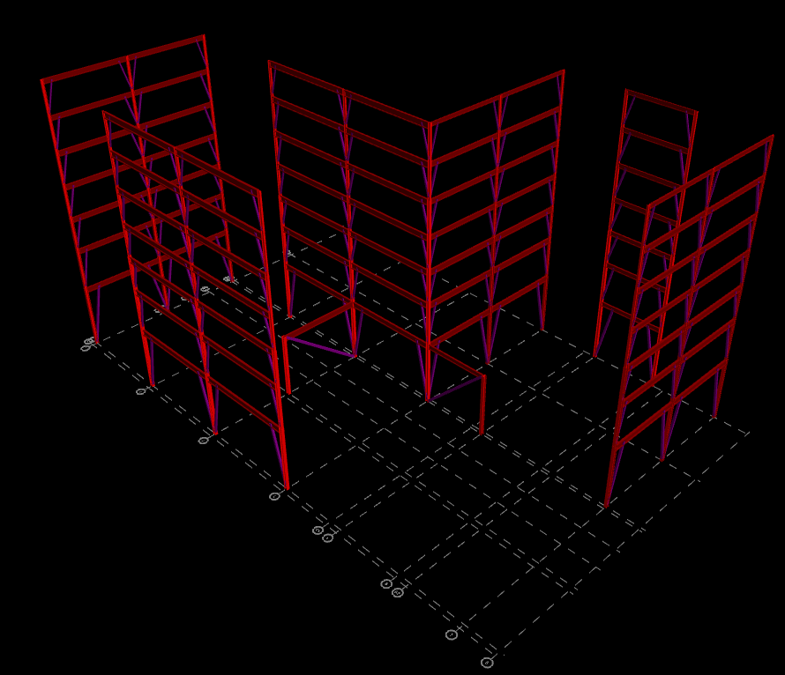

INTRODUCTION GRAVITY LATERAL REDESIGN DAYLIGHTING CONCLUSION
EXISTING ECCENTRIC FRAMES
N
- FULL HEIGHT FRAMES
- GROUND LEVEL FRAMES

Slide 19
INTRODUCTION GRAVITY LATERAL REDESIGN DAYLIGHTING CONCLUSION
PROPOSAL

Slide 20
INTRODUCTION GRAVITY LATERAL REDESIGN DAYLIGHTING CONCLUSION
OPEN-WEB STEEL JOIST FLOOR SYSTEM
PROPOSAL

Slide 21
INTRODUCTION GRAVITY LATERAL REDESIGN DAYLIGHTING CONCLUSION
OPEN-WEB STEEL JOIST FLOOR SYSTEM
HVAC INTEGRATION
PROPOSAL

Slide 22
INTRODUCTION GRAVITY LATERAL REDESIGN DAYLIGHTING CONCLUSION
OPEN-WEB STEEL JOIST FLOOR SYSTEM
HVAC INTEGRATION
CONCENTRIC LATERAL FRAMING
PROPOSAL

Slide 23
INTRODUCTION GRAVITY LATERAL REDESIGN DAYLIGHTING CONCLUSION
OPEN-WEB STEEL JOIST FLOOR SYSTEM
HVAC INTEGRATION
CONCENTRIC LATERAL FRAMING
ARCHITECTURAL IMPACT
PROPOSAL

Slide 24
INTRODUCTION GRAVITY LATERAL REDESIGN DAYLIGHTING CONCLUSION
OPEN-WEB STEEL JOIST FLOOR SYSTEM
NON-COMPOSITE SYSTEM
2” DECK WITH 4.5” SLAB
28” DEPTH RESTRICTION
42’ SPAN
80psf DEAD LOAD
100psf LIVE LOAD
N

Slide 25
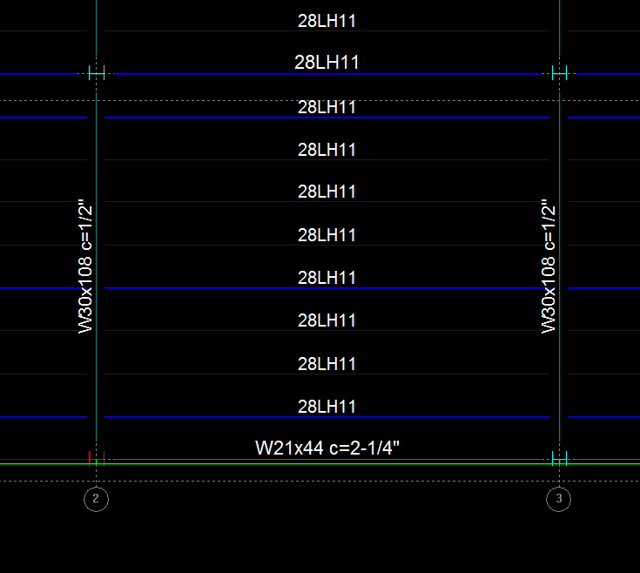
INTRODUCTION GRAVITY LATERAL REDESIGN DAYLIGHTING CONCLUSION
OPEN-WEB STEEL JOIST FLOOR SYSTEM
NON-COMPOSITE SYSTEM
2” DECK WITH 4.5” SLAB
28” DEPTH RESTRICTION
42’ SPAN
80psf DEAD LOAD
100psf LIVE LOAD
N

Slide 26


INTRODUCTION GRAVITY LATERAL REDESIGN DAYLIGHTING CONCLUSION
VIBRATION CONCERNS
2” DECK WITH 4.5” SLAB
28LH11JOISTS w/ 42’ SPAN
W30x108 GIRDER w/ 35’ SPAN
80psf DEAD LOAD
100psf LIVE LOAD
N
$\frac{a_{o}}{g}= \frac{65e^{\left(−0.35\right)(0.005)}}{0.003 (603348)}=0.0035<0.005$

Slide 27
INTRODUCTION GRAVITY LATERAL REDESIGN DAYLIGHTING CONCLUSION
N

Slide 28
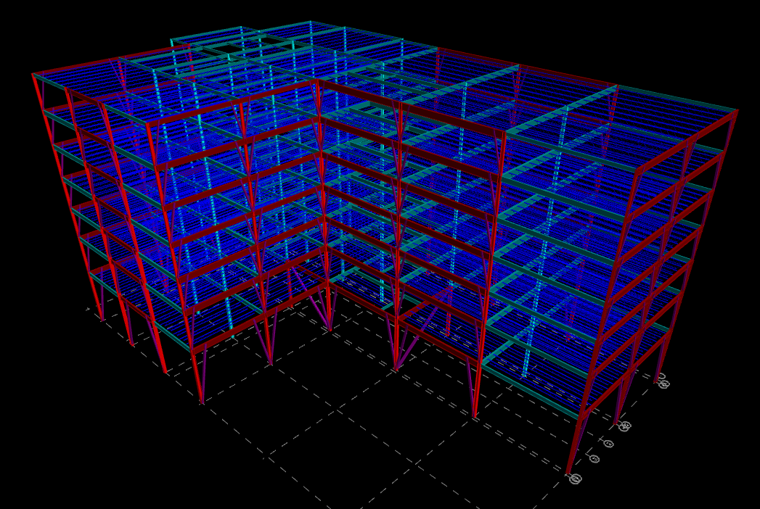
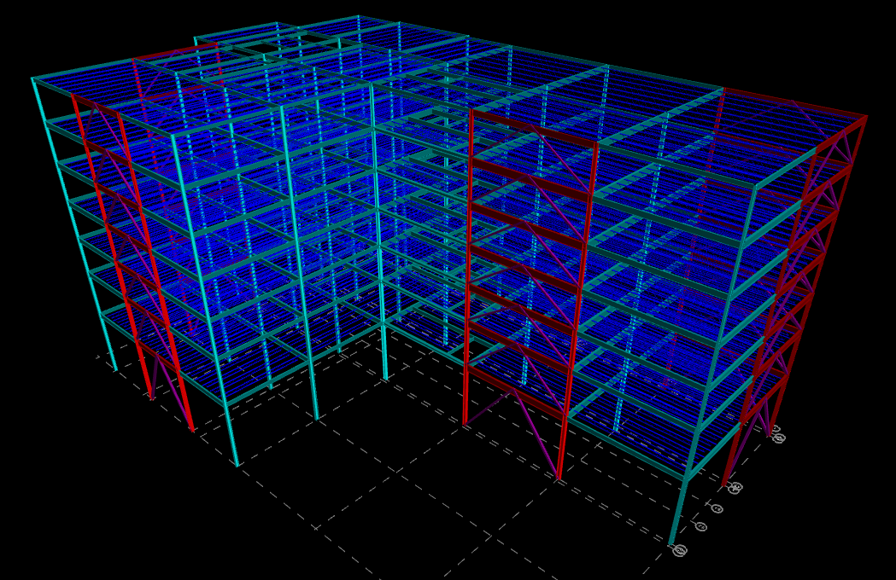
INTRODUCTION GRAVITY LATERAL REDESIGN DAYLIGHTING CONCLUSION
N
ECCENTRIC FRAMING
CONCENTRIC FRAMING
N
N

Slide 29
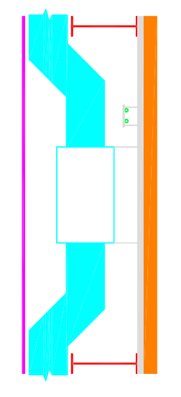
INTRODUCTION GRAVITY LATERAL REDESIGN DAYLIGHTING CONCLUSION
HVAC INTEGRATION
18” X 30” SUPPLY DUCT
8” AUXILARY DUCTS
36”
- CONCRETE SLAB
- HVAC DUCTS
- ACOUSTIC TILE CEILING
- FLOOR STRUCTURE

Slide 30
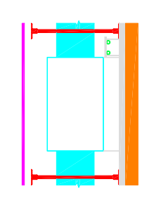
INTRODUCTION GRAVITY LATERAL REDESIGN DAYLIGHTING CONCLUSION
HVAC INTEGRATION
18” X 30” SUPPLY DUCT
8” AUXILARY DUCTS
31”
36”
- CONCRETE SLAB
- HVAC DUCTS
- ACOUSTIC TILE CEILING
- FLOOR STRUCTURE

Slide 31
INTRODUCTION GRAVITY LATERAL REDESIGN DAYLIGHTING CONCLUSION
FRAME COMPARISON
MAXIMUM WIND SPEED 90mph
CONTROLLING LOAD CASE WIND N-S
TOTAL BASE SHEAR
496 kips

Slide 32
INTRODUCTION GRAVITY LATERAL REDESIGN DAYLIGHTING CONCLUSION
FRAME COMPARISON
MAXIMUM WIND SPEED 90mph
CONTROLLING LOAD CASE WIND N-S
TOTAL BASE SHEAR
496 kips
N
CENTER OF RIGIDITY

Slide 33
INTRODUCTION GRAVITY LATERAL REDESIGN DAYLIGHTING CONCLUSION
FRAME COMPARISON
MAXIMUM WIND SPEED 90mph
CONTROLLING LOAD CASE WIND N-S
TOTAL BASE SHEAR
496 kips
N
CENTER OF RIGIDITY
- LINE 1 FRAME ANALYZED

Slide 34
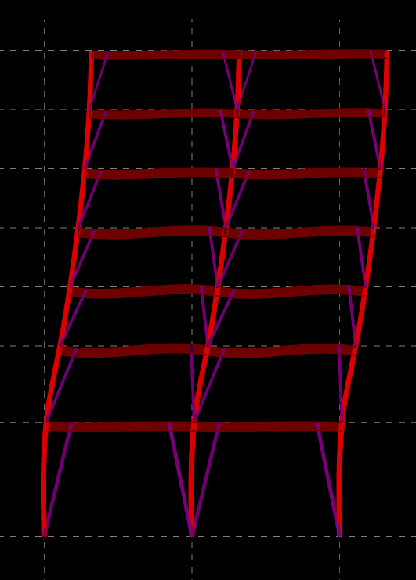
INTRODUCTION GRAVITY LATERAL REDESIGN DAYLIGHTING CONCLUSION
FRAME COMPARISON
MAXIMUM WIND SPEED 90mph
CONTROLLING LOAD CASE WIND N-S
TOTAL BASE SHEAR
496 kips
N
CENTER OF RIGIDITY
DRIFT AT ROOF – 3.28”
- LINE 1 FRAME ANALYZED
DISPLACEMENTS AMPLIFIED BY A FACTOR OF 50

Slide 35
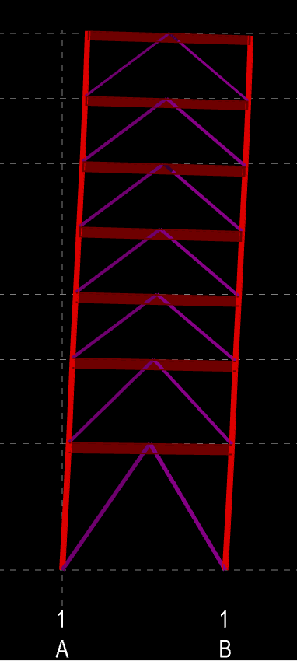
INTRODUCTION GRAVITY LATERAL REDESIGN DAYLIGHTING CONCLUSION
FRAME COMPARISON
MAXIMUM WIND SPEED 90mph
CONTROLLING LOAD CASE WIND N-S
TOTAL BASE SHEAR
496 kips
N
CENTER OF RIGIDITY
DRIFT AT ROOF – 3.28”
DRIFT AT ROOF – 1.52”
- LINE 1 FRAME ANALYZED
DISPLACEMENTS AMPLIFIED BY A FACTOR OF 50

Slide 36
INTRODUCTION GRAVITY LATERAL REDESIGN DAYLIGHTING CONCLUSION
ARCHITECHURAL IMPACT
N
ECCENTRIC FRAMING
ECCENTRIC BAYS - 11

Slide 37
INTRODUCTION GRAVITY LATERAL REDESIGN DAYLIGHTING CONCLUSION
ARCHITECHURAL IMPACT
N
N
ECCENTRIC FRAMING
CONCENTRIC FRAMING
ECCENTRIC BAYS - 11
CONCENTRIC BAYS - 5

Slide 38
INTRODUCTION GRAVITY LATERAL REDESIGN DAYLIGHTING CONCLUSION
N
CONCENTRIC FRAMING
ARCHITECHURAL IMPACT

Slide 39
INTRODUCTION GRAVITY LATERAL REDESIGN DAYLIGHTING CONCLUSION
N
ARCHITECHURAL IMPACT

Slide 40
INTRODUCTION GRAVITY LATERAL REDESIGN DAYLIGHTING CONCLUSION
N
ARCHITECHURAL IMPACT

Slide 41
INTRODUCTION GRAVITY LATERAL REDESIGN DAYLIGHTING CONCLUSION
STRUCTURAL REVIEW

Slide 42
INTRODUCTION GRAVITY LATERAL REDESIGN DAYLIGHTING CONCLUSION
OPEN-WEB STEEL JOIST FLOOR SYSTEM
28LH11 JOIST
W30X108 GIRDER C=1/2”
SATISFIES VIBRATION CONCERNS
STRUCTURAL REVIEW

Slide 43
INTRODUCTION GRAVITY LATERAL REDESIGN DAYLIGHTING CONCLUSION
OPEN-WEB STEEL JOIST FLOOR SYSTEM
28LH11 JOIST
W30X108 GIRDER C=1/2”
SATISFIES VIBRATION CONCERNS
HVAC INTEGRATION
CEILING RAISE POTENTIAL OF 5”
STRUCTURAL REVIEW

Slide 44
INTRODUCTION GRAVITY LATERAL REDESIGN DAYLIGHTING CONCLUSION
STRUCTURAL REVIEW

Slide 45
INTRODUCTION GRAVITY LATERAL REDESIGN DAYLIGHTING CONCLUSION
CONCENTRIC FRAMING
ELIMINATION OF 6 FRAMING BAYS
24 BRACING MEMBERS &
42 WELDED CONNECTIONS
STRUCTURAL REVIEW

Slide 46
INTRODUCTION GRAVITY LATERAL REDESIGN DAYLIGHTING CONCLUSION
CONCENTRIC FRAMING
ELIMINATION OF 6 FRAMING BAYS
24 BRACING MEMBERS &
42 WELDED CONNECTIONS
ARCHITECTURAL IMPACT
CURTAIN WALLS USED IN FRAMING BAYS
STRUCTURAL REVIEW

Slide 47
INTRODUCTION GRAVITY LATERAL REDESIGN DAYLIGHTING CONCLUSION
BREADTH
STUDIES

Slide 48
INTRODUCTION GRAVITY LATERAL REDESIGN DAYLIGHTING CONCLUSION
DAYLIGHTING
BUILDING MODELED TO VISUALIZE SHADOWS
JANUARY & JUNE
9AM – 12PM – 4PM
BREADTH
STUDIES

Slide 49
INTRODUCTION GRAVITY LATERAL REDESIGN DAYLIGHTING CONCLUSION
DAYLIGHTING
BUILDING MODELED TO VISUALIZE SHADOWS
JANUARY & JUNE
9AM – 12PM – 4PM
GREEN ROOF
MOST APPROPRIATE SYSTEM RESEARCHED
LOADING IMPLICATIONS
FALL PROTECTION
BREADTH
STUDIES

Slide 50

INTRODUCTION GRAVITY LATERAL REDESIGN DAYLIGHTING CONCLUSION
JANUARY – 9AM

Slide 51
INTRODUCTION GRAVITY LATERAL REDESIGN DAYLIGHTING CONCLUSION
JANUARY – 9AM
JANUARY – 12PM

Slide 52
INTRODUCTION GRAVITY LATERAL REDESIGN DAYLIGHTING CONCLUSION
JANUARY – 9AM
JANUARY – 12PM
JANUARY – 4PM

Slide 53
INTRODUCTION GRAVITY LATERAL REDESIGN DAYLIGHTING CONCLUSION
JANUARY – 9AM
JANUARY – 12PM
JANUARY – 4PM

Slide 54
INTRODUCTION GRAVITY LATERAL REDESIGN DAYLIGHTING CONCLUSION
JUNE– 9AM

Slide 55
INTRODUCTION GRAVITY LATERAL REDESIGN DAYLIGHTING CONCLUSION
JUNE– 9AM
JUNE – 12PM

Slide 56
INTRODUCTION GRAVITY LATERAL REDESIGN DAYLIGHTING CONCLUSION
JUNE– 9AM
JUNE – 12PM
JUNE – 4PM

Slide 57
INTRODUCTION GRAVITY LATERAL REDESIGN DAYLIGHTING CONCLUSION
JUNE– 9AM
JUNE – 12PM
JUNE – 4PM

Slide 58
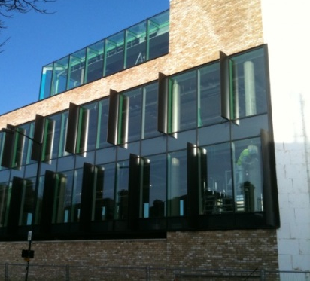
INTRODUCTION GRAVITY LATERAL REDESIGN DAYLIGHTING CONCLUSION
JANUARY
LOW SOUTHERN LIGHT BEST MITIGATED WITH OPERABLE INTERIOR SHADES
MORNING AND EVENING SUNLIGHT PARTIALLY SHADED USING VERTICAL FINS
DAYLIGHTING CONCLUSIONS
http://www.angarch.com/products/brise-soleil_01_archive.html

Slide 59
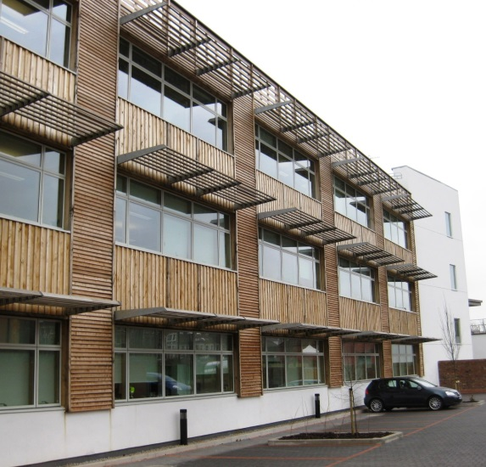
INTRODUCTION GRAVITY LATERAL REDESIGN DAYLIGHTING CONCLUSION
JUNE
HIGH ANGLE AFTERNOON LIGHT BEST MITIGATED WITH HORIZONTAL CANTILEVER SHADES
MORNING AND EVENING SUNLIGHT BEST MITIGATED WITH INTERIOR OPERABLE SHADES
DAYLIGHTING CONCLUSIONS
http://levolux.blogspot.com/2012_02

Slide 61
ACKNOWLEDGEMENTS
MILLCRAFT INV.
A.E. DEPT. FACULTY
FAMILY, FRIENDS, CLASSMATES

Slide 62
ACKNOWLEDGEMENTS
MILLCRAFT INV.
A.E. DEPT. FACULTY
FAMILY, FRIENDS, CLASSMATES
QUESTIONS?

