Slide 1
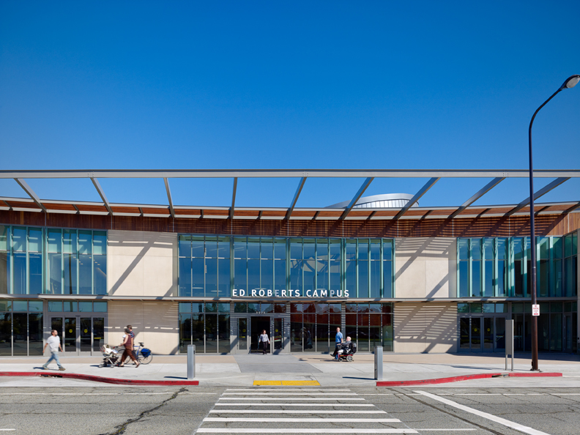
The Ed Roberts Campus
Berkeley, CA
Introduction
Existing Systems
Mechanical Depth
Structural Breadth
Conclusion
Anderson Clemenceau
Mechanical Option
Penn State A.E. Senior Thesis
April 14, 2015
Leddy Maytum Stacy Architects, Photo by Tim Griffith

Slide 2
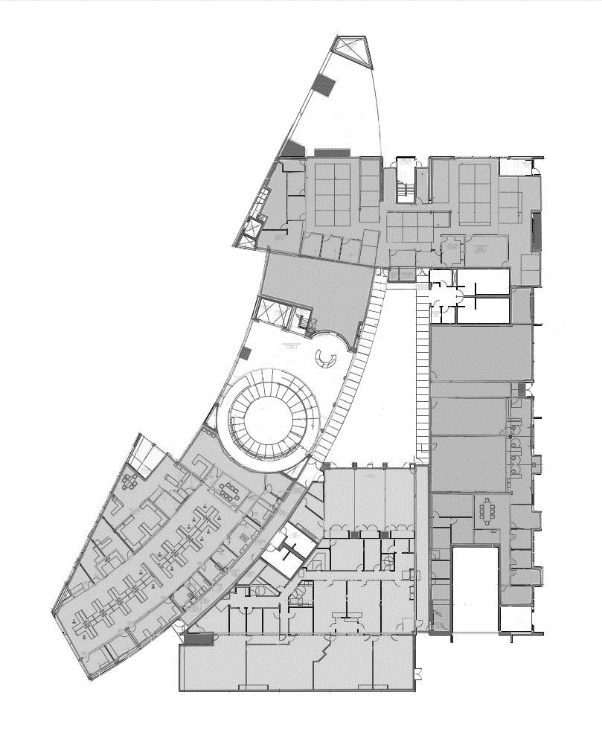
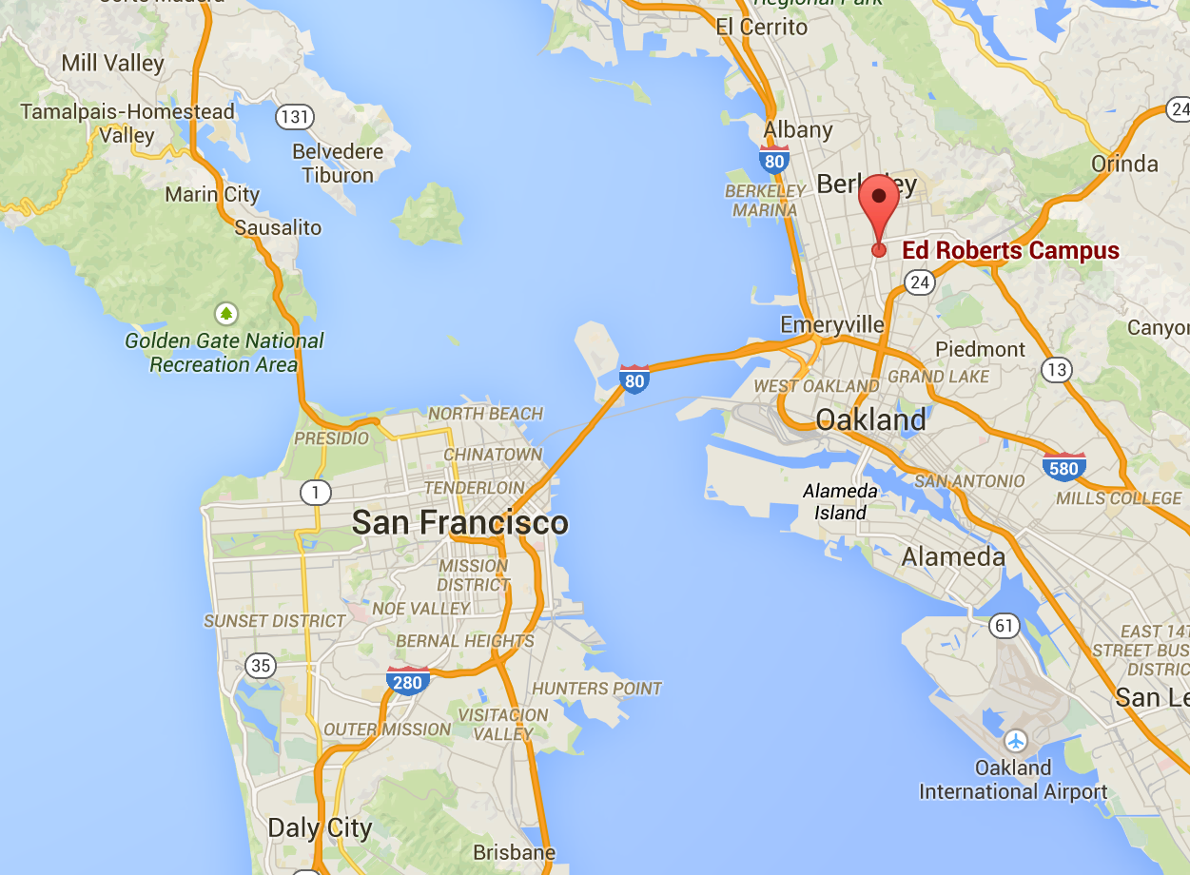
The Ed Roberts Campus
Introduction
Existing Systems
Mechanical Depth
Structural Breadth
Conclusion
ASHRAE Climate Zone 3C
99.6% Heating DB: 37°F
0.4% Cooling DB: 81.8°F
MCWB: 65°F
Google Maps
Anderson Clemenceau – Mechanical Option
Senior Thesis 2015
Leddy Maytum Stacy Architects

Slide 3
The Ed Roberts Campus
Introduction
Existing Systems
Mechanical Depth
Structural Breadth
Conclusion
Existing Systems
Equipment
Cooling and Heating
100% OA System
Radiant Floor
Energy Use
Anderson Clemenceau – Mechanical Option
Senior Thesis 2015

Slide 4
The Ed Roberts Campus
Water Source Heat Pump System With 100% Outdoor Air
2 Gas-fired Boilers Provide Hot Water
900 MBH (Each)
98% Efficiency
2 Cooling Towers Provide Chilled Water
100 Ton Capacity (Each)
Introduction
Existing Systems
Mechanical Depth
Structural Breadth
Conclusion
Existing Systems
Equipment
Cooling and Heating
100% OA System
Radiant Floor
Energy Use
Anderson Clemenceau – Mechanical Option
Senior Thesis 2015

Slide 5
The Ed Roberts Campus
Water Source Heat Pump System With 100% Outdoor Air
2 Gas-fired Boilers Provide Hot Water
900 MBH (Each)
98% Efficiency
2 Cooling Towers Provide Chilled Water
100 Ton Capacity (Each)
5 Air Handling Units
3 Constant Air Volume Units
2 Variable Air Volume Units
Paired with Exhaust Fans
Water Source Heat Pumps
Total of 63 Units
Range of Capacity: 0.75 – 3.25 tons
COP: 4.1 – 4.4
EER: 13.7 - 16.0
Introduction
Existing Systems
Mechanical Depth
Structural Breadth
Conclusion
Existing Systems
Equipment
Cooling and Heating
100% OA System
Radiant Floor
Energy Use
Anderson Clemenceau – Mechanical Option
Senior Thesis 2015

Slide 6
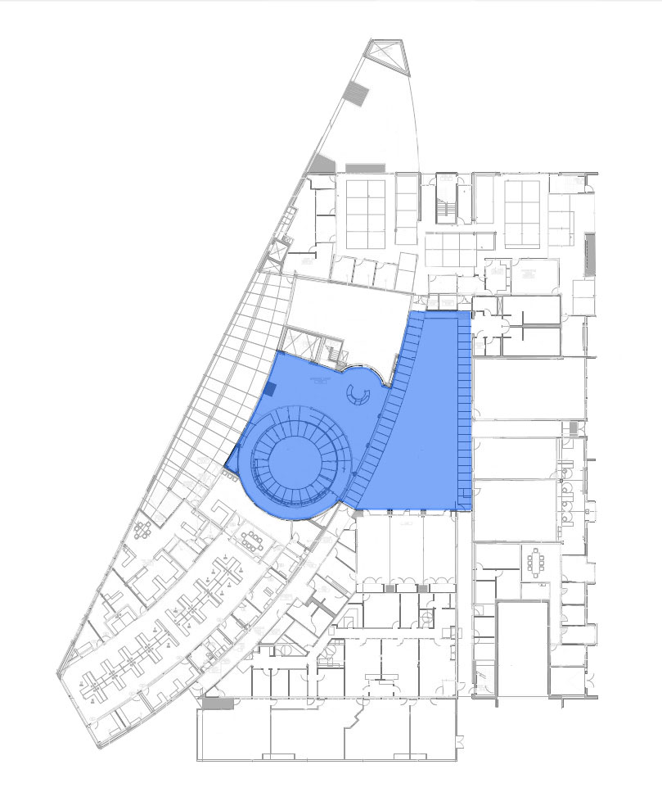
The Ed Roberts Campus
Water Source Heat Pump System With 100% Outdoor Air
2 Gas-fired Boilers Provide Hot Water
900 MBH (Each)
98% Efficiency
2 Cooling Towers Provide Chilled Water
100 Ton Capacity (Each)
5 Air Handling Units
3 Constant Air Volume Units
2 Variable Air Volume Units
Paired with Exhaust Fans
Water Source Heat Pumps
Total of 63 Units
Range of Capacity: 0.75 – 3.25 tons
COP: 4.1 – 4.4
EER: 13.7 - 16.0
Radiant Floor
Introduction
Existing Systems
Mechanical Depth
Structural Breadth
Conclusion
Existing Systems
Equipment
Cooling and Heating
100% OA System
Radiant Floor
Energy Use
Anderson Clemenceau – Mechanical Option
Senior Thesis 2015
Leddy Maytum Stacy Architects

Slide 7
The Ed Roberts Campus
Water Source Heat Pump System With 100% Outdoor Air
2 Gas-fired Boilers Provide Hot Water
900 MBH (Each)
98% Efficiency
2 Cooling Towers Provide Chilled Water
100 Ton Capacity (Each)
5 Air Handling Units
3 Constant Air Volume Units
2 Variable Air Volume Units
Paired with Exhaust Fans
Water Source Heat Pumps
Total of 63 Units
Range of Capacity: 0.75 – 3.25 tons
COP: 4.1 – 4.4
EER: 13.7 - 16.0
Radiant Floor
Heating and Cooling Capacity
Serves Lobby and Courtyard Areas – 7,150 sq. ft.
Introduction
Existing Systems
Mechanical Depth
Structural Breadth
Conclusion
Existing Systems
Equipment
Cooling and Heating
100% OA System
Radiant Floor
Energy Use
 | Area Served | Coverage Area (sqft) | Cooling Cap. (MBH) | Heating Cap. (MBH)
Zone 1 | Courtyard North | 1800 | 27 | 18
Zone 2 | Courtyard South | 2000 | 30 | 20
Zone 3 | Lobby | 3350 | 58 | 30
Anderson Clemenceau – Mechanical Option
Senior Thesis 2015

Slide 8
The Ed Roberts Campus
Trace 700 Model vs. Real Building
Energy Use
~30% Less Electricity Use
~30% More Gas Use
Introduction
Existing Systems
Mechanical Depth
Structural Breadth
Conclusion
Existing Systems
Equipment
Cooling and Heating
100% OA System
Radiant Floor
Energy Use
 | Modeled | Building Capacity
Cooling | 146 Tons | 200 Tons
Heating | 2,200 MBH | 1800 MBH
Anderson Clemenceau – Mechanical Option
Senior Thesis 2015

Slide 9
The Ed Roberts Campus
Trace 700 Model vs. Real Building
Energy Use
~30% Less Electricity Use
~30% More Gas Use
Introduction
Existing Systems
Mechanical Depth
Structural Breadth
Conclusion
Existing Systems
Equipment
Cooling and Heating
100% OA System
Radiant Floor
Energy Use
 | Modeled | Building Capacity
Cooling | 146 Tons | 200 Tons
Heating | 2,200 MBH | 1800 MBH
Anderson Clemenceau – Mechanical Option
Senior Thesis 2015

Slide 10
The Ed Roberts Campus
Trace 700 Model vs. Real Building
Energy Use
~30% Less Electricity Use
~30% More Gas Use
Introduction
Existing Systems
Mechanical Depth
Structural Breadth
Conclusion
Existing Systems
Equipment
Cooling and Heating
100% OA System
Radiant Floor
Energy Use
 | Modeled | Building Capacity
Cooling | 146 Tons | 200 Tons
Heating | 2,200 MBH | 1800 MBH
Anderson Clemenceau – Mechanical Option
Senior Thesis 2015

Slide 11
The Ed Roberts Campus
Introduction
Existing Systems
Mechanical Depth
Structural Breadth
Conclusion
Mechanical Depth
Variable Refrigerant Flow System
Equipment
Unit Sizing
Energy Use
Solar Thermal
Radiant Floor and DHW
System Sizing
Energy Use
Anderson Clemenceau – Mechanical Option
Senior Thesis 2015

Slide 12
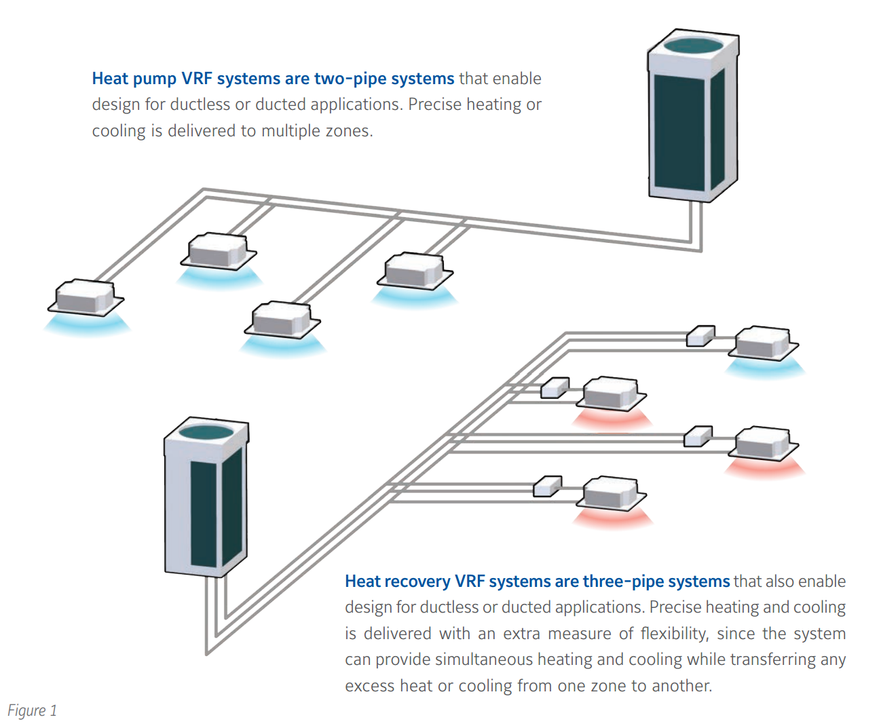
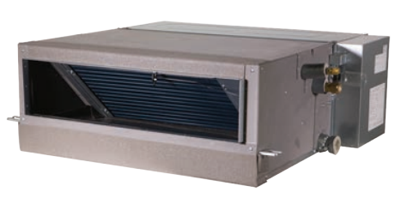
The Ed Roberts Campus
c
Ceiling-Mounted, Ducted Indoor Units
6,000-48,000 Btu/h Capacities
.32 in wg Static Pressure
Introduction
Existing Systems
Mechanical Depth
Structural Breadth
Conclusion
VRF Heat Recovery System
Air-cooled Condenser (Outdoor) Unit
Variable-Speed Scroll Compressor
Simultaneous Cooling And Heating
Heat Recovery Between Indoor Units
Mechanical Depth
Variable Refrigerant Flow System
Equipment
Unit Sizing
Energy Use
Solar Thermal
Radiant Floor and DHW
System Sizing
Energy Use
c
Johnson Controls
c
Anderson Clemenceau – Mechanical Option
Senior Thesis 2015
Johnson Controls

Slide 13
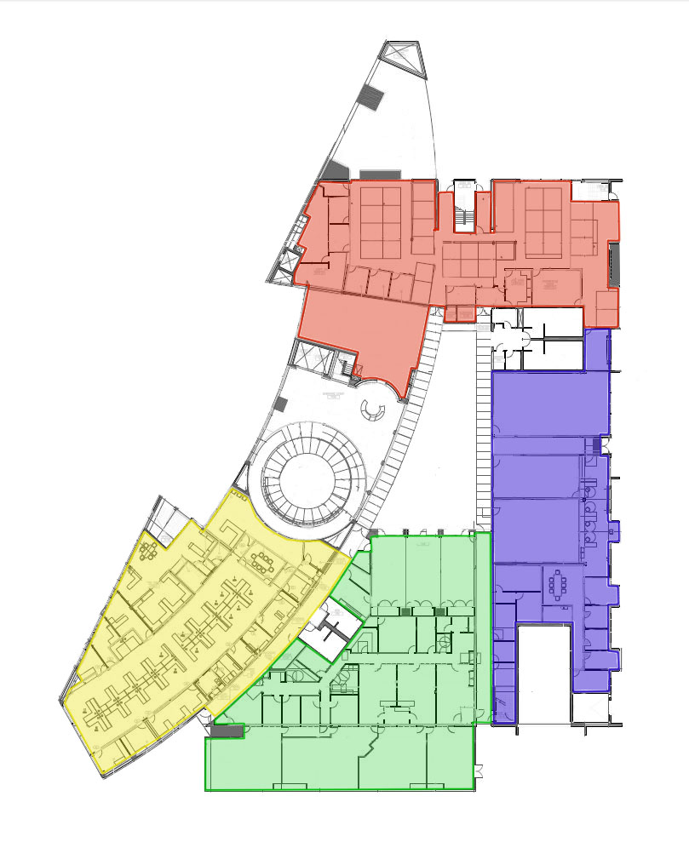
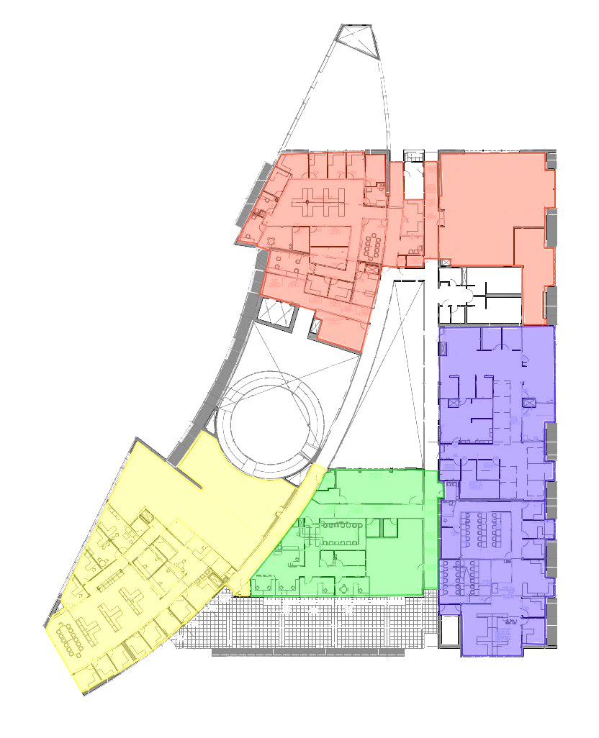
The Ed Roberts Campus
VRF Mechanical Zoning Plan
Introduction
Existing Systems
Mechanical Depth
Structural Breadth
Conclusion
 | Nominal Size of Outdoor Unit [tons] | IEER | COP
VRF Zone 1 | 26 (10+10+6) | 18.8 | 3.56
VRF Zone 2 | 22 (10+6+6) | 18.8 | 3.61
VRF Zone 3 | 18 (6+6+6) | 19.2 | 3.49
VRF Zone 4 | 28 (8+8+6+6) | 21.2 | 3.87
Mechanical Depth
Variable Refrigerant Flow System
Equipment
Unit Sizing
Energy Use
Solar Thermal
Radiant Floor and DHW
System Sizing
Energy Use
First Floor
Second Floor
Anderson Clemenceau – Mechanical Option
Senior Thesis 2015
Leddy Maytum Stacy Architects
Leddy Maytum Stacy Architects

Slide 14
The Ed Roberts Campus
Dedicated Outside Air System (DOAS)
Supplies Filtered, Dehumidified Ventilation Air
Variable-Speed Fan Operation
DX Cooling, Electric Heating
 | Required Airflow [cfm] | Model | DOAS Unit Nominal Airflow [cfm]
VRF Zone 1 | 4,426.47 | JDHA-210 | 2250-5500
VRF Zone 2 | 5,480.2 | JDHA-300 | 3750-8700
VRF Zone 3 | 3,808.54 | JDHA-210 | 2250-5500
VRF Zone 4 | 5,867.72 | JDHA-300 | 3750-8700
Lobby/Reception | 2,503.64 | JDHA-120 | 1500-3550
Introduction
Existing Systems
Mechanical Depth
Structural Breadth
Conclusion
Mechanical Depth
Variable Refrigerant Flow System
Equipment
Unit Sizing
Energy Use
Solar Thermal
Radiant Floor and DHW
System Sizing
Energy Use
Anderson Clemenceau – Mechanical Option
Senior Thesis 2015

Slide 15
The Ed Roberts Campus
% Change in Utility Cost - WSHP vs. VRF
Jan | Feb | Mar | Apr | May | Jun | Jul | Aug | Sep | Oct | Nov | Dec
8.86% | 5.55% | -2.40% | -13.90% | -17.26% | -26.34% | -30.78% | -26.67% | -28.40% | -18.22% | -5.59% | 6.78%
Introduction
Existing Systems
Mechanical Depth
Structural Breadth
Conclusion
Mechanical Depth
Variable Refrigerant Flow System
Equipment
Unit Sizing
Energy Use
Solar Thermal
Radiant Floor and DHW
System Sizing
Energy Use
Yearly Utility Cost Change: 14.3%
Yearly Savings: $23,200
Anderson Clemenceau – Mechanical Option
Senior Thesis 2015

Slide 16
The Ed Roberts Campus
Life Cycle Cost Analysis
2014 Supplement to NIST Manual 135
Discount Rate: 3%
Existing System Energy Costs | VRF Energy Costs | Net Savings | Investment | Discounted Payback Period
$4,336,036.32 | $3,718,476.30 | $617,560.02 | $364,300.00 | 20 Years
Introduction
Existing Systems
Mechanical Depth
Structural Breadth
Conclusion
Mechanical Depth
Variable Refrigerant Flow System
Equipment
Unit Sizing
Energy Use
Solar Thermal
Radiant Floor and DHW
System Sizing
Energy Use
Anderson Clemenceau – Mechanical Option
Senior Thesis 2015

Slide 17
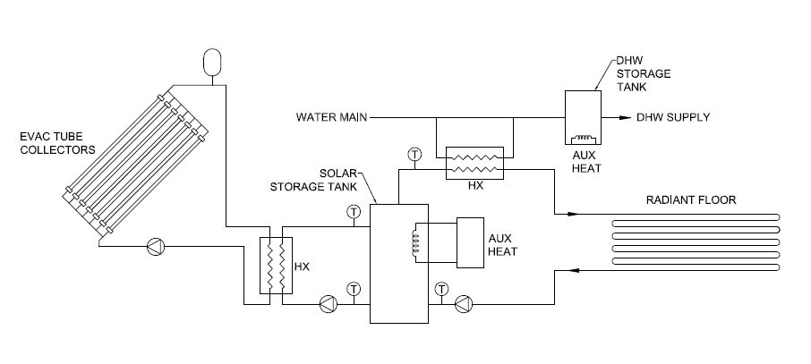
The Ed Roberts Campus
Solar Thermal Water Heating System
Domestic Water Heating
Radiant Floor Space Heating
Analysis: CombiSys
Solar Thermal Water Heating Simulation
Introduction
Existing Systems
Mechanical Depth
Structural Breadth
Conclusion
Mechanical Depth
Variable Refrigerant Flow System
Equipment
Unit Sizing
Energy Use
Solar Thermal
Radiant Floor and DHW
System Sizing
Energy Use
Solar Thermal Schematic
Anderson Clemenceau – Mechanical Option
Senior Thesis 2015

Slide 18
The Ed Roberts Campus
Solar Thermal Water Heating System
Domestic Water Heating
Radiant Floor Space Heating
Analysis: CombiSys
Solar Thermal Water Heating Simulation
Model Inputs:
Collector Area: 90 m² (970 ft²)
Collector Performance Characteristics: η₀=0.687, a₁=1.505 [W/m²-K], a₂=0.011 [W/m²-K]
Dom. Hot Water Load: 3 gal/d per occupant, 50 occupants
Space Loss Coefficient: 500 W/K (~1700 Btu/h/°F)
Introduction
Existing Systems
Mechanical Depth
Structural Breadth
Conclusion
Mechanical Depth
Variable Refrigerant Flow System
Equipment
Unit Sizing
Energy Use
Solar Thermal
Radiant Floor and DHW
System Sizing
Energy Use
Anderson Clemenceau – Mechanical Option
Senior Thesis 2015

Slide 19
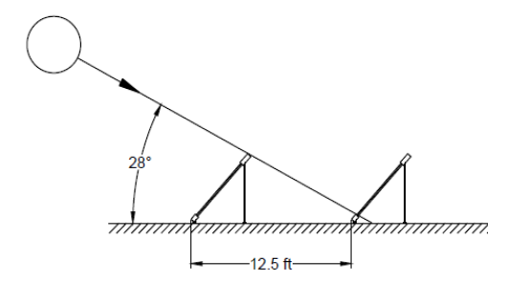
The Ed Roberts Campus
Solar Thermal Water Heating System
Domestic Water Heating
Radiant Floor Space Heating
Analysis: CombiSys
Solar Thermal Water Heating Simulation
Model Inputs:
Collector Area: 90 m² (970 ft²)
Collector Performance Characteristics: η₀=0.687, a₁=1.505 [W/m²-K], a₂=0.011 [W/m²-K]
Dom. Hot Water Load: 3 gal/d per occupant, 50 occupants
Space Loss Coefficient: 500 W/K (~1700 Btu/h/°F)
Introduction
Existing Systems
Mechanical Depth
Structural Breadth
Conclusion
Mechanical Depth
Variable Refrigerant Flow System
Equipment
Unit Sizing
Energy Use
Solar Thermal
Radiant Floor and DHW
System Sizing
Energy Use
Gross Roof Area:
~2,500 sq. ft.
Anderson Clemenceau – Mechanical Option
Senior Thesis 2015

Slide 20
The Ed Roberts Campus
CombiSys Solar Thermal Simulation
Introduction
Existing Systems
Mechanical Depth
Structural Breadth
Conclusion
Mechanical Depth
Variable Refrigerant Flow System
Equipment
Unit Sizing
Energy Use
Solar Thermal
Radiant Floor and DHW
System Sizing
Energy Use
Model Inputs:
Collector Area: 90 m² (970 ft²)
Collector Performance Characteristics: η₀=0.687, a₁=1.505 [W/m²-K], a₂=0.011 [W/m²-K]
Dom. Hot Water Load: 3 gal/d per occupant, 50 occupants
Space Loss Coefficient: 500 W/K (~1700 Btu/h/°F)
Avg. Solar Fraction
91%
Avg. Collector Efficiency
24%
Anderson Clemenceau – Mechanical Option
Senior Thesis 2015

Slide 21
The Ed Roberts Campus
CombiSys Solar Thermal Simulation
Introduction
Existing Systems
Mechanical Depth
Structural Breadth
Conclusion
Mechanical Depth
Variable Refrigerant Flow System
Equipment
Unit Sizing
Energy Use
Solar Thermal
Radiant Floor and DHW
System Sizing
Energy Use
Model Inputs:
Collector Area: 90 m² (970 ft²)
Collector Performance Characteristics: η₀=0.687, a₁=1.505 [W/m²-K], a₂=0.011 [W/m²-K]
Dom. Hot Water Load: 3 gal/d per occupant, 50 occupants
Space Loss Coefficient: 500 W/K (~1700 Btu/h/°F)
Anderson Clemenceau – Mechanical Option
Senior Thesis 2015

Slide 22
The Ed Roberts Campus
Life Cycle Cost Analysis
Introduction
Existing Systems
Mechanical Depth
Structural Breadth
Conclusion
Mechanical Depth
Variable Refrigerant Flow System
Equipment
Unit Sizing
Energy Use
Solar Thermal
Radiant Floor and DHW
System Sizing
Energy Use
Yearly Cost Savings | Net Savings | Investment | Discounted Payback Period
$3,058.63 | $80,074.93 | ~$75,000 | 25+ Years
Anderson Clemenceau – Mechanical Option
Senior Thesis 2015

Slide 23
The Ed Roberts Campus
Alternative Application:
Domestic Hot Water Only
Introduction
Existing Systems
Mechanical Depth
Structural Breadth
Conclusion
Mechanical Depth
Variable Refrigerant Flow System
Equipment
Unit Sizing
Energy Use
Solar Thermal
Radiant Floor and DHW
System Sizing
Energy Use
Peak 1-Hour Demand of 150 gal
Constant, Year-Round Load
Solar Fraction | Collector Efficiency | Yearly Cost Savings | Investment | Payback Period
96% | 23% | $2,016 | ~$25,000 | 18 Years
Anderson Clemenceau – Mechanical Option
Senior Thesis 2015

Slide 24
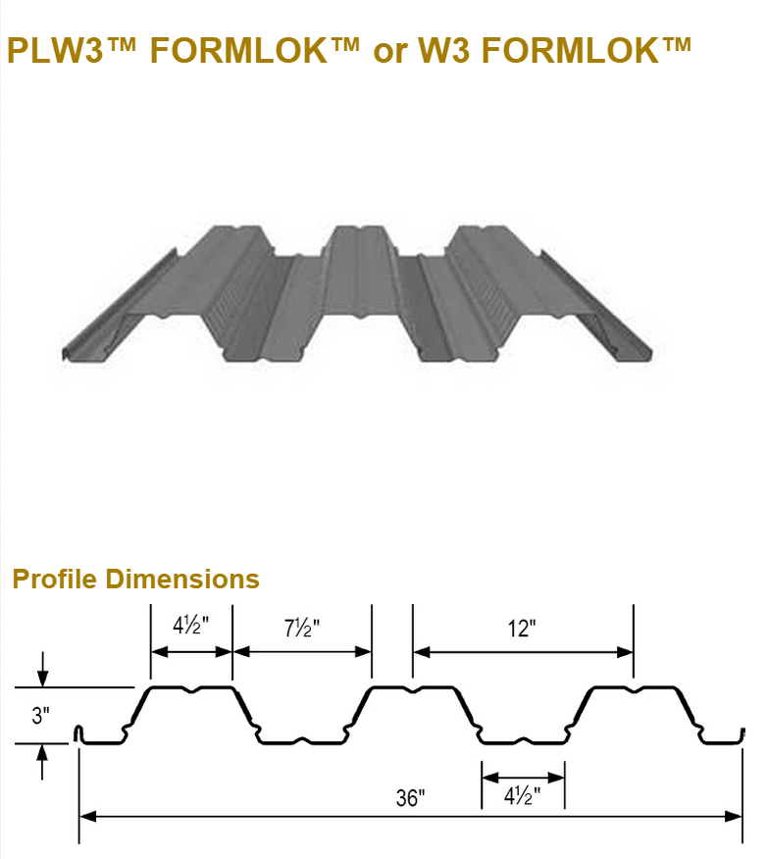
The Ed Roberts Campus
Current Roof Structure
Structural Steel Framing
18 Gage Verco W3 Metal Decking
3-1/2” LW Concrete Topping
Current Roof Structure
Max Unshored Clear Span: 15’-7” @3-Span
Allowable Superimposed Load for 11’-0” Span Condition: 207 psf
Introduction
Existing Systems
Mechanical Depth
Structural Breadth
Conclusion
Roof Structure Redesign
Current Structure
New Design Criteria
Results
Typical Framing Plan for South East Roof:
3 Spans @10’-8”
Verco Decking, Inc.
Anderson Clemenceau – Mechanical Option
Senior Thesis 2015

Slide 25
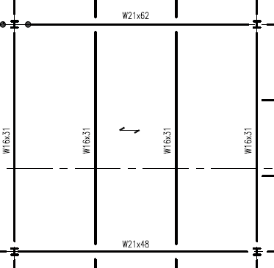
The Ed Roberts Campus
Current Roof Structure
Structural Steel Framing
18 Gage Verco W3 Metal Decking
3-1/2” LW Concrete Topping
Solar Panel Array for DHW and Space Heating
30 Panels at 225 lb/panel
Vertical Pull Force Due To Wind: ~610 lb
Panel Area on Roof: 1,100 sq ft.
Total Additional Load: ~55 psf
Vulcraft Deck Manuals
3VLI Composite Deck, LW Concrete Topping
19 Gage, 2” Topping
Self-Weight: 35 psf
Maximum SLL @10’-8” Spans: 105 psf
Introduction
Existing Systems
Mechanical Depth
Structural Breadth
Conclusion
Roof Structure Redesign
Current Structure
New Design Criteria
Results
Arup, San Francisco
Anderson Clemenceau – Mechanical Option
Senior Thesis 2015

Slide 26
The Ed Roberts Campus
Variable Refrigerant Flow System
First Cost: $364,300
Yearly Energy Savings: $23,200
Payback Period: 20 Years
Conclusion:
Not Recommended For A Complete Renovation
Could Be Considered For New Construction
Solar Thermal Water Heating System
Two Options:
Space Heating and DHW
First Cost: $75,000
Payback: 25+ Years
DHW Only
First Cost: $25,000
Payback: 18 Years
Conclusion:
Not Recommended
Could More Economical In Different Climate Conditions
Introduction
Existing Systems
Mechanical Depth
Structural Breadth
Conclusion
Anderson Clemenceau – Mechanical Option
Senior Thesis 2015

